Slide 1
The Network Layer
Chapter 5

Slide 2
Network Layer Design Issues
Store-and-forward packet switching
Services provided to transport layer
Implementation of connectionless service
Implementation of connection-oriented service
Comparison of virtual-circuit and datagram networks

Slide 3
Store-and-Forward Packet Switching
The major components of the network
ISP’s equipment, including routers and transmission lines
Customers’ equipment.
The example:
Host H1 is directly connected to one of the ISP’s routers
Host H2 is on a LAN, with a router F owned and operated by the customer. Router F has a leased line to the ISP’s equipment.

Slide 4
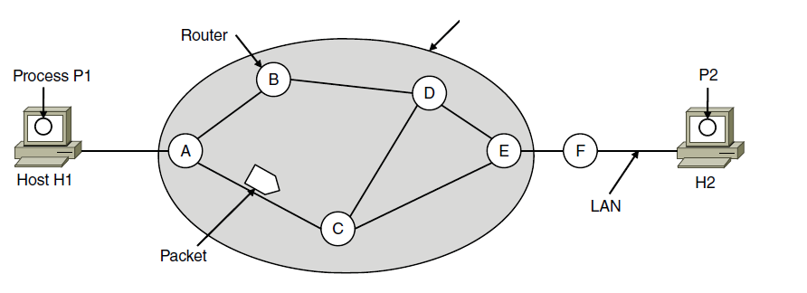
Store-and-Forward Packet Switching
ISP’s equipment
The environment of the network layer protocols.

Slide 5
Store-and-Forward Packet Switching
Store-and-Forward
A host sends its packet to the nearest router.
The packet is stored in the router, then forwarded to the next router along the path until it reaches the destination.
The network layer is the lowest layer that deals with end-to-end transmission.

Slide 6
Services Provided to the Transport Layer
Services independent of router technology.
Transport layer shielded from number, type, topology of routers.
Network addresses available to transport layer use uniform numbering plan
even across LANs and WANs
Two main types of services: connectionless and connection-oriented services.

Slide 7
Services Provided to the Transport Layer
Connectionless services
Packets are injected into the network individually and routed independently of each other.
No advance setup is need.
In connectionless services, packets are often called datagrams; the network is called datagram network.
Connection-oriented services
A path from the source router all the way to the destination router must be established before any data packets are sent
The connection is called a VC (virtual circuit)
The network is called a virtual-circuit network.

Slide 8
Implementation of Connectionless Service
Process P1 has a long message for P2.
P1 hands the message to the transport layer. A transport header is added to the front of the message.
The message is handed to the network layer.
Assume that the message is 4 times longer than the maximum packet size, so the network layer has to break it into 4 packets, 1, 2, 3, 4.
The network layer sends the packets to router A.
Each router has an internal table. Each table entry consists of a destination and the outgoing line for that destination.
At router A, packets 1, 2, and 3 are stored briefly, arrived fully on the incoming line, and have their checksums verified.

Slide 9
Implementation of Connectionless Service
Process P1 has a long message for P2.
Each packet is forwarded according to A’s table to the outgoing link to C within a new frame.
Packet 1 is forwarded to E and then to F. When it gets to F, it is sent over the LAN to H2. Packet 2 and 3 follow the same route.
Packet 4 is different. When it gets to A it is sent to router B even though it is also destined for F.
For some reason, A decided to send packet 4 via a different route, e.g., a traffic jam somewhere along the ACE path. A updates its routing table.

Slide 10
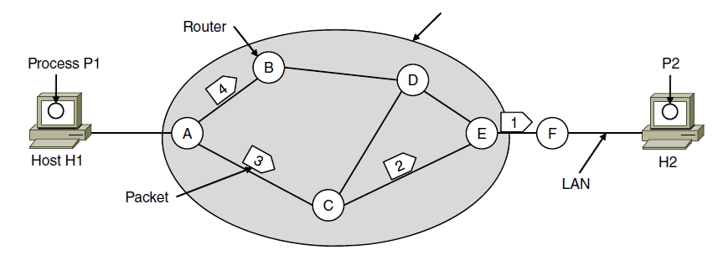
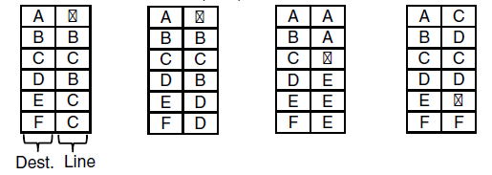
Implementation of Connectionless Service
ISP’s equipment
A’s table (initially) A’s table (later) C’s Table E’s Table
Routing within a datagram network

Slide 11
Implementation of Connectionless Service
Routing algorithm manages the routing table and makes the routing decision.
IP (Internet Protocol), the basis for the entire Internet, is a connectionless network service.
Each packet carries a destination IP address that routers use to individually forward each packet.
The addresses are 32 bits in IPv4 packets and 128 bits in IPv6 packets.

Slide 12
Implementation of Connection-Oriented Service
When a connection is established, a route from the source machine to the destination machine is chosen as the connection setup and stored in the table inside routers.
The route is used for all packets with the same connection identifier.
When the connection is released, the virtual circuit is also terminated.

Slide 13
Implementation of Connection-Oriented Service
Host H1 has established connection 1 with host H2.
The connection is remembered as the first entry in each of the routing table.
The first line of A’s table says that if a packet with connection identifier 1 comes in from H1, it is to be sent to router C and given connection identifier 1.
If H3 also wants to establish a connection to H2,
Router A assigns a different connection identifier 2 to the outgoing traffic for the second connection to avoid conflict.
This process is called label switching.

Slide 14
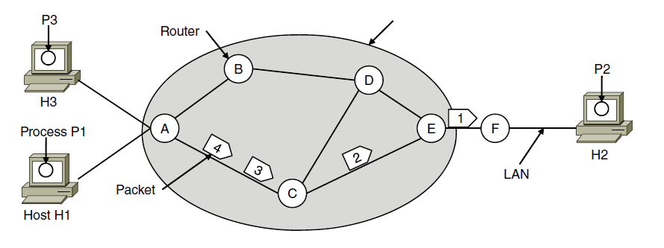

Implementation of Connection-Oriented Service
ISP’s equipment
A’s table C’s Table E’s Table
Routing within a virtual-circuit network

Slide 15
Implementation of Connection-Oriented Service
MPLS (MultiProtocol Label Switching) is a connection-oriented network service.
It is used within ISP networks in the Internet, with IP packets wrapped in an MPLS header having a 20-bit connection identifier or label.
It is used to help when quality of service is important.

Slide 16
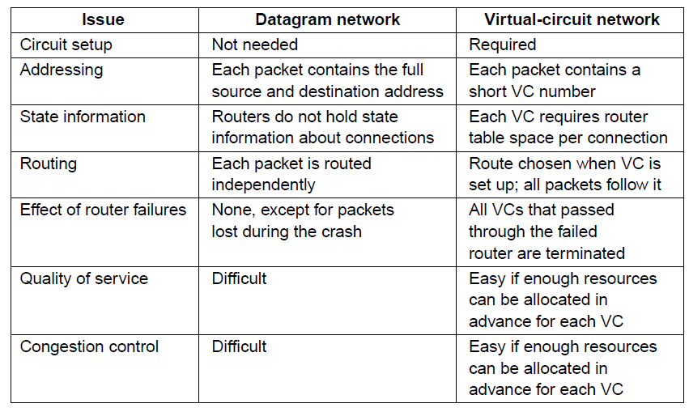
Comparison of Virtual-Circuit and Datagram Networks
Comparison of datagram and virtual-circuit networks

Slide 17
Comparison of Virtual-Circuit and Datagram Networks
Issue 1: setup time versus address parsing time.
Using virtual circuits requires a setup phase, which takes time and consumes resources.
Once the setup is done, the router just uses the circuit number to index into a table to find out where a packet goes.
In a datagram network, no setup is needed but a more complicated lookup procedure is required to locate the entry for the destination.
The destination addresses used in datagram networks are longer than circuit numbers used in VC networks. If the packets are small, including a long destination address represents a significant amount of overhead.

Slide 18
Comparison of Virtual-Circuit and Datagram Networks
Issue 2: table space required in router memory.
A datagram network needs to have an entry for every possible destination.
A VC network just needs an entry for each VC.
Issue 3: quality of service.
VCs can guarantee quality of service and avoid congestion since resources (e.g., buffers, bandwidth, and CPU cycles) are reserved in advanced.
Issue 4: vulnerability
If a router crashes, all the VCs passing through it will have to aborted.
Datagram can change the routes.

Slide 19
Routing Algorithms
Routing algorithms
Decide which output line an incoming packet should be transmitted on.
For datagram network, this decision is made anew for every data packet since the best route may have changed since last time.
For VC networks, routing decisions are made only when a new VC is being set up. All data packets just follow this route. This is sometimes called session routing.

Slide 20
Routing Algorithms
Routing consists of
Forwarding
When a packet arrives, look up the outgoing line to use in the routing table.
Filling in and updating the routing table.
Decided by the routing algorithm

Slide 21
Routing Algorithms
Certain properties are desirable in a routing algorithm.
Correctness
Simplicity
Robustness
Cope with changes in the topology and traffic without requiring all jobs in all hosts to be aborted.
Stability
Converge quickly. Reach equilibrium and stay there.
Fairness
Efficiency
Suppose there is enough traffic between A-A’, B-B’, C-C’ to saturate the horizontal links. X-X’ traffic may be shut up altogether.

Slide 22
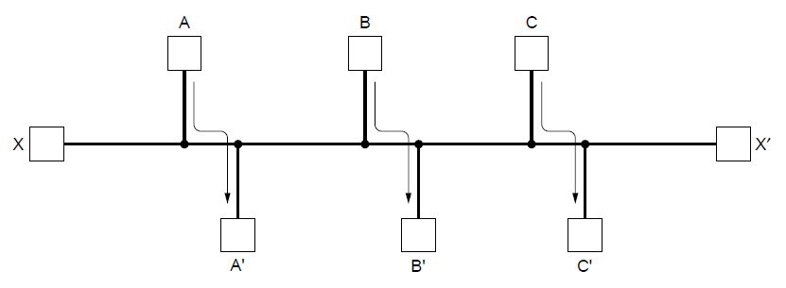
Fairness vs. Efficiency
Network with a conflict between fairness and efficiency.

Slide 23
Routing Algorithms
What to optimize in routing algorithms?
Minimize the mean packet delay.
Maximize total network throughput
Minimize the distance a packet must travel
Reduce the number of hops a packet must take.
Two classes of routing algorithms.
Nonadaptive algorithms.
Static routing. Do not base routing decisions on any measurements or estimates of the current topology and traffic.
Adaptive algorithms.
Dynamic routing. Change routing decisions to reflect changes in the topology and sometimes changes in the traffic.

Slide 24
Routing Algorithms
Two classes of routing algorithms.
Nonadaptive algorithms.
The choice of the route to use to get from A to B is computed in advance, offline, and downloaded to the routers when the network is booted.
Adaptive algorithms.
Dynamic routing algorithms differ in where they get their information (e.g., locally, from adjacent routers), when they change the routes (when the topology changes or periodically), what metric is used for optimization.

Slide 25
Routing Algorithms
Optimality principle
Shortest path algorithm
Flooding
Distance vector routing
Link state routing
Routing in ad hoc networks

Slide 26
The Optimality Principle
The optimality principle.
If router J is on the optimal path from router I to router K, then the optimal path from J to K also falls along the same router.
Sink tree.
The set of optimal routes from all sources to a given destination from a tree rooted at the destination.
The goal of all routing algorithms is to discover and use the sink tree for all routers.
No loops. Each packet will be delivered within a finite and bounded number of hops
A sink tree is not unique; other trees with the same path length may exist.
DAG (Directed Acyclic Graph): all possible paths are chosen, contains no loops.

Slide 27
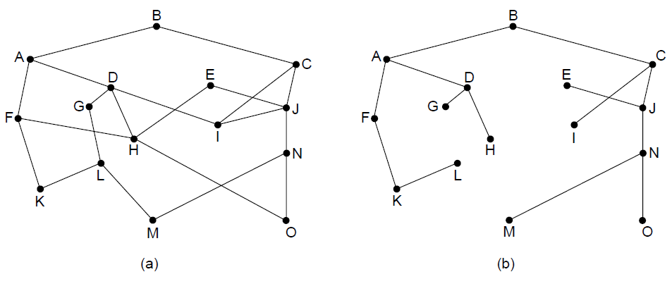
The Optimality Principle
(a) A network. (b) A sink tree for router B.

Slide 28
Shortest Path Algorithm
Use a graph to represent the network.
Each node represents a router.
Each edge represents a link.
To choose a route between a given pair of routers, the algorithm just finds the shortest path between them on the graph.
Shortest path. What is the metric for “shortest”?
The number of hops, path ABC = path ABE
Geographic distance, path ABC > path ABE
The mean delay of a standard test packet, the fastest path.
The weight on the edges could be computed as a function of the distance, bandwidth, average traffic, communication cost, measured delay and others.

Slide 29
Shortest Path Algorithm
The Dijkstra algorithm.
Find the shortest paths between a source and all destinations in the network.
Each node is labeled with its distance from the source node along the best known path.
Initially, no paths are known, so all nodes are labeled with infinity. As the algorithm proceeds, the labels may change.
A label may be tentative or permanent. Initially, all labels are tentative. When a label is discovered to be the shortest path from the source to that node, it is made permanent.

Slide 30
Shortest Path Algorithm
Example: a weighted undirected graph. Source is A.
Make node A as permanent.
Examine each node adjacent to A, relabeling each node with the distance to node A. Also relabel the node from which the probe was made.
Having examined each node adjacent to A, we examine all the tentatively labeled nodes in the whole graph and make the one with the smallest label permanent. This node becomes the new working node.
Examine all nodes adjacent to the working node B. If the sum of the label on B and the distance from B to the node is less than the label on that node, we relabel the node.
Make the node with the smallest value permanent and the working node. Repeat 4 and 5.

Slide 31
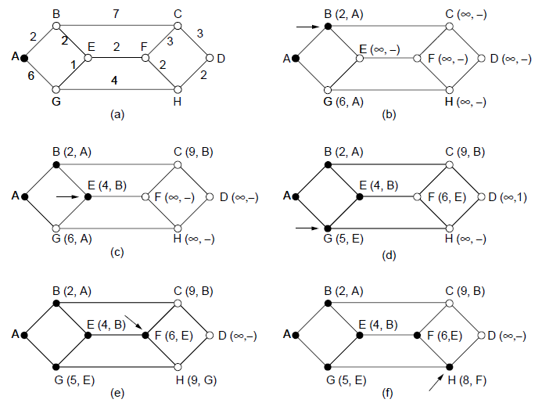
Shortest Path Algorithm
The first five steps used in computing the shortest path from A to D. The arrows indicate the working node

Slide 32
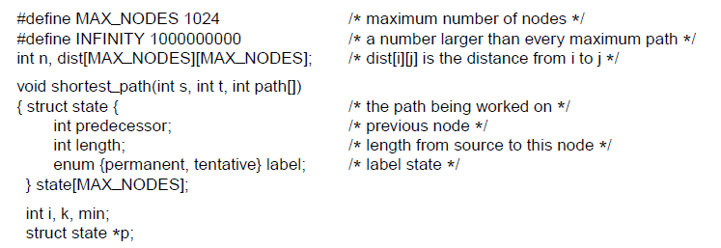
Shortest Path Algorithm
. . .
Dijkstra’s algorithm to compute the shortest path through a graph.

Slide 33
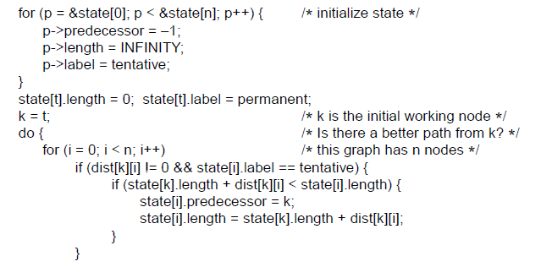
Shortest Path Algorithm
. . .
. . .
Dijkstra’s algorithm to compute the shortest path through a graph.

Slide 34
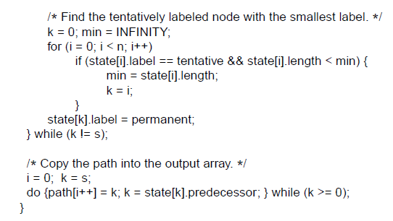
Shortest Path Algorithm
. . .
Dijkstra’s algorithm to compute the shortest path through a graph.

Slide 35
Flooding
In most cases, each router only has local knowledge of their neighbors, not the complete picture of the network.
Flooding. Every incoming packet is sent out on every outgoing line except the one it arrived on.
Flooding will generate vast numbers of duplicate packets. Measures to damp the process.
1. Have a hop counter contained in the header of each packet.
Decrease the counter at each hop. When the counter becomes 0, discard the packet.
Set the counter as the estimated shortest path from the source to the destination.
Can initiate the counter to the worst case.

Slide 36
Flooding
Flooding will generate vast numbers of duplicate packets. Measures to damp the process.
2. Have routers keep track of which packets have been flooded, to avoid sending them out a second time.
The source router puts a sequence number in each packet.
Each router needs a list per source router telling which sequence numbers originating at that source have already been seen. If an incoming packet is on the list, it is not flooded.
The prevent the list from growing without bound, each list can have a counter k, meaning that all sequence numbers through k have been seen.

Slide 37
Flooding
Flooding is not practical for most packets, but it does have some important uses.
Ensure that a packet is delivered to every node in the network. Useful for broadcasting information.
Flooding is robust. In extreme cases, e.g., military network, flooding will find a path if one exists.
Flooding requires little setup. The routers only need to know their neighbors. Thus, flooding can be used as a building block for other routing algorithms.
Flooding can find the shortest path since it chooses every possible path in parallel. Thus, it can be used as a metric to compare with other routing algorithms.

Slide 38
Distance Vector Routing
Distance vector routing algorithm.
Known by other names, e.g., Bellman-Ford routing algorithm.
It was the original ARPANET routing algorithm and was used in the Internet under the name RIP.
The idea is that each router maintains a routing table containing one entry for each router in the network.
Each entry has two parts: 1) the preferred outgoing line to that destination router; 2) the estimated distance to that destination router.
The distance can be hops or propagation delay.
Assume that each router knows its delay to its neighbors.

Slide 39
Distance Vector Routing
Distance vector routing algorithm.
Every T msec, each router sends to each neighbor a list of its estimated delays to each destination. It also receives such a list from each neighbor.
For example, suppose the delay from router A to its neighbor X is m msec. If router A receives from neighbor X to say it takes Xi msec from X to router I, router A knows that it can reach router I via X in Xi+m msec.
Router A can perform such calculation based on the list of every neighbor to find the best link to update its new routing table.

Slide 40
Distance Vector Routing
Example. Figure (a) shows the network.
The first 4 columns in Figure (b) shows the lists from the neighbors to router J. For example, router A claims to have a 12-msec delay to B, a 25-msec delay to C.
Suppose that J has measured its delay to its neighbors A, I, H, and K as 8, 10, 12, and 6 msec.
Consider how J computes its new route to router G.
J knows it can get to A in 8 msec, and A claims to be able to get to G in 18 msec, so J knows it can get to G in 26 msec via A. Similarly, J computes the delay to G via I, H and K as 41, 18 and 37. the best value is 18, so it makes an entry in its routing table that the delay to G is 18 msec via H.

Slide 41
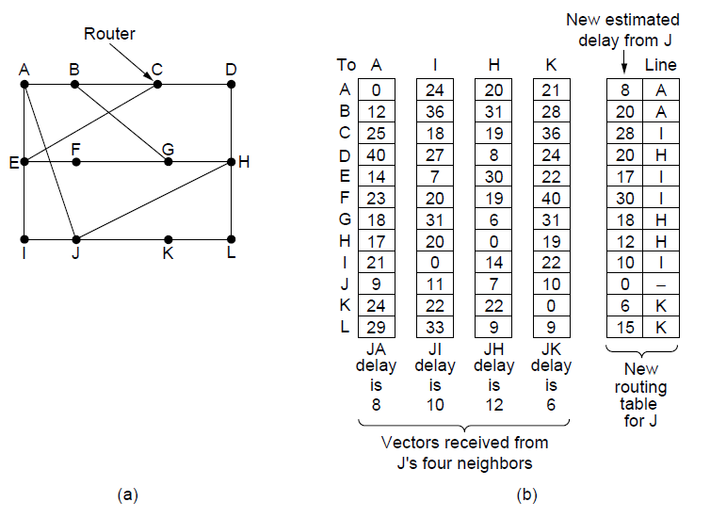
Distance Vector Routing
(a) A network. (b) Input from A, I, H, K, and the new routing table for J.

Slide 42
Distance Vector Routing The Count-to-Infinity Problem
Convergence. The settling of routes to best paths across the network.
Distance Vector Routing has a serious drawback: it can converge to the correct best path, but may do so slowly.
It reacts rapidly to good news, but slow to bad news.
Good news. In Figure (a), router A is initially down, but then comes up. The metric of distance is hops.
Initially, every router records the delay to A as infinity.
After A comes up, at the first exchange, B learns that its left hand neighbor has 0 delay to A and updates its entry to indicate that A is one hop away.
At the following exchanges, C, D and E updates their entries regarding A.

Slide 43
Distance Vector Routing The Count-to-Infinity Problem
Good news.
The good news spread at the rate of one hop per exchange. In a network whose longest path is N hops, within N exchanges everyone will know about the newly revived links and routers.
Bad news. In Figure (b), router A is initially up, but then goes up.
At the first exchange, B does not hear anything from A, but C says “Do not worry; I have a path to A of length 2”. B does not know that C runs through B itself. B may think that C has some other links to A in 2 hops. Therefore, B thinks it can reach A via C with a path of 3.

Slide 44
Distance Vector Routing The Count-to-Infinity Problem
Bad news. In Figure (b), router A is initially up, but then goes up.
At the second exchange, C notices that each of its neighbors claims to have a path to A of length 3. C makes its new distance to A 4.
Subsequent exchanges happen. Gradually all routers work their way up to infinity. (the value for infinity is set to the longest path plus 1).
This is known as the Count-to-Infinity Problem.
The core problem is that when X tells Y that it has a path somewhere, Y has no way of knowing whether itself is on the path.
No ideal solutions yet.

Slide 45
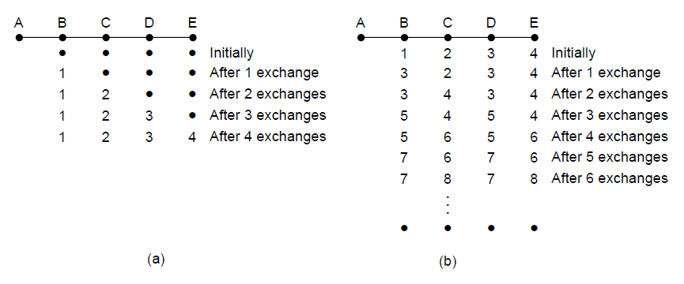
The Count-to-Infinity Problem
The count-to-infinity problem

Slide 46
Link State Routing
Link State Routing replaced distance vector routing which has the count-to-infinity problem.
The idea of link state routing is to distribute the complete topology to every router. Then each router can run the Dijkstra’s algorithm to find the shortest path to every other router.

Slide 47
Link State Routing
Discover neighbors, learn network addresses.
Set distance/cost metric to each neighbor.
Construct packet telling all learned.
Send packet to, receive packets from other routers.
Compute shortest path to every other router.

Slide 48
Link State Routing Learning about the Neighbors
A newly booted router must know who its neighbors are.
Send a HELLO packet on each point-to-point line.
The router on the other end send back a reply giving its name.
The name is globally unique
When two or more routers are connected by a broadcast link, e.g., a broadcast LAN, we model the LAN as a node itself.
As shown in the following figure, a new artificial node N connects A, C, and F. A designated router on the LAN is selected to play the role of N in the routing protocol.
The fact that it is possible to go from A to C on the LAN is represented by the path ANC here.

Slide 49
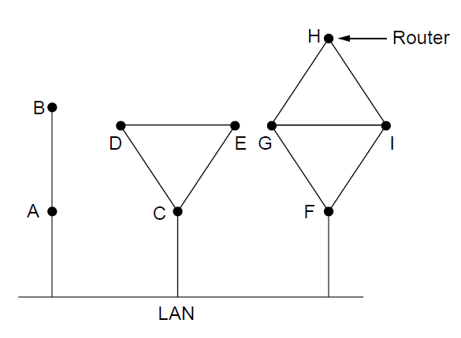
Learning about the Neighbors
Nine routers and a broadcast LAN.

Slide 50
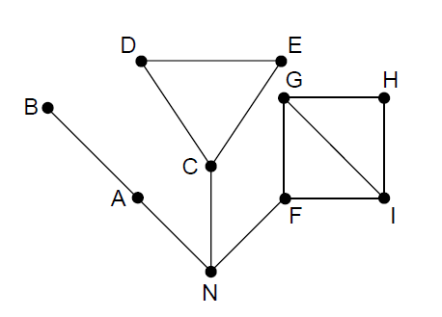
Learning about the Neighbors
A graph model of previous slide.

Slide 51
Link State Routing Setting Link Costs
The cost of a link should be set to find shortest path.
The cost can be made inversely proportional to the bandwidth of the link.
E.g., 1-Gbps Ethernet may have a cost of 1, and 100-Mbps Ethernet a cost of 10.
The delay of the links may be factored into the cost.
Send over the line a special ECHO packet to find the delay.
The other side send back immediately the packet.
The round-trip time is divided by 2 to get the estimate of delay.

Slide 52
Link State Routing Building Link State Packets
Each router builds a packet containing all the data.
The identity of the sender.
The sequence number
The age (to be described later)
A list of neighbors, and their costs.
When to build the link state packets?
At regular interval
When some significant event occurs, e.g., a line or neighbor goes down.

Slide 53
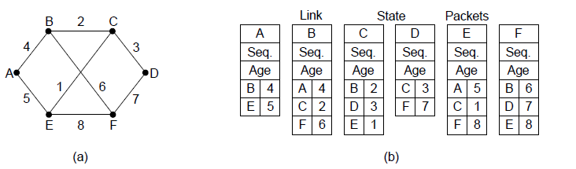
Building Link State Packets
(a) A network. (b) The link state packets for this network.

Slide 54
Link State Routing Distributing the Link State Packets
All routers must get all of the link state packets quickly and reliably.
If different routers use different versions of the topology, the routes they compute may have loops, unreachable machines and other problems.
Basic distribution algorithm.
Use flood to distribute link state packets to all routers.
To keep the flood in check, each packet contains a sequence number. Routers record all (source router, sequence) pairs they see. When a new link state packet comes, if it is new, it is forwarded on all lines except the one it arrived on; if it is a duplicate or an old version, it is discarded.

Slide 55
Link State Routing Distributing the Link State Packets
Problem 1: if the sequence numbers wrap around, e.g., from 0 to 10, then restart from 0, confusion will reign.
The solution is to use a 32-bit sequence number. With one link state packet per second, it takes 137 years to wrap around.
Problem 2: if a router crashes, it will start the sequence number at 0. This link state packet will be rejected as a duplicate.
Problem 3: transmission error, e.g., a one-bit error happens and the sequence number 4 becomes 65,540. Then, packets 5~65,540 will be rejected as obsolete.

Slide 56
Link State Routing Distributing the Link State Packets
The solution to all these problems is to include the age of each packet after the sequence number and decrement it once per second. When the age hits zero, the information from that router is discarded.
Normally the Age is set as 60. A new link state packet may come in every 10 second. Router information will time out if 6 consecutive packets have been lost, an unlikely event.
The Age field will also decremented by each router during flooding, a packet whose age is 0 is discarded. No packet will live indefinitely.

Slide 57
Link State Routing Distributing the Link State Packets
The data structure used by router B for the network.
Each row corresponds to a recently arrived, but as yet not fully processed, link state packet.
Records the source router, its sequence number and age, and the data.
Send and ACK flags for each of B’s three links to A, C and F. The send flags mean that the packet must be sent on the link; the ACK flags mean that it must be acknowledged there.
The link state packet from A arrives, it must be sent to C and F and acknowledged to A.
The packet from E arrives via both EAB and EFB. It has to be sent only to C and must be acknowledged to both A and F.

Slide 58
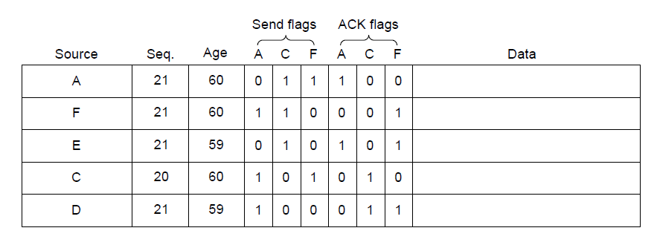
Distributing the Link State Packets
The packet buffer for router B in previous slide

Slide 59
Link State Routing Computing the New Routes
Once a router has accumulated a full set of link state packets, it can construct the entire network graph because every link is represented.
Dijkstra’s algorithm can be run locally to construct the shortest paths to all possible destinations. This information is installed in the routing table.
Compared with distance vector routing, link state routing requires more memory and computation.
With n routers, each of which has k neighbors, the memory to store the input data is proportional to kn.

Slide 60
Link State Routing
Link state routing is widely used in actual networks.
Many ISPs use the IS-IS (Intermediate System-Intermediate System) link state protocol.
OSPF (Open Shortest Path First) is another main link state protocol, designed after IS-IS.
Link state and distance vector and some other algorithms rely on processing at all routers to compute routes.
Problems with a small number of routers can wreak havoc across the network.
E.g., if a router claims to have a link it does not have or forgets a link it does have, the network graph will be incorrect.

Slide 61
Hierarchical Routing
As networks grow in size, it may not be feasible for every router to have an entry for every other router, so the routing will have to be done hierarchically.
The routers are divided into regions. Each router knows all the details about all routers within its own region but nothing about the internal structure of other regions.
Two-level hierarchy may be insufficient, we may have multiple levels.
Example: route a packet from Berkeley, California to Malindi, Kenya.

Slide 62
Hierarchical Routing
Example: route a packet from Berkeley, California to Malindi, Kenya.
The Berkeley router knows the detailed topology within California but will send all out-of-state traffic to the Los Angeles router.
The Los Angeles router can router traffic directly to other domestic routers but will send all foreign traffic to New York.
The New York router will direct all traffic to the router in the destination country responsible for handling foreign traffic, say, in Nairobi.
Finally, the packet will work its way down the tree in Kenya until it got to Malindi.

Slide 63
Hierarchical Routing
Example: a two-level hierarchy with 5 regions.
The full routing table for 1A will have 17 entries.
With hierarchical routing, there are 3 entries for local routers and 5 entries for other regions.
All traffic for region 2 goes via the 1B-2A line.
Traffic for other regions goes via the 1C-3B line.
The gains in space will lead to increased path length.
The best route from 1A to 5C is via region 2, but with hierarchical routing all traffic to region 5 goes via region 3, because that is better for most destination in region 5.

Slide 64
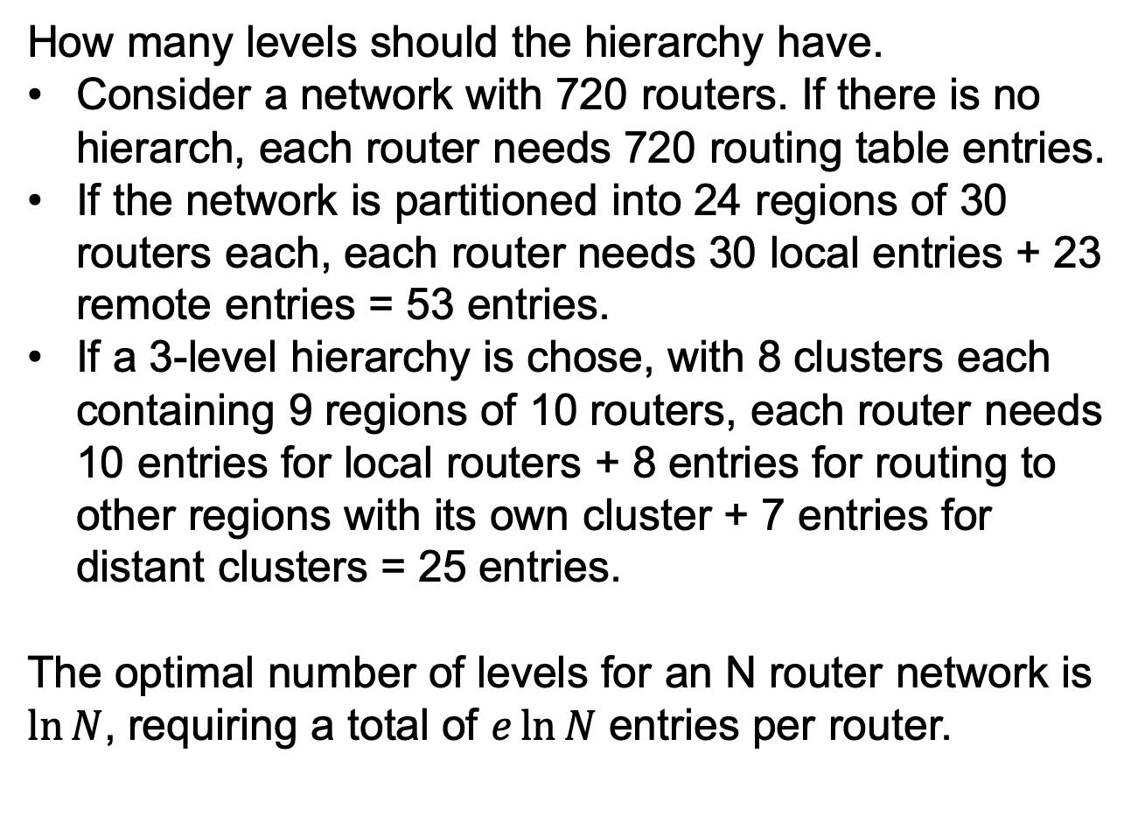
Hierarchical Routing
How many levels should the hierarchy have.
Consider a network with 720 routers. If there is no hierarch, each router needs 720 routing table entries.
If the network is partitioned into 24 regions of 30 routers each, each router needs 30 local entries + 23 remote entries = 53 entries.
If a 3-level hierarchy is chose, with 8 clusters each containing 9 regions of 10 routers, each router needs 10 entries for local routers + 8 entries for routing to other regions with its own cluster + 7 entries for distant clusters = 25 entries.
The optimal number of levels for an N router network is $\ln{N}$, requiring a total of $e\ln{N}$ entries per router.

Slide 65
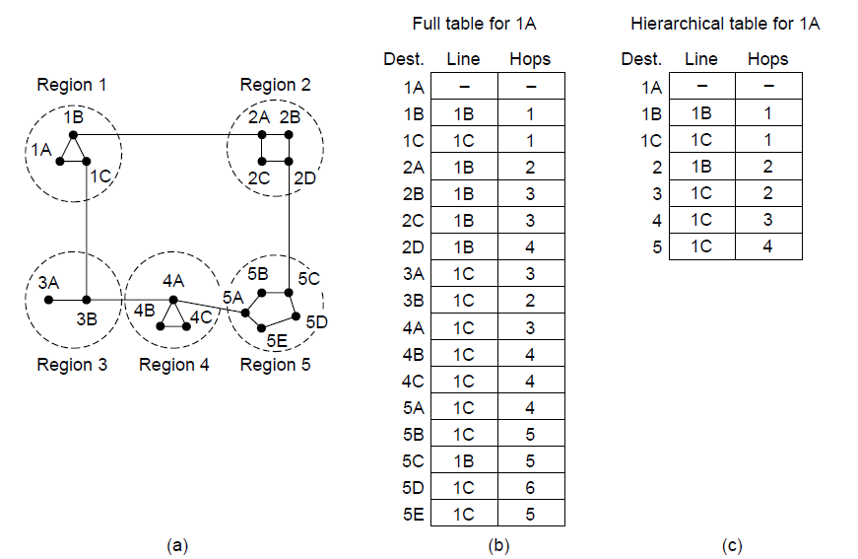
Hierarchical Routing
Hierarchical routing.

Slide 66
Routing Algorithms
Broadcast routing
Multicast routing
Anycast routing
Routing for mobile hosts
Routing in ad hoc networks

Slide 67
Broadcast Routing
In some applications, hosts need to send messages to many or all other hosts, called broadcasting.
Broadcast routing 1
The source simply sends a distinct packet to each destination, e.g., following the shortest paths.
Wasteful of bandwidth and slow.
The source has to have a complete list of all destinations.

Slide 68
Broadcast Routing
Broadcast routing 2: multidestination routing
Each packet contains a list of destinations.
When a packet arrives at a router, the router checks all the destinations to determine the set of output lines.
The router generates a new copy of the packet for each output line and includes in each packet only those destinations that are to use the line.
Requires the source to know all the destinations. Requires the routers to determine where to send the multidestination packet.
Broadcast routing 3: flooding
Flooding with a sequence number per source, use links efficiently with a decision rule at routers that is relatively simple.

Slide 69
Broadcast Routing
Broadcast routing 4: reverse path forwarding
Suppose every router knows the shortest path for each destination.
When a broadcast packet arrives, the router checks if the packet arrived on the link that is used to send packets toward the source of the broadcast (shortest path)
If so, there is an excellent chance that the broadcast packet follows the best route and is the first copy to arrive at the router. The router forwards it onto all links except the incoming line.
If not, the packet is discarded as a likely duplicate.

Slide 70
Broadcast Routing
Broadcast routing 4: reverse path forwarding
Example. (a) is the network. (b) is the sink tree (all shortest paths from source node I). (c) the reverse path forwarding process.
On the first hop, I sends packets to F, H, J and N. Each packet arrives on the preferred path to I and is indicated by a circle around the letter.
On the second hop, 8 packets are generated, all arrived at unvisited routers, 5 of them arrive along the preferred line.
Reverse path forwarding does not require routers to remember sequence numbers or list all destinations in the packet.

Slide 71
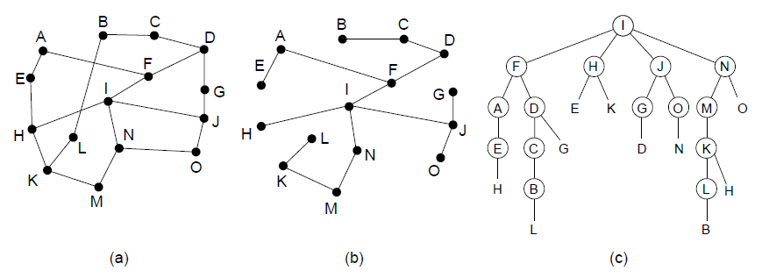
Broadcast Routing
Reverse path forwarding. (a) A network. (b) A sink tree. (c) The tree built by reverse path forwarding.

Slide 72
Broadcast Routing
Broadcast routing 5: spanning tree
Spanning tree is a subset of the network that includes all the routers but contains no loops. Sink tree is a special spanning tree consisting of all shortest paths.
Assume all routers know the same spanning tree.
Each router copies an incoming broadcast packet onto all the spanning tree lines except the one it arrived on.
E.g., when the sink tree of (b) is used as the spanning tree, the packet arrived at H will not be forwarded to E and K.
The problem is that each router must have knowledge of some spanning tree.

Slide 73
Multicast Routing
Multicasting: Send message to well-defined groups that are numerically large in size but small compared to the network as a whole, e.g., a group of 1000 machines on a million-node network.
Multicast routing schemes build on the broadcast routing schemes, sending packets along spanning trees to deliver the packets to the members of the groups.
Prune the broadcast spanning tree by removing links that do not lead to members.
The result is an efficient multicast spanning tree.

Slide 74
Multicast Routing
Example. Two groups 1 and 2. Some routers belong to one or both of these groups.
A spanning tree for the leftmost router is shown in (b).
All links that do not lead to members of group 1 are removed in (c). The result is the multicast spanning tree for the leftmost router to send to group 1.
7 links instead of 10, more efficient.
The multicast spanning tree after pruning for group 2 is in (d).
Different multicast groups have different spanning trees.

Slide 75
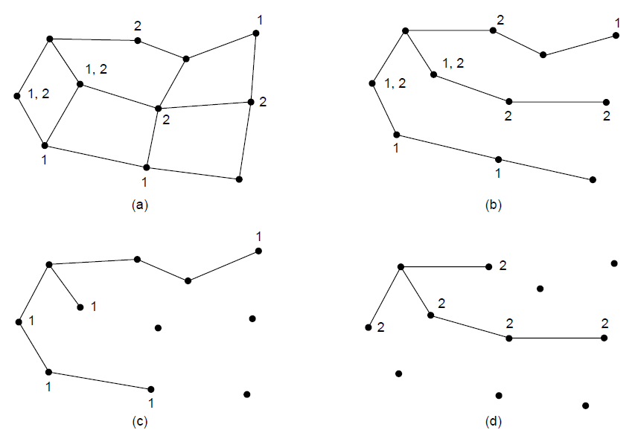
Multicast Routing
(a) A network. (b) A spanning tree for the leftmost router. (c) A
multicast tree for group 1. (d) A multicast tree for group 2.

Slide 76
Multicast Routing
Various ways of pruning the spanning tree.
With link state routing, each router is aware of the full topology. Each router can construct a sink tree (the sender is the sink/root node) and then remove all links that do not connect group members to the sink node. MOSPF (Multicast OSPF) is a link state protocol that works in this way.
If distance vector routing, we use reverse path forwarding for pruning.
If a router with no hosts in the group and no connection to other routers receives the multicast message, it responds with a PRUNE message telling the neighbor not to send it the multicast message.

Slide 77
Multicast Routing
Various ways of pruning the spanning tree.
If distance vector routing, we use reverse path forwarding for pruning.
If a router with no hosts in the group receives multicast message on all lines to which it sends the multicast, it responds with a PRUNE message.
DVMRP (Distance Vector Multicast Routing Protocol) is a multicast routing protocol that works in this way.

Slide 78
Multicast Routing
In large networks, pruning may be inefficient.
E.g., in the previous figure, the leftmost router uses the spanning tree in (c) to send to group 1. But the rightmost router must build a different spanning tree to send to group 1. Considerable storage is needed to store all trees.
Core-based trees: compute a single spanning tree for the group.
All routers agree on a root, called core or rendezvous point.
To send to this group, a sender sends a packet to the core. At the core, the packet is forwarded down the tree.
As soon as a packet reaches the tree, it can be forwarded up to the root and down to the branches.

Slide 79
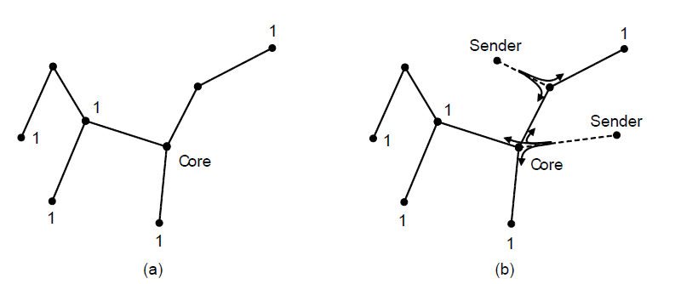
Multicast Routing
Core-based tree for group 1.
Sending to group 1.

Slide 80
Multicast Routing
Shared trees can save storage costs, messages sent and computation.
Each router has to keep only one tree per group.
PIM (Protocol Independent Multicast) is a popular core-based tree protocol for multicasting.

Slide 81
Anycast Routing
Anycast: a packet is delivered to the nearest member of a group.
Anycast routing: distance vector and link state routing can produce anycast routes.
Suppose we want to anycast to the members of group 1. They will all be given the address “1”, instead of different addresses.
Distance vector routing will choose the shortest path to destination 1. Routers will send to the nearest instance of destination 1.
Link state routing will also find the shortest paths to instances of destination 1.

Slide 82
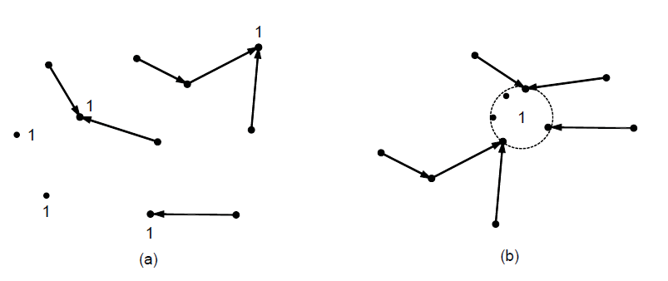
Anycast Routing
Anycast routes to group 1.
Topology seen by the routing protocol.

Slide 83
Routing for Mobile Hosts
People may use their wireless devices on the go. We refer to them as mobile hosts, as distinct from stationary hosts that never move.
We assume that each host has a permanent home location that never changes. Each host also has a permanent home address to determine its home location.
If we recompute routes as the mobile host moves and the topology changes, the model will lead to the entire network endlessly computing new routes. Thus we use home address to find the current location of the device.

Slide 84
Routing for Mobile Hosts
The basic idea for mobile routing is for the mobile host to tell a host at the home location where it is now. This host is called the home agent.
Example. A sender wants to send a packet to a host normally located in New York but is now at San Diego.
The mobile host in San Diego acquires a local network address called a care of address. The mobile host sends a registration message to the home agent with the care of address.
The sender sends a packet to the mobile host using its permanent address. This packet is routed by the network to the home agent.

Slide 85
Routing for Mobile Hosts
Example. A sender wants to send a packet to a host normally located in New York but is now at San Diego.
3. The home agent encapsulates the packet with a new header and sends this bundle to the care of address using the technique of tunneling (introduced later).
4. The mobile host unwraps the packet, and sends its reply packet directly to the sender. The overall route is called triangle routing.
5. The sender may learn the current care of address. Subsequent packets can be routed directly to the mobile host, bypassing the home location.

Slide 86
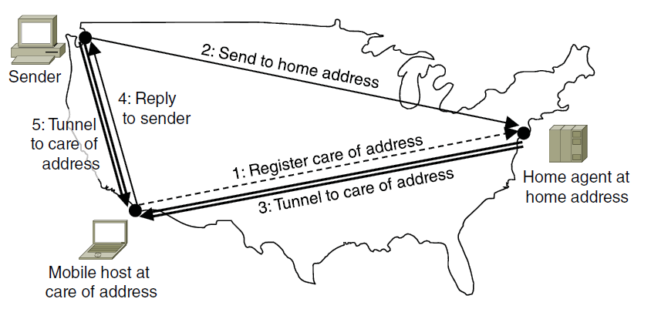
Routing for Mobile Hosts
Packet routing for mobile hosts

Slide 87
Routing in Ad Hoc Networks
An extreme case is that not only the hosts are mobile but the routers are mobile.
E.g., emergency workers at an earthquake, military vehicles on a battlefield.
In these cases, each node communicates wirelessly and acts as both a host and a router.
Called ad hoc networks or MANETS (Mobile Ad Hoc NETworks).
The topology changes frequently and suddenly.
We will introduce one of the most popular routing algorithm AODV (Ad hoc On-demand Distance Vector)

Slide 88
Routing in Ad Hoc Networks
Routes to a destination are discovered on demand.
Main algorithm. Consider the example of a newly formed ad hoc network in the following figure. Node A wants to send a packet to node I.
Node A looks in its table and does not find an entry for I. It now has to discover a route to I “on demand”.
Node A constructs a ROUTE REQUREST packet and broadcasts it using flooding.
Each node rebroadcasts the request.
A sequence number is set by node A to weed out duplicates. E.g., D discards the transmission from B in (c) because it already forwarded the request.
Eventually, the request reaches node I.

Slide 89
Routing in Ad Hoc Networks
Main algorithm.
Node I constructs a ROUTE REPLY packet. This packet is unicast to the sender along the reverse path followed by the request.
For this to work, each intermediate node must remember the node that sent it the request.
Each intermediate node increments a hop count as it forwards the reply.
This tells the nodes how far they are from the destination.
The replies tell each intermediate node which neighbor to use to reach the destination: the node that sent them the reply.
G and D put the best route into their table.
ADGI route has been created.

Slide 90
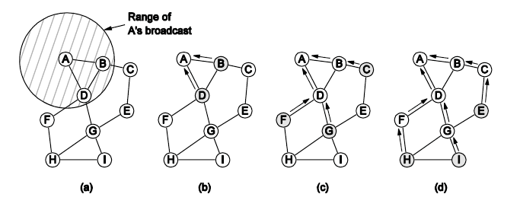
Routing in Ad Hoc Networks
The shaded nodes are new recipients. The dashed lines show possible reverse routes. The solid lines show the discovered route.
Range of A’s broadcast.
After B and D receive it.
After C, F, and G receive it.
After E, H, and I receive it.

Slide 91
Routing in Ad Hoc Networks
To reduce overhead, the scope of the broadcast is limited using the IP packet’s Time to live field.
The field is initialized by the send and decremented on each hop. If it hits 0, the packet is discarded instead of being broadcasted.
To locate a destination, the sender broadcasts a ROUTE REQUEST packet with Time to live set to 1.
If no response comes back, another one is sent with Time to live set to 2.

Slide 92
Routing in Ad Hoc Networks Route Maintenance
Nodes may move or switched off, the topology can change. For example, if G is switched off, node A will not realize that the route ADGI is no longer valid.
To deal with this, each node periodically broadcasts a HELLO message to its neighbors. If no response comes, the node knows that the neighbor is unreachable.
If any of node A’s neighbors becomes unreachable, it checks its routing table to see which destinations have routes using the now-gone neighbor.
For each of these routes, the active neighbors of A are informed that their route via node A is now invalid and must be purged from the tables.
E.g., D purges its entries for G and I and notifies A, which purges its entry for I.

Slide 93
Routing in Ad Hoc Networks Route Maintenance
In the spirit of an on demand protocol, intermediate nodes only store the routes that are in use.
Other route information learned during broadcasts is timed out after a short delay. Helps save bandwidth and battery life.
Route discovery are shared when routes overlap.
E.g., if B wants to send packets to I, it floods the request to D, which already has a route to I. Node D can then generate a reply to tell B the route without any additional work.

Slide 94
End
Chapter 5

