Slide 1
The Transport Layer
Chapter 6

Slide 2
Transport Service
Upper Layer Services
Transport Service Primitives
Berkeley Sockets
Example of Socket Programming: Internet File Server

Slide 3
Services Provided to the Upper Layers
The goal of the transport layer is to provide efficient, reliable, and cost-effective data transmission service to the application layer.
To achieve this, the transport layer uses the services provided by the network layer.
Transport entity: the software and hardware within the transport layer.
Two types of transport services: connection-oriented and connectionless.
Similar to the network layer.

Slide 4
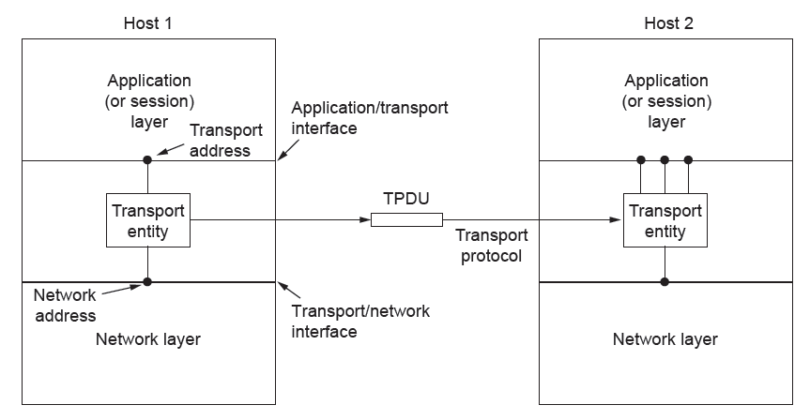
Services Provided to the Upper Layers
The network, transport, and application layers

Slide 5
Services Provided to the Upper Layers
Why do we need the transport layer?
The network layer mostly runs on the routers, which are operated by the carrier. The users have no real control over the network layer.
The transport code runs entirely on the users’ machines.
The transport layer makes the transport service more reliable than the underlying network.
The transport layer isolates the upper layers (e.g., application layer) from the technology, design and imperfections of the network.

Slide 6
Transport Service Primitives
Transport layer provides operations to application layers to access the transport service.
The transport service provides a reliable service on top of an unreliable network.
The transport layer can also provide unreliable (datagram) service. But we concentrate on the connection-oriented transport service.
The five primitives in the next table allows application programs to establish, use and release connections.

Slide 7
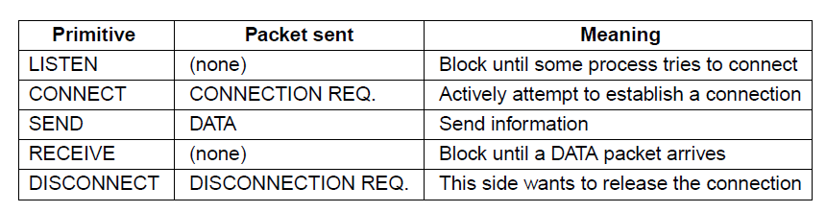
Transport Service Primitives
The primitives for a simple transport service

Slide 8
Transport Service Primitives
An example, an application with a server and many remote clients.
The server executes a LISTEN primitive.
When a client wants to talk to the server, it executes a CONNECT primitive.
The transport entity of the client sends a CONNECTION REQUEST segment to the server.
The server sends back a CONNECTION ACCEPTED segment to the client.
The connection is established. Data can be exchanged using the SEND and RECEIVE primitives.

Slide 9
Transport Service Primitives
Segment: the message unit for the transport layer.
Some older protocols used the name TPDU (Transport Protocol Data Unit)
Segments (exchanged by the transport layer) are contained in packets (exchanged by the network layer). In turn, these packets are contained in frames (exchanged by the data link layer).
When a frame arrives, the data link layer processes the frame header. If the destination address matches for local delivery, passes the frame payload to the network layer.
The network layer processes the packet header, then passes the packet payload to the transport layer.

Slide 10
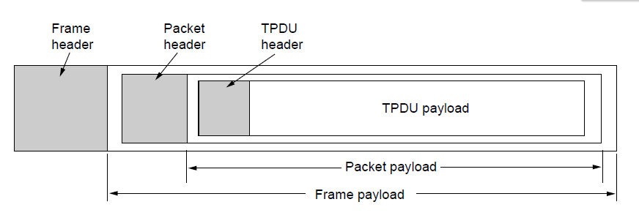
Transport Service Primitives
Nesting of TPDUs, packets, and frames.

Slide 11
Transport Service Primitives
To release a connection, disconnection has two variants: asymmetric and symmetric.
Asymmetric: either transport user issues a DISCONNECT primitive; a DISCONNECT segment sent to the other transport user; the connection is released.
Symmetric: each direction is closed separately.
When one side does a DISCONNECT, that means it has no more data to send but it is still willing to accept data from its partner.
A connection is released when both sides have done a DISCONNECT.
A state diagram for connection establishment and release.

Slide 12
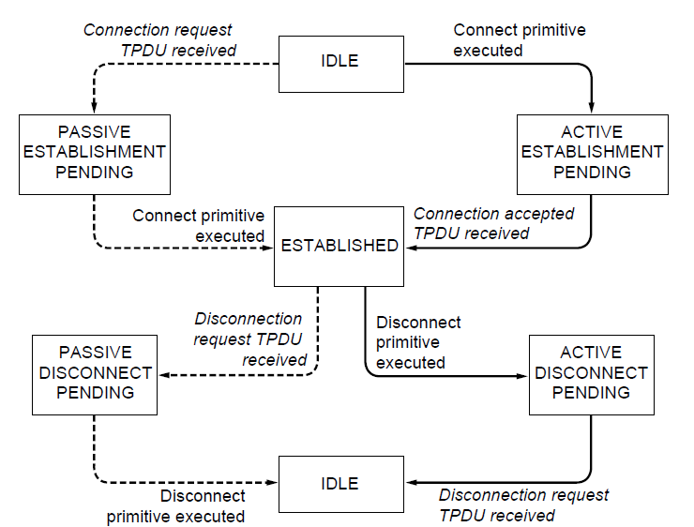
Transport Service Primitives
A state diagram for a simple connection management scheme. Transitions labeled in italics are caused by packet arrivals. The solid lines show the client’s state sequence. The dashed lines show the server’s state sequence.

Slide 13
Berkeley Sockets
Another set of transport primitives, the socket primitives used for TCP.
First released as part of the Berkeley UNIX 4.2BSD software distribution in 1983.
The listed primitives follow the model of the server-client example but offer more features and flexibility.

Slide 14
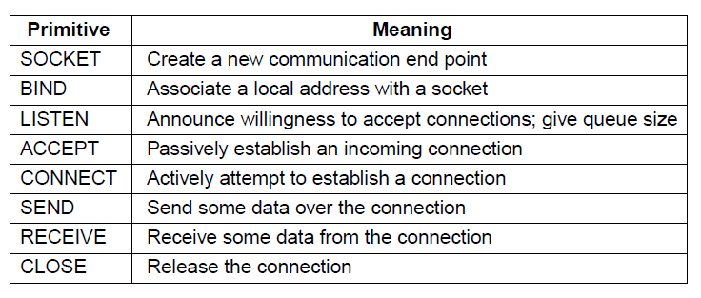
Berkeley Sockets
The socket primitives for TCP

Slide 15
Berkeley Sockets
Server side:
The server executes the SOCKET primitive to create a new endpoint and allocate table space for it within the transport entity.
The parameters of the call specify the addressing format, the type of service desired, and the protocol.
A successful SOCKET call returns an ordinary file descriptor for use in succeeding calls.
The server executes the BIND primitive to bound an address to a socket.
The server executes the LISTEN primitive to allocate space to queue incoming calls for several clients that try to connect at the same time.

Slide 16
Berkeley Sockets
4. When a segment asking for a connection arrives, the transport entity executes ACCEPT primitive.
Create a new socket with the same properties as the original one and returns a file descriptor for it.
The server forks off a process or thread to handle the connection on the new socket and go back to the original socket to wait for the next connection.

Slide 17
Berkeley Sockets
Client side:
The client executes the SOCKET primitive. BIND is not required. The server executes the BIND primitive to bound an address to a socket.
The server executes the CONNECT primitive to establish a connection.
Both sides can use SEND and RECEIVE to transmit and receive data over the connection.
Connection release with sockets is symmetric.
When both sides have executed a CLOSE primitive, the connection is released.

Slide 18
Example of Socket Programming: An Internet File Server
We have a very primitive Internet file server and an example client that uses it.
The code has many limitations.
But in principle the server code and the client code can be compiled and run on any UNIX machine on the Internet.

Slide 19
Example of Socket Programming: An Internet File Server
Server code:
Standard headers.
Constant definition.
SERVER_PORT. Any number between 1024 and 65535 will work, as long as it is not in use by other process.
BUF_SIZE. The chunk size in bytes for file transfer.
QUEUE_SIZE. How many pending connections can be held before additional ones are discarded upon arrival.

Slide 20
Example of Socket Programming: An Internet File Server
Server code:
Initialize a data structure to hold the server’s IP address.
The call to memset sets the data structure to all 0s.
The following three assignments fill in 3 of its fields.
The functions htonl and htons convert values to a standard format.
Create a socket and check for errors.
Bind the IP address to the socket and check for errors.
Call to listen to announce the server’s willingness to accept incoming calls.

Slide 21
Example of Socket Programming: An Internet File Server
Server code:
Enter the main loop.
Call accept to blocks the server until some client tries to establish a connection with it.
The socket sa can be used for reading from the connection and writing to it.
After the connection is established, the server reads the file name from it.
After getting the file name, the server opens the file and enters a loop that reads blocks from the file and writes them to the socket.
Close the file and the connection and waits for the next connection.

Slide 22
Example of Socket Programming: An Internet File Server
Client code:
Assume the code is called client, a typical call is
client flits.cs.vu.hl /usr/tom/filename >f
flits.cs.vu.hl is the server address, and /usr/tom/filename is the directory and name of the file.
If the call is successful, the file is transferred over the Internet and written to f.
Start by checking to see if it has been called with the right number of arguments.
Create a socket.
Establish a connection to the server, using connect.
The client enters a loop, reading the file block by block from the socket and copying it to standard output.

Slide 23
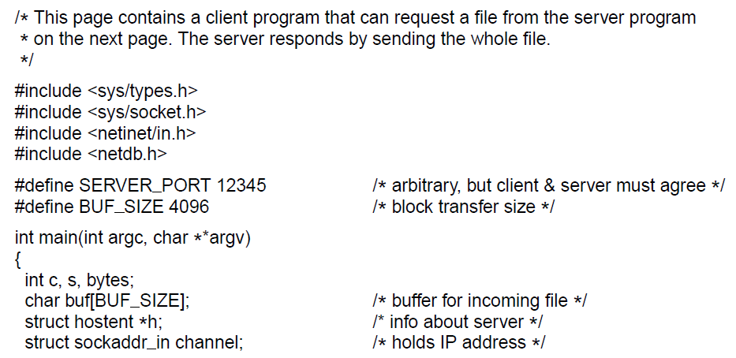
Example of Socket Programming: An Internet File Server
. . .
Client code using sockets

Slide 24
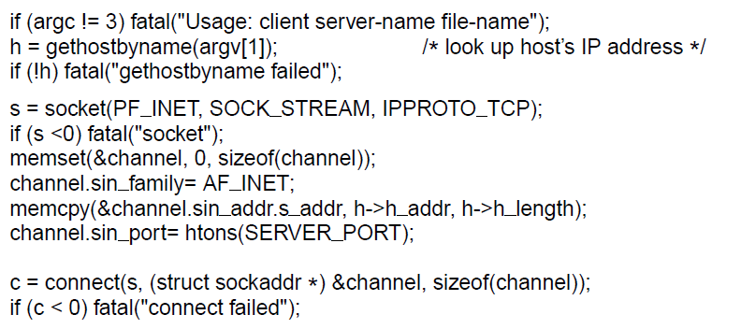
Example of Socket Programming: An Internet File Server
. . .
. . .
Client code using sockets

Slide 25
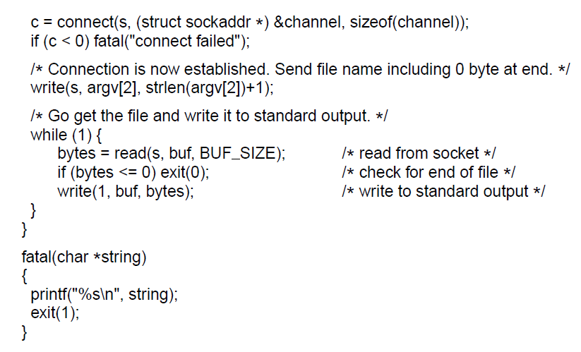
Example of Socket Programming: An Internet File Server
. . .
Client code using sockets

Slide 26
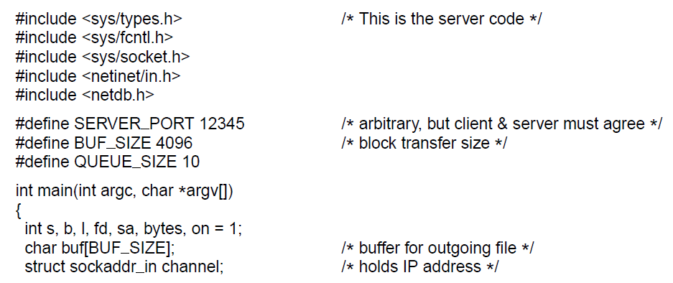
Example of Socket Programming: An Internet File Server
. . .
Server code

Slide 27
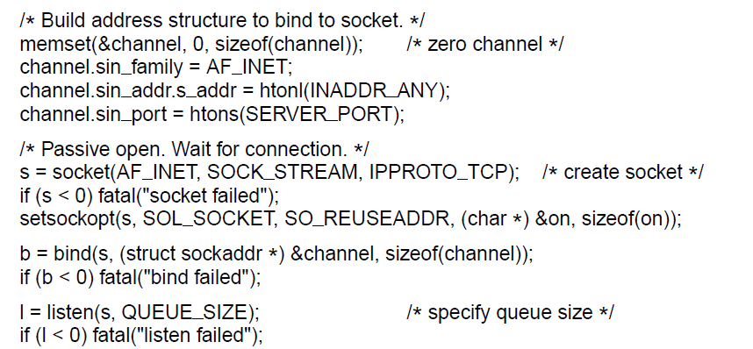
Example of Socket Programming: An Internet File Server
. . .
. . .
Server code

Slide 28
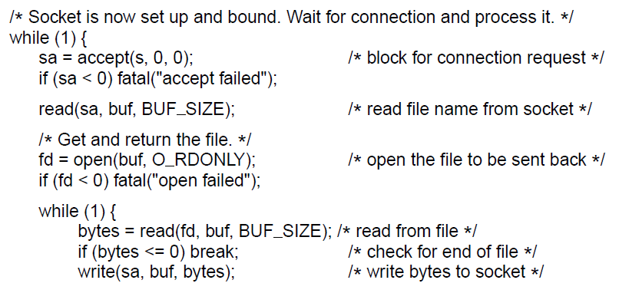
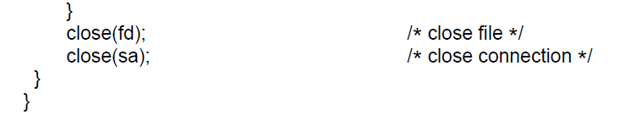
Example of Socket Programming: An Internet File Server
. . .
Server code

Slide 29
Elements of Transport Protocols
Addressing
Connection establishment
Connection release
Error control and flow control
Multiplexing
Crash recovery

Slide 30
Elements of Transport Protocols
The transport service is implemented by a transport protocol used between the two transport entities.
Transport protocols resemble the data link protocols. Both have to deal with error control, sequencing and flow control.
The major dissimilarities lie between the environments in which the two protocols operate.
At the data link layer, two routers communicate directly via a physical channel, wired or wireless
At the transport layer, this physical channel is replaced by the entire network.

Slide 31
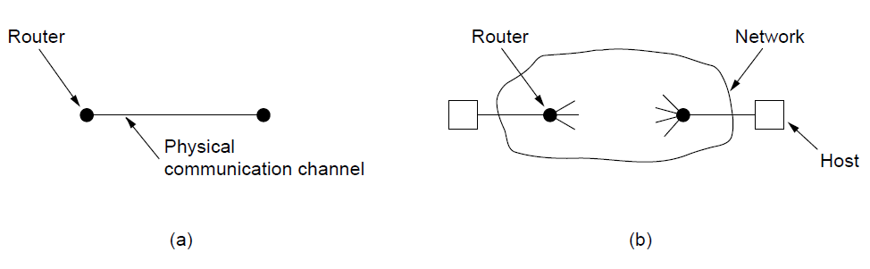
Elements of Transport Protocols
Environment of the data link layer.
Environment of the transport layer.

Slide 32
Elements of Transport Protocols Addressing
When an application process wishes to set up a connection to a remote application process, it must specify which one to connect to. Therefore, transport addresses are defined to which processes can listen for connection requests.
The transport layer endpoints are called ports in Internet, and the generic term is TSAP (Transport Service Access Point)
The endpoints in the network layer are called NSAPs (Network Service Access Points). IP addresses are examples of NSAPs.
Each computer has a single NSAP, but multiple TSAP for different applications.

Slide 33
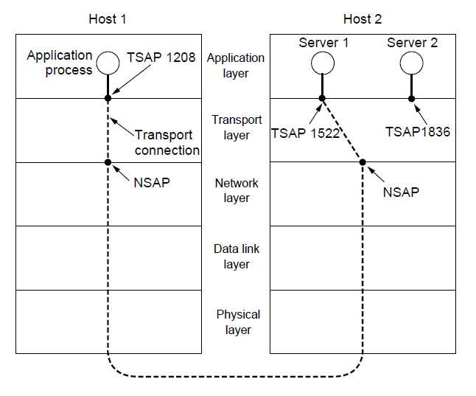
Addressing
TSAPs, NSAPs, and transport connections

Slide 34
Elements of Transport Protocols Addressing
Example:
1. A mail server process attaches itself to TSAP 1522 on host 2 to wait for an incoming call.
2. An application process on host 1 wants to send an email message, so it attaches itself to TSAP 1208 and issues a CONNECT request. The request specifies TSAP 1208 on host 1 as the source and TSAP 1522 on host 2 as the destination. A transport connection is established between the application process and the server.
3. The application process sends over the mail message.
4. The mail server responds to say that it will deliver the message.
5. The transport connection is released.

Slide 35
Elements of Transport Protocols Addressing
How does the user process on host 1 know that the mail server is attached to TSAP 1522?
Some services have stable TSAP addresses, e.g., the mail server is on TCP port 25.
For other services, there exists a special process called a portmapper.
To find the TSAP address of a given service name, e.g., “BitTorrent”, a user sets up a connection to the portmapper (which listens to a well-known TSAP).
The user sends the service name, and the portmapper sends back the TSAP address.
When a new service is created, it must register its service name and the TSAP with the portmapper

Slide 36
Elements of Transport Protocols Addressing
A machine may have many server processes. It is wasteful for all of them to be active and listening to a stable TSAP.
Solution: initial connection protocol
Each machine has a special process server that acts as a proxy for less used services. It listens to a set of ports at the same time.
A user performs a CONNECT request, specifying the service TSAP address. If no server is waiting for the user, the user gets a connection to the process server.
The process server asks the requested server to inherit the existing connection with the user, and goes back to listening for new requests.

Slide 37
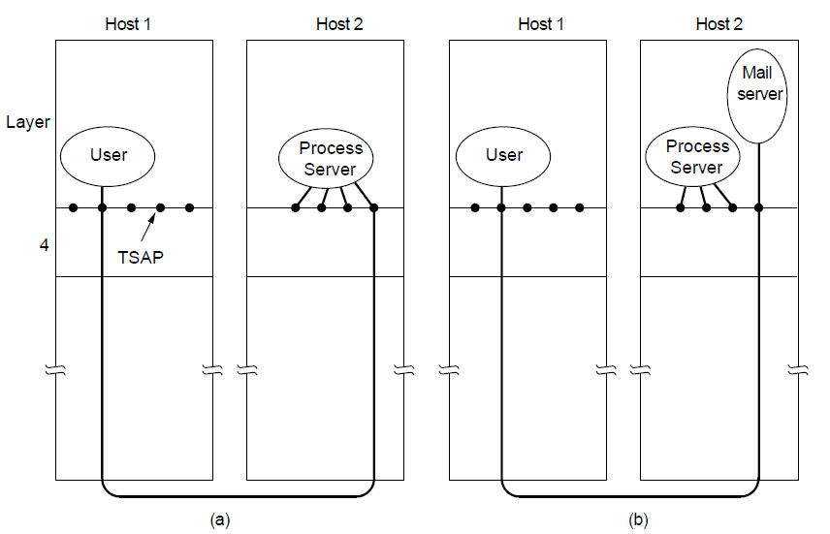
Addressing
How a user process in host 1 establishes a connection with a mail server in host 2 via a process server.

Slide 38
Elements of Transport Protocols Connection Establishment
Establishing a connection is nontrivial when the network can lose, delay corrupt and duplicate packets.
To deal with delayed duplicate segments, we use a scheme that can kill off aged packets that are still hobbling about.
Packet lifetime can be restricted to a known maximum using the following three techniques.

Slide 39
Connection Establishment
Techniques for restricting packet lifetime
Restricted network design.
Include any method that prevents packets from looping.
Putting a hop counter in each packet.
Set the hop counter to some appropriate value and decrement each time the packet is forwarded.
Timestamping each packet.
Each packet bears the time it was created. Require the router clocks to be synchronized.

Slide 40
Elements of Transport Protocols Connection Establishment
With packet lifetime bounded, it is possible to devise a practical and foolproof way to reject delayed duplicate segments.
Introduce a period T, which is some small multiple of the true maximum packet lifetime. , e.g., 120 sec in the Internet. If we wait T secs after a packet has been sent, we can be sure that all traces of it (the packet and its acknowledgment) are now gone.
The source label segments with sequence numbers that will not be reused within T secs. The period, T, and the rate of packets per second determine the size of the sequence numbers.
Only one packet with a given sequence number may be outstanding at any given time.

Slide 41
Elements of Transport Protocols Connection Establishment
Three-way handshake: distinguish duplicate sequence number across connections.
Host 1 chooses a sequence number x, and sends a CONNECTION REQUEST segment containing it to host 2.
Host 2 replies with an ACK segment acknowledging x and announcing its own initial sequence number y.
Host 1 acknowledges host 2’s choice of an initial sequence number in the first data segment that it sends.

Slide 42
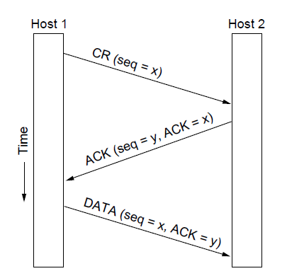
Connection Establishment
Three protocol scenarios for establishing a connection using a
three-way handshake. CR denotes CONNECTION REQUEST. Normal operation.

Slide 43
Elements of Transport Protocols Connection Establishment
Three-way handshake: how it works in the presence of delayed duplicate CONNECTION REQUEST segments. Example 1.
A delayed duplicate CONNECTION REQUEST from an old connection reaches host 2.
Host 2 reacts to this segment by sending host 1 an ACK segment, asking for verification that host 1 indeed tried to set up a new connection.
Host 1 reject host 2’s attempt to establish a connection.
Host 2 realizes that it was tricked by a delayed duplicate and abandons the connection.

Slide 44
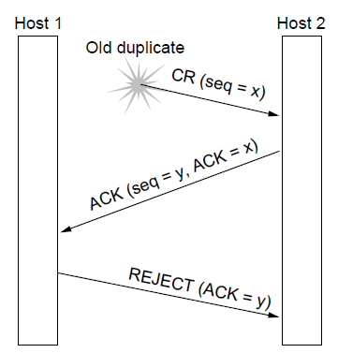
Connection Establishment
Three protocol scenarios for establishing a connection using a
three-way handshake. CR denotes CONNECTION REQUEST. Old duplicate CONNECTION REQUEST appearing out of nowhere.

Slide 45
Elements of Transport Protocols Connection Establishment
Three-way handshake: how it works in the presence of delayed duplicate CONNECTION REQUEST and ACK segments. Example 2.
A delayed duplicate CONNECTION REQUEST from an old connection reaches host 2.
Host 2 reacts to this segment by sending host 1 an ACK segment, and host 2 proposes to use y as the initial sequence number for host 2 to host 1 traffic.
The delayed duplicate ACK reaches host 2 with ACK = z.
Since z is being acknowledged but not y, host 2 realizes that the ACK is a duplicate.

Slide 46
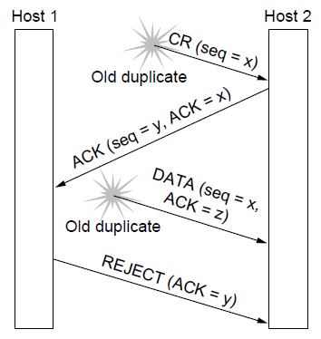
Connection Establishment
Three protocol scenarios for establishing a connection using a
three-way handshake. CR denotes CONNECTION REQUEST. Duplicate CONNECTION REQUEST and duplicate ACK

Slide 47
Elements of Transport Protocols Connection Release
Asymmetric and symmetric release.
Asymmetric release is abrupt and may result in data loss.
For example, after the connection is established, host 1 sends a segment that arrives properly at host 2.
Host 1 sends another segment.
Host 2 issues a DISCONNECT before the second segment arrives.
The connection is released and data are lost.

Slide 48
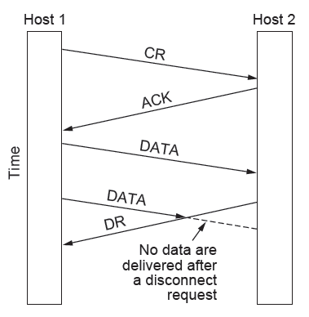
Connection Release
Abrupt disconnection with loss of data

Slide 49
Elements of Transport Protocols Connection Release
To avoid data loss, one way is to use symmetric release.
For example, host 1 says “I am done. Are you done too?” If host 2 responds “I am done too. Goodbye. ” The connection may be safely released.
However, this protocol will face the two-army problem.
A white army is in a valley. On both surrounding hillsides are blue armies. The white army is larger than either blue army alone, but together the blue armies are larger than the white army.
The blue armies want to synchronize their attacks. But their only communication medium is through the valley, which is unsafe. The message may get lost.

Slide 50
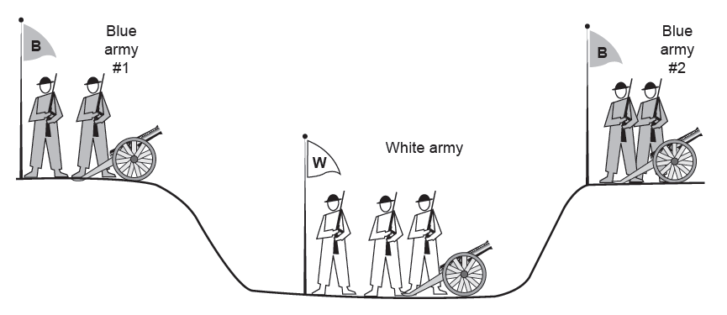
Connection Release
The two-army problem

Slide 51
Elements of Transport Protocols Connection Release
However, this protocol will face the two-army problem.
Does a protocol exist to allow the blue armies to win?
No!
A two-way handshake. Suppose that blue army #1 sends a message saying “How about we attack together on March 29?” Suppose the message arrives and blue army #2 agrees. Blue army #2’s reply also arrives at blue army #1 safely. Will the attack happen? Probably not, since #2 does not know if its reply got through.
A three-way handshake. Suppose blue army #1 acknowledges the reply of blue army #2 and #2 receives the acknowledgment. Blue army #1 will hesitate since it does not know if its acknowledgement got through.

Slide 52
Elements of Transport Protocols Connection Release
The connection release problem is like the two-army problem. Neither side is convinced that the other side is prepared to disconnect too, the disconnection will never happen.
Three-way handshake is fallible, but enough.
Normal case (a). Host 1 sends a DR (DISCONNECTION REQUEST) segment. Host 2 sends back a DR segment and starts a timer. When this DR arrives, host 1 sends back an ACK segment and releases the connection. When the ACK arrives, host 2 releases the connection.

Slide 53
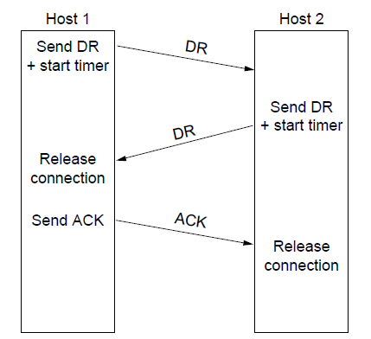
Connection Release
Four protocol scenarios for releasing a connection. (a) Normal case of three-way handshake

Slide 54
Elements of Transport Protocols Connection Release
Three-way handshake is fallible, but enough.
Abnormal case (b), the final ACK segment is lost. When the timer expires, the connection is released.
Abnormal case (c), the second DR is lost. Host 1 will not receive the expected response, will time out, and will start all over again.
Abnormal case (d), all the repeated attempts to retransmit the DR also fail. After N retries, the sender just gives up and releases the connection. The receiver times out and also exits.

Slide 55
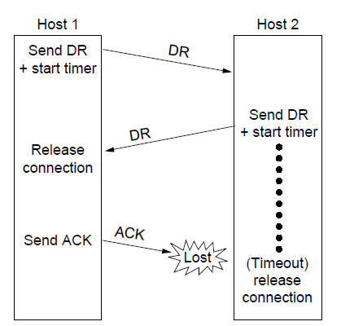
Connection Release
Four protocol scenarios for releasing a connection. (b) Final ACK lost.

Slide 56
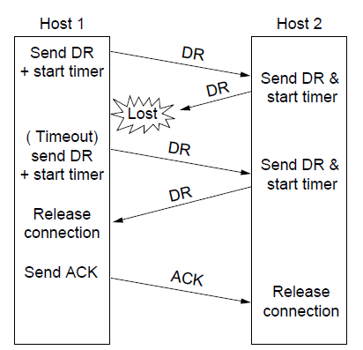
Connection Release
Four protocol scenarios for releasing a connection. (c) Response lost

Slide 57
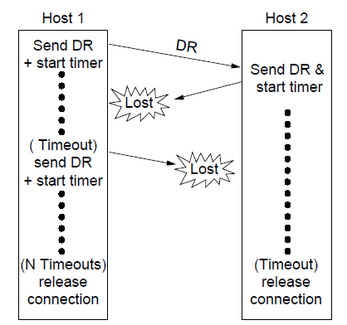
Connection Release
Four protocol scenarios for releasing a connection. (d) Response lost and subsequent DRs lost.

Slide 58
Elements of Transport Protocols Error Control and Flow Control
Both error control and flow control have come up before in data link layer.
A frame carries an error-correcting code to check if the information was correctly received.
A frame carries a sequence number and is retransmitted until an acknowledgement is received, called ARQ (Automatic Repeat reQuest).
There is a maximum number of frames that the sender will allow to be outstanding (unacknowledged) at anytime. If this maximum is one packet the protocol is called stop-and-wait.
The sliding window protocol combines these features.

Slide 59
Elements of Transport Protocols Error Control and Flow Control
Given that these mechanisms are used on frames at the link layer, why they are used on segments at the transport layer again?
Differences in function and degree.
Function. For example, the error detection in link layer protects a frame while it crosses a single link; the error detection in transport layer protects a segment when it crosses the entire network path.
Degree. For example, for the sliding window protocol, transport layer generally uses larger sliding windows since the transport layer has a longer end-to-end round trip time than the link layer transmission time.

Slide 60
Elements of Transport Protocols Error Control and Flow Control
Since a host may have many connections, buffer management is important.
How to organize the buffer pool?
If most segments are nearly the same size, we can organize the buffers as a pool of identically sized buffers, with one segment per buffer. Figure (a).
If there is wide variation in segment size, fixed-sized buffers presents problems.
Solution 1: variable-sized buffers in Figure (b). Better memory utilization but more complicated buffer management.
Solution 2: a single large circular buffer per connection in Figure (c).

Slide 61
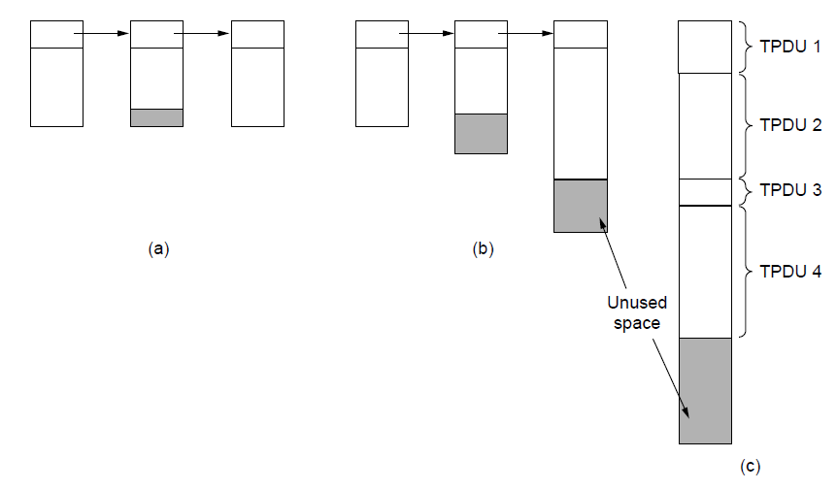
Error Control and Flow Control
(a) Chained fixed-size buffers. (b) Chained variable-sized buffers. (c) One large circular buffer per connection.

Slide 62
Elements of Transport Protocols Error Control and Flow Control
Dynamic buffer allocations.
As connections are opened and closed and as traffic pattern changes, the sender and receiver need to dynamically adjust their buffer allocations.
Dynamic buffer allocation means a variable-sized window.
Initially, the sender requests a certain number of buffers, based on its expected needs.
The receiver grants as many as it can afford.
Every time the sender transmits a segment, it must decrement its allocation, stopping when the allocation reaches zero.
The receiver piggybacks both acknowledgements and buffer allocations onto the reverse traffic.

Slide 63
Elements of Transport Protocols Error Control and Flow Control
Dynamic buffer allocation example: a datagram network with 4-bit sequence number.
Initially, A wants 8 buffers, but B only grants 4.
A sends 3 segments. The third segment is lost.
B acknowledges segments up to and including sequence number 1, allowing A to release those buffers, and furthermore informs A that it has permission to send 3 more segments starting beyond 1.
A knows that it already sent number 2, so it thinks that it may send segments 3 and 4. Then, A is blocked and wants for more buffer allocation.
Timeout of 2 induces retransmission.
B acknowledges receipt of segments up to and including 4 but refuses to let A continue.

Slide 64
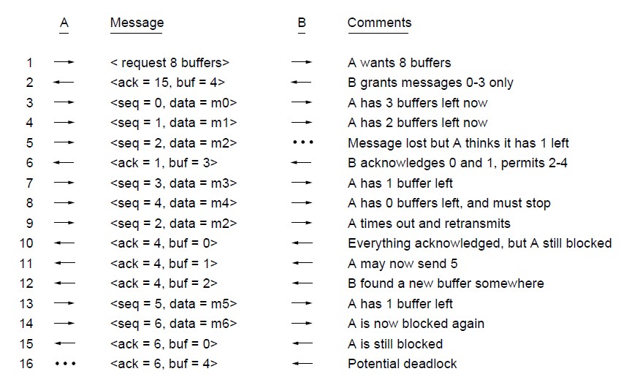
Error Control and Flow Control
Dynamic buffer allocation. The arrows show the direction of transmission. An ellipsis (...) indicates a lost TPDU

Slide 65
Elements of Transport Protocols Error Control and Flow Control
Problem: what if the control segment gets lost?
For example, the last ACK of B is lost. B has more buffer allocated to A, but the allocation segment is lost. A is now deadlocked.
To prevent this situation, each host should periodically send control segments giving the acknowledgement and buffer status on each connection.
Apart from buffer space available in the receiver, another bottleneck is the carrying capacity of the network:
If the network can handle c segments/sec and the round-trip time is r, the sender’s window should be cr.
The window size should be adjusted frequently.

Slide 66
Elements of Transport Protocols Multiplexing
Multiplexing in the transport layer can arise in a number of ways.
For example, in Figure (a), if only one network address (i.e., IP address) is available on a host, all transport connection on that machine have to use it.
When a segment comes in, some way is needed to tell which process to give it to.
Inverse multiplexing in Figure (b).
A host has multiple network paths that it can use, i.e., a connection that distributes the traffic among multiple network paths.
SCTP (Stream Control Transmission Protocol) runs a connection using multiple network interfaces.

Slide 67
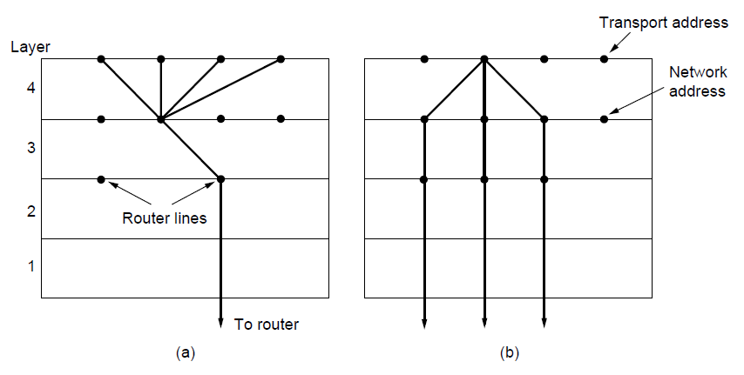
Multiplexing
(a) Multiplexing. (b) Inverse multiplexing.

Slide 68
Elements of Transport Protocols Crash Recovery
The transport entity is entirely within the hosts, recovery from network and router crashes can be handled by the transport entity.
A more troublesome problem is how to recover from host crashes. We show by example that this cannot be done within the transport layer (i.e., need the application layer)
Consider a client-server scenario, where the client is sending a long file to the server using a simple stop-and-wait protocol. The client can be in one of two states: one segment outstanding, S1, or no segments outstanding, S0.
The transport layer of the server crashes.

Slide 69
Elements of Transport Protocols Crash Recovery
To recover from the crash, there are two important issues?
Should the client retransmit the last segment?
Does the receipt of acknowledgement means that the server has written the segment to the application process before crashing?
The client can be programmed in one of 4 ways: always retransmit the last segment, never retransmit the last segment, retransmit only in state S0, or retransmit only in state S1.
The server can be programmed in one of 2 ways: acknowledge first or write first.

Slide 70
Elements of Transport Protocols Crash Recovery
The transport entity of the client has 3 events: sending an acknowledgement (A), writing to the application process (W), and crash (C).
The events can occur in 6 different orderings: AC(W), AWC, C(AW), C(WA), WAC, WC(A), the parentheses are used to indicate that neither A or W can follow C.
Together, we have 8 combinations of client and server strategies.
For each strategy there is some sequence of events that causes the protocol to fail.
For example, if the client always retransmits, the AWC event will generate an undetected duplicate.

Slide 71
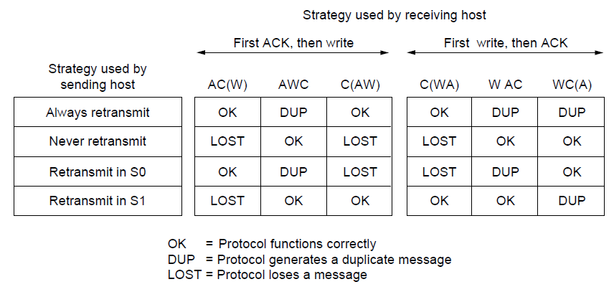
Crash Recovery
Different combinations of client and server strategy

Slide 72
Congestion Control
Desirable bandwidth allocation
Regulating the sending rate

Slide 73
Congestion Control
Congestion control is a combined responsibility of the network and transport layers.
Congestion occurs at routers, so it is detected at the network layer.
However, congestion is ultimately caused by traffic sent into the network by the transport layer. The only effective way to control congestion is for the transport layer to send segments into the network more slowly.
The Internet relies heavily on the transport layer for congestion control.
Specific algorithms are built into TCP and other protocols.

Slide 74
Congestion Control Desirable Bandwidth Allocation
The goal is more than to simply avoid congestion.
It is to find a good allocation of bandwidth to the transport entities that are using the network.
A good allocation will deliver good performance because
it uses all the available bandwidth but avoids congestion
it will be fair across competing transport entities
it will quickly track changes in traffic demands.

Slide 75
Congestion Control Desirable Bandwidth Allocation
Efficiency and power.
In figure (a), as the load increases, goodput initially increases at the same rate, but as the load approaches the capacity, goodput rises more gradually. If transport protocol retransmits packets that are delayed but not lost, the network can enter congestion collapse.
In figure (b), initially the delay is fixed, representing the propagation delay across the network. As the load approaches the capacity, the delay rises because bursts of traffic mounts up at high load and leads to buffering delay.

Slide 76
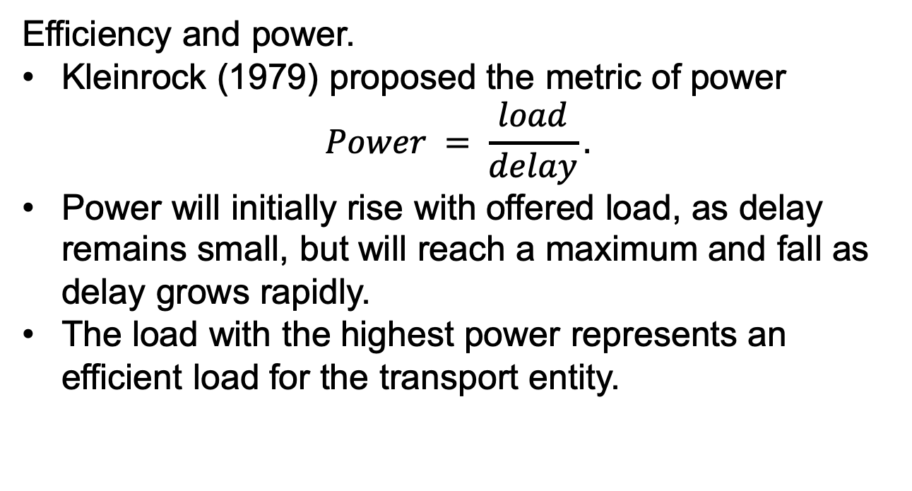
Congestion Control Desirable Bandwidth Allocation
Efficiency and power.
Kleinrock (1979) proposed the metric of power
$$Power = \frac{load}{delay}.$$
Power will initially rise with offered load, as delay remains small, but will reach a maximum and fall as delay grows rapidly.
The load with the highest power represents an efficient load for the transport entity.

Slide 77
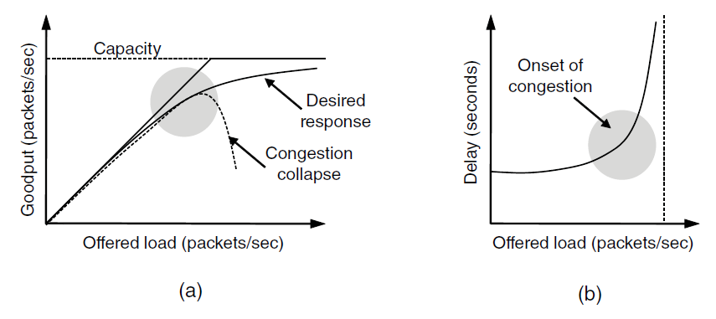
Desirable Bandwidth Allocation
(a) Goodput and (b) delay as a function of offered load

Slide 78
Congestion Control Desirable Bandwidth Allocation
Max-Min Fairness
How to divide bandwidth between different transport senders to achieve fairness.
An allocation is max-min fair if the bandwidth given to one flow cannot be increased without decreasing the bandwidth given to another flow with a no-larger allocation.
That is, increasing the bandwidth of a flow will only make the situation worse for flows that are less well off.

Slide 79
Congestion Control Desirable Bandwidth Allocation
Max-Min Fairness
Example. Four flows, A, B, C, D. Each link between routers has the same capacity of 1.
3 flows compete for the link between R4 and R5. Each flow gets 1/3 of the link.
Flow A competes with B on the link from R2 to R3. Since B has an allocation of 1/3, A gets the remaining 2/3 of the link.
All other links have spare capacity.
If more bandwidth on the link between R2 and R3 is given to flow B, A will have less bandwidth. This reasonable as flow A already has more bandwidth. However, the capacity of C or D must be decreased to give more bandwidth to B, and these flows will have less bandwidth than B.

Slide 80
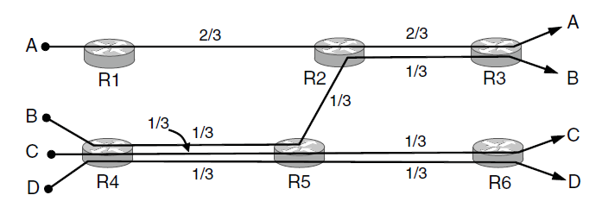
Desirable Bandwidth Allocation
Max-min bandwidth allocation for four flows

Slide 81
Congestion Control Desirable Bandwidth Allocation
Convergence
The congestion control algorithm should converge quickly to a fair and efficient allocation of bandwidth.
Connections are always coming and going, and the bandwidth needed by a given connection will vary over time.
For example, initially, flow 1 has all of the bandwidth. 1 second later, flow 2 starts. The allocation quickly changes to give each flow 1/2 of the bandwidth. At 4 seconds, a third flow joins that uses only 20% of the bandwidth. Flow 1 and 2 quickly adjust, dividing the available bandwidth. At 9 seconds, the second flow leaves, and the third flow remains unchanged. The first flow quickly captures 80% of the bandwidth. At all times, the total allocated bandwidth is about 100%.

Slide 82
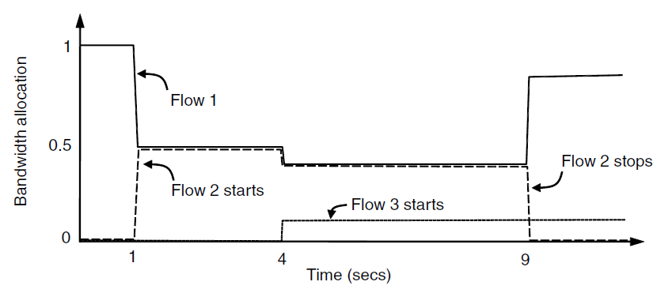
Desirable Bandwidth Allocation
Changing bandwidth allocation over time

Slide 83
Congestion Control Regulating the Sending Rate
The sending rate is limited by two factors.
Flow control. Insufficient buffering at the receiver.
In Fig (1), a thick pipe leading to a small-capacity receiver.
Congestion. Insufficient capacity in the network.
In Fig (2), the limiting factor is the internal carrying capacity of the network.
We already talked about flow control solution with a variable-sized window. Now we will consider a congestion control solution.
Since either problem can occur, the transport protocol will need to run both solutions and slow down if either problem occurs.

Slide 84
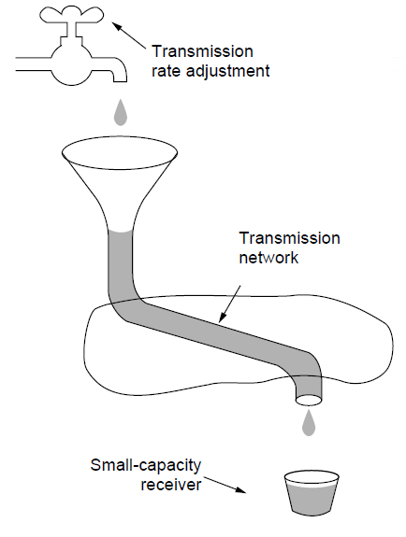
Regulating the Sending Rate (1)
A fast network feeding a low-capacity receiver

Slide 85
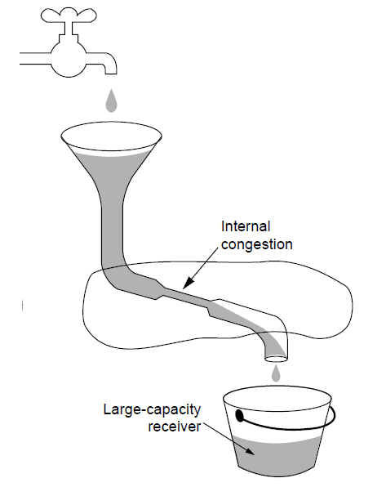
Regulating the Sending Rate (2)
A slow network feeding a high-capacity receiver

Slide 86
Congestion Control Regulating the Sending Rate
The transport protocol uses the network feedback to regulate the sending rate.
The feedback maybe explicit or implicit, may be precise or imprecise.
Explicit, precise design example: XCP, routers tell the sources the rate at which they may send.
Explicit, imprecise design example: ECN with TCP, routers set bits on packets that experience congestion to warn the senders to slow down, but do not tell how much to slow down.
Implicit design example: FAST TCP measures the round-trip delay to avoid congestion. The congestion control most prevalent in the Internet is TCP with drop-tail or RED routers, use packet loss as congestion signal.

Slide 87
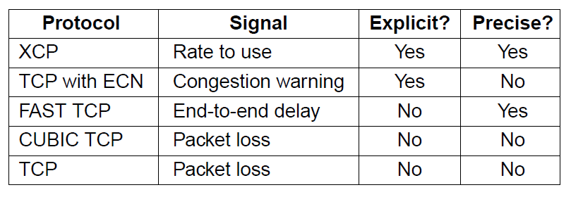
Regulating the Sending Rate
Some congestion control protocols

Slide 88
Congestion Control Regulating the Sending Rate
If explicit precise signal is given, the transport entity can use that signal to adjust its rate. Otherwise, we decide how to increase or decrease rate based on the control law.
AIMD (Additive Increase Multiplicative Decrease) is proved to be the appropriate control law.
The bandwidth allocated to user 1 on the x-axis and to user 2 on the y-axis.
When the allocation is fair, both users will receiver the same amount of bandwidth.
When the allocation sum to 100%, the allocation is efficient. A congestion signal is given by the network if the sum of allocations crosses this line.
The intersection is the desired operating point.

Slide 89
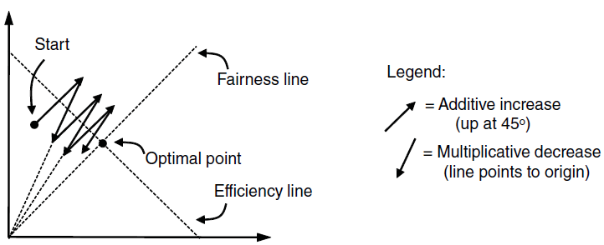
Regulating the Sending Rate
User 2’s allocation
User 1’s allocation
Additive Increase Multiplicative Decrease (AIMD) control law.

Slide 90
Congestion Control Regulating the Sending Rate
AIMD is the control law used by TCP.
The users additively increase bandwidth allocations and then multiplicatively decrease them when congestion is signaled.
The path traced by this behavior converges to the optimal point that is both fair and efficient.
There may be many different transport protocols that send traffic into the network.
Unequal bandwidth allocations may happen.
TCP-friendly congestion control in which TCP and non-TCP transport protocols can be freely mixed with no ill effects.

Slide 91
Congestion Control Wireless Issues
In wireless networks, using packet loss as congestion signal may be problematic since packet loss may be due to transmission errors rather than congestion.
To function well, the only packet losses that the congestion control algorithm should observe are losses due to insufficient bandwidth, not losses due to transmission errors.
One solution is to mask the wireless losses by using retransmissions over the wireless links.
For example, 802.11 retries transmissions multiple times before reporting a packet loss to the higher layer.

Slide 92
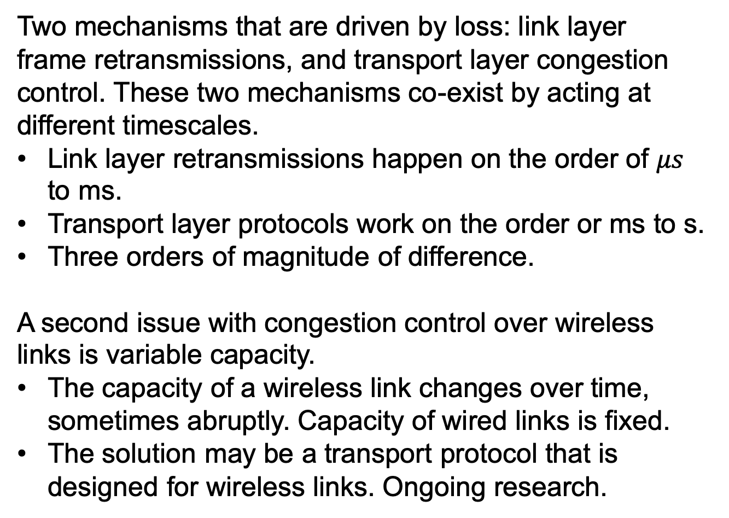
Congestion Control Wireless Issues
Two mechanisms that are driven by loss: link layer frame retransmissions, and transport layer congestion control. These two mechanisms co-exist by acting at different timescales.
Link layer retransmissions happen on the order of $μs$ to ms.
Transport layer protocols work on the order or ms to s.
Three orders of magnitude of difference.
A second issue with congestion control over wireless links is variable capacity.
The capacity of a wireless link changes over time, sometimes abruptly. Capacity of wired links is fixed.
The solution may be a transport protocol that is designed for wireless links. Ongoing research.

Slide 93
The Internet Transport Protocols: UDP
Introduction to UDP
Remote Procedure Call
Real-Time Transport

Slide 94
The Internet Transport Protocols: UDP Introduction to UDP
The Internet has two main protocols in the transport layer.
A connectionless protocol UDP. It does almost nothing.
A connection-oriented protocol. It does almost everything. It makes connections and adds reliability with retransmissions, along with flow control and congestion control.
UDP (User Datagram Protocol) provides a way for applications to send encapsulated IP datagrams without having to establish a connection.

Slide 95
The Internet Transport Protocols: UDP Introduction to UDP
UDP transmits segments consisting of an 8-byte header followed by the payload.
Two ports identify the endpoints within the source and destination machine. Ports can be viewed as mailboxes that applications can rent to receive packets.
UDP length field includes the 8-byte header and the data. 8~65,515 bytes.
Checksum field, optional. It checksums the header, the data, and a conceptual IP pseudo-header.
IP pseudo-header contains the 32-bit IPv4 addresses of the source and destination machines, the protocol number for UDP (17), and the byte count for the UDP segment (including the header).

Slide 96
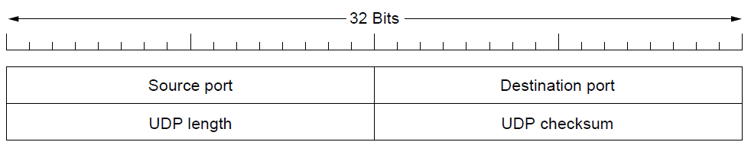
Introduction to UDP
The UDP header.

Slide 97
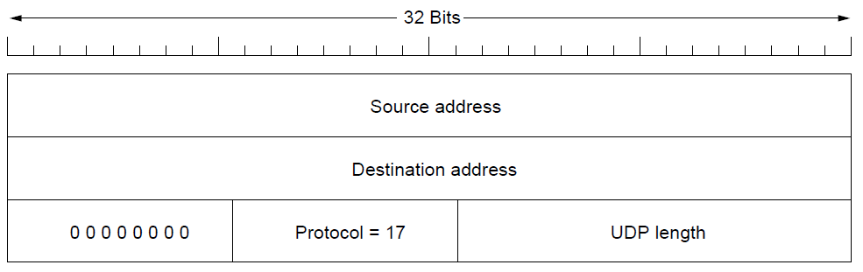
Introduction to UDP
The IPv4 pseudoheader included in the UDP checksum.

Slide 98
The Internet Transport Protocols: UDP Introduction to UDP
What does NOT UDP do?
No flow control.
No congestion control
No retransmission.
UDP only add the source and destination ports to the raw IP.
UDP is especially useful in client-server situations.
The client sends a short request to the server and expects a short reply back. If either the request or the reply is lost, the client can just time out and try again.
The code is simple, and fewer messages are needed than with a protocol requiring an initial setup like TCP.

Slide 99
The Internet Transport Protocols: UDP Remote Procedure Call
Sending a message to a remote host and getting a reply back is like making a function call in a programming language.
RPC (Remote Procedure Call) allows programs to call procedures located on remote hosts.
When a process on machine 1 calls a procedure on machine 2, the calling process on 1 is suspended and execution of the called procedure takes place on 2.
No message passing is visible to the application programmer.
The calling procedure is known as the client and the called procedure is known as the server.
UDP is a good base to implement RPC.

Slide 100
The Internet Transport Protocols: UDP Remote Procedure Call
To call a remote procedure, the client program is bound with a small library procedure called the client stub; the server is bound with a procedure called the server stub.
The client calls the client stub, a local procedure call, with the parameters of the function.
The client stub packing the parameters into a message and making a system call to send the message. Packing the message is called marshaling.
The operating system sends the message from the client to the server.
The operating system passes the incoming packet to the server stub.
The server stub calls the server procedure with the unmarshaled parameters. The reply traces the same path in the other direction.

Slide 101
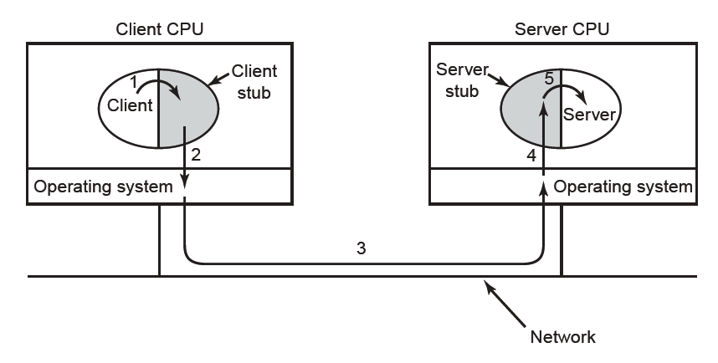
Remote Procedure Call
Steps in making a remote procedure call. The stubs are shaded.

Slide 102
The Internet Transport Protocols: UDP Remote Procedure Call
There are several problems.
Problems with pointer parameters.
Problems with weakly typed languages like C.
Problems with the types of the parameters, like printf.
Problems with the global variables.
RPC is widely used. Both requests and replies may be sent as a single UDP packet in the simplest case and the operation can be fast.
An implementation may include other machinery, e.g., retransmission, maximum packet size.

Slide 103
The Internet Transport Protocols: UDP Real-time Transport Protocols
Another area where UDP is widely used is real-time multimedia applications.
RTP (Real-time Transport Protocol) runs in user space over UDP in the operating system.
The multimedia application consists of multiple audio, video, text and other streams, which are fed into the RTP library.
RTP library multiplexes the streams and encodes them in RTP packets.
UDP packets are generated to wrap the RTP packets and handed to IP for transmission over a link.
RTP can be regarded as a transport protocol that just happens to be implemented in the applications layer.

Slide 104
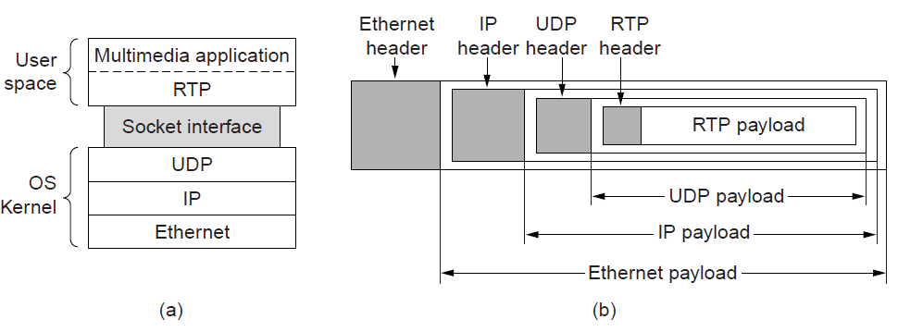
Real-Time Transport
(a) The position of RTP in the protocol stack. (b) Packet nesting.

Slide 105
The Internet Transport Protocols: UDP Real-time Transport Protocols
RTP multiplexes several real-time data streams onto a single stream of UDP packets.
If a packet is missing, no retransmission. The application layer may skip the video frame or approximate the missing value by interpolation. No acknowledgement.
RTP payloads can be coded any way that the application wants, specified in the RTP header field.
RTP provides timestamps that are relative to the start of the stream. The differences between timestamps are significant. The absolute values have no meaning. Timestamping allows multiple streams to be synchronized, e.g., a video stream and an audio stream.

Slide 106
The Internet Transport Protocols: UDP Real-time Transport Protocols
RTP header.
Version field, which is already at 2.
P field indicates that the packet has been padded to a multiple of 4 bytes.
X field indicates that an extension header is present. The format and meaning of the extension header are not defined.
CC field tells how many contributing sources are present.
M bit is an application-specific marker bit that can mark the start of a video frame, the start of a word in an audio channel.
Payload type field indicates the encoding algorithm.
Sequence number field is incremented every packet.

Slide 107
The Internet Transport Protocols: UDP Real-time Transport Protocols
RTP header.
Timestamp field is produced by the stream’s source.
Synchronization source identifier field tells which stream the packet belongs to.
Contributing source identifiers field, if any, are used when mixers are present in the studio.

Slide 108
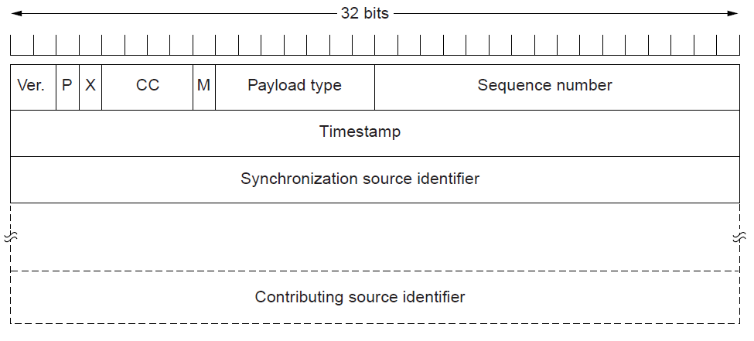
Real-Time Transport
The RTP header

Slide 109
The Internet Transport Protocols: UDP Real-time Transport Protocols
RTCP (Real-time Transport Control Protocol), defined along with RTP, and handles feedback, synchronization, and the user interface.
RTCP provides feedback on delay, jitter (variation in delay), bandwidth, congestion and other network properties to the sources. This information can be used by the encoding process to increase the data rate when the network is functioning well and vice versa. The Payload type field is used to tell what encoding algorithm is used for the current packet.
RTCP handles interstream synchronization. Different streams may use different clocks. RTCP can keep them in sync.

Slide 110
The Internet Transport Protocols: UDP Real-time Transport Protocols
Once the media information reaches the receiver, it must be played out at the right time.
Packets will take slightly different amount of time to transit the network.
The solution is to buffer packets at the receiver before they are played out to reduce the jitter.
For example, in the following figure. Packet 1 is sent at t = 0 and arrives at t = 1. Packet 2 undergoes more delay and takes 2 sec to arrive. At t = 10, playback begins, when packets 1~6 have been buffered so that they can be removed from the buffer at uniform interval for smooth paly. Packet 8 has been delayed so much that it is not available when its play slot comes up. Playback may skip packet 8 or stop until packet 8 arrives.

Slide 111
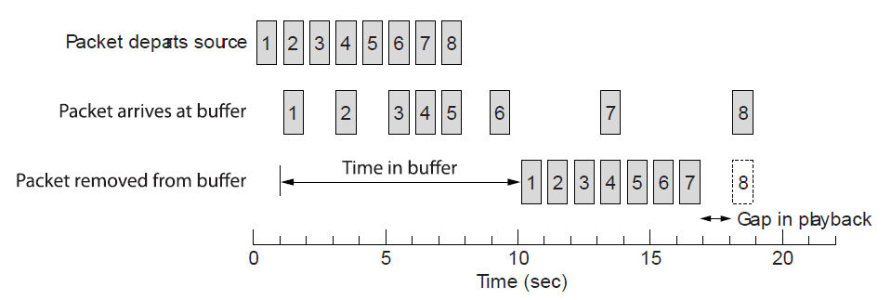
Real-Time Transport
Smoothing the output stream by buffering packets

Slide 112
The Internet Transport Protocols: UDP Real-time Transport Protocols
A key consideration for smooth playout is the playback point, i.e., how long to wait at the receiver for media before playing it out.
If there is high jitter, the playback point may need to be much further out than if there is low jitter.
The application can measure the jitter by looking at the difference between the RTP timestamps and the arrival time.

Slide 113
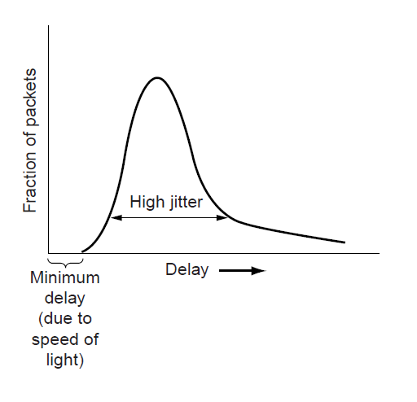
Real-Time Transport
High jitter

Slide 114
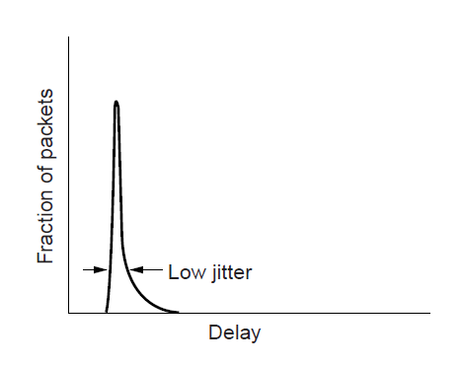
Real-Time Transport
Low jitter

Slide 115
The Internet Transport Protocols: TCP
Introduction to TCP
The TCP service model
The TCP protocol
The TCP segment header
TCP connection establishment
TCP connection release

Slide 116
The Internet Transport Protocols: TCP
TCP connection management modeling
TCP sliding window
TCP timer management
TCP congestion control

Slide 117
The Internet Transport Protocols: TCP Introduction to TCP
TCP (Transmission Control Protocol) is designed to provide a reliable end-to-end byte stream over an unreliable internetwork.
An internet has different topologies, bandwidths, delays, packet sizes and other parameters.
TCP can dynamically adapt to properties of the internetwork and be robust in face of many failures.
Each machine supporting TCP has a TCP transport entity.
A TCP entity accepts user data streams from local application processes, breaks them into pieces, and sends each piece as a separate IP datagram.
Arriving IP datagram are given to the TCP transport entity.

Slide 118
The Internet Transport Protocols: TCP The TCP Service Model
TCP service is obtained by both the sender and the receiver creating end points, called sockets.
Each socket consists of the IP address of the host and a 16-bit number local to that host called a port.
For TCP service to be obtained, a connection must be established between a socket on one machine and a socket on another machine.
A socket may be used for multiple connections at the same time.
Connections are identified by the socket identifiers at both ends, e.g., (socket1, socket2). No virtual circuit number or other identifiers are used.
Port numbers below 1024 are reserved for standard services that can usually only be started by privileged users (e.g., root in UNIX systems)

Slide 119
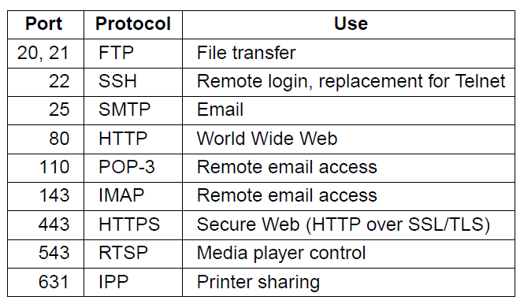
The TCP Service Model
Some assigned ports

Slide 120
The Internet Transport Protocols: TCP The TCP Service Model
Other ports from 1024~49151 can be chosen by applications.
For applications that are idle most of the time, we can have a single daemon called inetd (Internet daemon) in UNIX, attack itself to multiple ports and wait for the first incoming connection.
When an incoming connection is built, inetd forks off a new process and executes the appropriate daemon on it.
System administer can set up the system to have permanent daemons on the busiest ports and inetd on the rest.

Slide 121
The Internet Transport Protocols: TCP The TCP Service Model
TCP connections are full duplex and unicast. TCP does not support multicasting or broadcasting.
TCP connection is a byte stream, not a message stream. Message boundaries are not preserved end to end.
For example, if the sender does four 512-byte writes to a TCP stream, these data may be delivered to the receiver as four 512-byte chunks, two 1024-byte chunks, one 2048-byte chunk or some other way.
When a application passes data to TCP, TCP may send it immediately or buffer it in order to collect a larger amount to send at once.
Application can set the PUSH flag to tell TCP not to delay the transmission.

Slide 122
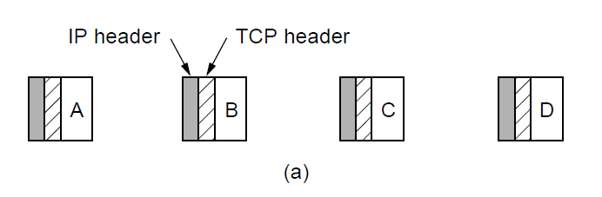
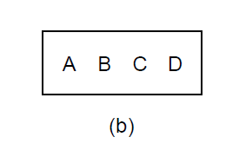
The TCP Service Model
Four 512-byte segments sent as separate IP diagrams
The 2048 bytes of data delivered to the application in a single READ call

Slide 123
The Internet Transport Protocols: TCP The TCP Protocol
A general overview of the TCP protocol.
Every byte on a TCP connection has its own 32-bit sequence number. It took over 1 week to cycle through the sequence number.
A TCP segment consists of a fixed 20-byte header (+ an optional part) + zero or more data bytes.
The TCP software decides the segment length.
Data can be accumulated from several writes into one segment or can split data from one write to multiple segments.
Each segment must fit in the 65,515-byte IP payload.
Each link has an MTU (Maximum Transfer Unit). TCP uses ICMP error messages to conduct path MTU discovery.

Slide 124
The Internet Transport Protocols: TCP The TCP Protocol
A general overview of the TCP protocol.
The basic protocol used by TCP entities is the sliding window protocol with a dynamic window size.
When a sender transmits a segment, it starts a timer.
When the segment arrives, the receiving TCP entity sends back a segment bearing the acknowledgement number equal to the next sequence number it expects to receiver and the remaining window size.
TCP handles many problems.
Segments can arrive out of order.
Segments can be delay that the sender times out and retransmits them. The retransmissions may include different byte ranges.

Slide 125
The Internet Transport Protocols: TCP The TCP Segment Header
Every segment begins with a fixed-format, 20-byte header.
Source port and destination port fields identify the local end points of the connection. A TCP port plus its host’s IP address forms a 48-bit unique end point. The source and destination endpoints identify the connection.
Sequence number and Acknowledgement number fields are similar as before. Cumulative acknowledgement: summarize the received data with a single number.
TCP header length field, the length of the header since Options field is of variable length.
A 4-bit unused field.

Slide 126
The Internet Transport Protocols: TCP The TCP Segment Header
CWR and ECE fields signal congestion. When ECN (Explicit Congestion Notification) is used, ECE is set as an ECN-Echo to tell a TCP sender to slow down. CWR is set to tell the TCP receiver that the sender has slowed down and it can stop sending the ECN-Echo.
URG is set to 1 if Urgent pointer is in use. Not in common use today.
ACK field is set to 1 to indicate that the Acknowledgement number is valid. If ACK is 0, the segment does not contain an acknowledgement, so the Acknowledgement number field is ignored.
PSH indicates PUSHed data. The receiver request to deliver the data to the application upon arrival and not buffer it.

Slide 127
The Internet Transport Protocols: TCP The TCP Segment Header
RST abruptly resets a connection that has become confused due to a host crash or some other reason.
SYN is used to establish connections. The connection request has SYN=1 and ACK=0 to indicate that the piggyback acknowledgement field is not in use. The connection reply bears an acknowledgement, so it has SYN=1 and ACK=0. The SYN bit denotes both CONNECTION REQUEST and CONNECTION ACCEPT.
FIN bit is used to release a connection. Both SYN and FIN segments have sequence numbers to guarantee to be processed in the correct order.
Window size field tells how many bytes may be sent starting at the byte acknowledged.

Slide 128
The Internet Transport Protocols: TCP The TCP Segment Header
Window size field tells how many bytes may be sent starting at the byte acknowledged.
A Window size field of 0 is legal and says that the bytes up to and including Acknowledgement number-1 have been received, but that the receiver would like no more data for the moment. The receiver can later grant permission to send by transmitting a segment with the same Acknowledgement number and a nonzero Window size field.
Checksum field checksums the header, the data, and a conceptual pseudo-header as UDP, except that the pseudo-header has the protocol number for TCP (6) and is mandatory.

Slide 129
The Internet Transport Protocols: TCP The TCP Segment Header
Options field.
A widely used option is the one that allows each host to specify the maximum segment size it is willing to accept.
The window scale option allows the sender and receiver to negotiate a window scale factor.
The timestamp option carries a timestamp sent by the sender and echoed by the receiver to compute round-trip time samples.
The SACK (Selective ACKnoweldgment) option lets a receiver tell a sender the ranges of sequence numbers that it has received. It supplements the Acknowledgement number and is used after a packet is lost but subsequent data has arrived.

Slide 130
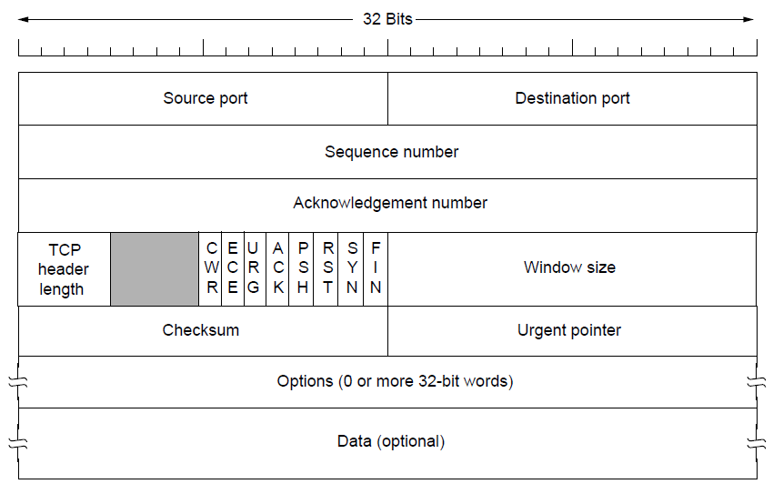
The TCP Segment Header
The TCP header.

Slide 131
The Internet Transport Protocols: TCP The TCP Connection Establishment
TCP connections are established by three-way handshake.
The server passively waits for an incoming connection by executing the LISTEN and ACCEPT primitives.
The client executes a CONNECT primitive, specifying the IP address and port. The CONNECT primitive sends a TCP segment with the SYN bit on and ACK bit off.
The TCP entity on the server checks if there is a process that LISTEN on the port given in the Destination port field. If not, it sends a reply with the RST bit on to reject.
If some process is listening, the server can accept or reject the connection.

Slide 132
The Internet Transport Protocols: TCP The TCP Connection Establishment
In the event that two hosts simultaneously attempt to establish a connection between the same two sockets, the result is that just one connection is established.
Connections are identified by their end points.
If the first setup results in a connection identified by (x,y), and the second one does too, only one table entry is made for (x,y).

Slide 133
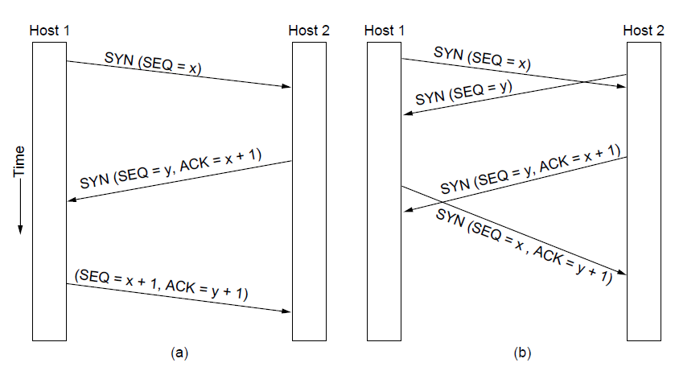
TCP Connection Establishment
TCP connection establishment in the normal case.
Simultaneous connection establishment on both sides.

Slide 134
The Internet Transport Protocols: TCP The TCP Connection Release
To understand connection release, it is best to think of a full duplex TCP connection as two simplex connections.
Each simplex connection is released independently.
To release a connection, a party can send a TCP segment with the FIN bit set, which means that it has no more data to transmit.
When the FIN is acknowledged, that direction is shut down for new data. Data may continue to flow in the other direction.
When both directions have been shut down, the connection is released.
If a response to a FIN is not forthcoming within two maximum packet lifetimes, the sender of the FIN releases the connection. The other side will eventually time out and release the connection.

Slide 135
The Internet Transport Protocols: TCP The TCP Connection Management Modeling
The steps required to establish and release connections can be represented in a finite state machine with 11 states.
Each connection starts in the CLOSED state. It leaves the state when it does either a passive open (LISTEN) or active open (CONNECT). If the other side does the opposite one, a connection is established and the state becomes ESTABLISHED.
Finite state machine illustration.
Solid line for the client, dotted line for the server. The lightface lines are unusual events. Each line is marked by an event/action pair.

Slide 136

TCP Connection Management Modeling
The states used in the TCP connection management finite state machine.

Slide 137
The Internet Transport Protocols: TCP The TCP Connection Management Modeling
From the client’s viewpoint.
Issue a CONECT request. The local TCP entity creates a connection record, marks it as being in the SYN SENT state, and sends off a SYN segment.
When SYN+ACK arrives, TCP sends the final ACK of the three-way handshake and enters the ESTABLISHED state.
Execute a CLOSE primitive, sends a FIN segment. When the ACK arrives, transit to the FIN WAIT 2 state and one direction of the connection is closed.
When the other side closes, too, a FIN comes in, which is acknowledged.

Slide 138
The Internet Transport Protocols: TCP The TCP Connection Management Modeling
From the server’s viewpoint.
Does a LISTEN.
When a SYN comes, acknowledges it and goes to the SYN RCVD state. When the server’s SYN is acknowledged, the three-way handshake is complete and the server goes to the ESTABLISHED state.
The client does a CLOSE, and the server received a FIN.
The server does a CLOSE too and sends a FIN to the client. When the client’s ACK arrives, the server releases the connection.

Slide 139

TCP Connection Management Modeling (2)
TCP connection management finite state machine.
The heavy solid line is the normal path for a client. The heavy dashed line is the normal path for a server. The light lines are unusual events. Each transition is labeled by the event causing it and the action resulting from it, separated by a slash.

Slide 140
The Internet Transport Protocols: TCP TCP Sliding Window
Window management in TCP decouples the issues of acknowledgement of the correct receipt of segments and receiver buffer allocation.
For example, the receiver has a 4096-byte buffer. If the sender transmits a 2048-byte segment, the receiver will acknowledge the segment and advertise a window of 2048 starting at the next byte expected.
The sender transmits another 2048 byte, which are acknowledged, but the advertised window is 0.
The sender must stop until the application process on the receiver has removed some data from the buffer.
Exception 1: urgent data may be sent.
Exception 2: window probe. The sender may send a 1-byte segment to force the receiver to say the next byte expected and the window size.

Slide 141

TCP Sliding Window
Window management in TCP

Slide 142
The Internet Transport Protocols: TCP TCP Sliding Window
Problem 1: the sending application delivering data to TCP one byte at a time.
Whenever 1 byte arrives at the sending TCP entity, TCP creates a 21-byte TCP segment, which it gives to IP to send as a 41-byte IP datagram.
At the receiver, TCP immediately sends a 40-byte ACK (20-byte TCP header+20-byte IP header).
The receiver has read the byte. TCP sends a 40-byte window update segment to move the window 1 byte.
Solution: Nagle’s algorithm. When data come into the sender in small pieces, just send the first piece and buffer all the rest until the first piece is acknowledged. Then send all the buffered data in one TCP segment and start buffering again until the next segment is acknowledged.

Slide 143
The Internet Transport Protocols: TCP TCP Sliding Window
Problem 1: the sending application delivering data to TCP one byte at a time.
Nagle’s algorithm is widely used by TCP, but interactive games may disable Nagle’s algorithm since the players want a rapid stream of short update packets.

Slide 144
The Internet Transport Protocols: TCP TCP Sliding Window
Problem 2: the silly window syndrome. The application at the receiver reads data only 1 byte at a time.
Initially, the buffer of the receiver is full.
The application reads 1 byte from the TCP, then sends a window update to the sender saying that it is all right to send 1 byte.
The sender sends 1 byte. The buffer is full, so the receiver acknowledges the 1-byte segment and sets the window to 0.
Solution: Clark’s solution. Prevent the receiver from a sending a window update for 1 byte. It is forced to wait until a decent amount of space is available.

Slide 145

TCP Sliding Window
Silly window syndrome

Slide 146
The Internet Transport Protocols: TCP TCP Sliding Window
Problem 3: the segments arrive out of order.
Cumulative acknowledgement.
If receiver gets segments 0,1,2,4,5,6,7, it can acknowledge everything up to and including the last byte in segment 2.
When the sender times out, it then retransmits segment 3.
Upon receipt of 3, the receiver can acknowledge all bytes up to the end of segment 7.

Slide 147
The Internet Transport Protocols: TCP TCP Timer Management
TCP uses multiple timers. The most important is the RTO (Retransmission). How long should the timeout be?
The problem is more difficult in the transport layer than in data link layer.
In the data link layer, the expected delay is highly predictable.
In the transport layer, the probability density function of the round trip time is more variable. The distribution can change rapidly within a few seconds as congestion builds up or is resolved.
Solution: use a dynamic algorithm that constantly adapts the timeout interval.

Slide 148

TCP Timer Management
Probability density of acknowledgment arrival times in data link layer. (b) … for TCP

Slide 149

The Internet Transport Protocols: TCP TCP Timer Management
Solution: use a dynamic algorithm that constantly adapts the timeout interval.
TCP maintains a variable SRTT (Smoothed Round-Trip Time) as the best current estimate of the round-trip time.
When a segment is sent, a timer is started. If the ack gets back before the timer expires, TCP measures how long the ack took, say R. SRTT is updated
$$SRTT= αSRTT+\left(1−α\right)R$$
TCP also tracks another smoothed variable, RTTVAR (Round-Trip Time VARiation) updated as
$$RTTVAR= βRTTVAR+\left(1−β\right)|SRTT−R|$$
RTO is set as
$$RTO= SRTT+4RTTVAR$$

Slide 150
The Internet Transport Protocols: TCP TCP Timer Management
Persistence timer
Designed to prevent the deadlock. The receiver sends an ack with a window size 0. Later, the receiver updates the window, but the packet with the update is lows. Now the sender and receiver are each waiting for the other to do something. When the persistence timer goes off, the sender sends a probe to the receiver to ask for the window size.
Keepalive timer.
When a connection is idle for a long time, the keepalive timer goes off to cause one side to check if the other side is still there.

Slide 151
The Internet Transport Protocols: TCP TCP Congestion Control
The network layer detects congestion at routers, and the transport layer receives congestion feed back from the network layer and slows down the rate that it sends into the network.
TCP uses an AIMD (Additive Increase Multiplicative Decrease) control with packet loss as the signal for congestion.
Keep a congestion window whose size is the number of bytes the sender may have in the network at any time.
The rate is the window size divided by the round trip time.
Congestion window and flow control window are both maintained. The smaller one decides the rate.

Slide 152
The Internet Transport Protocols: TCP TCP Congestion Control
Slow start:
When a connection is established, initialize the congestion window to a small initial value.
The sender sends the initial window.
For each segment that is acknowledged before the retransmission timer goes off, the sender adds one segment to the congestion window.
Exponential growth. For example, in the first round-trip time, the sender sends one segment. Two packets are sent in the next round-trip time, then four packets in the third round-trip time.
Slow start threshold. When the slow start threshold is crossed, TCP switches from slow start to additive increase. The congestion window is increased by one segment every round-trip time.

Slide 153

TCP Congestion Control
Slow start from an initial congestion window of 1 segment

Slide 154

TCP Congestion Control
Additive increase from an initial congestion window of 1 segment.

Slide 155
The Internet Transport Protocols: TCP TCP Congestion Control
TCP Tahoe: slow start followed by additive increase.
The slow start threshold is initially set to be arbitrarily high, to the size of the flow control window.
With an initial small window, TCP keeps increasing the congestion window in slow start until a timeout occurs or the congestion window exceeds the threshold.
If the congestion window exceeds the threshold, TCP enters additive increase.
If a timeout occurs (packet loss is detected), the slow start threshold is set to behalf of the current congestion window. The entire process is restarted, i.e., the congestion window is set as the initial value.

Slide 156

TCP Congestion Control
Slow start followed by additive increase in TCP Tahoe.

Slide 157
The Internet Transport Protocols: TCP TCP Congestion Control
Fast retransmission: instead of using timeout to infer packet loss (long time), we may use duplicate acknowledgement.
As packets beyond the lost packet arrive at the receiver, they trigger acknowledgements that return to the sender.
These acknowledgements bear the same acknowledgement number, i.e., the number of the lost packet to be expected.
Three duplicate acknowledgements imply that a packet has been lost. The congestion window will be reset as the initial value.

Slide 158
The Internet Transport Protocols: TCP TCP Congestion Control
TCP Reno:
Slow start similar to TCP Tahoe.
If the threshold is hit, turn to additive increase.
If packet loss is detected, e.g., by duplicate acknowledgements, the congestion window is reset as half of the current congestion window, but not to the initial value. Then additive increase takes place.

Slide 159

TCP Congestion Control
Fast recovery and the sawtooth pattern of TCP Reno.

Slide 160
Performance Issues
Performance problems in computer networks
Network performance measurement
System design for better performance
Fast TPDU processing
Protocols for high-speed networks

Slide 161
Performance Issues Performance Problems in Computer Networks
Congestion.
More traffic suddenly arrives at a router than the router can handle.
Structural resource imbalance.
E.g., a gigabit communication line is connected to a low-end PC. The PC will not be able to process the incoming packets fast enough, adding delay, wasting bandwidth.
Synchronous overload 1: broadcast storm.
If a bad segment is broadcast to 1000 machines, each one might send back an error message.
Wireless networks must be particular careful to avoid unchecked broadcast responses.

Slide 162
Performance Issues Performance Problems in Computer Networks
Synchronous overload 1: after electrical power failure.
All machines simultaneously start rebooting.
A typical reboot sequence may require first going to some DHCP server to learn one’s true identity, and then to some file server to get a copy of the operating system.
If hundreds of machines in a data center all do this at once, the server will probably collapse under the load.
System tuning 1: buffer space allocation.
If a machine has plenty of CPU and memory but not enough memory is allocated for buffer space, flow control will slow down segment reception.

Slide 163
Performance Issues Performance Problems in Computer Networks
System tuning 2: setting timeouts.
If retransmission timeout is set too short, unnecessary retransmissions will occur.
If timeout is set too long, unnecessary delays will occur after a segment is lost.
System tuning 3: other parameters.
How long to wait for data on which to piggyback before sending a separate acknowledgement.
How may retransmissions to make before giving up.
Jitter with real-time applications.

Slide 164
Performance Issues Network Measurement
When a network performs poorly, the operator must first examine what is going on.
Measurements can be made in different ways and at different locations.
E.g., start a timer when beginning some activity and see how long that activity takes.
Count how often some event has happened.
Know the amount of something such as the number of bytes processed in a certain time interval.
Measuring network performance has many potential pitfalls that we must be careful to avoid.

Slide 165
Network Performance Measurement
Issues in measuring performance
Sufficient sample size
Representative samples
Clock accuracy
Measuring typical representative load
Beware of caching
Understand what you are measuring
Extrapolate with care

Slide 166
Performance Issues Network Measurement
Make sure that the sample size is large enough.
Do not measure the time to send one segment, but repeat the measurement and take the average.
Reduce the uncertainty in the measured mean and standard deviation.
Make sure that the samples are representative.
The repeated measurements may be at different times of the day and the week to see the effect of different network conditions.
With wireless networks, location is an important variable because of signal propagation.

Slide 167
Performance Issues Network Measurement
Caching can wreak havoc with measurements.
With caching, unexpected fast answer may be returned. E.g., fetching a web page may involve a network exchange the first time, and then return the answer from a local cache without sending any packets over the network.
With buffering, if there is enough buffer space at the sender, 1000 UDP calls does not mean that all the data have been sent. Most of them may still be in the kernel.
Make sure that nothing unexpected is going on during your test.
Run tests on an idle network and create the entire workload yourself.

Slide 168
Performance Issues Network Measurement
Be careful when using a coarse-grained clock
Computer clocks function by incrementing some counter at regular intervals.
Using a ms timer to measure an event that takes less than 1 ms is possible but requires some care.
Be careful about extrapolating the results.
Suppose that you make measurement with simulated network loads from 0 to 0.4. The response time is shown in the following figure.
The curve may be extrapolate linearly, while the true values rises much faster than linearly when the load gets high.

Slide 169

Network Performance Measurement
Response as a function of load.

Slide 170
Performance Issues Host Design for Fast Networks
Software implementation of network protocols on hosts is often a performance bottleneck on fast networks.
Rules of thumb
Host speed more important than network speed
Reduce packet count to reduce software overhead
Minimize data touching
Minimize context switches
Avoiding congestion is better than recovering from it
Avoid timeouts

Slide 171
Performance Issues Host Design for Fast Networks
Host speed is more important than network speed.
In fast networks, operating system and protocol overhead dominate actual time on the wire.
The biggest problem in running at 1 Gbps is often getting the bits from the user’s buffer out onto the network fast enough and having the receiver process them as fast as they come in.
Reduce packet count to reduce overhead.
Each segment has a certain amount of overhead, e.g., the header.
Bandwidth and processing are required for both data and the header.
Send MTU packets that are as large as will pass along the network path without fragmentation.

Slide 172
Performance Issues Host Design for Fast Networks
Minimize data touching.
To implement a layered protocol stack with one module for each layer leads to data copying.
The packet is copied to the kernel buffer upon receiving, then copied to a network layer buffer then a transport layer buffer for corresponding processing.
Minimize data copying by combining the processing of multiple layers.
Minimize context switches.
Context switches (e.g., from kernel mode to user mode) will cause interrupts and copying.
Can be reduced by buffering sending or receiving data until enough data can be sent or can be passed to the user.

Slide 173

Host Design for Fast Networks
Four context switches to handle one packet with a user-space network manager.

Slide 174
Performance Issues Host Design for Fast Networks
Avoiding congestion is better than recovering from it.
Network congestion leads to packet loss, waste of bandwidth and delays.
Avoid timeouts.
When a timer goes off, some action is repeated.
To avoid extra work, timers are set a little bit on the conservative side.

Slide 175
Performance Issues Fast Segment Processing
Some special methods for speeding up segment processing.
The key to fast segment processing is to separate out the normal successful case and handle it rapidly, to minimize processing time when everything goes right.
Once in the ESTABLISHED state, segment processing can be through a fast path until one side starts to close the connection.

Slide 176

Fast Segment Processing
The fast path from sender to receiver is shown with a heavy line. The processing steps on this path are shaded.

Slide 177
Performance Issues Fast Segment Processing
Sender’s side.
First check if this is the normal case: the state is ESTABLISHED, neither side is trying to close the connection, a regular full segment is being sent, and enough window space is available at the receiver.
Header processing: in the usual case, the headers of consecutive data segments are almost the same.
Store a prototype header in the transport entity.
At the start of the fast path, it is copied to a scratch buffer. Those fields that change from segment to segment are overwritten in the buffer.

Slide 178
Performance Issues Fast Segment Processing
Sender’s side.
Header processing: in the usual case, the headers of consecutive data segments are almost the same.
In the following example, the fields that are the same between consecutive segments on a one-way flow are shaded.
All the sending transport entity copy the prototype header from into the output buffer, fill in the next sequence number, computer the checksum, and increment the sequence number in memory.
IP then copies its prototype header into the buffer, fills in the Identification field, and computes its checksum.

Slide 179

Fast Segment Processing
(a) TCP header. (b) IP header. In both cases, the shaded fields are taken from the prototype without change.

Slide 180
Performance Issues Fast Segment Processing
Receiver’s side.
Locate the connection record for the incoming segment.
Lookup a hash table that stores the connection record.
Improvement: maintain a pointer to the last one used and try that one first.
Check if the segment is normal: the state is ESTABLISHED, neither side is trying to close the connection, the segment is a full one, no special flags are set, the sequence number is the one expected.
Update the connection record and copies the data to the user. During copying, compute the checksum.

Slide 181
Performance Issues Fast Segment Processing
Buffer management.
Use a linked list of timer events sorted by expiration time.
Each successive entry contains a counter telling how many ticks after the previous entry it is. E.g, if timers expire in 3, 10, 12 ticks, the counters are 3, 7, 2.
At every clock tick, the counter in the head entry is decremented. When it hits zero, its event is processed and the next item becomes the head.
Inserting and deleting timers are expensive operations. The complexity is proportional to the length of the list.

Slide 182
Performance Issues Fast Segment Processing
Buffer management.
Use a timing wheel.
Assume that the maximum timer interval is bounded and known in advance.
Example, current time is T=4.
Timers are scheduled to expire at 3, 10, 12 ticks from now.
If a new timer is set to expire in 7 ticks, an entry is made at slot 11.
If the timer at T+10 has to be canceled, slot 14 has to be removed.
Cannot accommodate timers beyond T+15.

Slide 183

Fast Segment Processing
A timing wheel

Slide 184
Header Compression
On bandwidth-limited networks, the network, instead of software overhead, may be the bottleneck.
To use bandwidth well, protocol headers and payloads should be carried with the minimum of bits.
For payloads, use compact encodings of information, e.g., PDF or JPEG. Application-level caching mechanism can also reduce transfers.
What about protocol headers?
At the link layer, headers for wireless networks are typically compact as they were designed with scarce bandwidth in mind.
Higher layer protocols, e.g., IP, TCP and UDP has one version for all link layers. They are not designed with compact headers.

Slide 185
Header Compression
Header compression.
A combination of IP, UDP and RTP, requires 40 bytes of header (20 for IPv4, 8 for UDP, 12 for RTP)
Use special knowledge of the protocol format. Many of the header fields do not change from packet to packet. They can be omitted on the sending side and filled in on the receiving side.
ROHC (Robust Header Compression). Compressed headers are carried by referring to a context, e.g., a connection; header fields may be predicted for packets of the same connection, but not for different connections.

Slide 186
Protocols for Long Fat Networks
Long fat networks: gigabit networks that transmit data over large distances.
Discuss some problems with scaling up the speed and delay of network protocols.
Problem 1: sequence numbers.
Many protocols assume that the sequence number will wrap around after the maximum packet lifetime. Otherwise, old duplicates will exist when the sequence number wrap around.
TCP uses 32-bit sequence numbers, the wrap time is 1 week for 56-kbps leased lines, 57min for 10-Mbps Ethernet and 34s for a 1-Gbps Ethernet.
PAWS mechanism: Extend the timestamp optional field in the TCP header as the high-order bits.

Slide 187
Protocols for Long Fat Networks
Problem 1: sequence numbers.
Many protocols assume that the sequence number will wrap around after the maximum packet lifetime. Otherwise, old duplicates will exist when the sequence number wrap around.
TCP uses 32-bit sequence numbers, the wrap time is 1 week for 56-kbps leased lines, 57min for 10-Mbps Ethernet and 34s for a 1-Gbps Ethernet.
PAWS mechanism: Extend the timestamp optional field in the TCP header as the high-order bits.

Slide 188

Protocols for Long Fat Networks
Problem 2: size of the flow control window.
E.g., send a 64-KB burst of data to fill the receiver’s 64-KB buffer. The link is 1 Gbps, one-way delay is 20ms.
At t = 0, the pipe is empty as in (a). 500 $μs$ later, all segments are out on the fiber as in (b). 20ms later, the lead segment arrives at the receiver as in (c). 40ms later, the first ack gets back to the sender and the second burst can be transmitted.
The efficiency of the transmission line is only 1.25%
Bandwidth-delay product is the capacity of the pipe: bandwidth*round-time delay. The receiver’s window should be at least as large as the bandwidth-delay product. 1Gbps*20ms*2=40million bits.

Slide 189

Performance Problems in Computer Networks
The state of transmitting one megabit from San Diego to Boston. (a) At t = 0. (b) After 500 μ sec. (c) After 20 msec. (d) After 40 msec.

Slide 190
Protocols for Long Fat Networks
Problem 3: simple retransmission.
If we use go-back-n protocol, e.g., the 1-Gbps link with a round-trip time of 40ms. A sender can transmit 5MB in one round trip. If an error is detected, it will be 40ms before the sender is told about it. If go-back-n is used, the sender will have to retransmit not just the bad packet, but also the 5MB worth of packets.
More complicated protocols such as selective-repeat are needed.

Slide 191
Protocols for Long Fat Networks
Problem 4: delay limited rather than bandwidth limited.
The following figure show the time it takes to transfer a 1Mb file 4000km at various speeds.
At speeds up to 1Mbps, the transmission time is dominated by the rate at which the bits can be sent.
By 1 Gbps, the 40ms round-trip delay dominates the 1m it takes to put the bits on the fiber.
Using stop-and-wait protocol has an inherent upper bound on their performance.
Problem 5: communication speeds have improved faster than computing speeds.

Slide 192

Protocols for Long Fat Networks
Time to transfer and acknowledge a 1-megabit file over a 4000-km line

Slide 193
Protocols for Long Fat Networks
Solution 1: packet layout.
The header should contain as few fields as possible, and these fields should be big enough, e.g., the sequence number problem.
Solution 2: the maximum data size should be large to reduce software overhead.
Gigabit Ethernet supports jumbo frames of up to 9KB
Solution 3: feedback should be avoid.
It takes too long for the receiver to signal the sender.
Reserving resource in advance to avoid congestion and jitter. Going to high speed pushes the design toward connection-oriented operation.

Slide 194
Delay Tolerant Networking
DTN Architecture
The Bundle Protocol

Slide 195
Delay Tolerant Networking
TCP and most other transport layer protocols assume that the sender and the receiver are continuously connected by some working path.
DTN, Delay-Tolerant Network or Disruption-Tolerant Network.
Intermittent connectivity due to mobility or extreme conditions.
Use message switching, communicate by storing data at nodes and forwarding them later when there is a working link.
E.g., LEO satellite networks, buses, mobile phones.

Slide 196
Delay Tolerant Networking DTN architecture
In the following figure, DTN nodes are equipped with storage.
A message is called a bundle.
The memory at node store bundles until links become available and then forward the bundles.
Five intermittent links that are not currently working and 2 links that are working.
A working link is called a contact.
The bundles are relayed via contacts from the source to the destination.
Differences from queuing at routers.
Bundles may be stored for hours. Queuing at routers is at most seconds.
Nodes may move. Routers cannot move.

Slide 197

DTN Architecture
Delay-tolerant networking architecture

Slide 198
Delay Tolerant Networking DTN architecture
Example. The first DTN protocols in space.
The source of bundles is an LEO satellite that is recording earth images.
The satellite has only intermittent contact with 3 ground stations as it orbits the Earth.
Each of the satellite, ground stations, and collection point act as a DTN node.
At each contact, a bundle or a portion of a bundle is sent to a ground station.
The bundles are then sent over a backhaul terrestrial network to the collection point.
There may be no single contact long enough to send the images, they can be spread across the contacts.
Decouple the link between the satellite and ground station from the link over the backhaul network.

Slide 199

DTN Architecture
Use of a DTN in space.

Slide 200
Delay Tolerant Networking DTN architecture
Routing: how to find good routes via DTN nodes.
For predictable contacts, e.g., the satellite links, it is known ahead of time when contacts will occur, the contact intervals range from 5~14 min per pass with each ground station, and the downlink capacity is 8.134Mbps. The route can be planned beforehand.
For unpredictable contacts, one routing strategy is to send copies of the bundle along different paths in the hope that one copy is delivered to the destination.

Slide 201
Delay Tolerant Networking The Bundle Protocol
The DTN protocol stack.
The key is the Bundle protocol. It accepts messages from the application and sends them as one or more bundles via store-carry-forward operations to the destination DTN node.
The bundle protocol may be run over various kinds of protocols, e.g., TCP, UDP. A convergence layer is used to match the interface of these different lower layer protocols.

Slide 202

The Bundle Protocol
Delay-tolerant networking protocol stack.

Slide 203
Delay Tolerant Networking The Bundle Protocol
Each message consists a primary block that can be viewed as a header, a payload block for the data, and optionally other blocks, e.g., to carry security parameters
Primary block
Version field.
Flags field, encodes a class of service to let a source mark its bundles as higher or lower priority.
Addresses fields. Apart from Destination and Source identifier, there is a Custodian identifier. The custodian is the party responsible for seeing that the bundle is delivered. In the Internet, the source is usually the custodian. In DTN, another node may be the custodian.

Slide 204
Delay Tolerant Networking The Bundle Protocol
Primary block
Addresses fields. Report identifier for diagnostic messages. The identifiers are not IP addresses. Bundle protocol defines its own identifiers.
Creation field, the time at which the bundle was created.
Lifetime field, the time at which the bundle is no longer useful.
Dictionary field, provides compression when the custodian or report nodes are the same as the source or the destination.

Slide 205
Delay Tolerant Networking The Bundle Protocol
Payload block
Type field, identifies it as a payload.
Flags field describes processing options.
Length field.
Data field.
Optional blocks
E.g., security parameters.

Slide 206

The Bundle Protocol
Bundle protocol message format.

Slide 207
End
Chapter 6

