Slide 1


Managing AUV missions through small language models and behavior trees
Advisor:
Candidate: Emilio Gigante
Prof. Andrea Munafò
A.Y.: 2024/2025
Emilio Gigante

Slide 2
Introduction
  Problem
  Recent research
Approach
  Context
  Confidence
  Failure
  Model
Application
  Behavior Tree manager
  SLM manager
Results
  Training
  Confidence and Correctness
  Experiments in simulation
Conclusions
Emilio Gigante

Slide 3
1. Introduction - Problem
PROBLEM
SOLUTION
Simplify mission management and enhance autonomy for AUVs
Impossible LLM deployment on-board
Lower reliability of SLMs
with respect to LLMs
Build language model manager
Use Small Language Model (SLM)
Introduce context awareness, failure handling
and response confidence evaluation
Emilio Gigante
1/22

Slide 4







1. Introduction – Recent Research
LLM
SLM
AUV: Autonomous Underwater Vehicle
Pros:
Better reasoning skills
Broader comprehension skills
Cons:
Cloud access constraints
Long response times
Pros:
Significantly lighter, hence potentially deployable
Fast response times
Cons:
Limited reasoning skills
No context awareness
Posidonia Oceanica
Emilio Gigante
2/22

Slide 5
Introduction
  Problem
  Recent research
Approach
  Context
  Confidence
  Failure
  Model
Application
  Behavior Tree manager
  SLM manager
Results
  Training
  Confidence and Correctness
  Experiments in simulation
Conclusions
Emilio Gigante

Slide 6




1. Approach
GOAL
USER REQUEST ⟹ SUITABLE ROBOT ACTION
AUV: Autonomous Underwater Vehicle
USER
Workflow:
The user issues a request
Mission info is retrieved
User request + mission info = SLM prompt
The SLM generates a plan to execute
Response confidence is evaluated
Only a confident plan is executed
Execution updates mission info
MISSION
INFO
SLM
AUV CONTROL SYSTEM
Emilio Gigante
3/22

Slide 7




2. Approach
The small language model is called planner in this work, because it generates a plan, which is a sequence of tasks to execute
The request is sent to the planner in text form through the prompt
The response, also in text form, consist only of the task to complete, listed by their name tag
$$≡$$
TASK
SEQUENCE
PROMPT
(INSTRUCTIONS)
SLM
(PLANNER)
RESPONSE
(PLAN)
Emilio Gigante
4/22

Slide 8
1. Approach - Context
CONTEXT = Minimum amount of information needed from the model to make the right decision
AUV: Autonomous Underwater Vehicle
EXAMPLE:
U = User request, C= Context, R= Model response
U: “pass between the buoys”, C: “No buoys found so far” ⟹ R: “find buoy, find buoy, pass through”
U: “pass between the buoys”, C: “One buoy found” ⟹ R: “find buoy, pass through”
U: “pass between the buoys”, C: “Both buoys found” ⟹ R: “pass through”
Emilio Gigante
5/22

Slide 9





1. Introduction
2. Approach - Confidence
Confidence = Model trust in response correctness
Used as a safety measure to prevent the direct execution of potentially erroneous tasks
score > threshold ⟶ sequence execution
score ⩽ threshold ⟶ clarification request
EXECUTION
OVER
THRESHOLD
Posidonia Oceanica
RESPONSE
EVALUATION
SCORE
BELOW
THRESHOLD
CLARIFICATION
REQUEST
Emilio Gigante
6/22

Slide 10
1. Introduction - Method
2. Approach - Confidence
Clarification request ⟹ user provides more info
AUV: Autonomous Underwater Vehicle
User clarification either confirms the response or corrects it
The model uses:
The response evaluated as unsure
Info that led to its generation
Clarification sent from user
USER
CLARIFICATION
REQUEST
SLM
Emilio Gigante
7/22

Slide 11


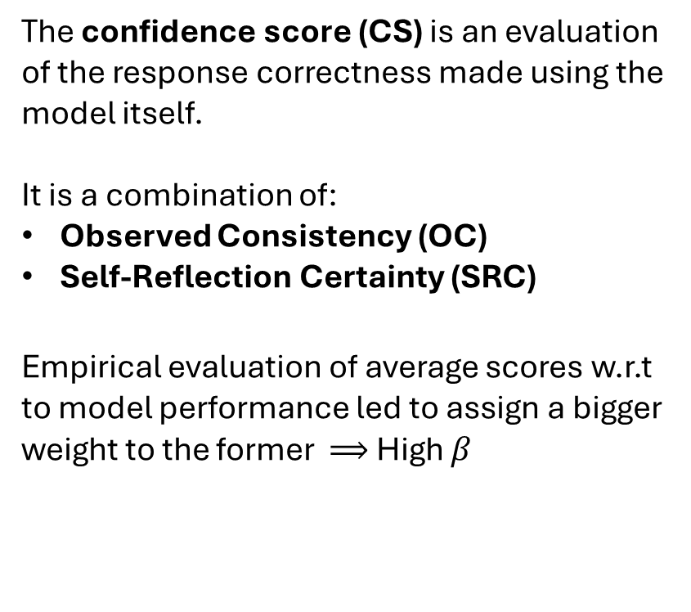
2. Approach - Confidence
The confidence score (CS) is an evaluation of the response correctness made using the model itself.
It is a combination of:
Observed Consistency (OC)
Self-Reflection Certainty (SRC)
Empirical evaluation of average scores w.r.t to model performance led to assign a bigger weight to the former ⟹ High $β$
AUV: Autonomous Underwater Vehicle
SRC
OC
Posidonia Oceanica
$$CS=β\left(OC\right)+(1−β)(SRC)$$
Emilio Gigante
8/22

Slide 12






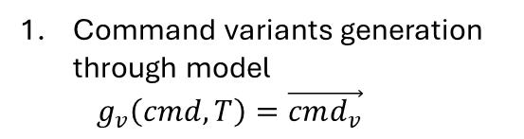

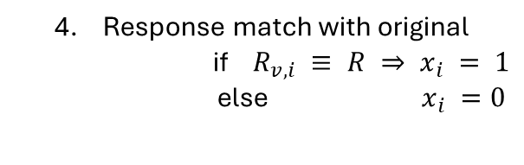
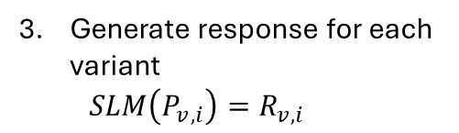
1. Introduction
2. Approach - Confidence
Command variants generation through model
  $$g_{v}\left(cmd, T\right)=\vec{cmd_{v}}$$
Original
Response
Original
prompt
OC SCORE
Score = match percentage out all variants
  $$OC = (\sum_{i=1}^{n_{v}}{x_{i}}/n_{v}) × 100$$
Replace original command in prompt with each variant
  $$P_{v,i}=P(cmd_{v,i})$$
Generate response for each variant
  $$SLM\left(P_{v,i}\right)=R_{v,i}$$
Response match with original
  if $R_{v,i} ≡ R ⇒ x_{i} = 1$
  else $x_{i} =0$
Emilio Gigante
9/22

Slide 13


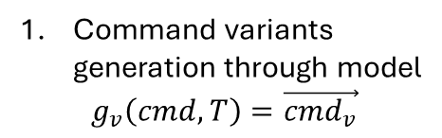
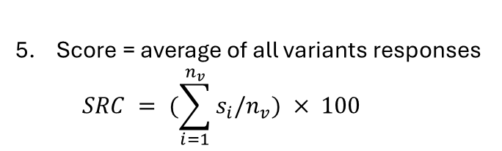

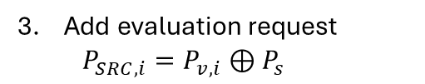
1. Introduction
2. Approach - Confidence
Command variants generation through model
  $$g_{v}\left(cmd, T\right)=\vec{cmd_{v}}$$
Original
Response
Original
prompt
Replace original command in prompt with each variant
  $$P_{v,i}=P(cmd_{v,i})$$
SRC SCORE
Score = average of all variants responses
  $$SRC = (\sum_{i=1}^{n_{v}}{s_{i}/n_{v}}) × 100$$
Add evaluation request
  $$P_{SRC, i}=P_{v,i}⊕P_{s}$$
Model responds with its correctness evaluation
  $SLM\left(P_{SRC, i}\right)= R_{SRC, i} ≡ s_{i}=0∧0.5∧1$
Emilio Gigante
10/22

Slide 14
1. Introduction - Method
2. Approach - Failure
Mission failure ⟹ Automatic replanning
AUV: Autonomous Underwater Vehicle
The concept is that another task will satisfy the request, like a plan B.
The model receives some failure context:
The name of the mission that failed
Events occurred during said mission
FAILURE
CONTEXT
USER
SLM
PLAN
EXECUTION
Emilio Gigante
11/22

Slide 15





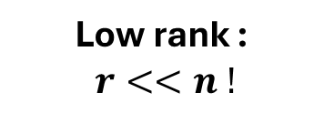
2. Approach - Model
Model selected: FLAN-T5-base
T5 = text-to-text encoder-decoder architecture
Transformers based
FLAN training for following instructions
n
r
Low rank :
$r<<n !$
$$\left[\begin{aligned}█ \\ █ \\ █ \\ █ \\ █\end{aligned}\begin{aligned}█ \\ █ \\ █ \\ █ \\ █\end{aligned}\begin{aligned}█ \\ █ \\ █ \\ █ \\ █\end{aligned}\begin{aligned}█ \\ █ \\ █ \\ █ \\ █\end{aligned}\begin{aligned}█ \\ █ \\ █ \\ █ \\ █\end{aligned}\right]$$
$$\left[\begin{aligned}█ \\ █ \\ █ \\ █ \\ █\end{aligned}\begin{aligned}█ \\ █ \\ █ \\ █ \\ █\end{aligned}\right]$$
n
n
n
$$\left[\begin{aligned}█████ \\ █████\end{aligned}\right]$$
r
Model fine-tuning:
LoRA method
Application-based dataset construction:
  Batch = same output examples
  Equal sized batch
  Examples type ratio per batch
  Training, validation and testing dataset
$$W=W_{0}+AB$$
FROZEN
TRAINABLE
Posidonia Oceanica
Emilio Gigante
12/22

Slide 16
Introduction
  Problem
  Recent research
Approach
  Context
  Confidence
  Failure
  Model
Application
  Behavior Tree manager
  SLM manager
Results
  Training
  Confidence and Correctness
  Experiments in simulation
Conclusions
Emilio Gigante

Slide 17

3. Application
CONTROL SYSTEM BEFORE APPROACH APPLICATION:
The system uses an element called BT manager that handles mission execution through behavior trees.
Each mission corresponds to a behavior tree
The user builds a message containing a mission tag defining the tree to trigger and execution parameters
The user sends the message to the BT manager
The BT manager handles execution by sending path info to the control system
USER
BT MANAGER
AUV CONTROL SYSTEM
Emilio Gigante
13/22

Slide 18
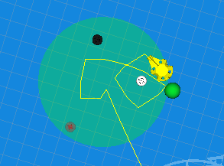
3. Application – Behavior Tree manager
A BT is a structure that follows an orderly logic of checking conditions and executing actions.
The BT manager triggers a tree based on the input received and handles execution in the system
EXAMPLE:
FALLBACK
?
SEQUENCE
⟶
buoy found?
reach buoy
go around buoy
⟶
SEQUENCE
find
buoy
reach buoy
go around buoy
Emilio Gigante
14/22

Slide 19

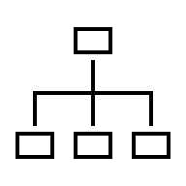

3. Application – SLM manager
The SLM manager is the element that implements the approach on the system.
It is a link between the user and the BT manager.
It has three functions:
Retrieve mission info from execution
Uses the SLM to generate a plan, which is a sequence of mission name tags
Send one mission at a time to the BT manager
CHAT
SLM MANAGER
MISSION
INFO
BT MANAGER
AUV CONTROL SYSTEM
Emilio Gigante
15/22

Slide 20
Introduction
  Problem
  Recent research
Approach
  Context
  Confidence
  Failure
  Model
Application
  Behavior Tree manager
  SLM manager
Results
  Training
  Confidence and Correctness
  Experiments in simulation
Conclusions
Emilio Gigante

Slide 21
4. Results – Training
Dataset example = [ input, target ]
Input = possible prompt
Target = desired model response to input
A training example may be:
Input =
Available missions: …
Memory: Buoys found so far: … Previous missions: …
Command: see what you can find in the buoy area
Instruction: Generate a response…
Target = “map buoy area A”
In a testing example only the command changes, using more complex sentence:
Command: document the coloured buoy area by providing a precise geo-localised map with marked buoy location coordinates
Some examples include clarification situations:
Input = …
Previous response: “make move A”
Clarification: “just find the buoys”
Target = “map buoy area A”
Others include failure situations:
Input = …
Failure context: plan A failed, no buoys found
Target = “map buoy area B”
Other include incapacity awareness:
Input = …
Command = Find the red marker
…
Target = “skip”
(It means the system cannot do it)
Emilio Gigante
16/22

Slide 22
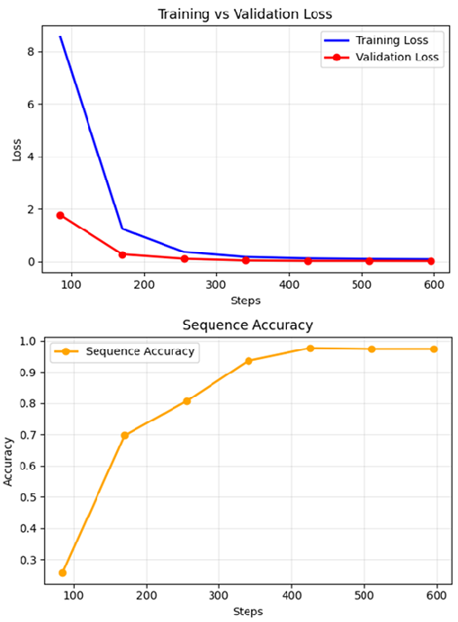
4. Results – Training
Important metrics:
Training loss: Metric to minimize for model learning
Validation loss: Same metric calculated to ensure proper learning
Sequence accuracy: This metric tells us if the model classifies the example exactly with its label
Posidonia Oceanica
Emilio Gigante
17/22

Slide 23
4. Results – Confidence and Correctness
The testing dataset was used to validate model effectiveness and confidence scores were computed for each testing example:
Most examples, 97.6%, are correctly classified
The average SRC score is not reliable, because it is not related to the correctness of the response
The average OC score is within 2% of difference with the percentage of correctly classified example
The average OC score for incorrectly classified examples is 20% lower than for correctly classified examples, meaning the threshold can be adjusted to make the system work properly
Posidonia Oceanica
Emilio Gigante
18/22

Slide 24
4. Results – Experiments in simulation
SLM MANAGER VS RULE-BASED USAGE
(Rule-based usage consists in sending missions manually to BT manager)
Performance
Definition:
Success rate is the percentage of completed missions out of the total in each session of tests
The SLM manager uses the BT manager, possibly introducing new errors, so at best it can be as performant as the rule-based system
Computational resources usage is measured
Results:
Success rate is almost the same for both systems
The SLM manager is deployable on the AUV
Emilio Gigante
19/22

Slide 25
4. Results – Experiments in simulation
SLM MANAGER VS RULE-BASED USAGE
(Rule-based usage consists in sending missions manually to BT manager)
User accessibility
Definition:
A text describing all tasks to complete is given to five operators who know nothing about the mission or how the system works
The operators are asked to used both systems to complete all the task and to stop when they think they are done
Chat GPT was used to simulate the operators
Results:
Using the SLM manager led to:
Comprehension errors decreased of 87%
Number of missions performed (command issued) to complete the tasks decreased of 40% (61%)
Emilio Gigante
20/22

Slide 26
4. Results – Experiments in simulation
User accessibility example
Operator 4
Task
Rule-based
SLM Manager
“go to the waypoint”
“pass through the gate”
“map the buoy area”
“perform the moves for each buoy”
“survey the pipeline”
(cannot be performed)
The correct mission for task 1 and 2 was sent
For task 3 had to choose between options A and B of the same mission, it picked the correct one by chance
For task 4 had to sent each move performing mission one by one
Misunderstood surveying the pipeline with surveying and area, issuing every possible survey mission, each one counts as a comprehension error
The operator sent each task rephrasing the task item of the list”
Each time the correct mission was chosen by the model
In task 3 case plan A was selected, when it failed plan B was issued automatically
The task 4 request made sure that all necessary move mission were chosen and executed in order
The answer to task 5 was “skip”, signaling to the operator the task couldn’t be performed
Emilio Gigante
21/22

Slide 27
Introduction
  Problem
  Recent research
Approach
  Context
  Confidence
  Failure
  Model
Application
  Behavior Tree manager
  SLM manager
Results
  Training
  Confidence and Correctness
  Experiments in simulation
Conclusions
Emilio Gigante

Slide 28
5. Conclusions
Coming back to introduction goals, the system on which the approach was applied:
Manages to translate natural language requests into robot actions
Can be deployed on the AUV on-board computer
Expresses a different degree of confidence for correct and wrong answers
Context awareness is implemented to the extent that the model is trained to recognize the possibilities of the system.
Possible future work could concern:
Using human operators for user accessibility experiments, introducing an experience rating
Testing the model on a wider and more varied range of possibilities
Using more modular behavior trees to better exploit the capabilities of the model
Perform real experiments on the AUV
Posidonia Oceanica
Emilio Gigante
22/22

