Slide 1

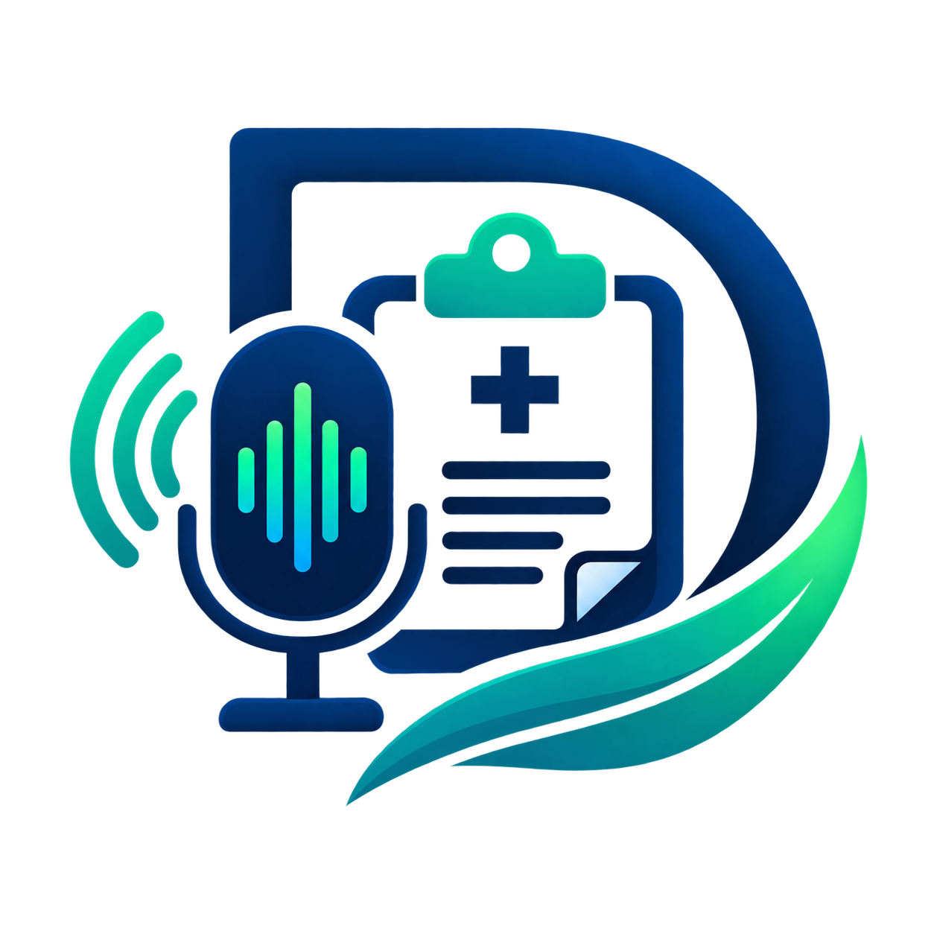
DaktariScribe
Field notes to finished reports, for frontline health teams.
Capture, organise and report clinical encounters, even with weak internet.
Uganda & East Africa
daktariscribe.vercel.app
Notes:
Open with the one-line promise: DaktariScribe turns what a health worker types, says or writes in the field into a clean, finished report. It is built for frontline teams in Uganda and East Africa, including places where the internet is weak. Point to the photo: this is the person we are building for.

Slide 2
Frontline teams lose time and data to paperwork
Paper records
Hard to read, easy to get wrong and impossible to share in real time.
Weak internet
Online-only tools stop working in camps and mobile clinics.
Time lost to charting
Workers can spend as much time writing notes as treating patients.
No standard format
Findings from different sites can’t be combined into one report.
DaktariScribe
2 / 13
Notes:
Walk through the four pain points quickly. Paper is slow and gets lost. Many tools need constant internet, which field sites don’t have. Health workers lose time to paperwork that should go to patients. And because every site writes differently, programme managers can’t combine the numbers.

Slide 3
Critical clinical data is lost, delayed or never recorded.
That hurts patient care, and the reports health programmes depend on.
DaktariScribe
3 / 13
Notes:
Let this slide land in silence for a second. The cost of the gap is not just inconvenience: when information is lost, patients get worse follow-up and programmes report incomplete numbers to funders and ministries.

Slide 4
One tool from field notes to a signed report
Health workers capture an encounter the way that suits them. DaktariScribe tidies it into a clean, standard record without adding or changing anything, ready to review, sign and share.
The software is the clerk.
The clinician is the author.
DaktariScribe
4 / 13
Notes:
This is the heart of the pitch. DaktariScribe is a documentation tool, not a decision maker. It organises what the clinician already said or wrote, files it under the right headings, and never invents a symptom, diagnosis or dose. The clinician stays in charge and signs every record.

Slide 5
Four steps for every encounter
Step 1
Step 2
Step 3
Step 4
Capture
Organise
Review
Export
Type, record an interview or upload written notes.
Notes are tidied under standard headings. Nothing is added.
The clinician checks each line against the original and signs off.
PDF report, Word file or metrics slides, in their language.
Nothing becomes final until a clinician signs it.
DaktariScribe
5 / 13
Notes:
Explain the flow left to right. One: the worker captures notes however they like. Two: DaktariScribe organises them under standard headings, and every line links back to the original. Three: the clinician reviews and signs off; nothing becomes final without a signature. Four: the signed record exports as a PDF report, a Word document or a slide deck of the numbers, in the language they choose.

Slide 6
Three ways to capture an encounter
All three work offline and upload once there is signal.
Type
Record
Upload
A simple entry screen that saves drafts on the device while you write.
Dictate hands-free during or after a visit, in English or a local language.
Photos of handwriting, PDF, Word, Excel or CSV, kept exactly as received.
DaktariScribe
6 / 13
Notes:
Workers capture in whatever way fits the moment. Typing saves drafts on the phone so nothing is lost. Recording lets them speak hands-free in five-minute segments: English through medical-grade transcription, Ugandan languages through Sunbird’s language services. Uploading means existing paper notes, PDFs, Word files and spreadsheets can be brought in as they are. All three work offline and upload once there is signal.

Slide 7
Built for the field clinic, not the city hospital
 | Abridge, Microsoft DAX Copilot, Heidi, Freed | DaktariScribe
Built for | Abridge and DAX: large health systems. Heidi and Freed: private practices | Field clinics, camps and outreach in Uganda
Price | Freed $39–119, Heidi $150, Abridge and DAX about $200+ per clinician a month | From UGX 500 a day, paid with MTN MoMo or Airtel Money
Offline | Heidi works offline in its mobile apps only | Offline capture on any phone or laptop
The note | They draft the note from the conversation | Organises only what was said, adds nothing
Like buying a data bundle, not signing a hospital software contract.
Prices in US dollars from vendor and review sites, mid-2026
7 / 13
Notes:
The best-known clinical scribe tools are Abridge and Microsoft’s DAX Copilot, sold to large health systems, and Heidi and Freed, sold to private practices. They are good products, but they are built for hospitals and clinics in rich markets: priced in US dollars, from about 39 dollars a month for Freed to 150 for Heidi and roughly 200 or more per clinician for Abridge and DAX. They draft the note from the conversation. DaktariScribe is built for the field clinic in Uganda: it costs from 500 shillings a day on mobile money, captures offline on any phone or laptop, and only organises what the clinician actually said, adding nothing. If asked: Heidi and Abridge do support many languages; our edge is Ugandan languages through Sunbird and field-first design. Confirm these prices before presenting, as they change often.

Slide 8
How patient data stays private
1
Encrypted on the device
AES-256 encryption before anything leaves the phone.
2
Identities removed
Names, phone numbers, NIN and emails become placeholders before any outside processing.
No patient text in logs. Only record IDs and actions are kept.
3
Processed privately
Never sold or shared. Patient data is used for the record and nothing else.
Only paid services whose terms bar them from training on the data.
Voice is the exception. Audio can’t be anonymised, so it only goes to providers with no-training terms.
4
Restored and signed
Real details return on our server only. The clinician signs off.
DaktariScribe
8 / 13
Notes:
This answers the biggest question: does patient data leak? Walk the four steps. One, everything is encrypted on the device first. Two, before any text goes to an outside processing service, names, phone numbers, national ID numbers and emails are replaced with placeholders, so the service never sees who the patient is. Three, we only use paid service tiers whose terms forbid training on the data. Four, the real details are put back on our own server and the clinician reviews and signs. Logs never hold patient text, and we never sell or share data. Be upfront about voice: a recording can’t be anonymised, so it only goes to providers with no-training terms, and the privacy policy says so.

Slide 9
Firm limits on automated processing
It may | It may never
File sentences under template headings | Add a symptom, diagnosis or dose
Fix spelling and grammar | Add a result or recommendation
Expand approved abbreviations (BP, RDT, ANC) | Change the meaning or drop a “no”
Pull out numbers the worker stated | Finalise a record without sign-off
Enforced in code, not just promised. Every line must link to its source, and checks block invented numbers, dates, medicines and dropped negations.
Disclaimer. DaktariScribe is a documentation tool. It does not diagnose or recommend treatment. The signing clinician is responsible for every record.
DaktariScribe
9 / 13
Notes:
This is how the automated processing is kept on a short leash. On the left, the only things it is allowed to do: organise, tidy spelling, expand approved abbreviations like BP or RDT, and pull out numbers the worker actually said. On the right, what it can never do: add clinical content, change meaning, drop a negation, or finalise anything. Stress that this is enforced in code: if a line can’t be traced to the original, or a number appears that wasn’t in the source, the record is flagged and can’t be signed. Finish on the disclaimer: DaktariScribe documents care; it does not make clinical decisions.

Slide 10
Made for real field conditions
Works with weak or no internet
Drafts save on the device and sync when the signal returns.
Outdoors, in bright sun, with weak signal and a patient waiting. Every design choice starts there.
Runs on devices teams already have
Mid-range Android phones and laptops, straight from the browser.
Readable in sunlight
High-contrast screens and large buttons, easy to use with gloves.
In the clinician’s language
Translate and export each record in the language they choose.
DaktariScribe
10 / 13
Notes:
Field reality drives the design. Capture works offline, with drafts saved on the device. It runs in the browser on ordinary Android phones and laptops, so there’s no special hardware. Screens are high contrast with large touch targets for bright sun and gloved hands. And records can be translated and exported in the clinician’s chosen language.

Slide 11
Simple prepaid passes
Every account starts with a 7-day free trial
Pay with MTN MoMo or Airtel Money through Nylon Pay, like buying a data bundle. No card, no auto-renewal.
Pass | Price (UGX) | Period | Reports | Voice min | Exports and extras
Daily | 500 | 1 day | 3 | 5 | PDF
Weekly | 2,000 | 7 days | 15 | 20 | PDF, Word, 1 language
Monthly Basic | 5,000 | 30 days | 40 | 60 | PDF, Word, all languages, templates
Monthly Pro (recommended) | 20,000 | 30 days | 150 | 180 | PDF, Word, slides, insights, custom logo
Also: Pro Quarter UGX 55,000 for 90 days · Voice top-up UGX 1,500 for 30 minutes · Teams UGX 25,000 per seat for 30 days (5 seats minimum)
DaktariScribe
11 / 13
Notes:
Pricing works the way people already buy airtime and data: prepaid passes in Ugandan shillings, paid by MTN MoMo or Airtel Money through Nylon Pay. Nothing renews automatically, and every account starts with a 7-day free trial. Daily is 500 shillings for one day, Weekly is 2,000 for seven days, Monthly Basic is 5,000 for thirty days, and Monthly Pro, the one we recommend, is 20,000 for thirty days with slides, insights and a custom logo. Heavier users can take Pro Quarter at 55,000 for ninety days, top up voice minutes, or buy team seats for an organisation. When a pass ends, the worker keeps all their records.

Slide 12
From mobile money to cards and teams
Launch
Next
Scale
Mobile money
Card payments
Organisations
MTN MoMo and Airtel Money prepaid passes, from UGX 500. How most clinicians already pay.
Visa cards through Nylon Pay’s hosted checkout. Card details never touch our servers.
Team seats for NGOs, clinics and programmes, paid by invoice or bank transfer.
One provider for every method, all in UGX, with every payment confirmed by a verified, signed notice.
DaktariScribe
12 / 13
Notes:
Payments grow in three stages on one provider, Nylon Pay. We launch with mobile money because that is how health workers in Uganda already pay for airtime and data. Next we add card payments: Nylon Pay’s hosted checkout takes the card, so card numbers never pass through or get stored on DaktariScribe. Then we scale to organisations: NGOs, clinics and health programmes buy team seats and pay by invoice or bank transfer. Every payment is confirmed by a signed notice that the system verifies, so passes are only granted for real payments.

Slide 13
Built and working today
Live now
Final step
Type, record or upload
Offline, encrypted capture
English and local languages
Line-by-line review
Clinician sign-off
PDF, Word and slides
Supervisor insights
Full audit trail
Mobile money payments through Nylon Pay, to switch on prepaid passes.
Try it at daktariscribe.vercel.app
13 / 13
Notes:
Close with momentum: the product is built. Workers can type, record or upload notes, offline and encrypted on the device, in English or local languages. Every line is reviewed against its source, signed off by the clinician, and exported as PDF, Word or slides. Supervisors get insights across sites, and every action is in the audit trail. The one remaining step is connecting mobile money through Nylon Pay so clinicians can buy passes. Invite the audience to try it at daktariscribe.vercel.app, then take questions.

