Slide 1
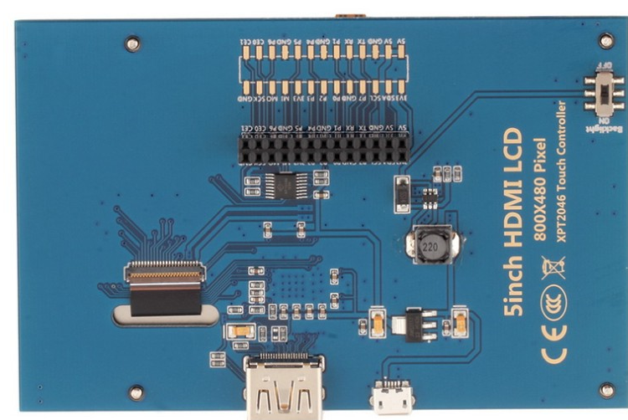
Pin 26
Pin 1

Slide 2
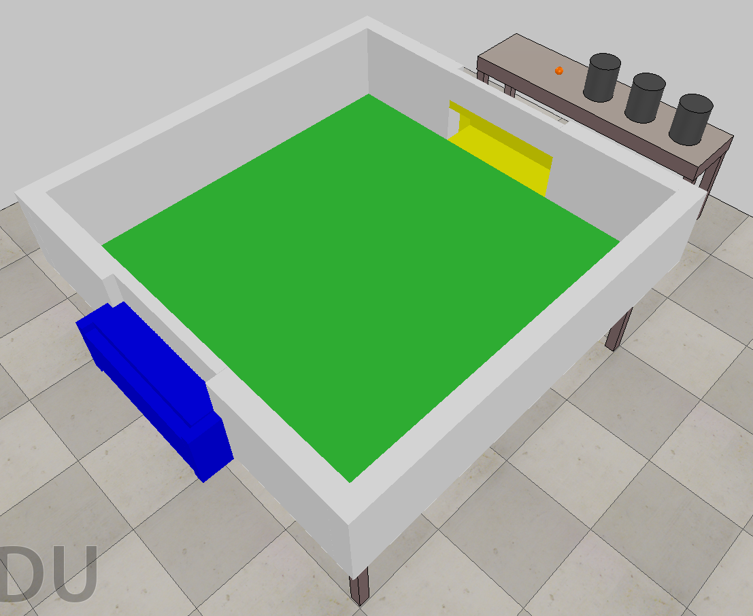
Z
Y
X

Slide 3
Roller Velocity (V_{R})
Wheel Velocity
(V_{w})
Robot Forward
Velocity
Robot Forward
Velocity
(V)

