Slide 1

Elevator UML
By the us

Slide 2
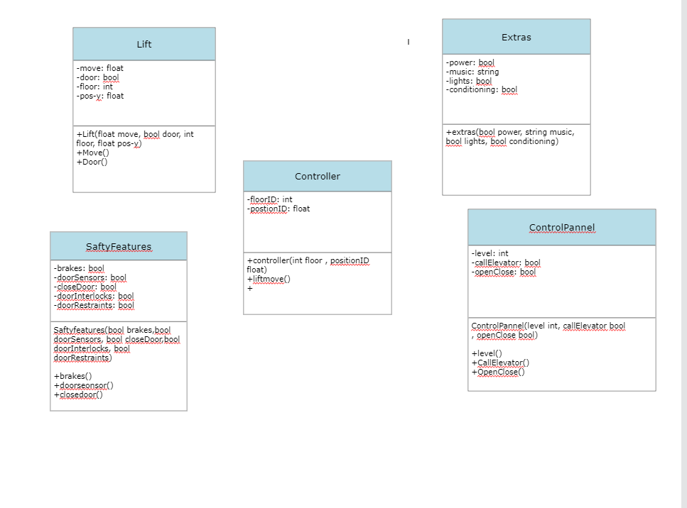

Slide 3
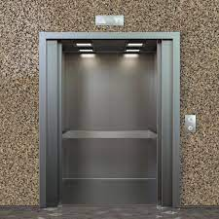
The Lift Class

Slide 4
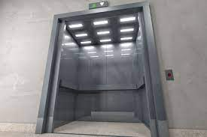
The Safety Features Class

Slide 5
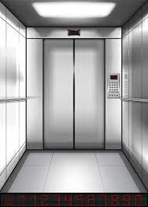
The Extra Features Class

Slide 6
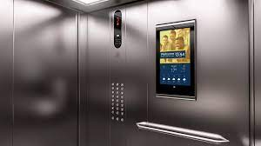
The Control Panel Class

Slide 7
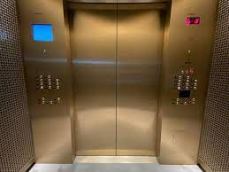
The Control Class

