Slide 1

Elevator UML
By the us

Slide 2
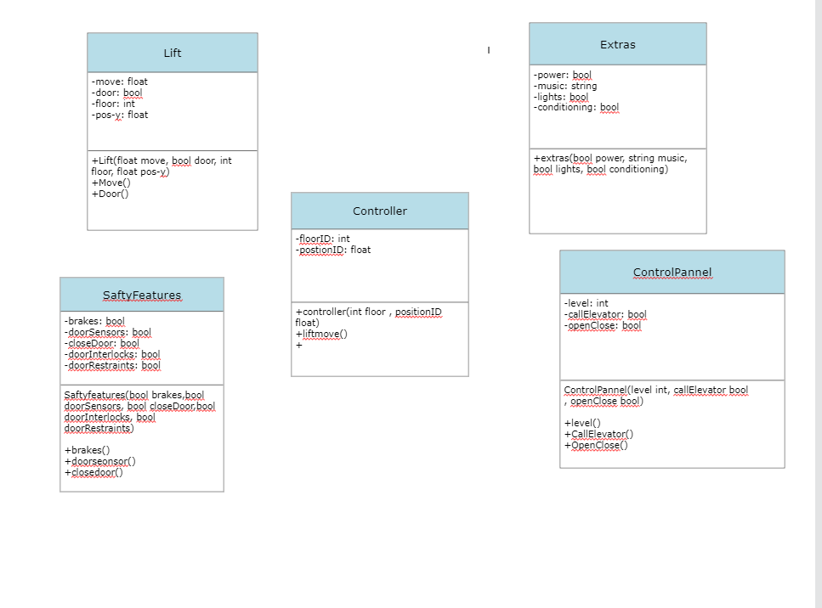

Slide 3
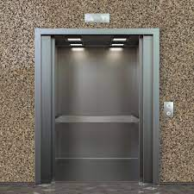
The Lift Class
Variables:
-A move variable that controls the movement of the elevator.
-A door variable that is either true for open or false for closed.
-A floor variable that tells the user the floor there going too.
-A position variable that shows the position of the elevator/where they currently are.
-Lift is the constructor.
-The Move() method calculates the movement and the Door() method controls the doors.

Slide 4
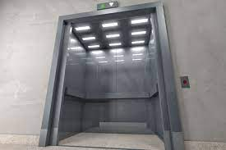
The Safety Features Class
The safety features involved in making a lift operate safely are extremely important. When looking at the parts involved in it we had taken the assumption that they typically will work of some sort of Boolean methods.
So things like the doors being open or closed will be a variable that will tell the elevator if it can move or not
The door sensors will keep the doors from closing on someone.
The interlock and restraints will also keep the elevator from moving while looked inplace.

Slide 5
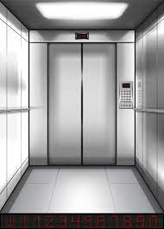
The Extra Features Class
The extras feature class will add music, air conditioning and lighting. The class will also power everything off if the elevator is not running.
The variables are lights, music, power and conditioning. All bools besides music.

Slide 6
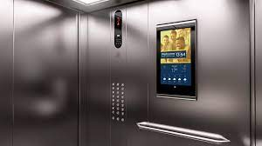
The Control Panel Class
The control panel class is the control panel you find inside and outside of the elevator and its job is too call the elevator and to open and close the doors along with controlling which floor the elevator will goto and this will be done with it working in conjunction with the move method.

Slide 7
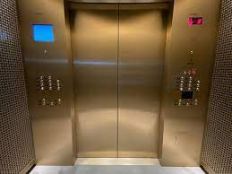
The Control Class
The controller class will keep track of the current position and floor of the elevator with position of the elevator would be measured with a float due to the fact that it may be important to have a more precise value of its position.
As well as an int value of the floor currently on.
The controller will have a method which deals with the movement of the elevator in particular checking if the elevator is safe to move based off of the safety precausions

Slide 8
