Slide 1

Elevator UML
By the us

Slide 2
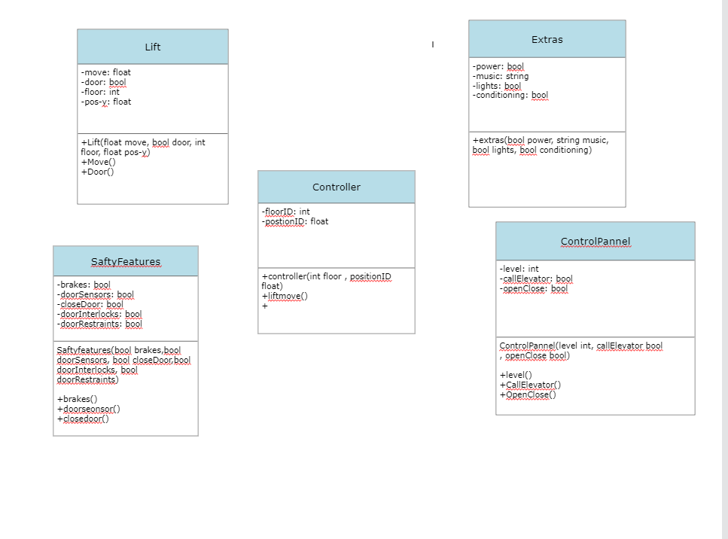

Slide 3
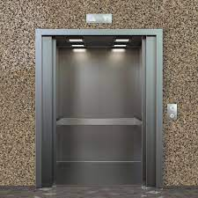
The Lift Class
Variables:
-A move variable that controls the movement of the elevator.
-A door variable that is either true for open or false for closed.
-A floor variable that tells the user the floor there going too.
-A position variable that shows the position of the elevator/where they currently are.
-Lift is the constructor.
-The Move() method calculates the movement and the Door() method controls the doors.

Slide 4
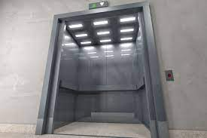
The Safety Features Class

Slide 5
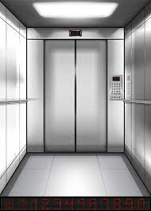
The Extra Features Class

Slide 6
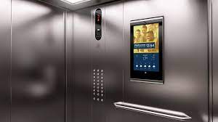
The Control Panel Class

Slide 7
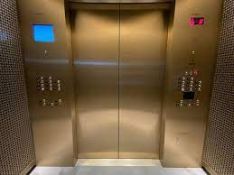
The Control Class

