Slide 1

Elevator UML
By the us

Slide 2
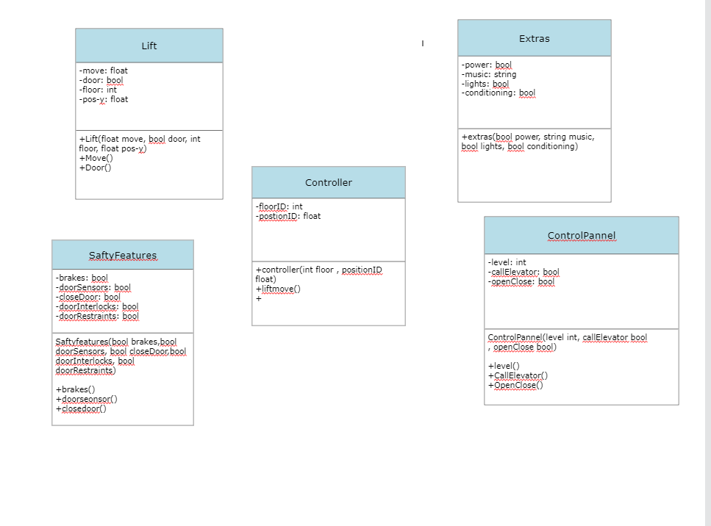

Slide 3
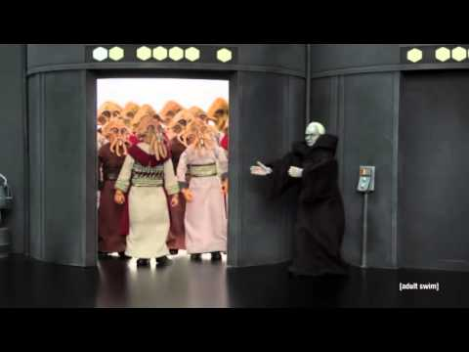
Lift
The idea behind the lift section in the diagram was to control the movement of the lift to accurately move between floors and to keep track of where it currently is so it will know how much it needs to move by to get to the next floor

Slide 4
The safety features
The safety features involved in making a lift operate safely are extremely important. When looking at the parts involved in it we had taken the assumption that they typically will work of some sort of Boolean methods.
This is because it includes things like door sensors and the door being
closed, restraints and locks and the elevator will only be calling to the
things that involve moving and some other features that will only be
able activate while many of the safety features arnt active.

