Slide 1
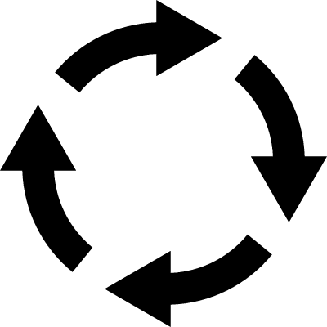
RILs
5G
Base Population

Slide 2
RILs
9G
Base Population

Slide 3
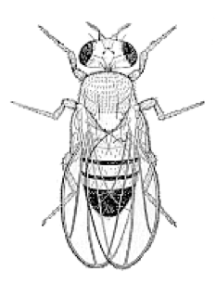
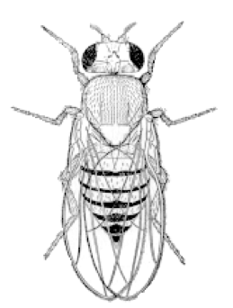
RILs
♂₁. . . . . ♂₂₈
Sires
5G
Factors
Dams
Base Population
♀₁
♀₂
♀₃
. . . . ♀₇₉
Offspring phenotypes
Data
Diets

Slide 4
DSPR RILs
5G
Base Population
Sires
♂₁. . . . . ♂₂₈
Dams
♀₁
♀₂
♀₃
. . . . ♀₇₉
Diets
C
DR
HS
Offspring Vials
Replicates
a b a b a b a b a b a b a b a b a b

