Slide 1
AAI-521
Team Members
Alejandro Monje: alejandromonje@sandiego.edu
Edgar Munoz: edgarmunoz@sandiego.edu
Xavier Plasencia: xplasencia@sandiego.edu

Slide 2
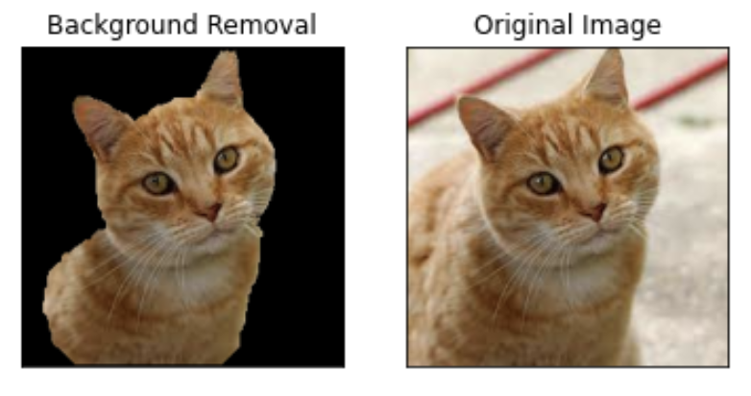
Our Goal
Our project demonstrates our ability to use computer vision techniques to create a machine learning model that takes in the images, classifies them, and lastly use the grabcut algorithm to perform image segmentation. The goal of this project is to have a model that can take in a dataset of images and accurately classify those images. In our case we used a dataset that consists of dog and cat images. We also want to to be able to perform image segmentation on these images.

Slide 3
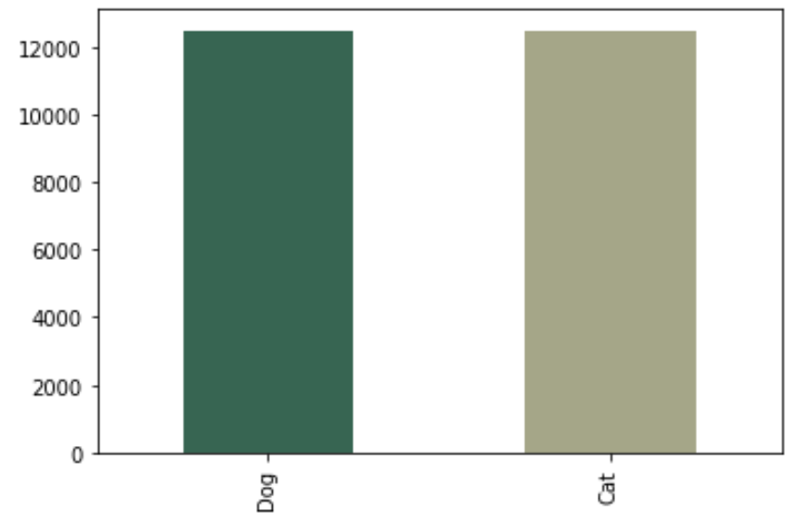
Our Data
Our data set comes from Kaggle (https://www.kaggle.com/competitions/dogs-vs-cats/data)
It contains a total of 25,000 images. It’s equally split between cat (12,500) and dog (12,500) images.
The images in the dataset vary in size and we can see the distribution of sizes in the image below.

Slide 4
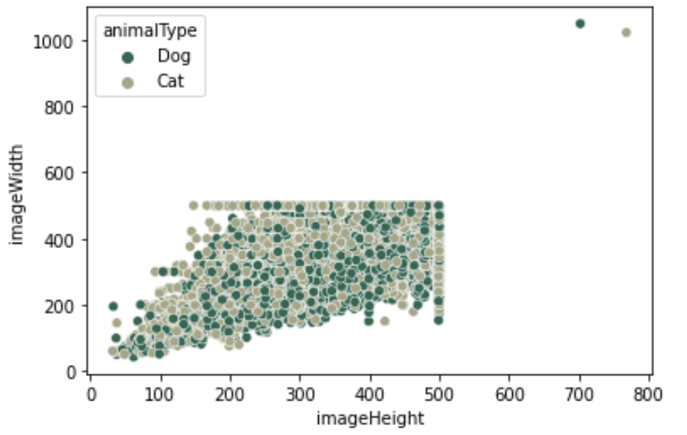
Exploratory Data Analysis
After choosing our dataset we performed some Exploratory Data Analysis (EDA) which helped unearth some valuable insights and some potential issues we would have to resolve.
As mentioned in the previous slide we discovered that our dataset had an equal amount of cat and dog images.
One issue however was that our images varied in size so we would have to resolve this problem by normalizing and scaling the data later.

Slide 5
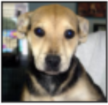
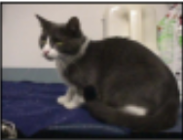
Classification
?
?
?
We used deep learning Convolutional Neural Networks of the pre-trained VGG16 model for classification.
Before applying the images to the deep learning models, the cat and dog datasets were split into test and train sets. 80% of cat and dog images were used for training the models, and 20% were used for validation.
Since a pre-trained model (VGG16) was used for transfer learning, pre-processing the images required image scaling and allowed for pixel centering, giving pixel values a mean of zero. Before training, an iterator was used to fix our issue of having images of various sizes. All training and test images were made a target size of (224, 224) since the VGG16 model was initially trained on images of dimensions (224, 224).
?
?

Slide 6
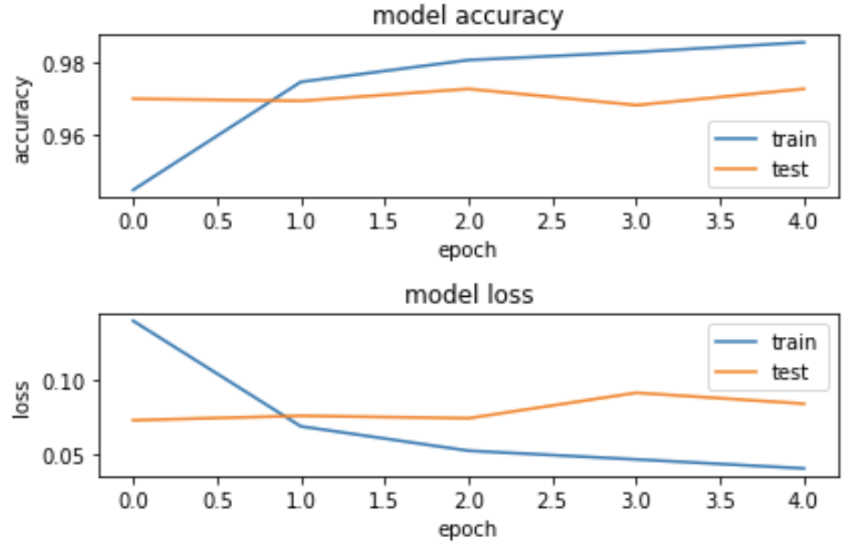
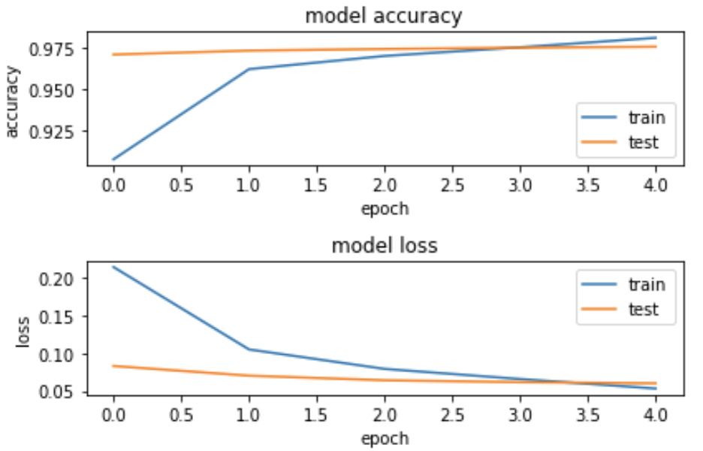
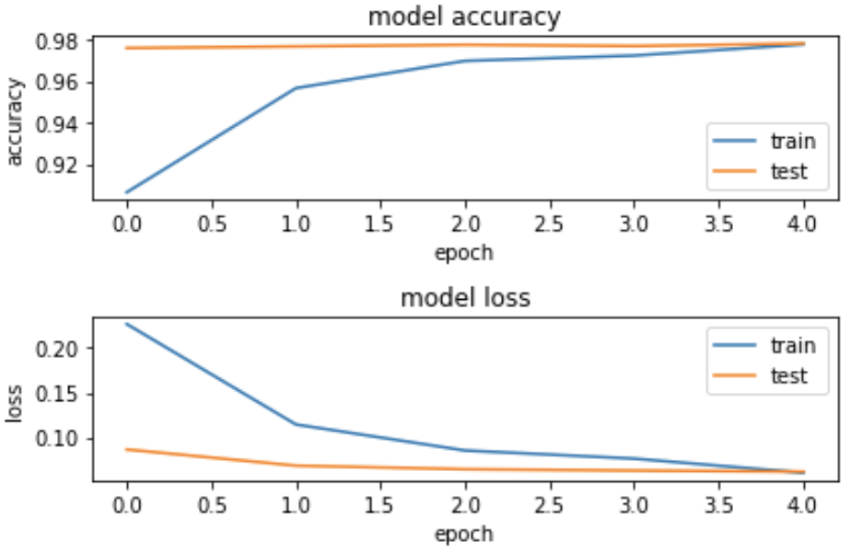
Metrics/Results
Model 1 Model 2 Model 3

Slide 7
Evaluation
Model 1 converges quickly and diverges with a validation accuracy that doesn’t exceed 97.27% and with overfitting issues.
Model 2 performs better than Model 1 and converges around the 4th epoch.
Model 3 converges on the 5th epoch and has a higher validation accuracy than the other two models.
All the models were trained with 5 epochs
Our best performing model had an accuracy of 97.80%
(dense layers with 256 and 128 neurons)

Slide 8
Image Segmentation
The GrabCut algorithm
A zero-filled mask of the same image shape was created to perform background elimination.
Additionally, two zero-filled masks models were created, one for the background and one for the foreground.
The Upper left and bottom right corners were then calculated on the image to create a rectangle where the object of interest will be located.
The GrabCut algorithm takes in the following inputs: image, rectangle, mask, two models, and the number of iterations. A second mask is created to keep the foreground object (animal) while allowing the background to turn completely black.
The product of the second mask and the original image create the desired background removal effect.

