Slide 1
DocSecOps
Group 22
Joseph Lee, Jarold Sabillon, Daniel Ruess, Omar Muniz, Laura Casals

Slide 2
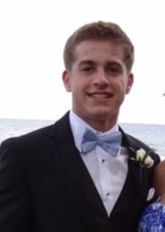
Objective/Problem
As the Navy keeps growing, they need a way to offer accurate quality training and guidance that will lead the new cadets to the proper equipment and information.
Problem is, large amounts of data are needed to teach these new cadets, but the Navy must make sure that the data that the cadets are receiving are accurate and informational.
Simple errors in links, tables, and spelling can cause misunderstanding in learning and can cause negative effects on the battlefield ultimately costing lives.
There needs to be a way to validate the data that the Navy offers to the new cadets. The data needs to be checked and validated to make sure the data that the cadets are receiving are accurate and safe.

Slide 3
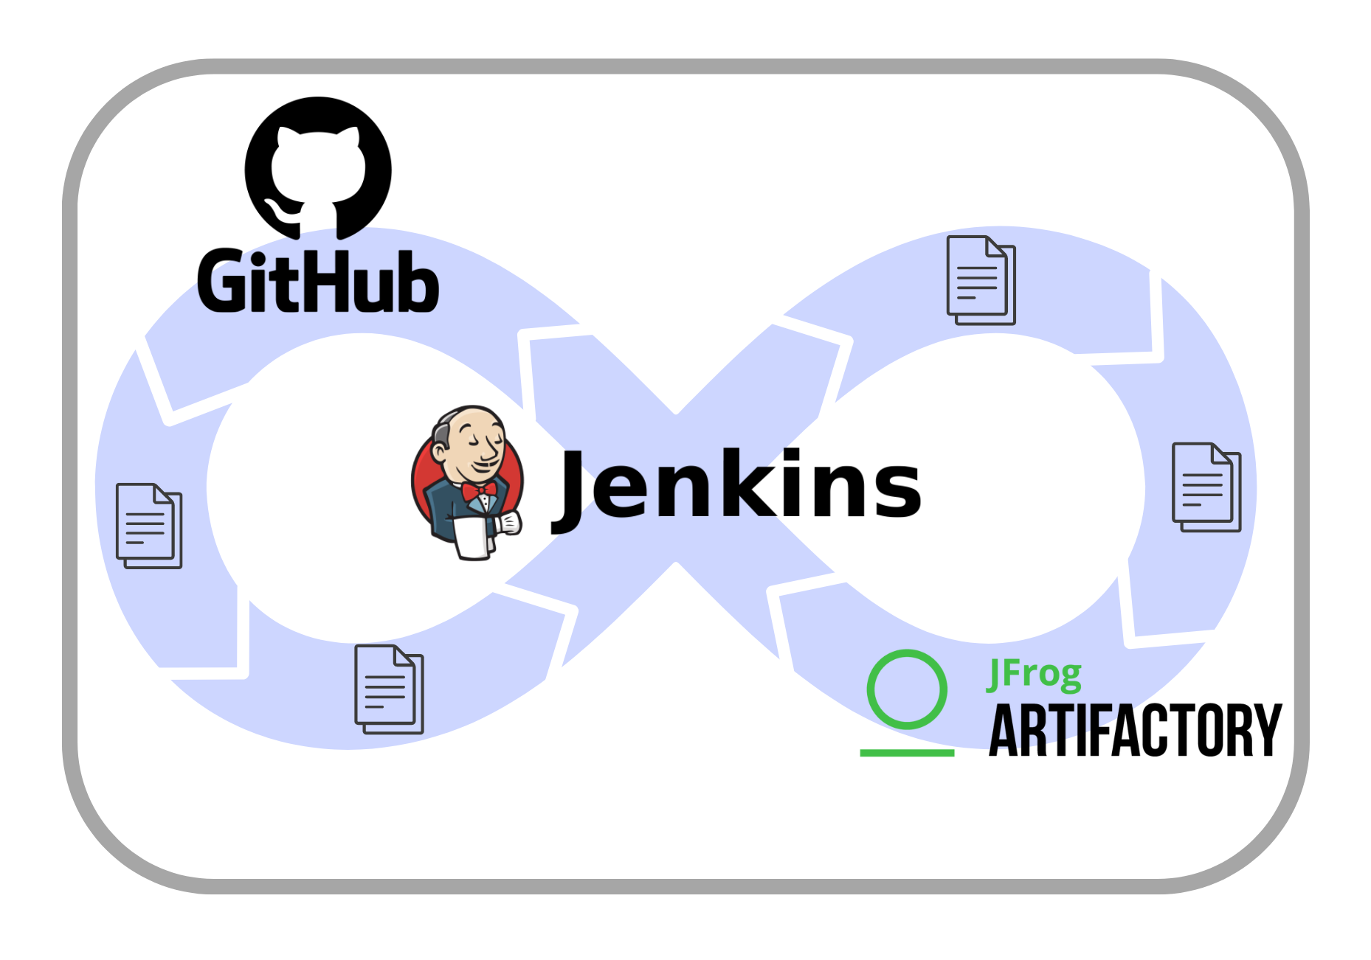

Proposed Solution: Main Components
DevSecOps Ecosystem
GitHub repository: entry point of the system
Jenkins pipeline: processes the input documents
JFrog Artifactory: artifact repository houses processed files after going through the pipeline

Slide 4
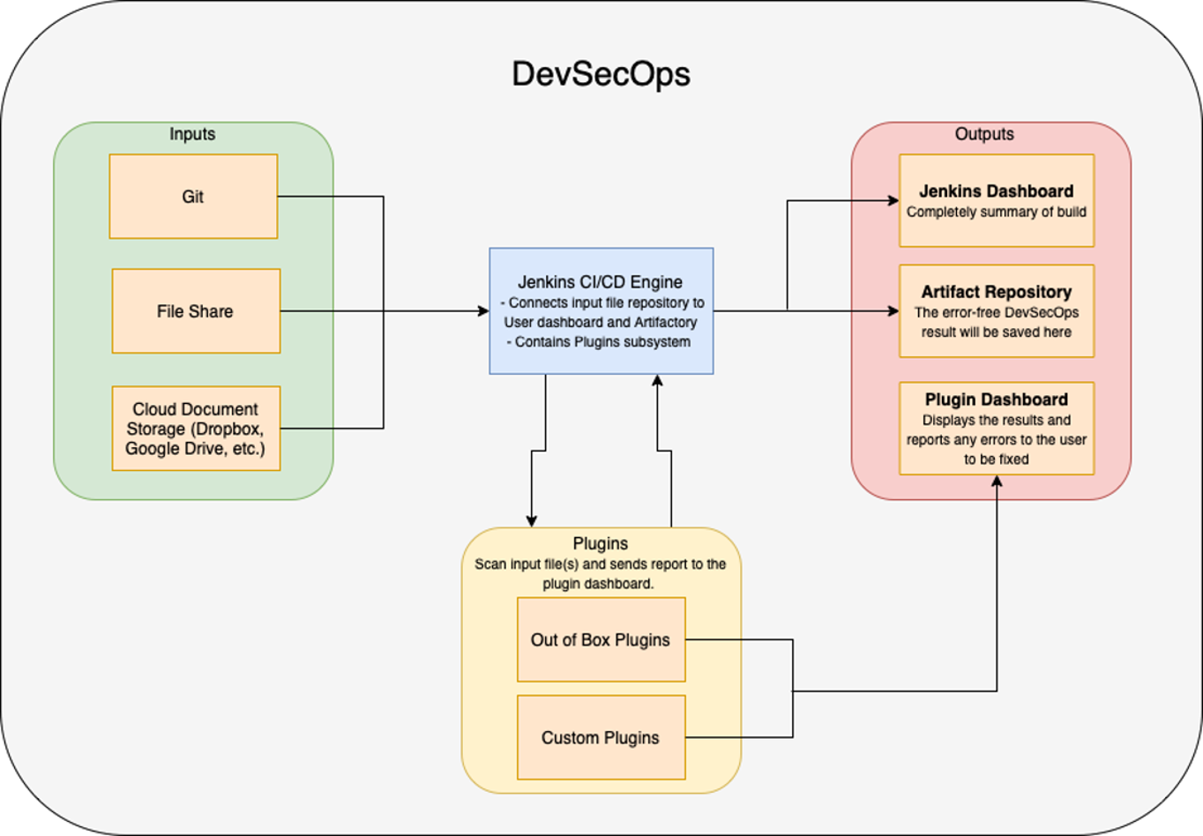
Proposed Solution: Block Diagram

Slide 5
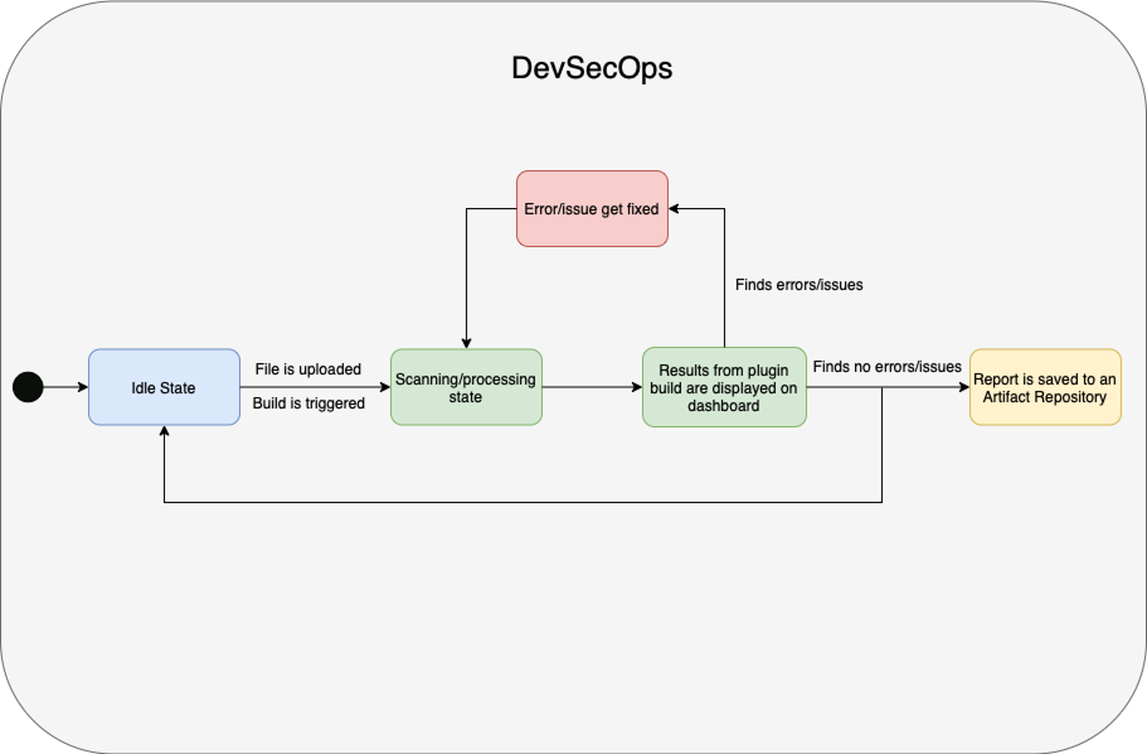
Proposed Solution: State Diagram

Slide 6




Infrastructural Overview
This platform was designed with virtualization and containerization in mind
Kubernetes was chosen as the best candidate for container orchestration
Docker was considered, however the additional layers of management present in Kubernetes tipped the scales in favor of it
The choice to go with Kubernetes allowed for a resilient, flexible and repeatable approach to systems design for this project
The entirety of this stack could be deployed to a new Kubernetes cluster with a few minor tweaks to a handful of YAML configuration files
An existing dedicated server was repurposed to host the infrastructure for this project

Slide 7
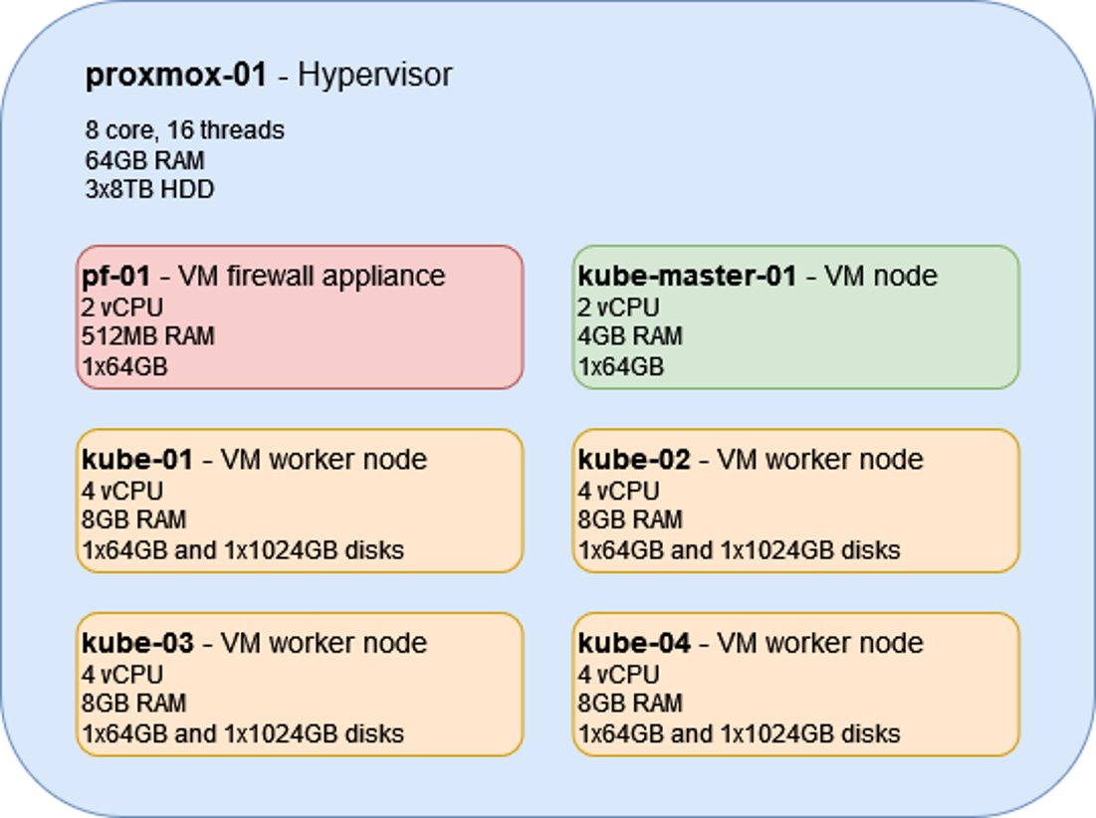
Virtual Machine
Six virtual machines are in use
One software firewall / router
One master / control k8s node
Four worker k8s nodes
Worker nodes also provide distributed storage backend for Longhorn

Slide 8
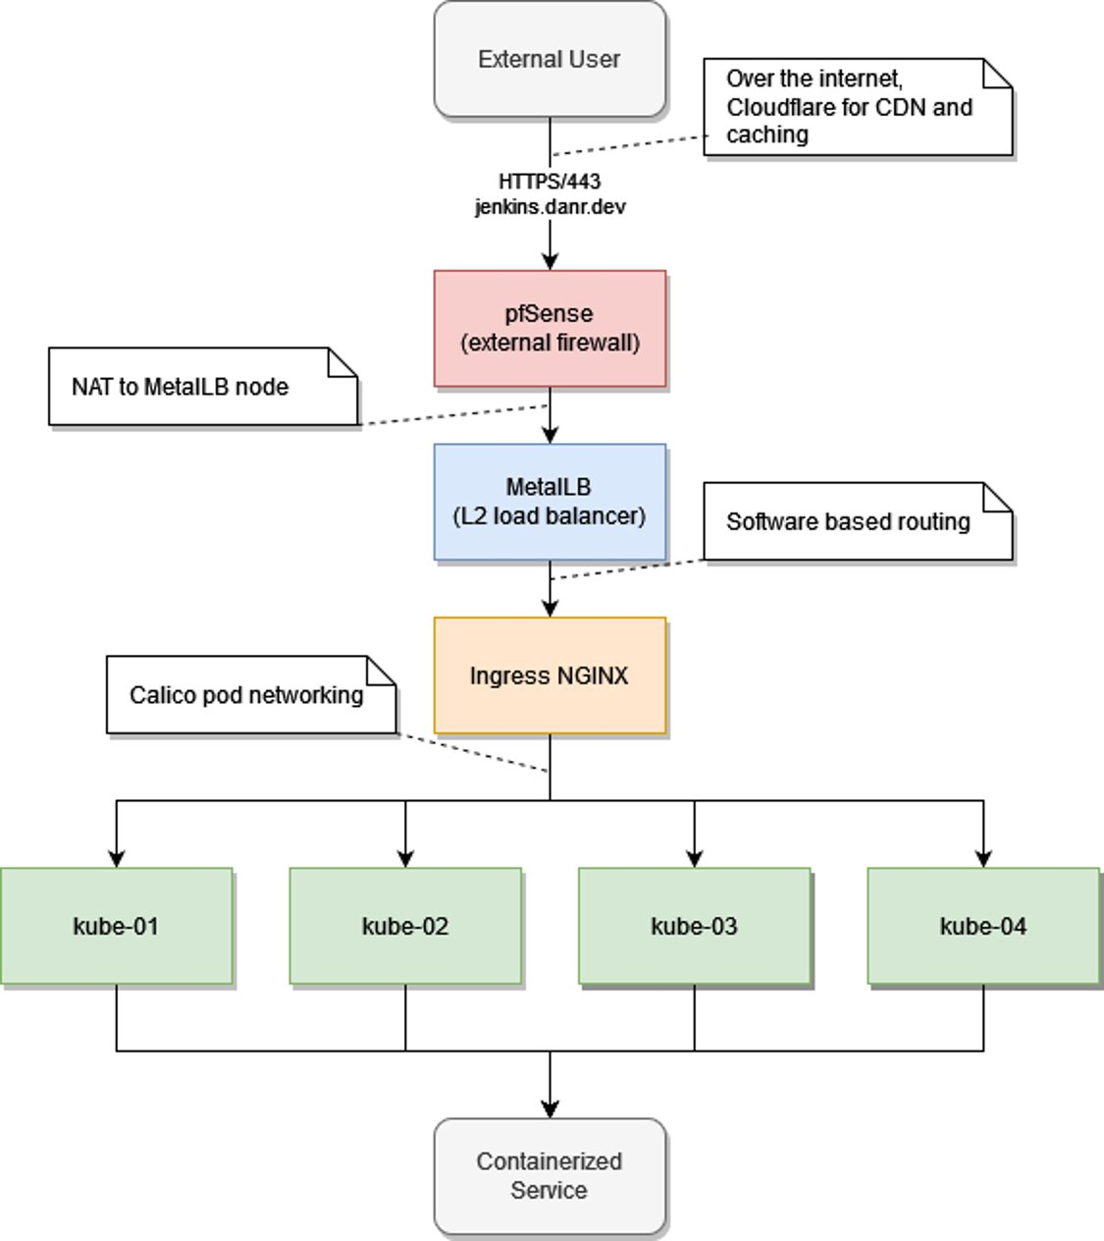
Network Overview
Bare-metal deployments have some added challenges over traditional cloud deployments​
Additional software is required to enable a full suite of functionality in a non-cloud environment​
Calico is used for cluster networking services between pods and nodes​
MetalLB is used in place of a traditional cloud load balancer

Slide 9
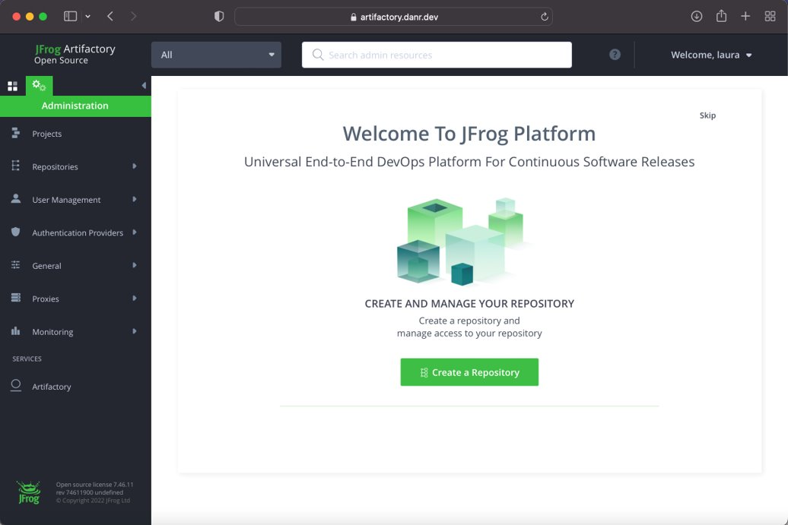
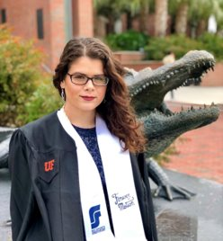
JFrog Artifactory
Will be leverage as documents housing location
Once the files have successfully passed through the pipeline, they will be deployed to artifact repository

Slide 10
What has been accomplished this semester
URL Validator as well as Regex expression to find the data. Using python as well as Java. (Joseph Lee)
Tested multiple different plugins.
Created a demo pipeline to test changes.

Slide 11
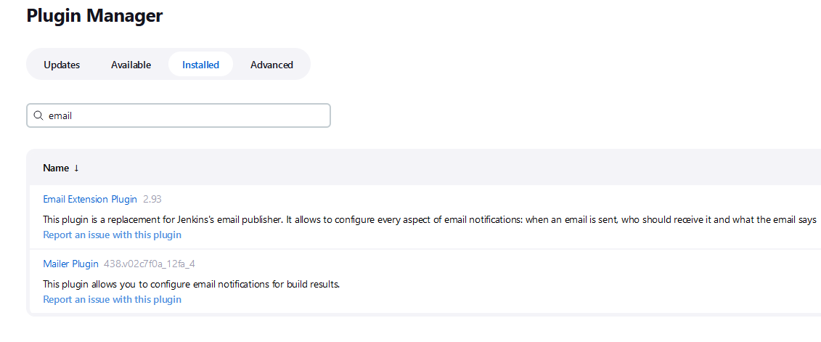
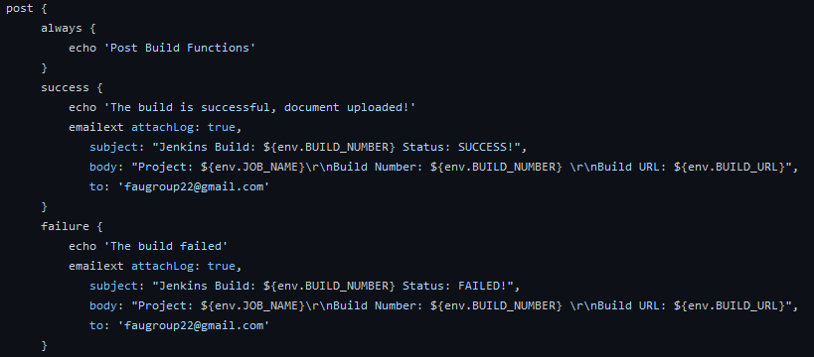
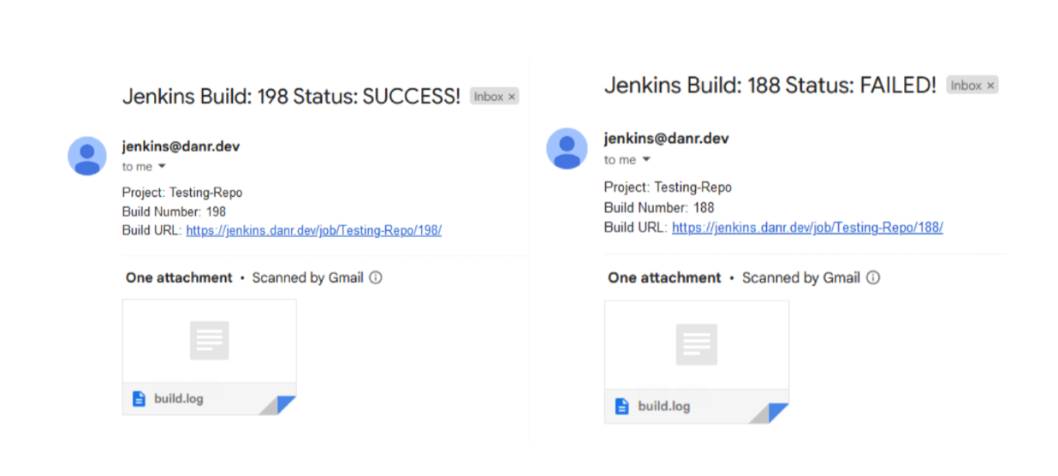
What has been accomplished this semester
Added necessary plugins to the Jenkins controller to add customizable email functionality
Wrote post-build actions for email notifications
build number
build status
build URL
job name
build log
File types are deployed to respective artifact repository in JFrog

Slide 12
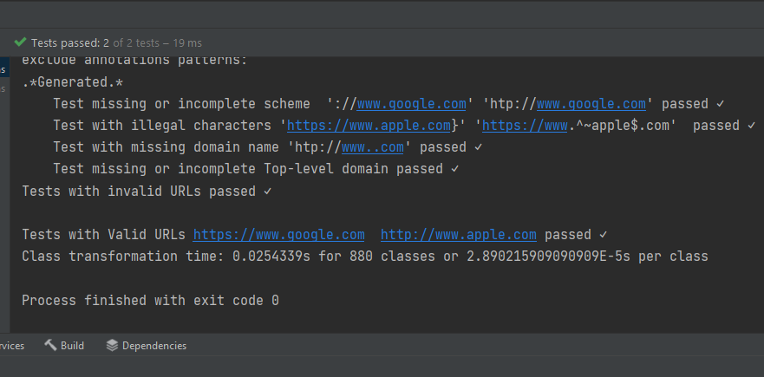
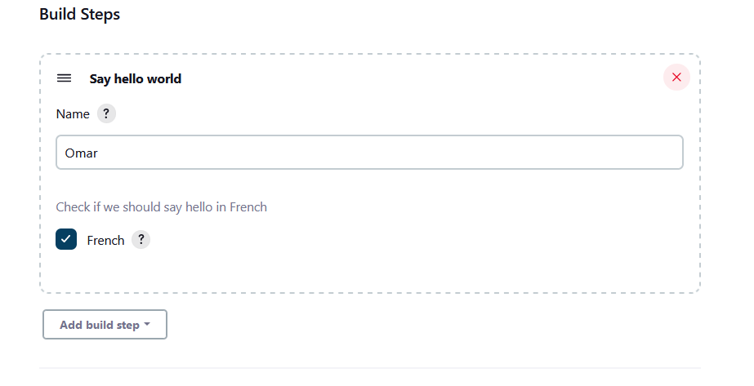
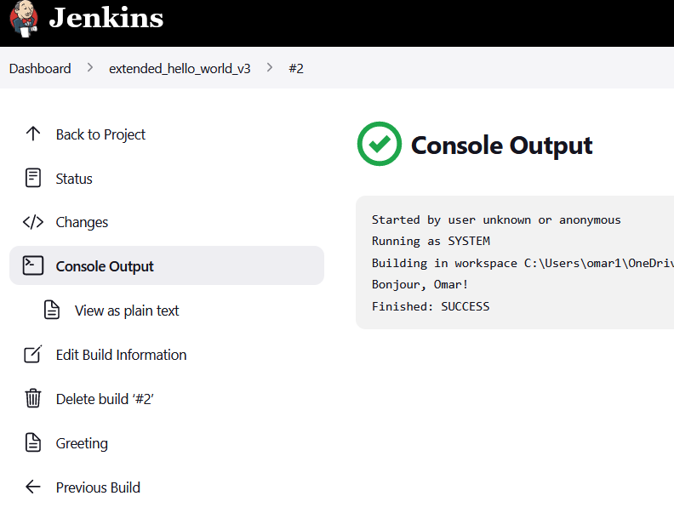
What has been accomplished this semester
Assisted with URL Validator and Regex expression to find the data.
Wrote Unit Tests with JUnit to check the functionality the URL validation
Assisted Jarold with development of File detection code
Made progress with Jenkins plugin development
Have gotten an example plugin to build in a local Jenkins instance.
Need to debug GUI section of the plugin

Slide 13


What has been accomplished
Found and learned to use a variety of external libraries and tested how they extracted data.
Wrote own method of sorting files into a data structure based on extension.
Found that PdfBox and POI Apache work best for our needs.
Implemented PdfBox methods to extract metadata.

Slide 14
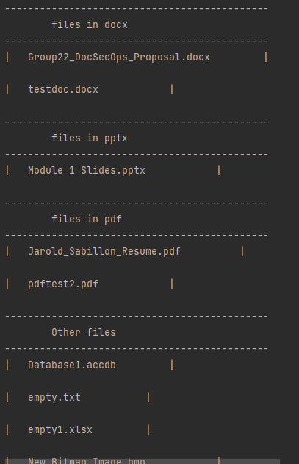
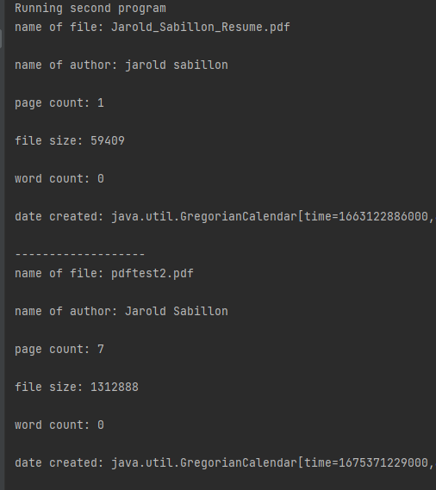
Results – an example

Slide 15
What is left to be completed
Docx
PPT

Slide 16
Demonstration

