Slide 1



Knowledge Distillation-based modeling for Camera Obstruction Detection using a custom Dataset
Emmanuel George P Aileen Emelda V Dr. Masilamani V
IIIT Kottayam IIITDM Kancheepuram IIITDM Kancheepuram
IEEE CICT 2025
19–21 December 2025

Slide 2
Outline
Motivation
Background
Problem Statement
Objectives
System Architecture/Mathematical Formulation
Key Results
Discussion
Conclusion
Camera Obstruction Detection

Slide 3
Motivation
CCTV surveillance cameras, though extensively deployed for security in diverse environments, are highly susceptible to both intentional and accidental obstructions, which can render surveillance systems ineffective.
The traditional reliance on human operators to constantly monitor live feeds for such blockages is not only time-consuming but also impractical, especially within large camera networks.
Since CCTV surveillance data is sensitive information sending data to the cloud for processing is not ideal, thus we need a model that can run on edge devices with a decent accuracy.
Camera Obstruction Detection

Slide 4
Background
Vikas et al. proposed ResNet-based models with GAN-augmented data to detect mud and water camera blockages, achieving high accuracy but lacking scalability to diverse CCTV obstructions and requiring heavy computation.
Hsing Hung et al. used knowledge distillation with Gramian matrix and KL-divergence, improving lightweight student accuracy on CIFAR-100 while significantly reducing model size and computational complexity.
Camera Obstruction Detection

Slide 5
Background
Hyeonseok Hong et al. introduced feature distribution–based knowledge distillation using KL-divergence demonstrating notable accuracy improvements across multiple architectures on the CIFAR-100 benchmark.
Gyeongdo Ham et al. proposed cosine similarity–based distillation with adaptive temperature scaling, enabling effective teacher–student alignment and achieving improved accuracy over baseline models on CIFAR-100
Camera Obstruction Detection

Slide 6
Problem Statement
Obstructions in CCTV camera surveillance can render systems ineffective, and manual detection becomes impractical when monitoring a large number of cameras. This work proposes a camera obstruction detection system designed to run on low-resource devices, preserving data privacy by eliminating the need to transmit data to the cloud.
Camera Obstruction Detection

Slide 7
Objectives
Create an image dataset containing two classes: normal and blocked.
Develop lightweight models using knowledge distillation based on feature and KL-divergence losses.
Implement hyperparameter tuning to find optimal hyperparameters and compare results.
Test model inference time on edge devices
Camera Obstruction Detection

Slide 8
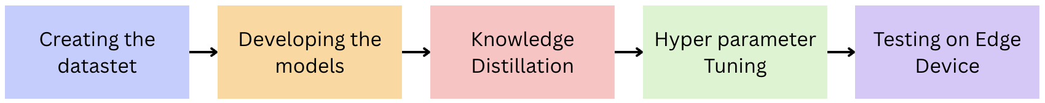
System Architecture/Mathematical Formulation
Overall system architecture dataset creation, developing models, knowledge distillation, hyperparameter tuning and finally testing on edge devices
Camera Obstruction Detection

Slide 9
System Architecture/Mathematical Formulation
The dataset used here was created by the following methods
Frames were extracted from the CCTV surveillance video dataset
Some images were created manually by blocking the camera and clicking the pictures
Blocking by the hand was also stimulated by taking images from the 11K hands dataset
Blocked images were also created using the diffusion models with appropriate prompts
Camera Obstruction Detection

Slide 10
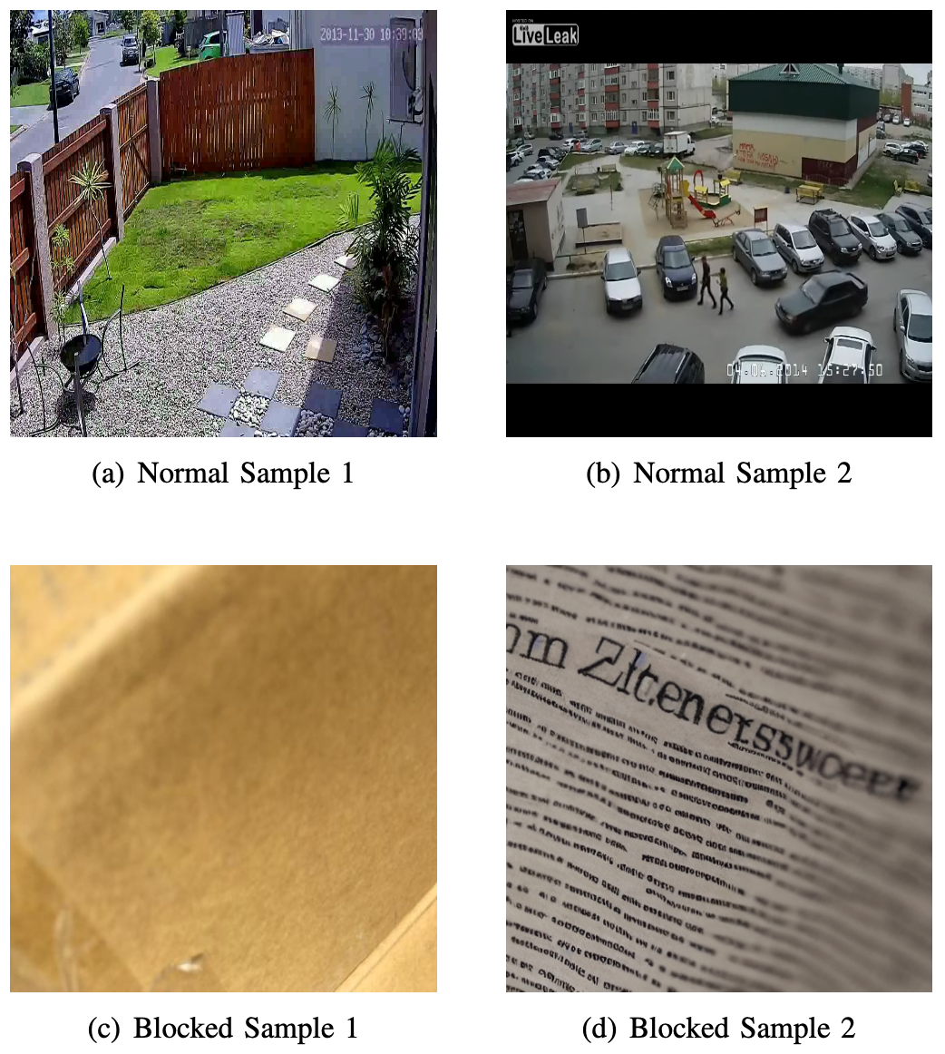
System Architecture/Mathematical Formulation
Some samples of the images in the dataset
Camera Obstruction Detection

Slide 11
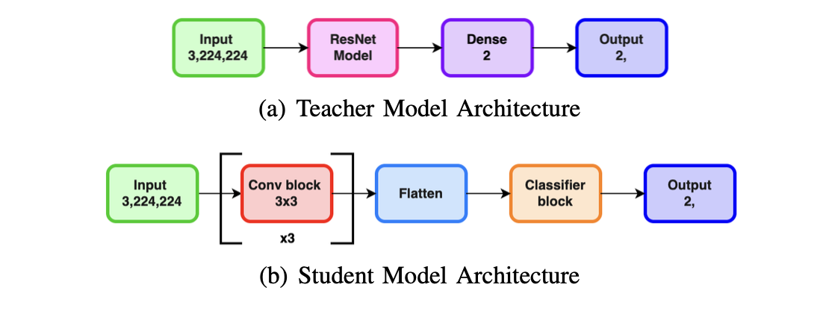
System Architecture/Mathematical Formulation
Two models, teacher and student models were designed with the following model architectures.
Camera Obstruction Detection

Slide 12
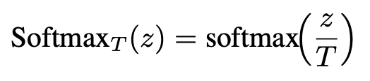


System Architecture/Mathematical Formulation
The KL divergence based knowledge distillation was done on these proposed models. The KL divergence loss was found out and added to the cross entropy loss function.
Camera Obstruction Detection

Slide 13
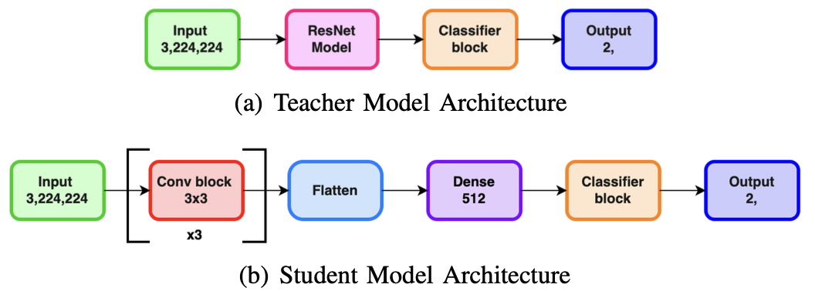
System Architecture/Mathematical Formulation
In Order to implement feature based knowledge distillation the models were altered to give identical intermediate feature outputs.
Camera Obstruction Detection

Slide 14
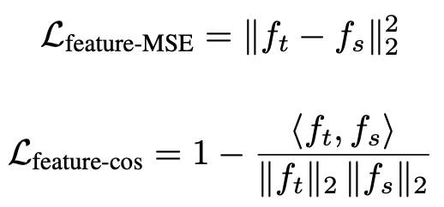

System Architecture/Mathematical Formulation
Three types of loss functions, MSE, Cosine Similarity and Combined which is combination of both them, were used to implement feature based knowledge distillation
Camera Obstruction Detection

Slide 15
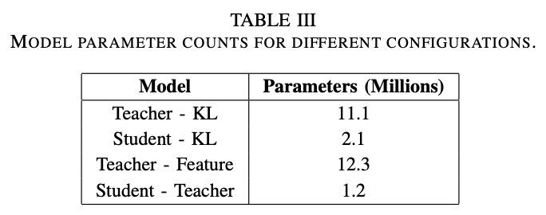
System Architecture/Mathematical Formulation
Comparison of number of parameters in the student and teacher model
Camera Obstruction Detection

Slide 16
System Architecture/Mathematical Formulation
The KL divergence model has 2 hyperparameters which are T and alpha while the feature based models have one that is alpha except for the combined model which has an additional hyperparameter beta.
Further we tested on multiple different combinations of these hyperparameters using cross validation and found out the best performing combination.
Then for testing on edge devices we converted the model to onnx format and ran it on the raspberry pi.
Camera Obstruction Detection

Slide 17
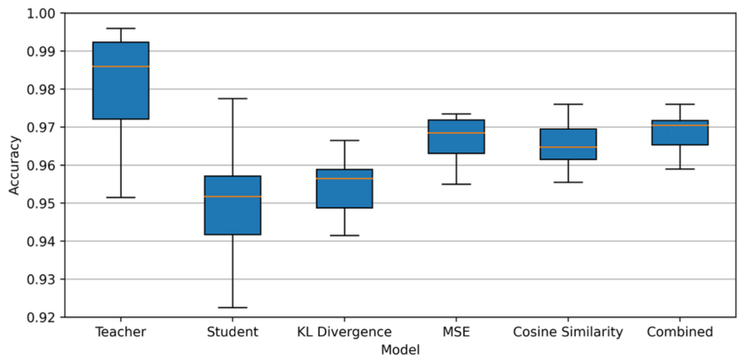
Key Results
Box plot showing accuracy values for all 10 runs of cross validation
Camera Obstruction Detection

Slide 18
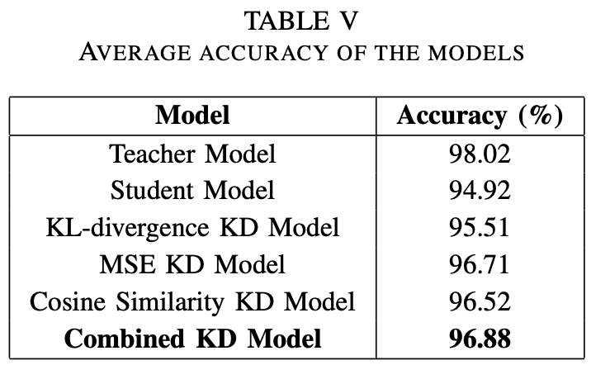
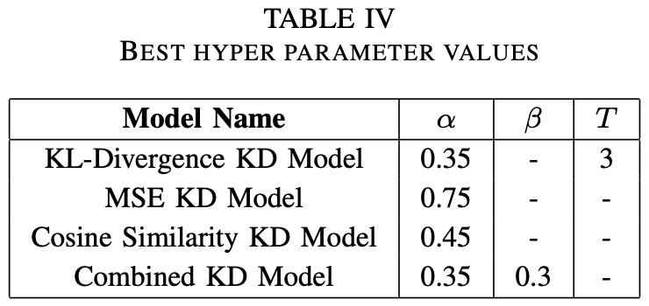
Key Results
Tables showing best hyper parameter values and the average accuracies of all the models
Camera Obstruction Detection

Slide 19
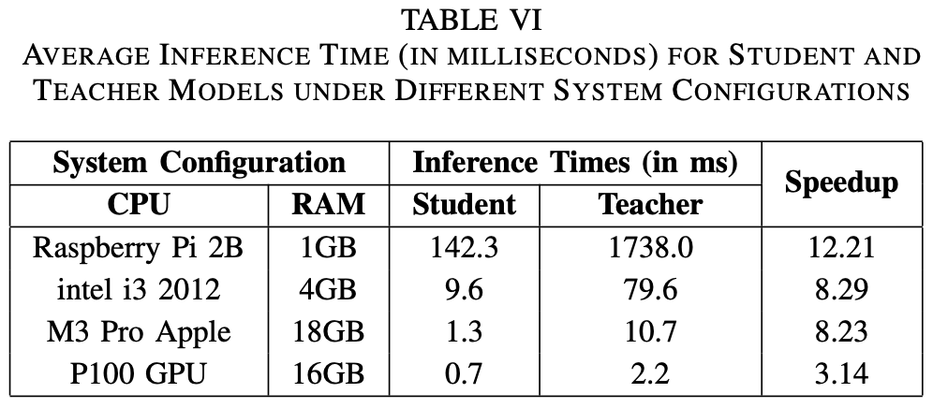
Key Results
Table showing inference time comparisons of the teacher and student model
Camera Obstruction Detection

Slide 20
Discussion
The MSE loss accounts for the magnitude of the feature vector and the cosine similarity loss accounts for the direction of the feature vector in the feature space thus combined loss function gives higher accuracy.
The student model achieved 142.3 ms inference time, with 12.21× speedup and 10.25× model size reduction.
Camera Obstruction Detection

Slide 21
Conclusion and Future Work
A new dataset of 14,000 CCTV images was introduced, classified into Blocked and Normal categories.
Future work will focus on expanding the dataset, improving robustness under diverse conditions.
Combined MSE and cosine similarity loss model achieved the best accuracy of 96.88% after optimization with the small model thus suitable for deployment on low resource systems.
Other model compression techniques like quantization can be implemented on the models.
Camera Obstruction Detection

Slide 22
Thank You
Thank You!
Questions and discussion are welcome.
emmanuel22bcs104@iiitkottayam.ac.in
Camera Obstruction Detection

