Slide 1
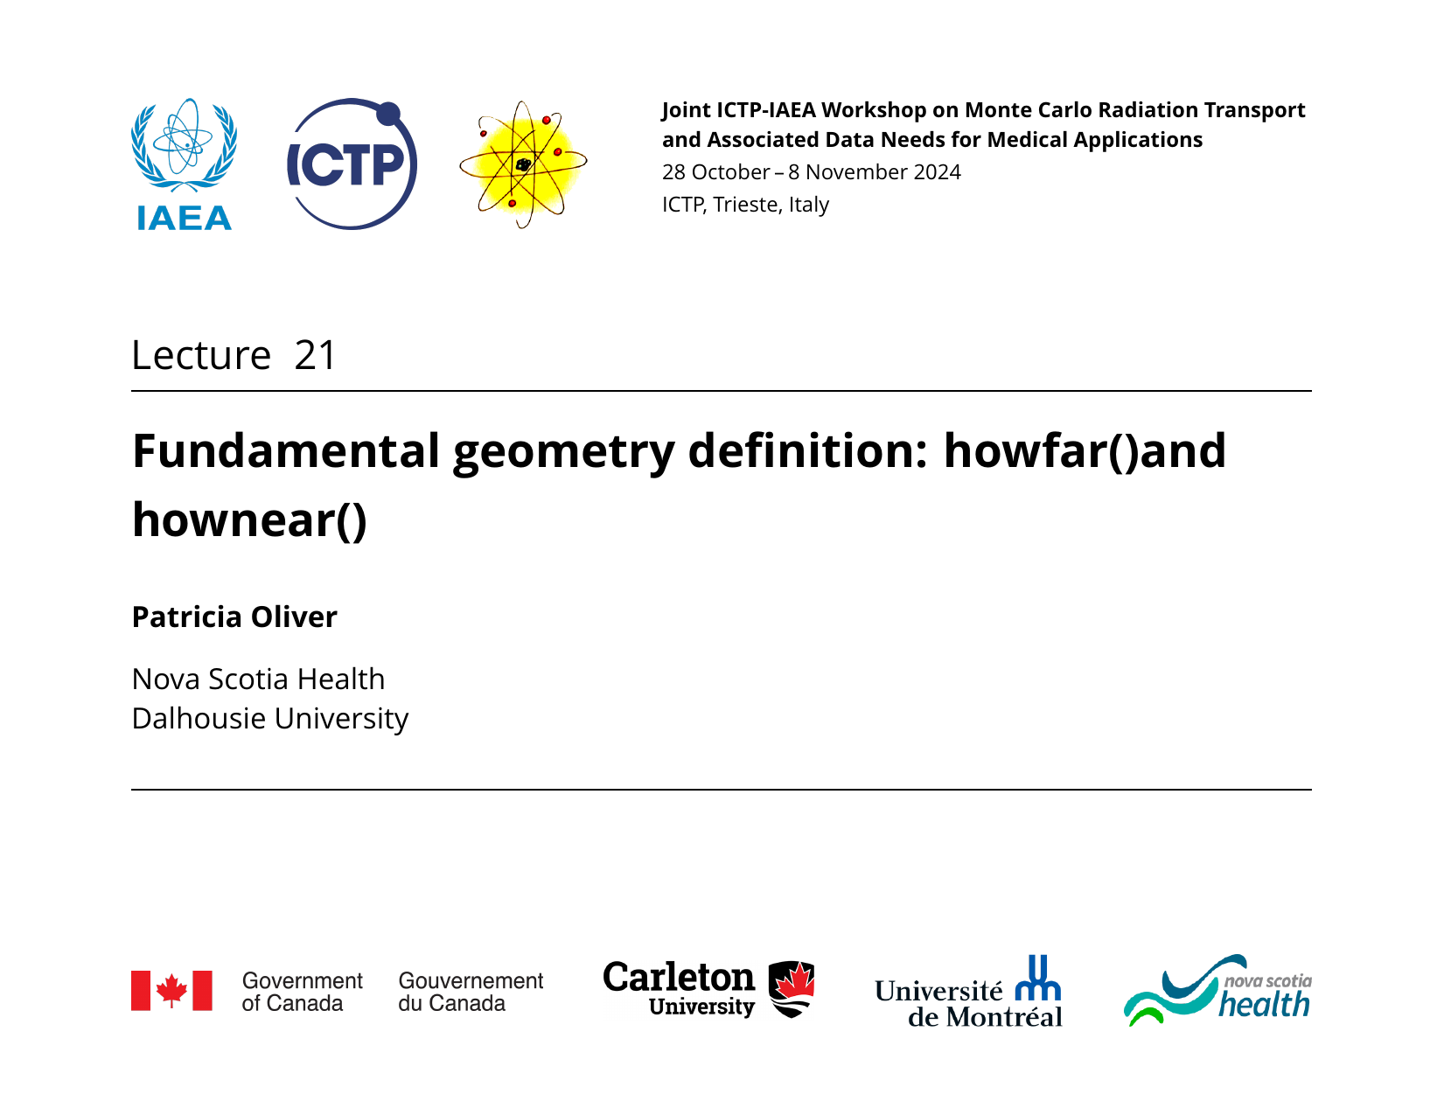
(This talk is based on slides from Frédéric Tessier)

Slide 2
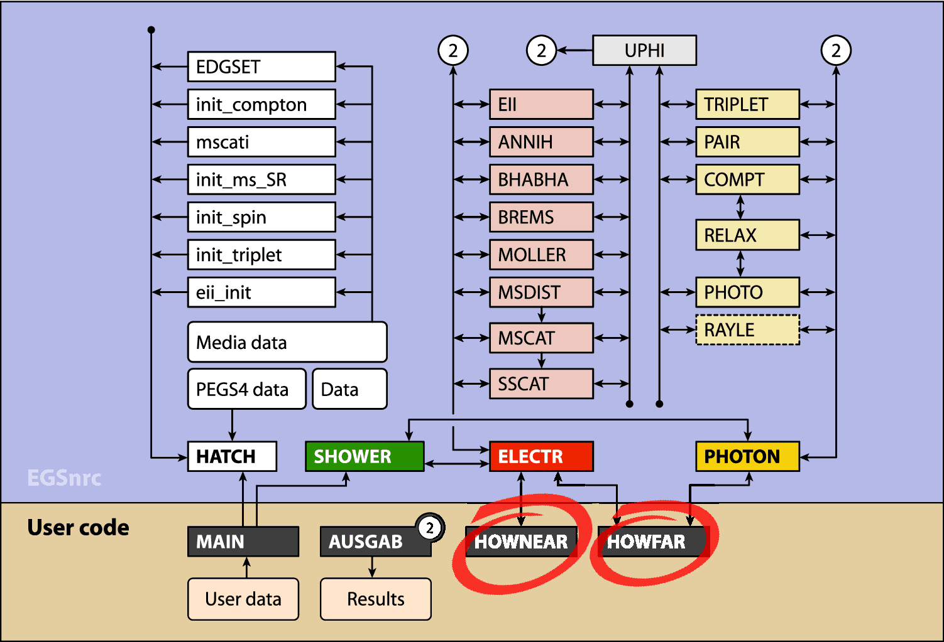
howfar()and hownear()are part of the geometry
Decoupling of physics and geometry
EGSnrc only concerns itself with transport of particles in infinite media.
EGSnrc only needs to know the composition of the medium that the particles are being transported in
User code handles geometry

Slide 3
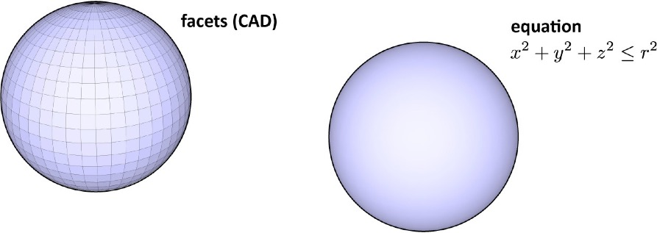
howfar()defines your geometry
Called by ELECTR and PHOTON EGSnrc subroutines before a particle step.
Inputs to howfar(): region number, particle position, particle direction and USTEP
USTEP is the straight-line distance over which EGSnrc wants to transport the particle (if there were no geometrical boundaries).
USTEP is based on the physics of radiation transport in infinite media (e.g., based on attenuation coefficients for photons) plus any other step-size constraints that the user may specify (e.g., ESTEPE, the max fractional energy loss per charged particle step)
EGSnrc relies on a functional representation of geometry to determine whether a boundary will be crossed.

Slide 4
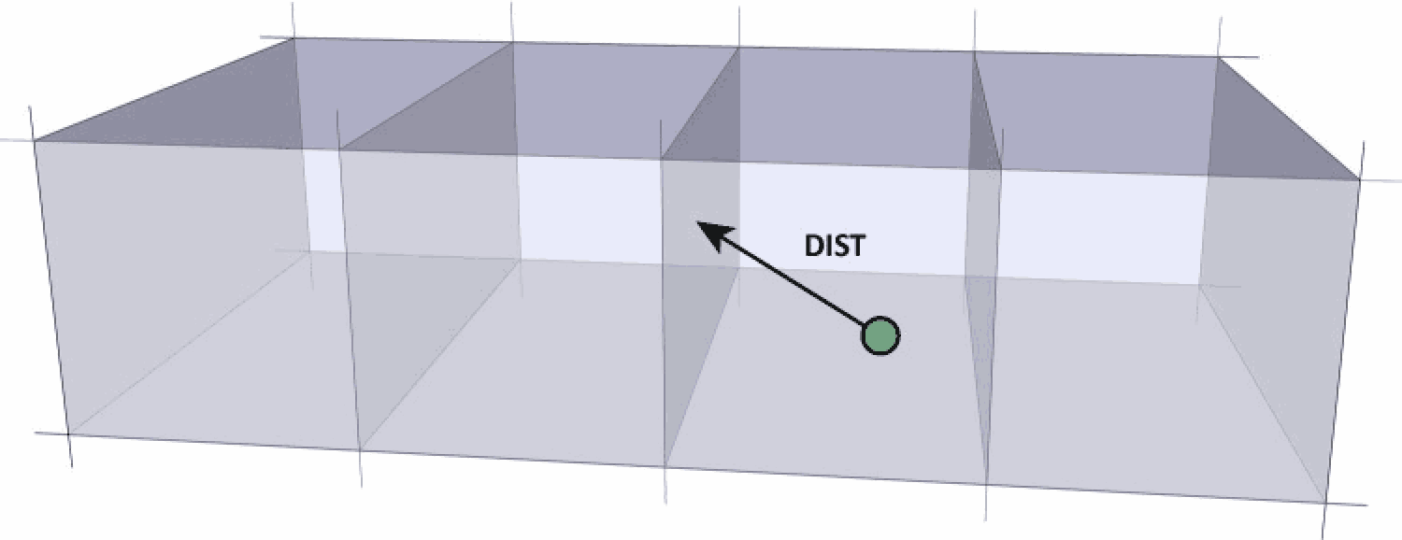
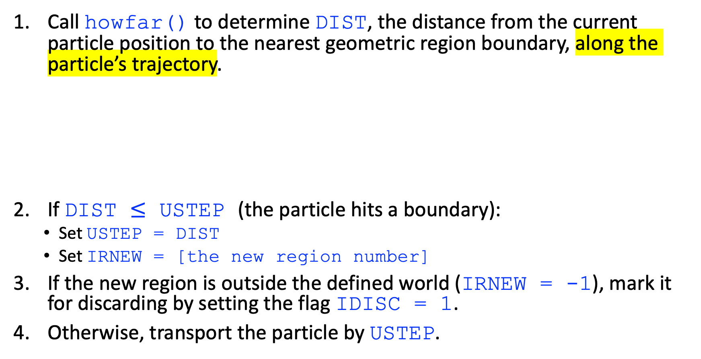
howfar()calculates distance
Call howfar() to determine DIST, the distance from the current particle position to the nearest geometric region boundary, along the particle’s trajectory.
If DIST $≤$ USTEP (the particle hits a boundary):
Set USTEP = DIST
Set IRNEW = [the new region number]
If the new region is outside the defined world (IRNEW = -1), mark it for discarding by setting the flag IDISC = 1.
Otherwise, transport the particle by USTEP.
i.e., shorten the step so that the particle arrives exactly at the boundary

Slide 5
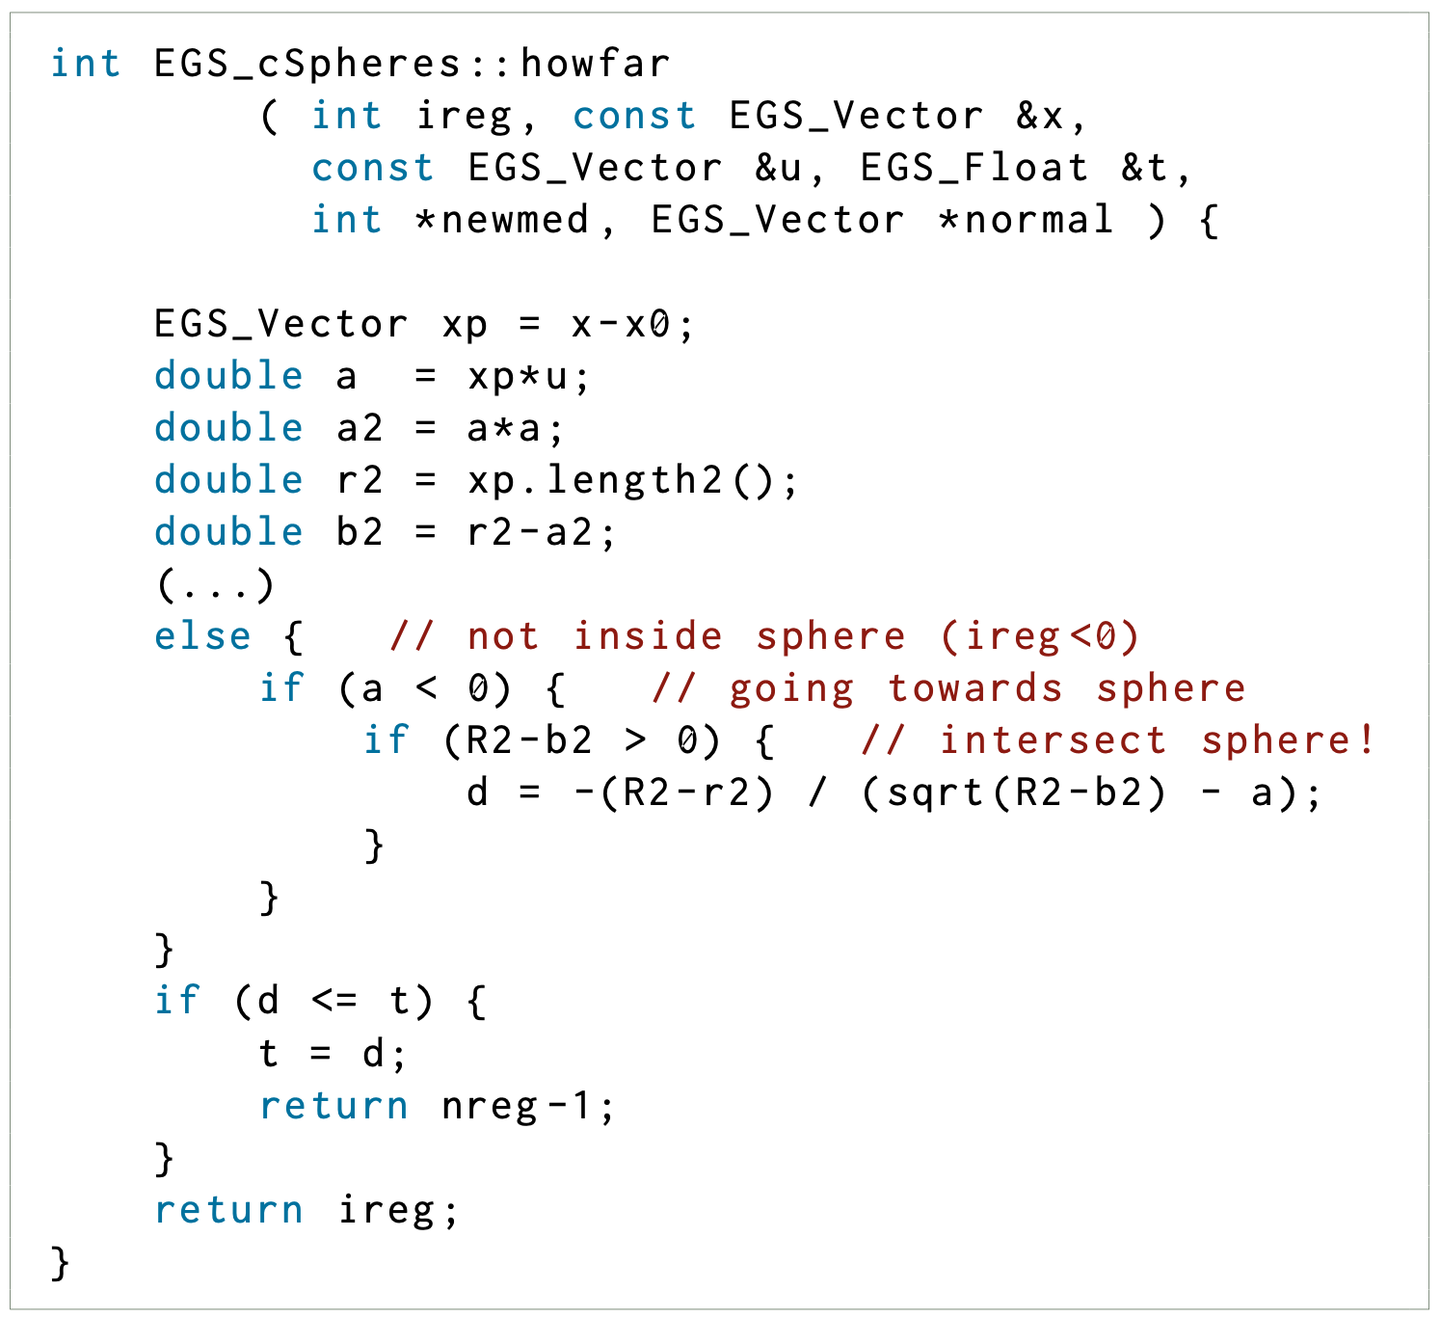
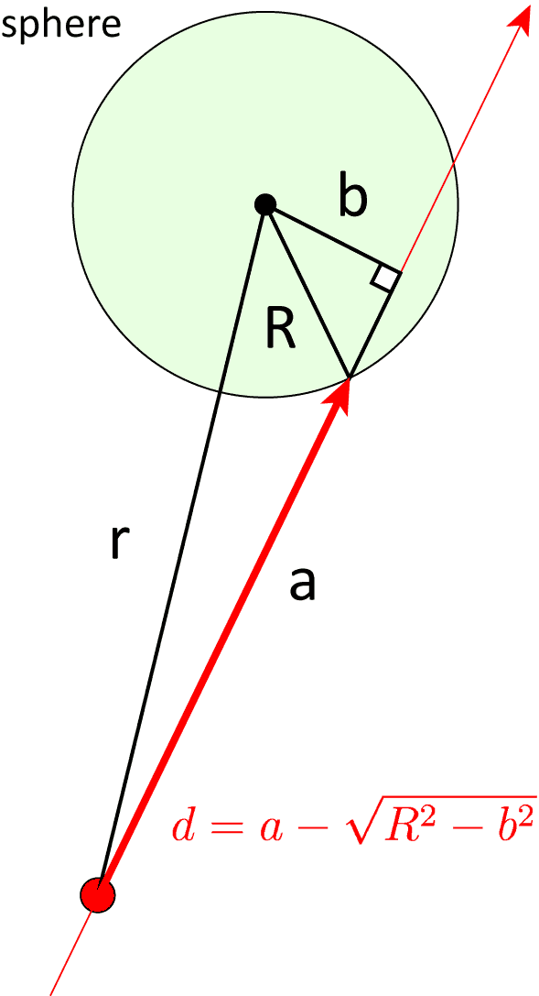

Example: sphere howfar()
region 0
x₀
// xp points from x0 to x (pointing down in the diagram)
// u is a unit vector along the particle’s trajectory (pointing up)
region -1 (outside sphere)
-a - sqrt(R2-b2);
(length of x_{p} = x – x₀)
// DIST $≤$ USTEP
// region corresponding to inside sphere
(d is just the bold red portion)
x

Slide 6
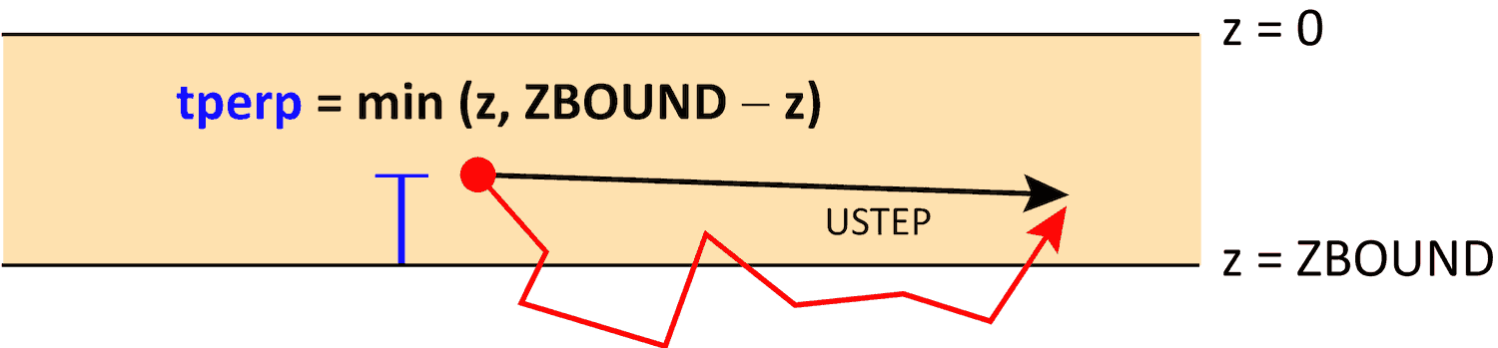
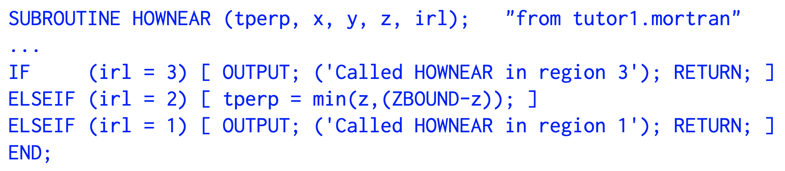
hownear() is needed for electron transport
The hownear() method computes the closest distance tperp to any surface in the geometry, from the current location of the particle, in any direction.
When an electron takes a step close to a boundary, it is necessary to turn off multiple scattering to model the electron trajectory faithfully.
region 1
If not handled properly, condensed history steps near an interface can lead to incorrect dose in both regions, and incorrect particle transport (if the two media differ).
region 2
cond. hist. step
ZBOUND – z
region 3
actual trajectory
Notes:
Relevant transport parameter: skin depth for BCA, which determines the distance from a boundary (in elastic MFP) at which the algorithm will go into single scattering mode

Slide 7
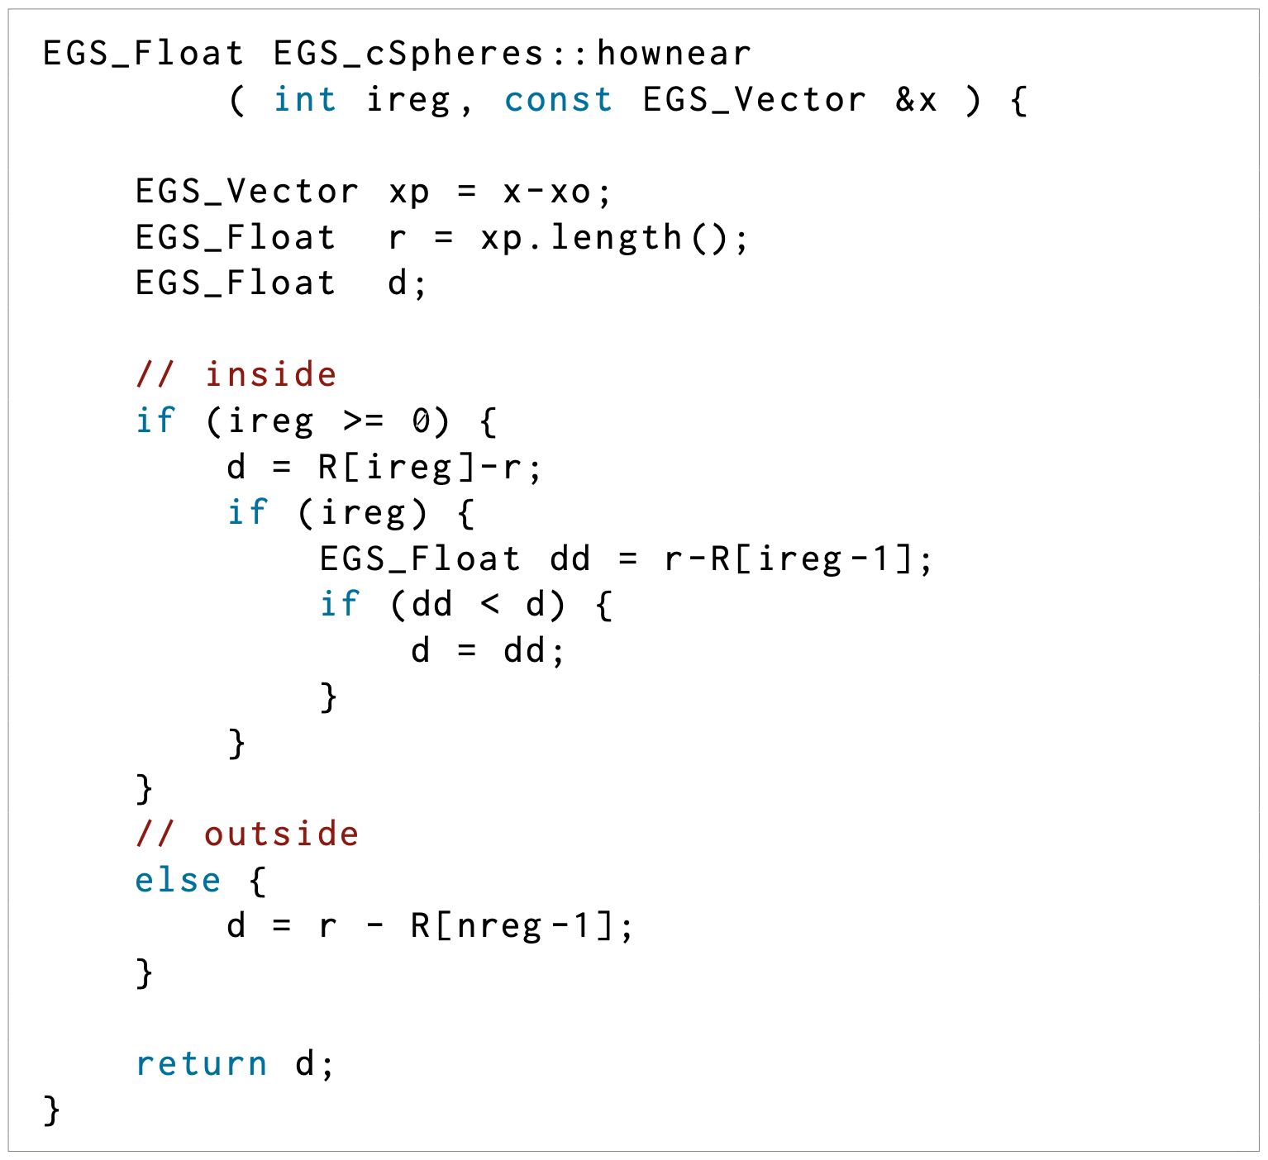
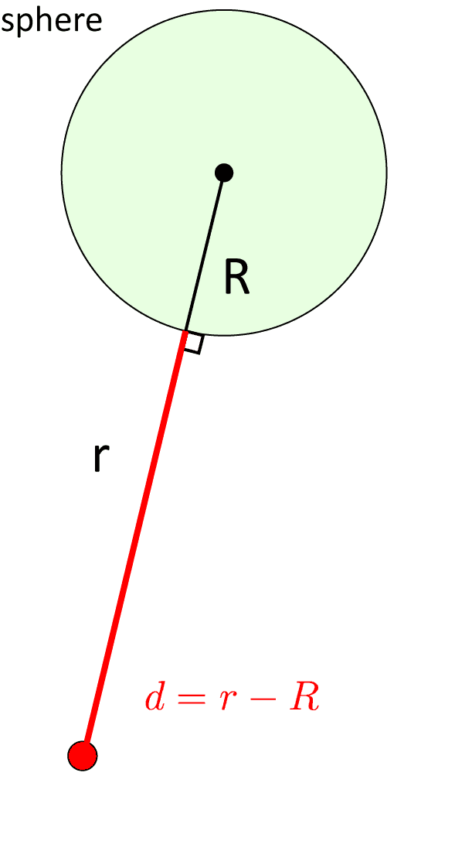
Example: sphere hownear()
// a set of concentric spheres…
region 0
x₀
// d > 0 because we are inside a sphere
// if it’s a set of concentric spheres
region -1 (outside sphere)
// dd > 0 because we are in the shell
// take the smallest distance
(length of x_{p} = x – x₀)
x
Notes:
region numbers increase from inside to outside

Slide 8
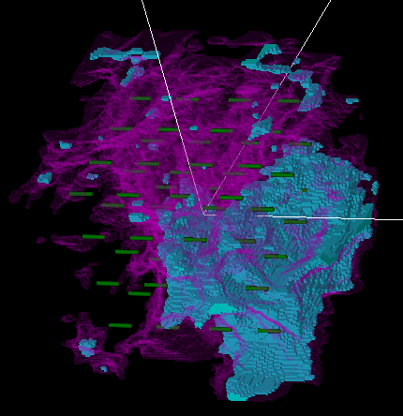
What about complex geometries?
Elementary geometries can be combined to form composite geometries. Simulations will be slower if howfar() has to navigate through a complex hierarchy of geometries.
Example from egs_brachy manual: breast LDR simulation with voxelized tissue geometry and 64 seeds

Slide 9
Boundary crossing
EGSnrc applications typically do not impose “fuzzy" boundaries to ensure that particles cross region boundaries (but BEAMnrc does!):
The particle is placed exactly at the boundary (i.e., USTEP = DIST)
This can lead to rounding errors due to the finite precision of floating point numbers
Position of particle is in conflict with region number
Errors in howfar() typically show up as negative USTEP errors.
Fuzzy boundaries in BEAMnrc: particle is “pushed” an additional small distance to avoid rounding errors

Slide 10
Floating point rounding errors
Example:
Particle is in region 1 and is directed toward region 2
howfar() is called with USTEP large enough to escape region 1
USTEP = DIST and the particle is at the interface between regions 1 and 2
The current region is updated: IRNEW = 2
Consider the case where rounding errors result in an undershoot
The particle’s region number is 2 but its position corresponds to region 1!
region 1
region 2
2
1

Slide 11
Floating point rounding errors
In general, if there is a contradiction between the particle’s region number and (x, y, z) position:
Case #1: If the particle is still headed in the direction of the surface, then this surface is ignored, as if the particle had already crossed.
region 1
region 2
2
3
1

Slide 12
Floating point rounding errors
In general, if there is a contradiction between the particle’s region number and (x, y, z) position:
Case #2: If the particle is headed away from the surface, then howfar() will return a small negative number for USTEP
To resolve this, USTEP is set to zero, and the surface is assumed to be crossed again:
IRNEW = 2 → 1
On the next step, the particle may continue its backscatter trajectory in region 1
Position and region number are no longer in conflict
region 1
region 2
2,3
1
4

Slide 13
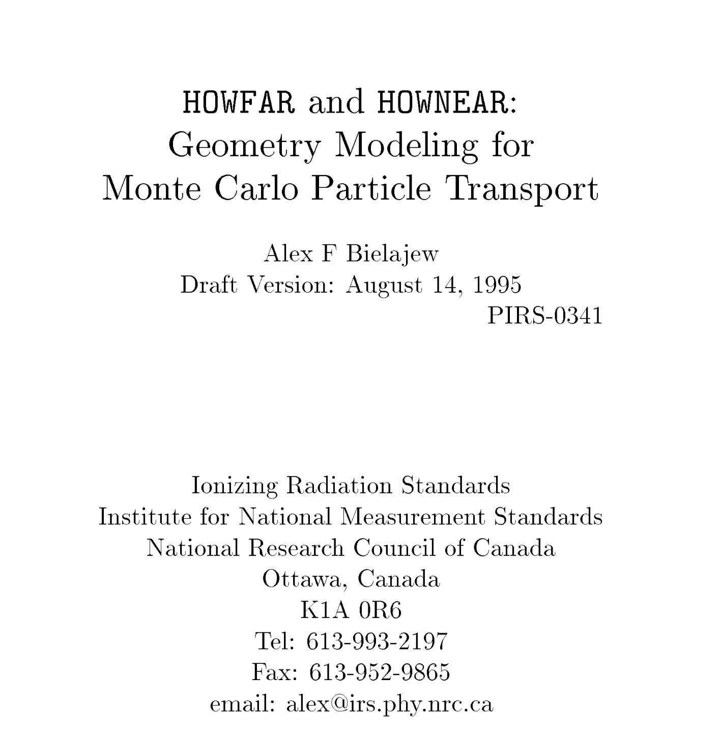
Where to learn more

