Slide 1


Slide 2
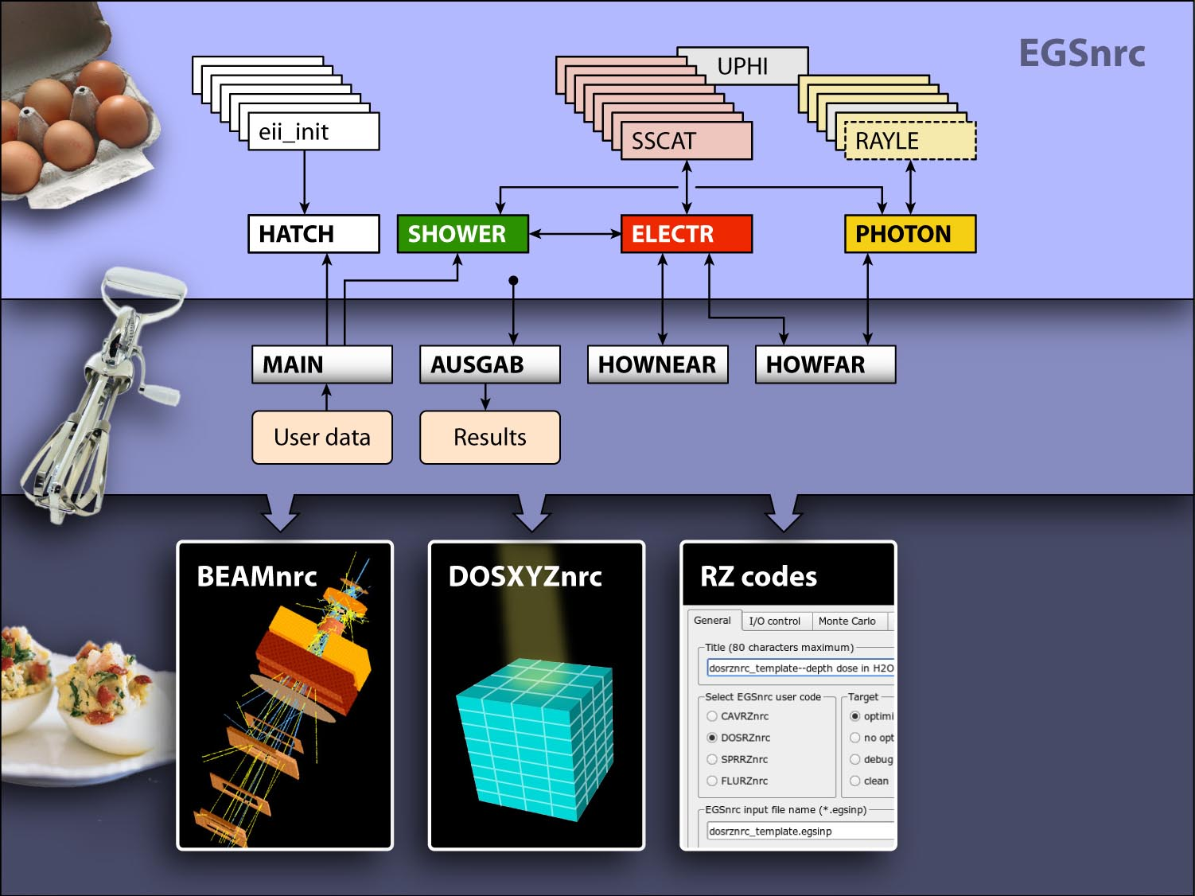


Slide 3
BEAMnrc models a stack of component modules (CM)
CM 1
CM 2
CM 3
CM 4
CM 5
CM 6
CM 7
z

Slide 4
BEAMnrc models a stack of component modules (CM)
CM 1
CM 2
Zmin for CM 3
default medium
CM 3
CM 4
CM 5
CM 6
CM 7
z

Slide 5
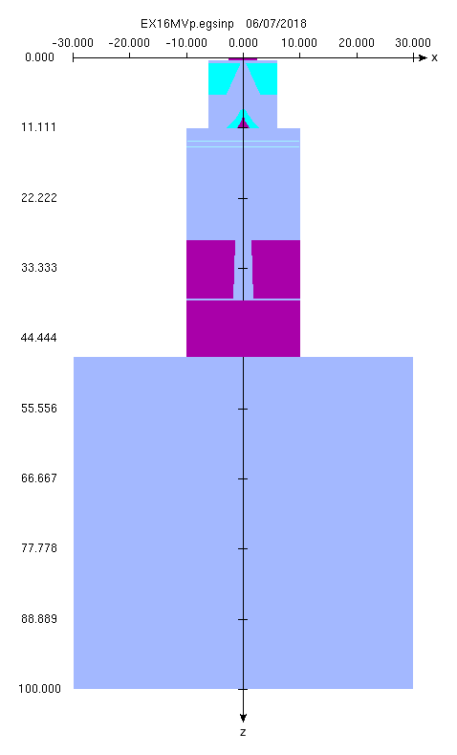
Each component module has a type and a name
CM 1: SLABS “target”
CM 2: CONS3R “primcoll”
CM 3: FLATFILT “flattenf”
CM 4: CHAMBER “chamber”
CM 5: MIRROR “mirror”
CM 6: JAWS “secjaws”
CM 7: SLABS “airslab”
Rmax for CM 7

Slide 6
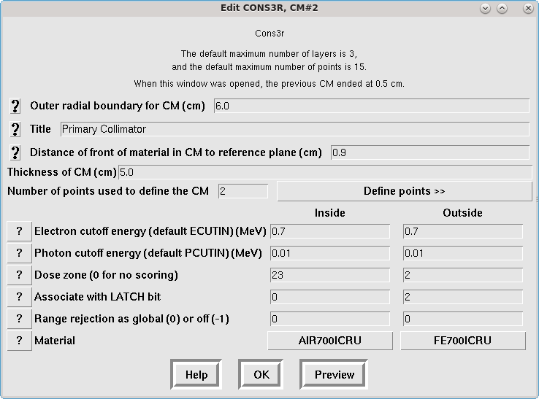
Edit CM parameters with beamnrc_gui
CM 1: SLABS “target”
CM 2: CONS3R “primcoll”
CM 3: FLATFILT “flattenf”
CM 4: CHAMBER “chamber”
CM 5: MIRROR “mirror”
CM 6: JAWS “secjaws”
CM 7: SLABS “airslab”
Rmax for CM 7

Slide 7
Edit CM parameters with beamnrc_gui
CM 1: SLABS “target”
CM 2: CONS3R “primcoll”
CM 3: FLATFILT “flattenf”
CM 4: CHAMBER “chamber”
CM 5: MIRROR “mirror”
CM 6: JAWS “secjaws”
CM 7: SLABS “airslab”
Rmax for CM 7

Slide 8
Define the accelerator in a .module text file
Create text file $EGS_HOME/beamnrc/spec_modules/mylinac.module This file specifies what component modules you want inside your accelerator, and their names. For example:
Run beam_build.exe mylinac (no extension) This program collects the source code for your accelerator inside a new application directory $EGS_HOME/BEAM_mylinac/
Launch beamnrc_gui and load your accelerator This program is a Tcl/Tk graphical user interface to visualize an accelerator and edit all the simulation parameters.
CM names: SLABS CONS3R JAWS SLABS
Identifiers: mytarget mycollim myjaws myair

Slide 9
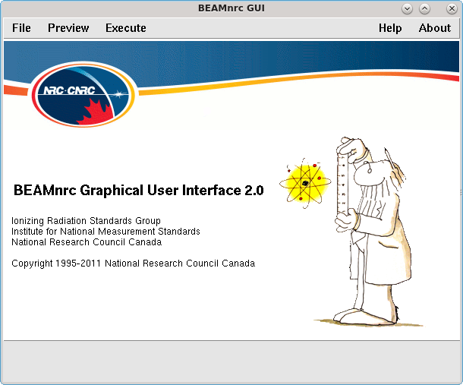
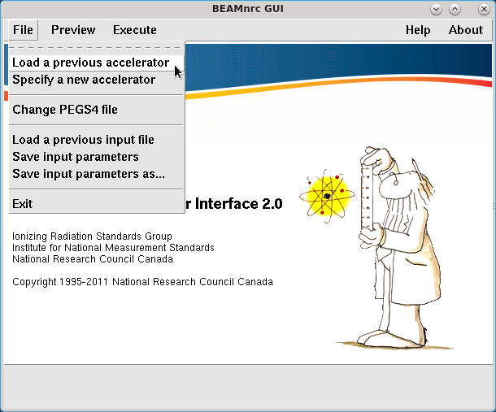
Edit your BEAMnrc input file with beamnrc_gui

Slide 10
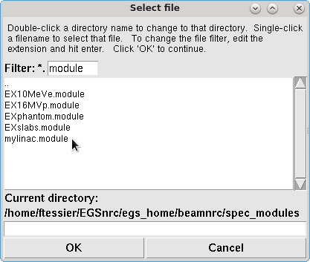
Edit your BEAMnrc input file with beamnrc_gui

Slide 11
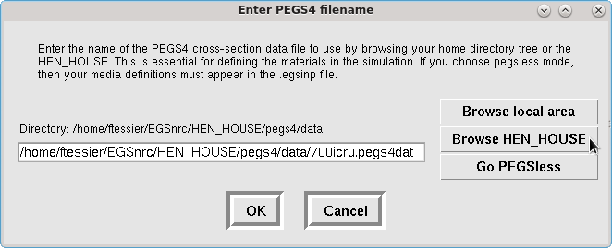
Edit your BEAMnrc input file with beamnrc_gui

Slide 12
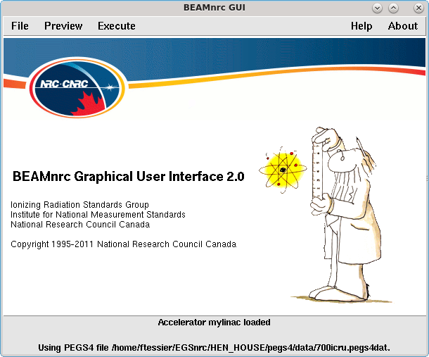
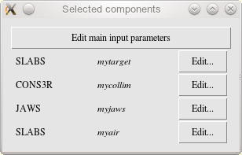
Edit your BEAMnrc input file with beamnrc_gui

Slide 13
BEAMnrc scoring concepts
Dose zone: A collection of geometrical regions for which dose is reported as a whole at the end of the simulation. You define which geometrical regions are associated to each doze zone in the CM inputs.
Scoring plane: A plane positioned below any CM to: a) calculate number, fluence, average energy and angle, in user-defined planar scoring zone; and b) save all particles reaching the plane to a phase space file.
Latch bits: The latch variable is a bit field travelling with a particle to keep track where the particle and its ancestors have been, or where they have interacted.

Slide 14
1. Dose zone
Somewhere in the CM input, for each geometrical region, there is a dose zone input:
CM 1
Suppose I set the dose zone to 12 for all 4 jaw regions in this diagram.
Then BEAMnrc will output a dose summary for the dose zone 12, which will give the dose deposited in all 4 regions, as a whole.
(Dose zones don’t have to be assigned.)
CM 2
12
12
CM 3
CM 4
12
12

Slide 15
2. Scoring plane: a) analyze fluence
You can define up to 3 scoring planes, located at the bottom of any CM. The properties of particles reaching a scoring plane are “recorded”.
CM 1
CM 2
CM 3
scoring plane 1 (CM 3)
CM 4
CM 5
scoring plane 2 (CM 5)
CM 6
CM 7
scoring plane 3 (CM7)
z

Slide 16
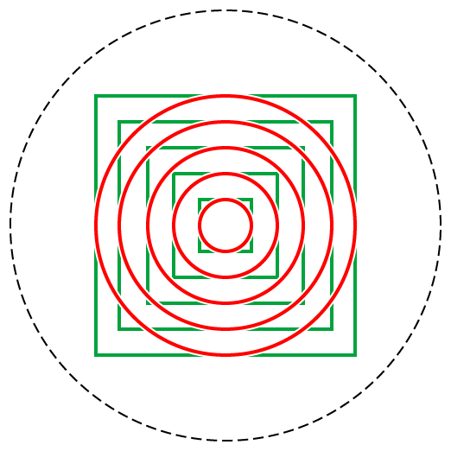
2. Scoring plane: a) analyze fluence
CM 1
Each scoring plane can be further divided in radial or square scoring zones.
CM 2
BEAMnrc reports number, fluence, average energy and angle for each scoring zone.
CM 3
1
CM 4
CM 5
2
CM 6
CM 7
3
z

Slide 17
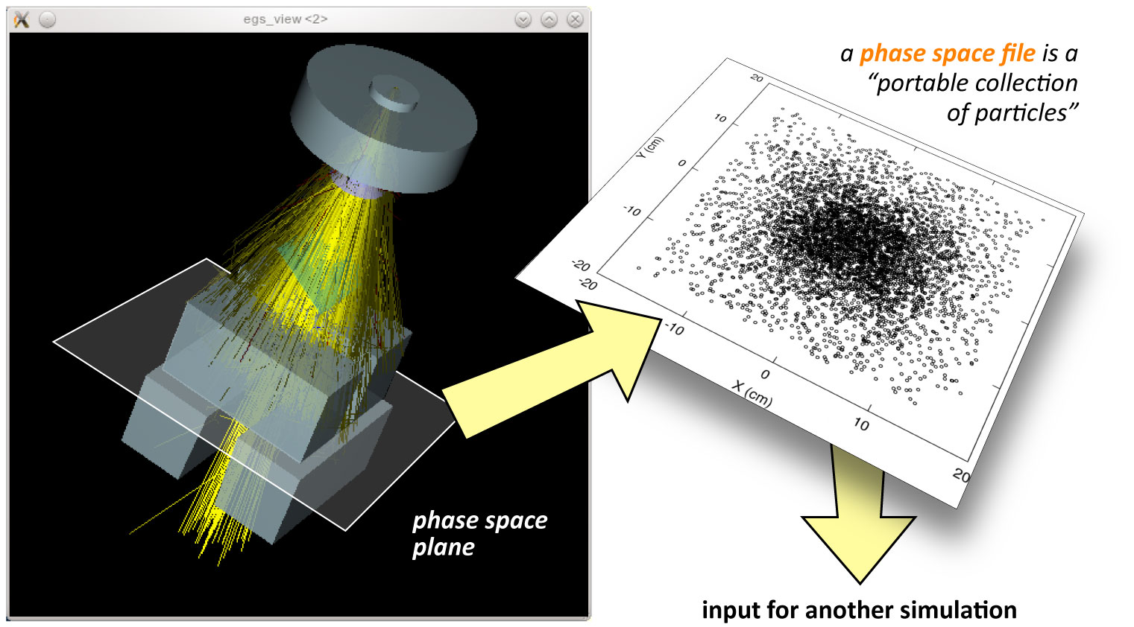
2. Scoring plane: b) save particles to file
Scoring plane

Slide 18
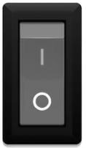
3. “Latch” but not least: latch bits
If you can operate a light switch, you understand latch! The latch variable is a set of 32 bits that particles carry around with them. We care about bits 1–23.
When you design a component module, you can associate any geometrical region with any given latch bit:
region 53
regions 2, 42, 13, 9
default
1
2
3
4
5
6
7
8
9
10
11
12
13
14
15
16
17
18
19
20
21
22
23

Slide 19

3. “Latch” but not least: latch bits
If you can operate a light switch, you understand latch! The latch variable is a set of 32 bits that particles carry around with them. We care about bits 1–23.
When you design a component module, you can associate any geometrical region with any given latch bit:
region 53
regions 2, 42, 13, 9
default
1
2
3
4
5
6
7
8
9
10
11
12
13
14
15
16
17
18
19
20
21
22
23
particle passes in region 53

Slide 20

3. “Latch” but not least: latch bits
If you can operate a light switch, you understand latch! The latch variable is a set of 32 bits that particles carry around with them. We care about bits 1–23.
When you design a component module, you can associate any geometrical region with any given latch bit:
region 53
regions 2, 42, 13, 9
default
1
2
3
4
5
6
7
8
9
10
11
12
13
14
15
16
17
18
19
20
21
22
23
particle passes in region 53
particle passes in region 2 or 42 or 13 or 9

Slide 21
3. “Latch” but not least: latch bits
If you can operate a light switch, you understand latch! The latch variable is a set of 32 bits that particles carry around with them. We care about bits 1–23.
When you design a component module, you can associate any geometrical region with any given latch bit:
region 53
regions 2, 42, 13, 9
default
1
2
3
4
5
6
7
8
9
10
11
12
13
14
15
16
17
18
19
20
21
22
23
particle passes in region 53
particle passes in region 2 or 42 or 13 or 9
likely
If the particle passes through any region associated with a latch bit, this bit is turned on (set to 1). This is a bit filter for dose components and analysis!

Slide 22
3. “Latch” but not least: latch inheritance
latch bits
latch bit associations (not region numbers!)
1
...
2
3
4
5
6

Slide 23
3. “Latch” but not least: latch inheritance
latch bit associations (not region numbers!)
1
...
2
3
4
5
6

Slide 24
3. “Latch” but not least: latch inheritance
latch bit associations (not region numbers!)
1
2
3
4
...
5
6

Slide 25
3. “Latch” but not least: latch inheritance
latch bit associations (not region numbers!)
1
non-inherited latch: bits are set by passage, and no latch information is passed on to secondaries.
2
3
4
secondary
5
6
...
...

Slide 26
3. “Latch” but not least: latch inheritance
latch bit associations (not region numbers!)
1
non-inherited latch: bits are set by passage, and no latch information is passed on to secondaries.
inherited latch, by passage:
bits are set by passage, and latch is copied to newly created secondary particles.
2
3
4
secondary
5
6
...
...

Slide 27
3. “Latch” but not least: latch inheritance
latch bit associations (not region numbers!)
1
non-inherited latch: bits are set by passage, no latch information is passed on to secondaries.
inherited latch, by passage:
bits are set by passage, and latch is copied to newly created secondary particles.
inherited latch, by interaction:
for photons, a bit is only set if the photon interacts in the associated region(s).
2
3
4
5
6
secondary photon
...

Slide 28
Edit your BEAMnrc input file with beamnrc_gui

Slide 29
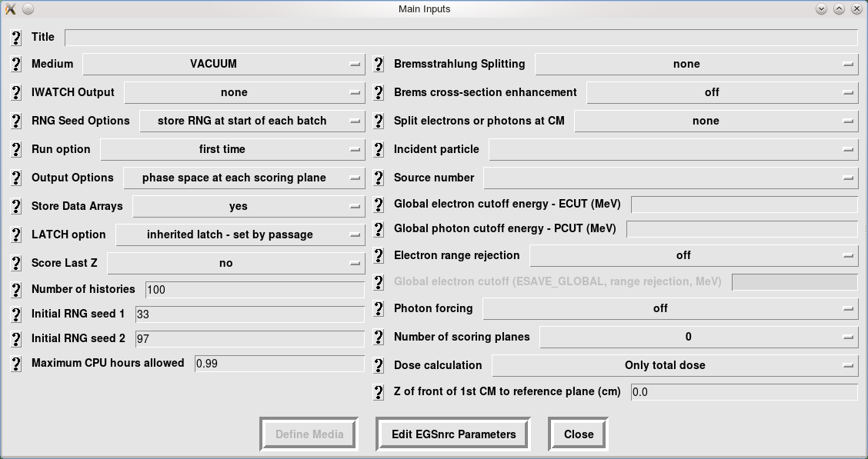

BEAMnrc main inputs: everything except geometry
Help!

Slide 30
BEAMnrc main inputs: the “easy” ones

Slide 31
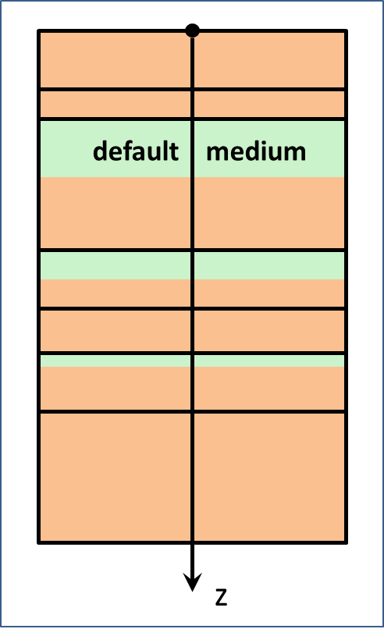
Default medium

Slide 32
Number of histories and seeds
NCASE

Slide 33


Number of histories and seeds
Remember: using the same seeds will run exactly the same simulation (on the same hardware)
NCASE

Slide 34
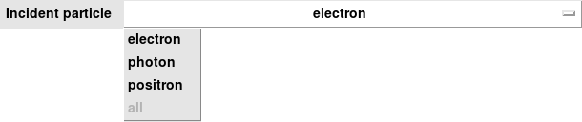
Source particle can be electron, photon or positron

Slide 35
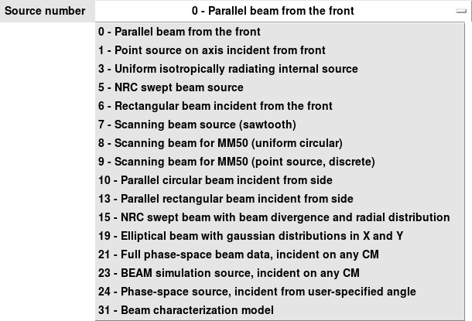
BEAMnrc offers 16 different source types

Slide 36
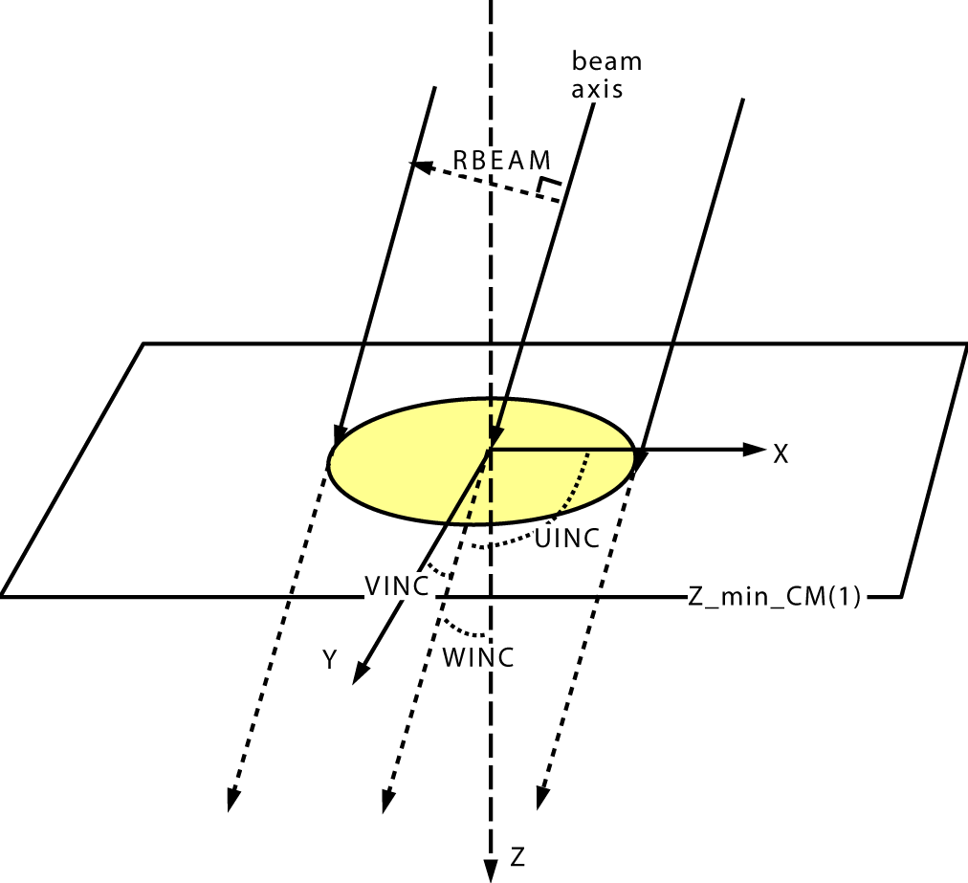
Example: source 0, parallel beam from the front
See the BEAMnrc manual for the precise meaning
of the inputs

Slide 37
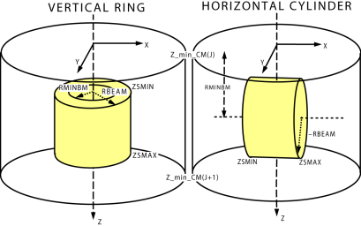
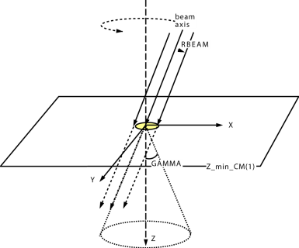
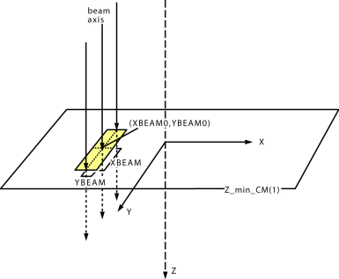
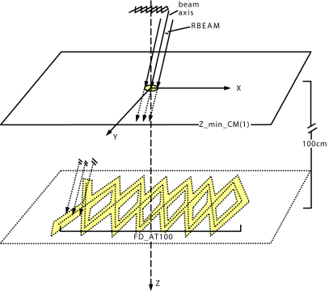
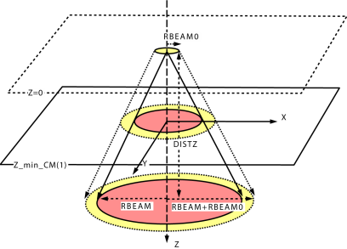
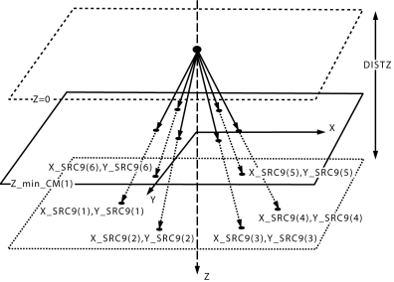
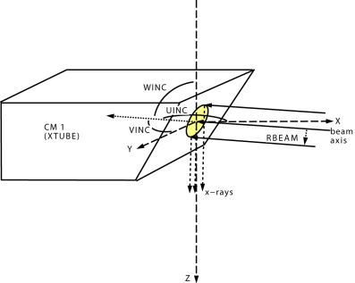
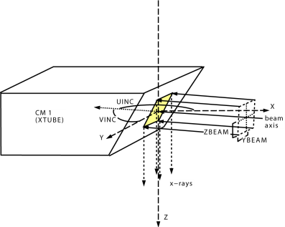
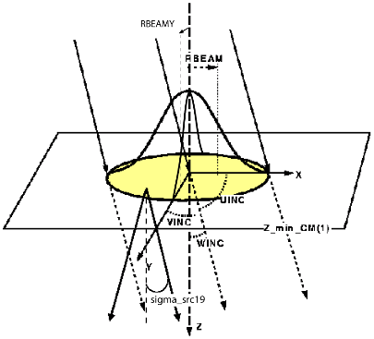
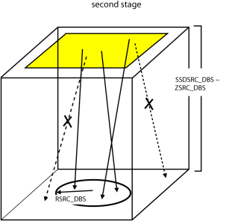
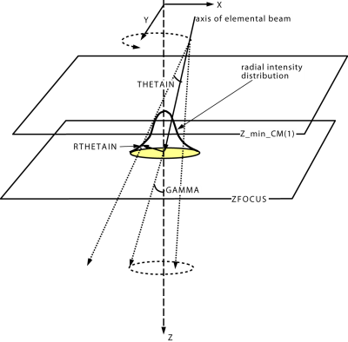
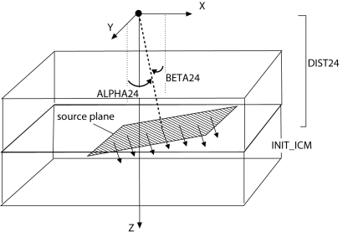
Sources will be discussed in the next lecture

Slide 38
Default ECUT and PCUT

Slide 39
Default ECUT and PCUT
Global ECUT and PCUT are applied to all regions by default. Input value is in MeV.
They can be overridden (increased) in each region, via CM input parameters.
It is common in linacs to have larger cutoff values because we care about what reaches the bottom of the linac.
For example, ECUT = 0.700 PCUT = 0.189 is a common choice (this is why there is a 700icru pegs data set!)

Slide 40
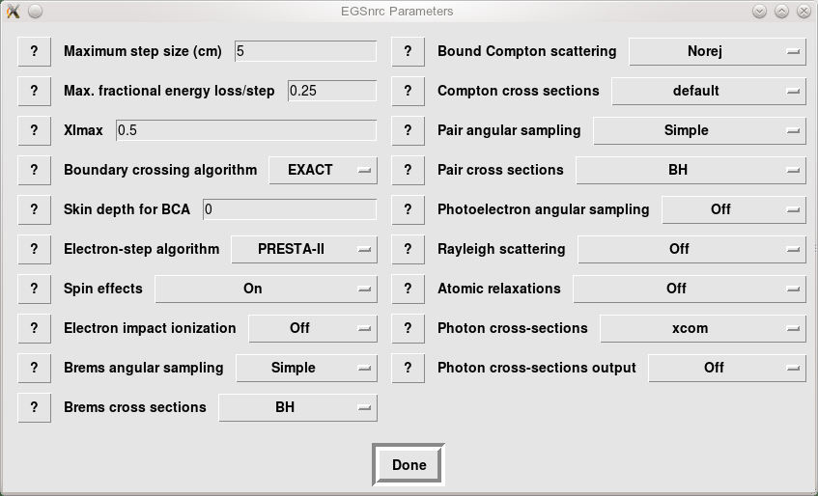
EGSnrc parameters discussed in previous lectures

Slide 41
BEAMnrc main inputs: VRTs discussed in other lecture

Slide 42
BEAMnrc main inputs: scoring and output

Slide 43
BEAMnrc main inputs: scoring planes
CM 1
CM 2
CM 3
1
CM 4
CM 5
CM 6
CM 7
2
z

Slide 44
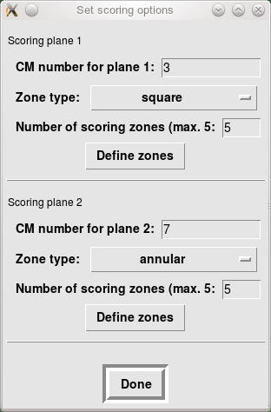
BEAMnrc main inputs: scoring planes

Slide 45
BEAMnrc main inputs: scoring planes

Slide 46
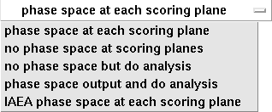
By default, phase space is stored at scoring planes
CM 1
CM 2
CM 3
1
CM 4
CM 5
CM 6
CM 7
2
IO_OPT
z

Slide 47
By default, phase space is stored at scoring planes
CM 1
CM 2
CM 3
Format | File names
EGSnrc | inputfile.egsphsp1
IAEA | inputfile.1.IAEAheader inputfile.1.IAEAphsp
1
CM 4
CM 5
CM 6
CM 7
2
IO_OPT
z

Slide 48
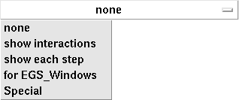
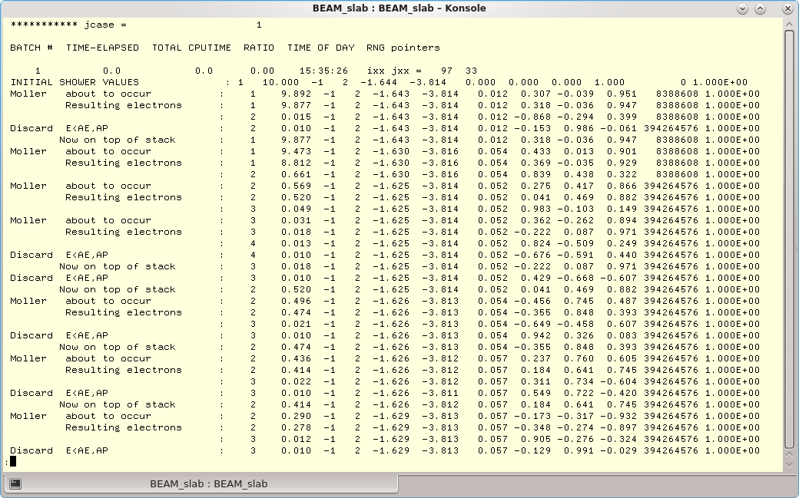
Inspect particle histories in detail with IWATCH
Output to screen or .egslog file
IWATCH

Slide 49
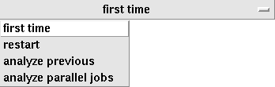
Data arrays must be stored for recovery
By default, run a fresh simulation
Recover, or run more histories
IRESTART
IDAT

Slide 50

By default, RNG seeds are stored at start of batch
BEAMnrc stores seeds periodically, to recover from crashes or improve statistics.
Storing the seeds at every history is very slow! Stored in .egsrns file

Slide 51
Data arrays must be stored for recovery
By default, run a fresh simulation
Recover, or run more histories
Combine .egsdat files from parallel runs and analyze the results
IRESTART
IDAT

Slide 52

Data arrays must be stored for recovery
By default, run a fresh simulation
Restart and analysis require:
Recover, or run more histories
Combine .egsdat files from parallel runs and analyze the results
No reason to turn this off (unless you have thousands of doze scoring zones)
IRESTART
IDAT

Slide 53

By default, LATCH bits are inherited, and by passage
latch bit associations
1
2
3
4
secondary
5
6
...
...

Slide 54
You can keep track of the last interaction position
IZLAST

Slide 55

You can keep track of the last interaction position
in phase space file!
IZLAST

Slide 56
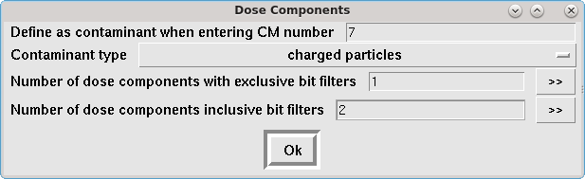


Beyond total dose: components and contaminants
As soon as a particle of this type enters the specified CM, the dose resulting from it (and descendants) is tallied under contaminant dose.
ICM_CONTAM

Slide 57
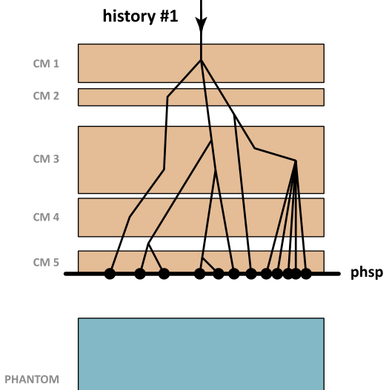
You can keep track of the last interaction position
IZLAST

Slide 58
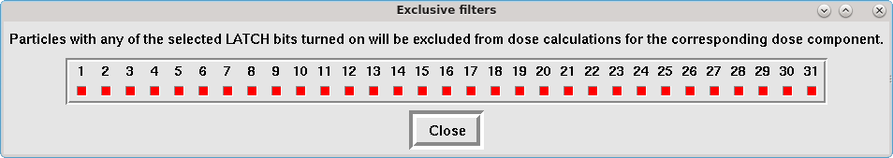
LATCH bits are particle filters for dose components
bit region where particle passed or interacted
when inherited, settings are “cumulative”
bit region number where secondary was created
contaminant

Slide 59
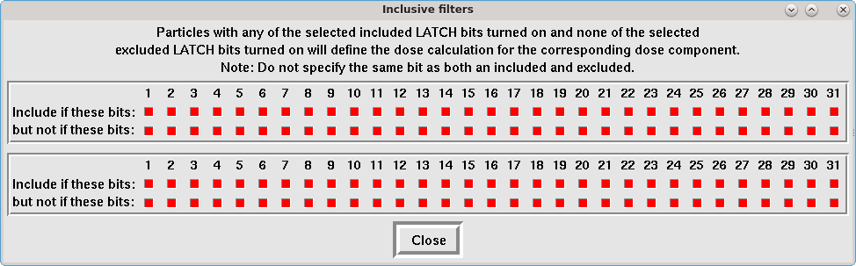
LATCH bits are particle filters for dose components
#1
#2

Slide 60
LATCH bits are particle filters for dose components
#1
bit regions are assigned during CM definition (see CM lecture)
bits 1−23 can be assigned to regions
by default regions are assigned to bit 23

Slide 61
Limits can be changed, but you have to recompile
Defined in $OMEGA_HOME/beamnrc/beamnrc_user_macros.mortran
​Copy into $EGS_HOME/BEAM_myaccel directory to change for myaccel only
Need to recompile (make) myaccel to apply changes
Macro | Description | Default
$MAX_CMs | maximum number of CMs | 24
$MXMED | maximum number of media | 12
$MXREG | maximum number of regions | 3 000
$MXSTACK | maximum number of particles on stack | 10 000
$MAXBRSPLIT | maximum brems splitting number | 2 000
$MAX_DOSE_ZONE | maximum number of dose zones | 1 500
$MAX_SC_PLANES | maximum number of scoring planes | 3
$MAX_SC_ZONES | maximum number of scoring zones | 5

Slide 62
Conclusions
BEAMnrc is installed by default as part of EGSnrc.
BEAMnrc is a well-vetted workhorse EGSnrc application builder for modelling “linear accelerators” (stacked components).
Recommendation: use beamnrc_gui to edit your input files.
BEAMnrc offers quite a complete library of linac component modules.
Compile BEAMnrc as a shared library to use as a source (make library).
BEAMnrc offers some aggressive variance reduction techniques.
You can implement your own component modules or sources, based on existing ones (in MORTRAN).

