Slide 1
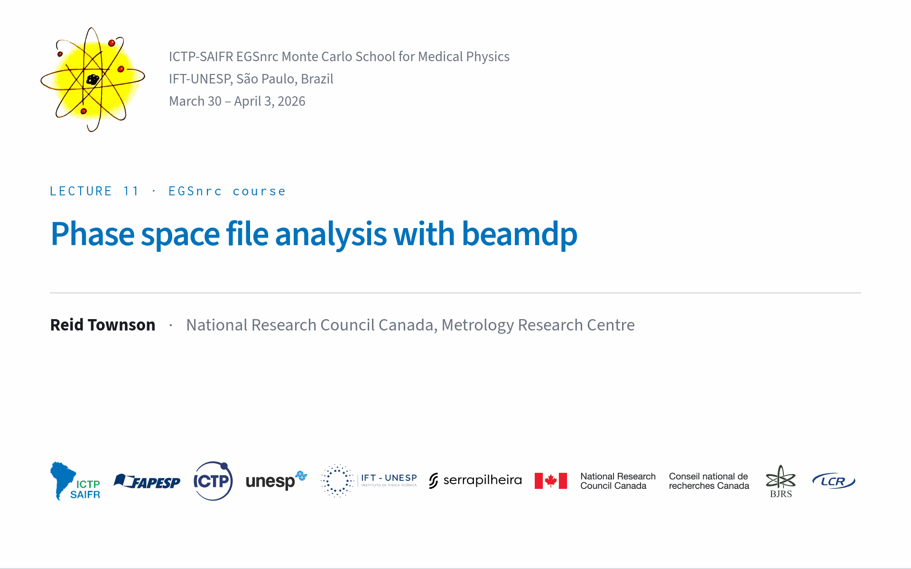

Slide 2
beamdp analyzes data stored in (2D) phase space files
fluence/inicdent particle
X
Y

Slide 3
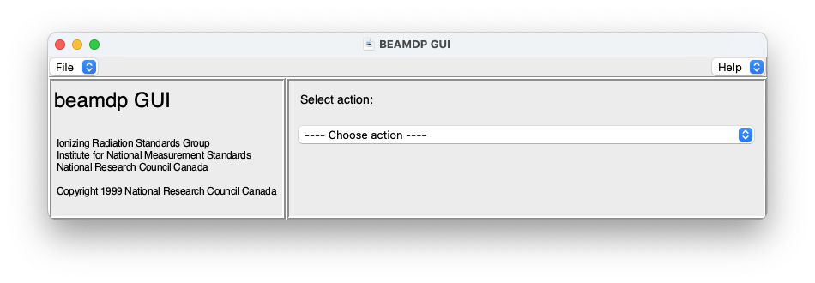
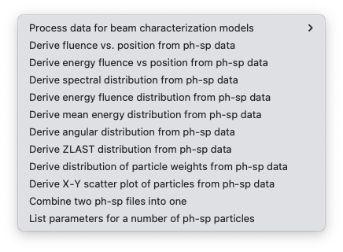
Spatial vs Spectral quantities

Slide 4
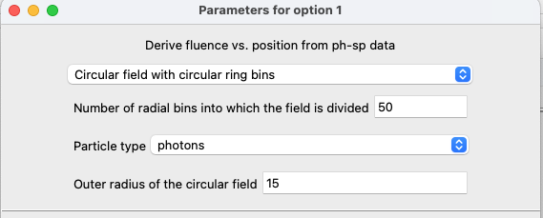
Spatial fields
circular or square fields centered at origin divided into bins of equal area
X
X
Y
Y

Slide 5
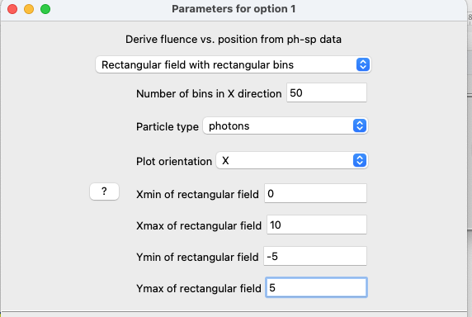
Spatial fields
rectangular fields anywhere on the phase space plane divided into bins of equal width
bins (plots) oriented in X- or Y-direction
X
Xmax
X
Xmin
Ymin
Ymax
Y

Slide 6
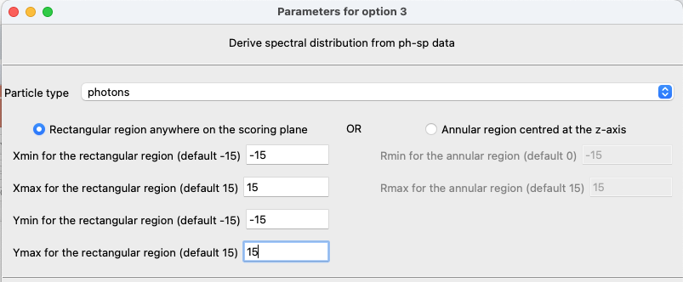
Spectral fields
Rectangle anywhere on the plane or annular region centered at origin
X
X
X
Xmax
Rmax
Rmin
Y
Y
Xmin
Ymin
Ymax

Slide 7
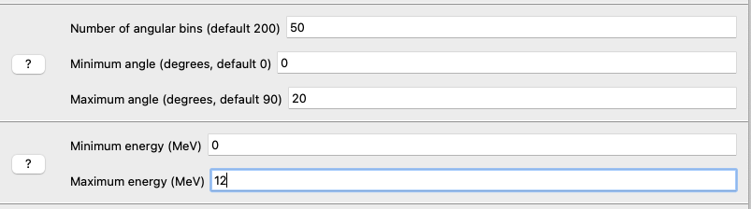
Spectral quantities
Specify range and number of bins
e.g. Angular distribution:
For angular distribution only: also specify an energy range

Slide 8
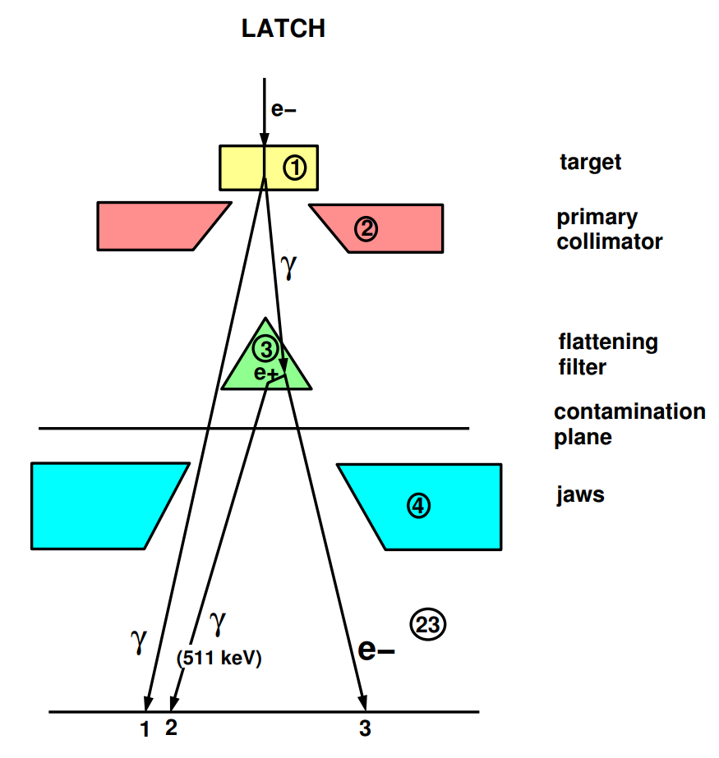
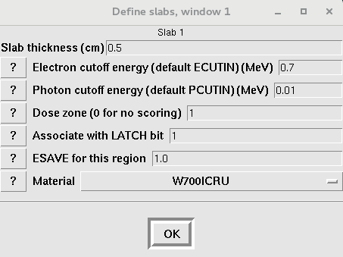

LATCH Review I
From beamnrc_gui:
LATCH is a 32-bit integer variable that travels with the particle
LATCH bits are associated with regions in BEAMnrc or other application

Slide 9
LATCH Review II
For secondaries: 24-28, downshifted by 24 bits, store the bit (1-23) associated with the region where they were created
For primaries: not set
Set if brems or positron annihiliation occurred
Set if particle interacted/passed through corresponding region
In BEAMnrc, AIR regions default to bit 23

Slide 10
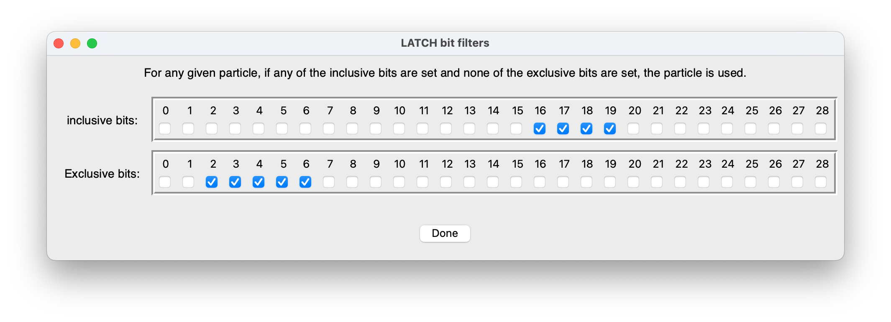
BEAMDP LATCH filtering: inclusive/exclusive for bits
Include the particle only if any “inclusive bits” are set
AND none of the “Exclusive bits” are set

Slide 11
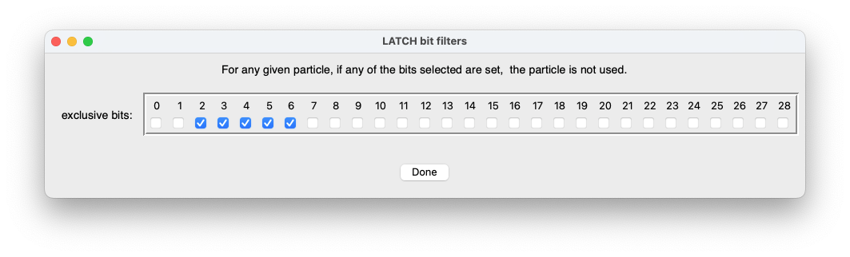
Latch filtering: exclusive for bits
Include the particle only if none of the “exclusive bits” are set

Slide 12
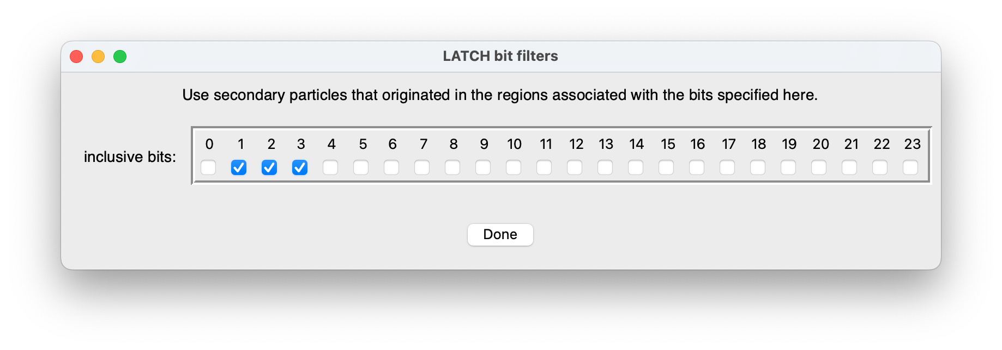
Latch filtering: inclusive for regions
Include only secondary particles originating in regions associated with “inclusive bits”
LATCH bits associted with regions in BEAMnrc or other application
Stored in bits 24-28 of LATCH
Region 23 is usually reserved for air

Slide 13
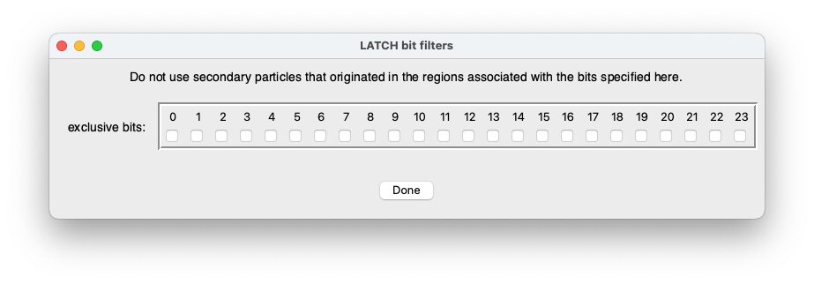
Latch filtering: exclusive for regions
Include only secondary particles not originating in regions associated with “exclusive bits”

Slide 14

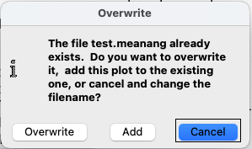
Input/Output files
Input phase space data
Output data file optimized for
plotting with xmgrace/qtgrace
Use the same output file for the option to add data to an existing plot

Slide 15

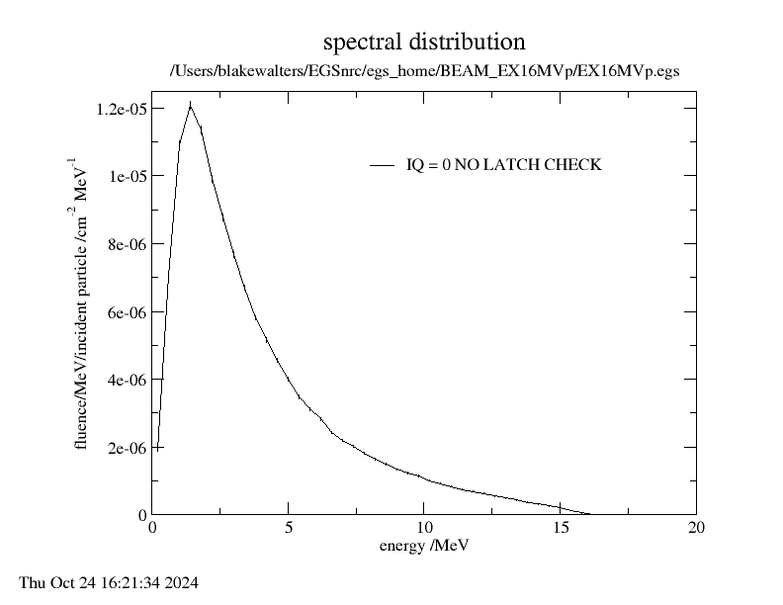
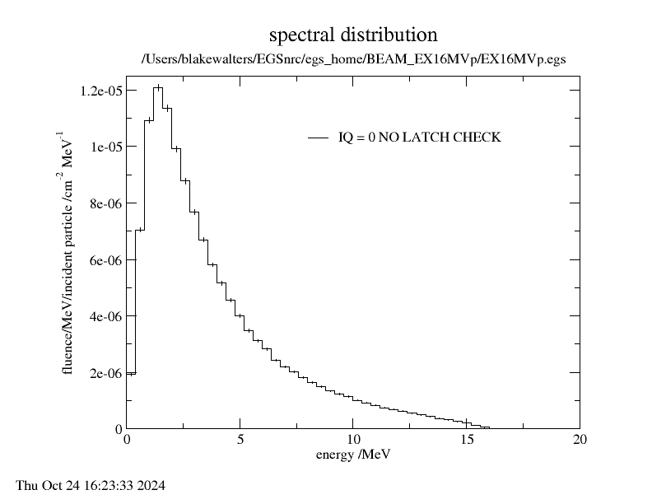
Plot type
point plot
histogram

Slide 16

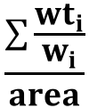

Fluence type
planar fluence =
$$\frac{\sum{{wt}_{i}}}{area}$$
estimated real fluence
$$\frac{\sum{\frac{{wt}_{i}}{w_{i}}}}{area}$$
=
w = Z-direction cosine
w_{i}
γ_{i}
(weight = wt_{i})
phase space plane
min. w = 0.08716 (85º)
Z

Slide 17

Angular distributions
Z=0
solid angle i (rad)
phase space plane
Z
angular bin i

Slide 18
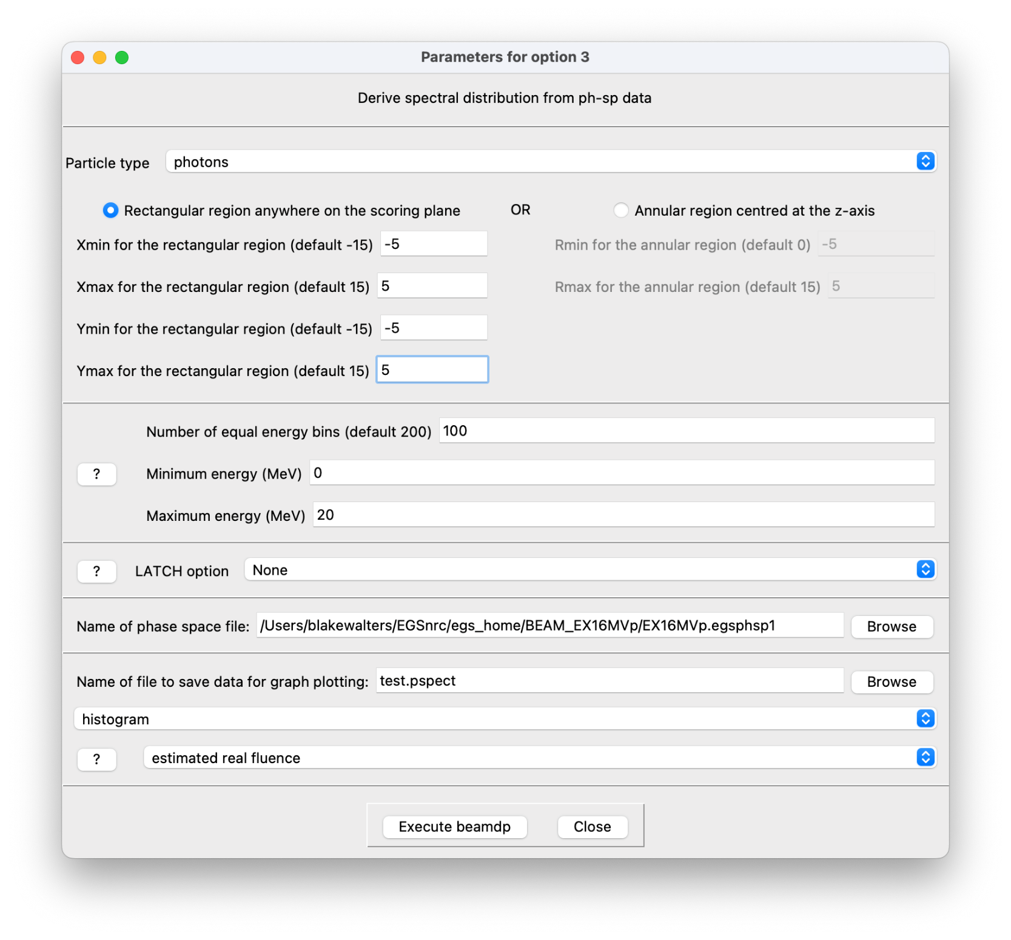
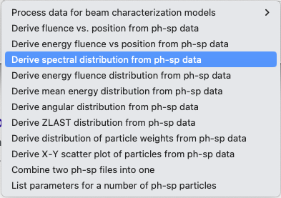
Example: Derive spectral distribution
Don’t forget to select particle type!

Slide 19

Example: Derive spectral distribution
statistically-independent histories (i.e. e- incident on target)

Slide 20
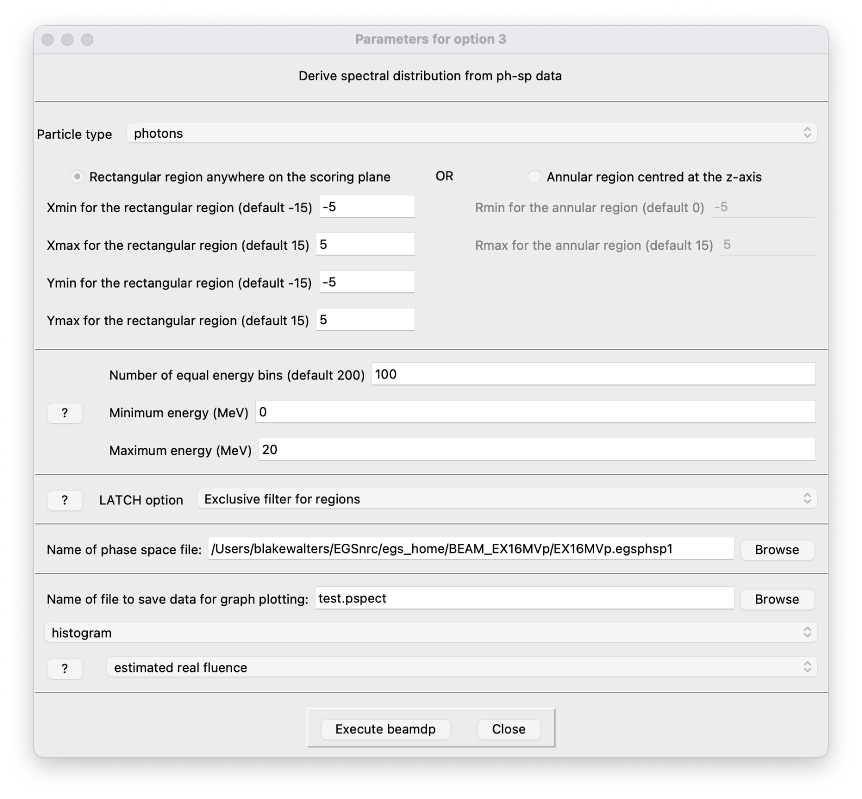
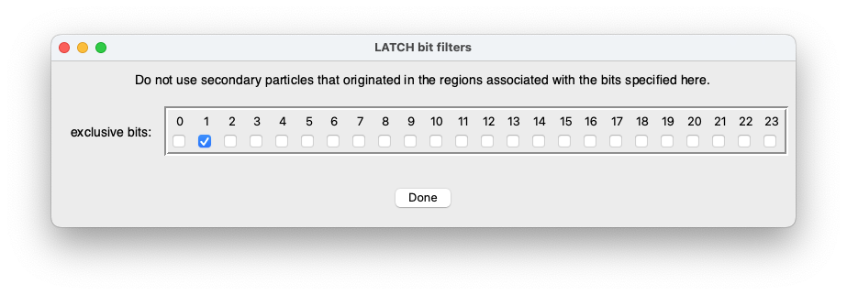
Example: Derive spectral distribution
Plot secondary photons
LATCH bit 1 associated with target

Slide 21
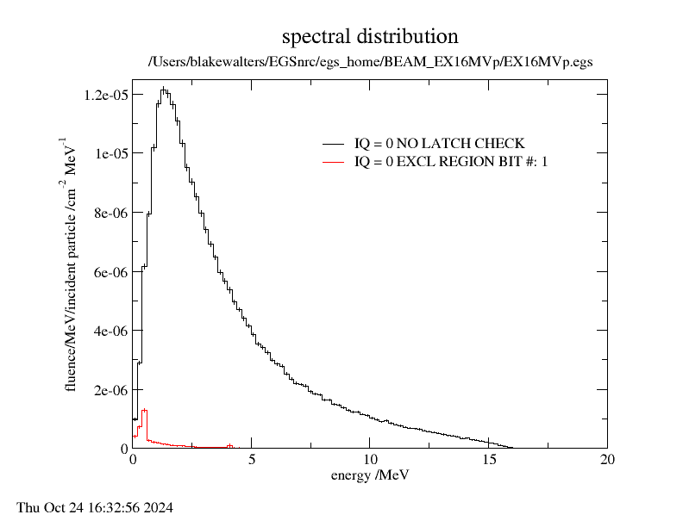
Example: Derive spectral distribution

Slide 22
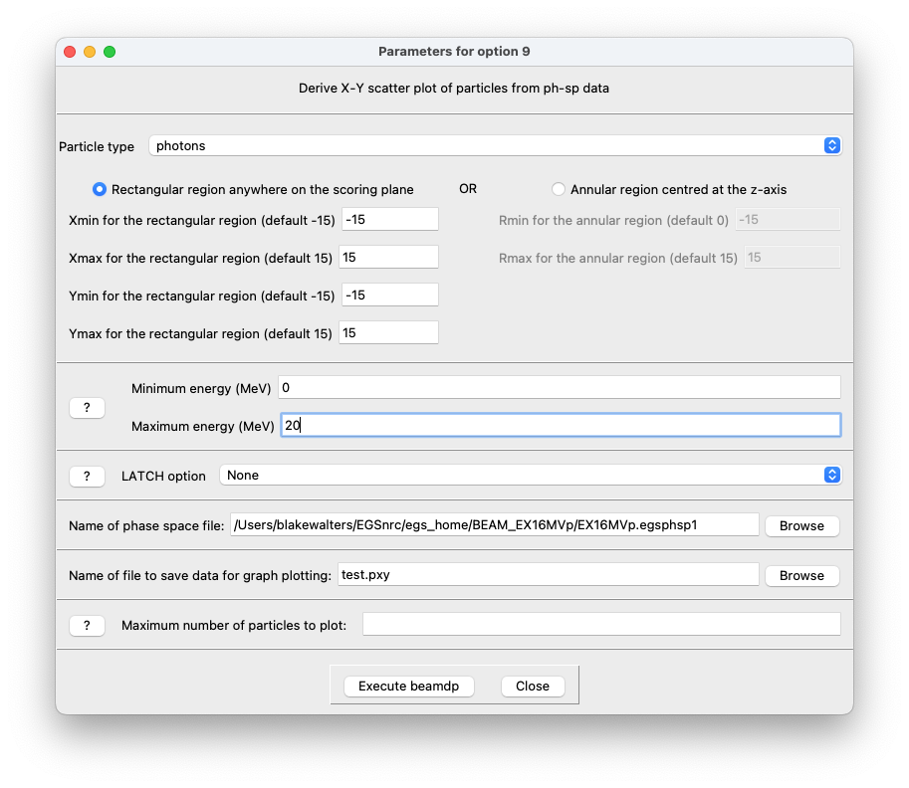
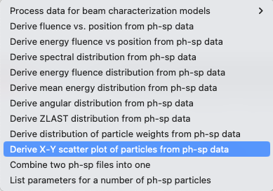
X-Y Scatter plot
defaults to plot all photons

Slide 23
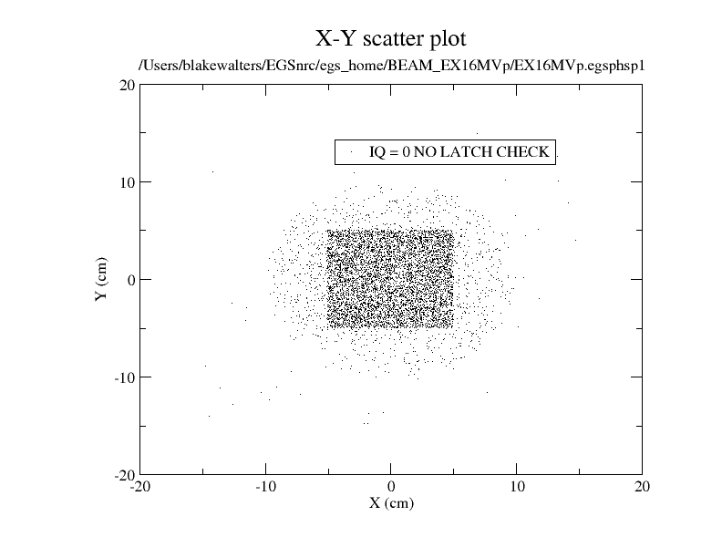

Slide 24
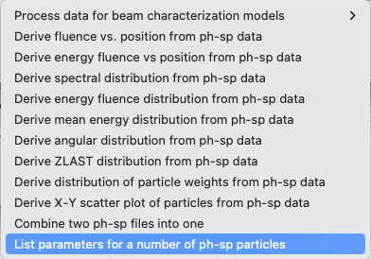
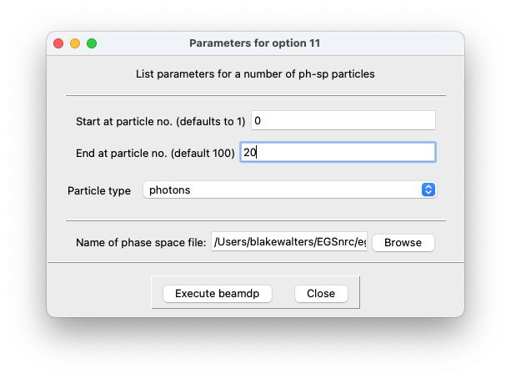
List parameters for a number of particles

Slide 25
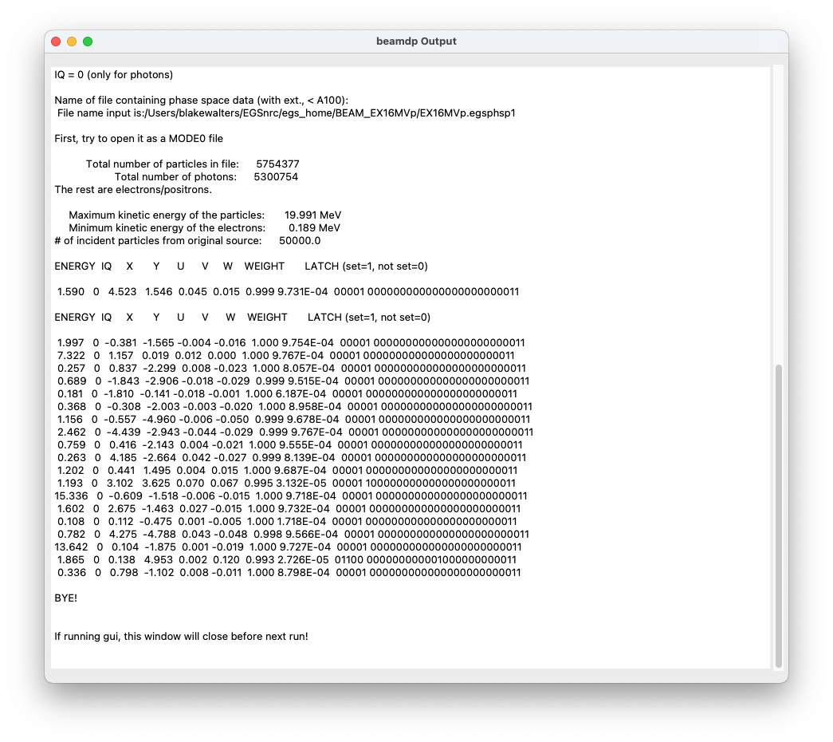
List parameters for a number of particles

