Slide 1
Ibadan wet season data

Slide 2
Desriptive Statistics
Slide deck provides a detailed description of the Ibadan wet season data. The data was collected from over 3000 households and has a total of over 6000 individuals tested for rdt.

Slide 3
Wards were the data was collected
Agugu
Bashorun
Challenge
Ologuneru

Slide 4
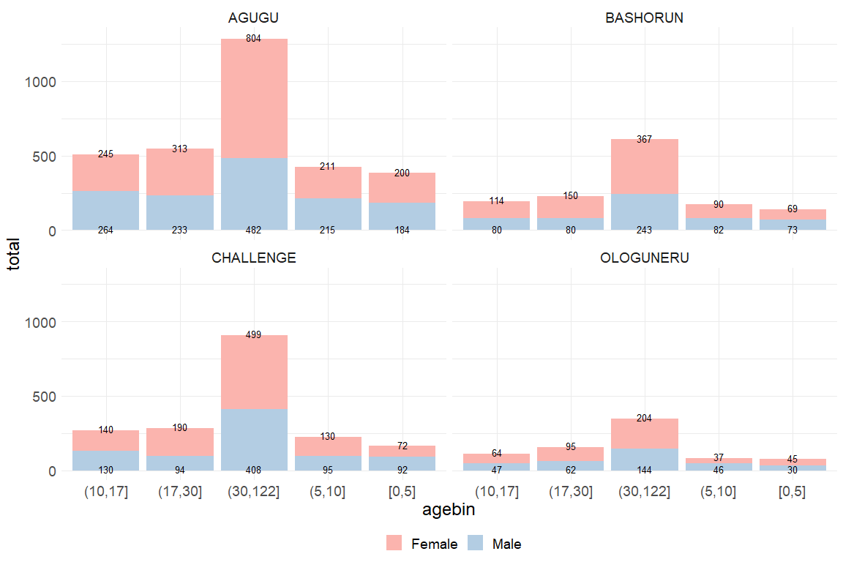
Slide with R Output

Slide 5
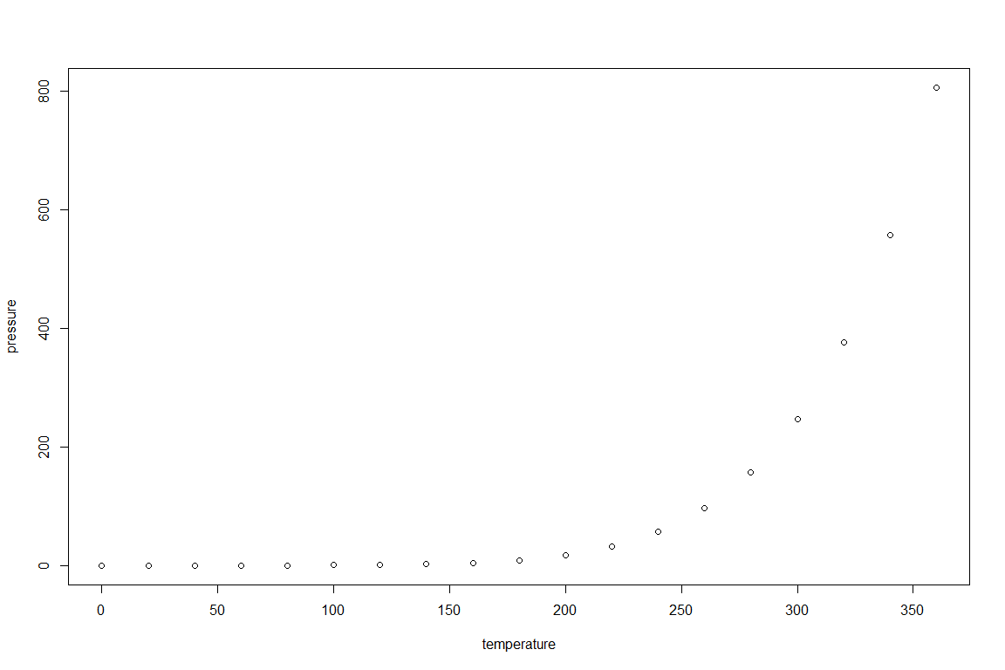
Slide with Plot

