Slide 1
MyPortfolio Presentation
Student Name: Gayathri E
Register no and NMID : 212400998/ 7C69FA267133B348F054B26B41C226D2
Department computer applications
College university of madras

Slide 2
What is a Portfolio?
A portfolio is a personal website or collection of documents that showcases your skills, education, achievements, and projects. It acts as an online resume where employers, teachers, and peers can learn more about your capabilities.

Slide 3
Benefits of a Portfolio
- Showcases your skills and strengths
- Helps in academic and career opportunities
- Builds a strong online presence
- Demonstrates your projects and achievements
- Easy to share with employers and peers

Slide 4
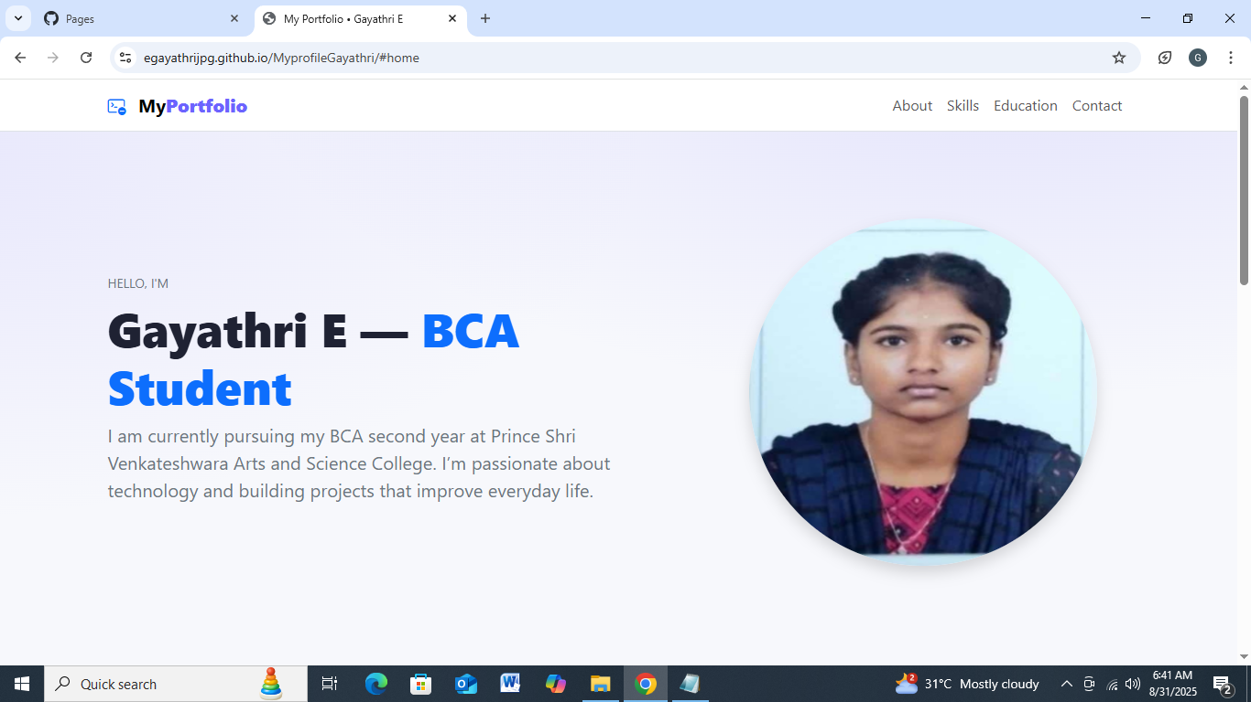
My Portfolio Screen1

Slide 5
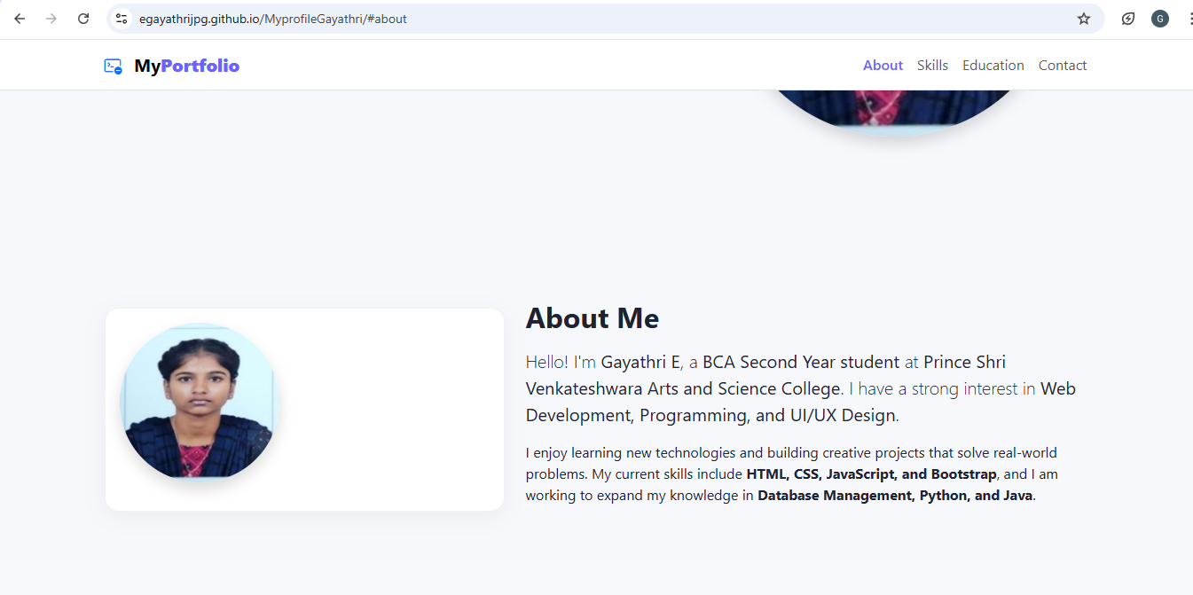
My Portfolio Screen 2

Slide 6
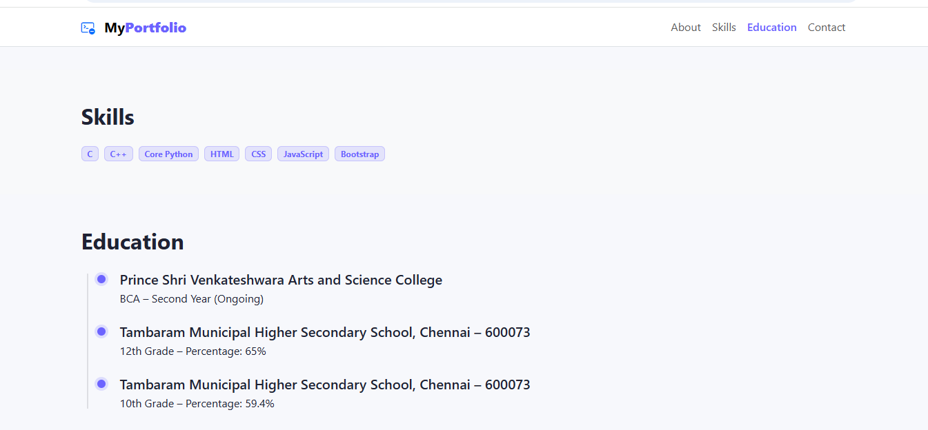
My Portfolio Screen 3

Slide 7
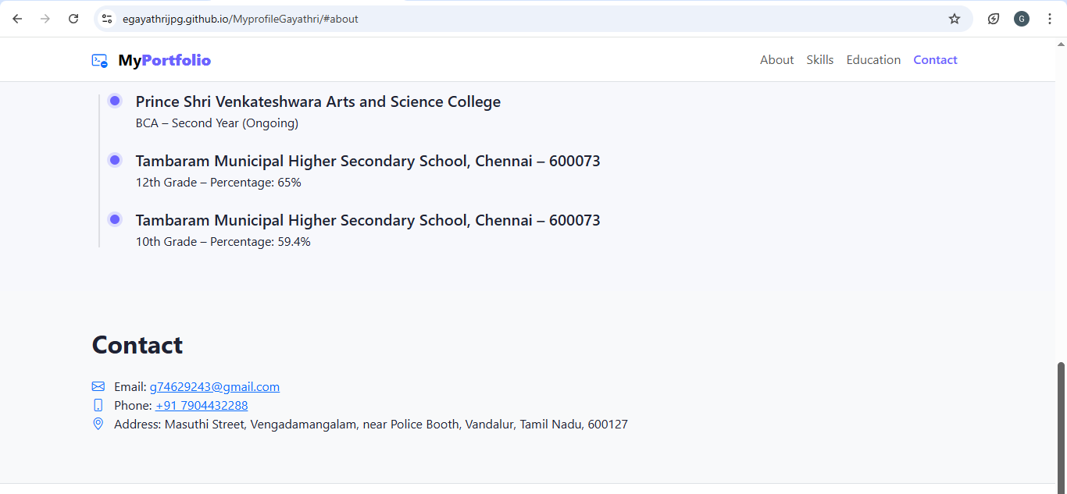
My Portfolio Screen 4

Slide 8
Thank You

