Slide 1

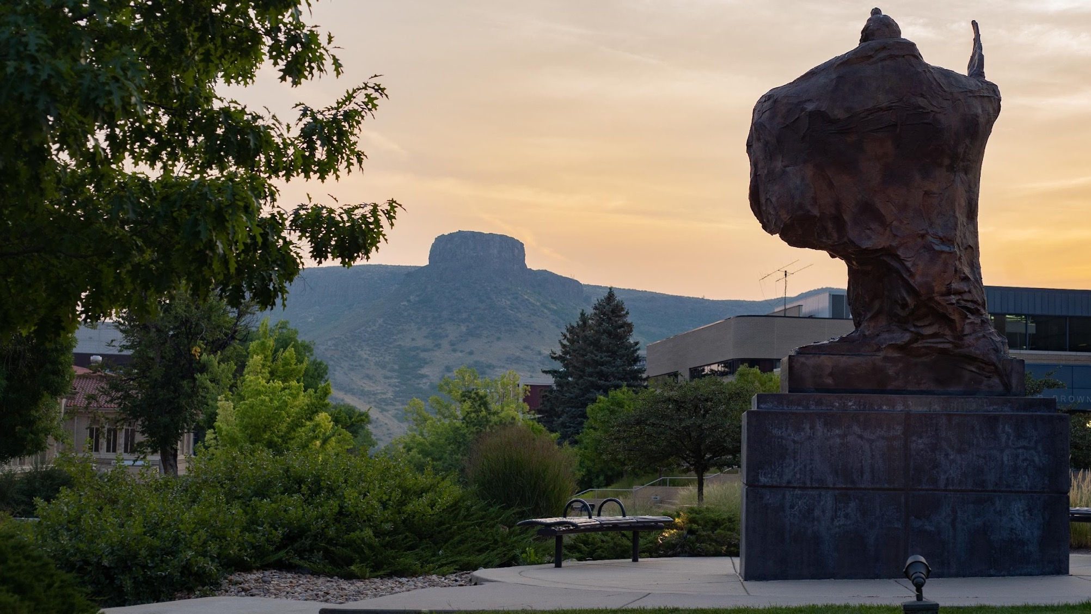
WiFi simulation over House Domain
MATH550: Numerical Solution for PDE Fall-2023
Eric and Ahmed
1

Slide 2
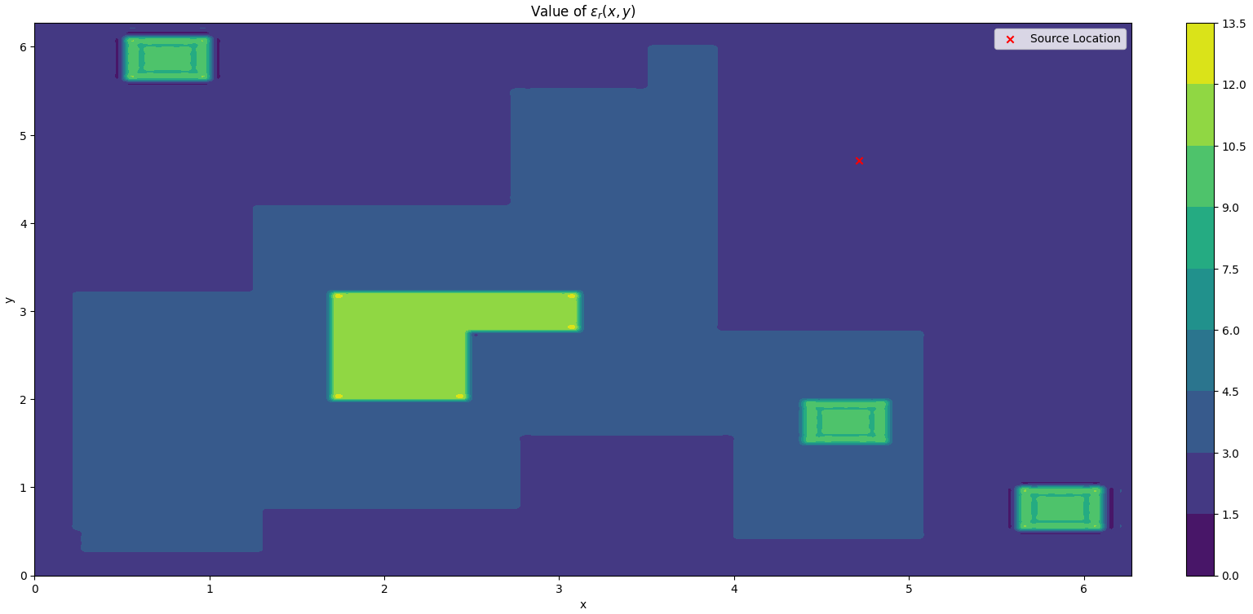
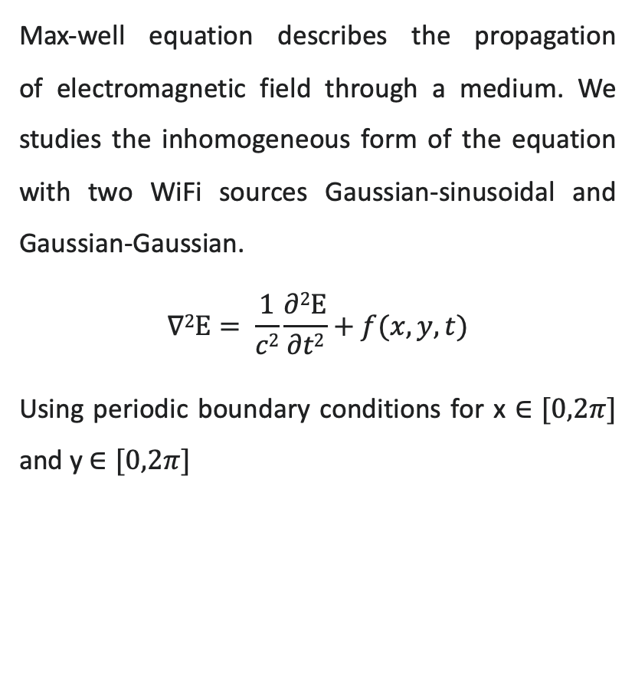
Max-well wave equation
Max-well equation describes the propagation of electromagnetic field through a medium. We studies the inhomogeneous form of the equation with two WiFi sources Gaussian-sinusoidal and Gaussian-Gaussian.
$$∇2Ε= \frac{1}{c2}\frac{∂2Ε}{∂t2}+f(x,y,t)$$
Using periodic boundary conditions for x $∈[0,2π]$ and y $∈[0,2π]$
2

Slide 3
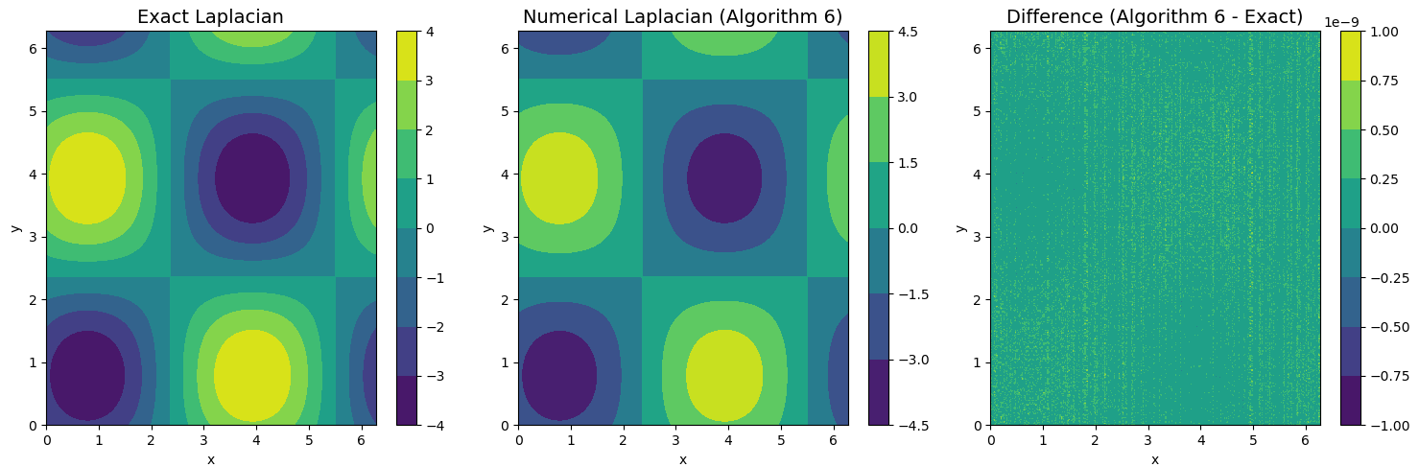
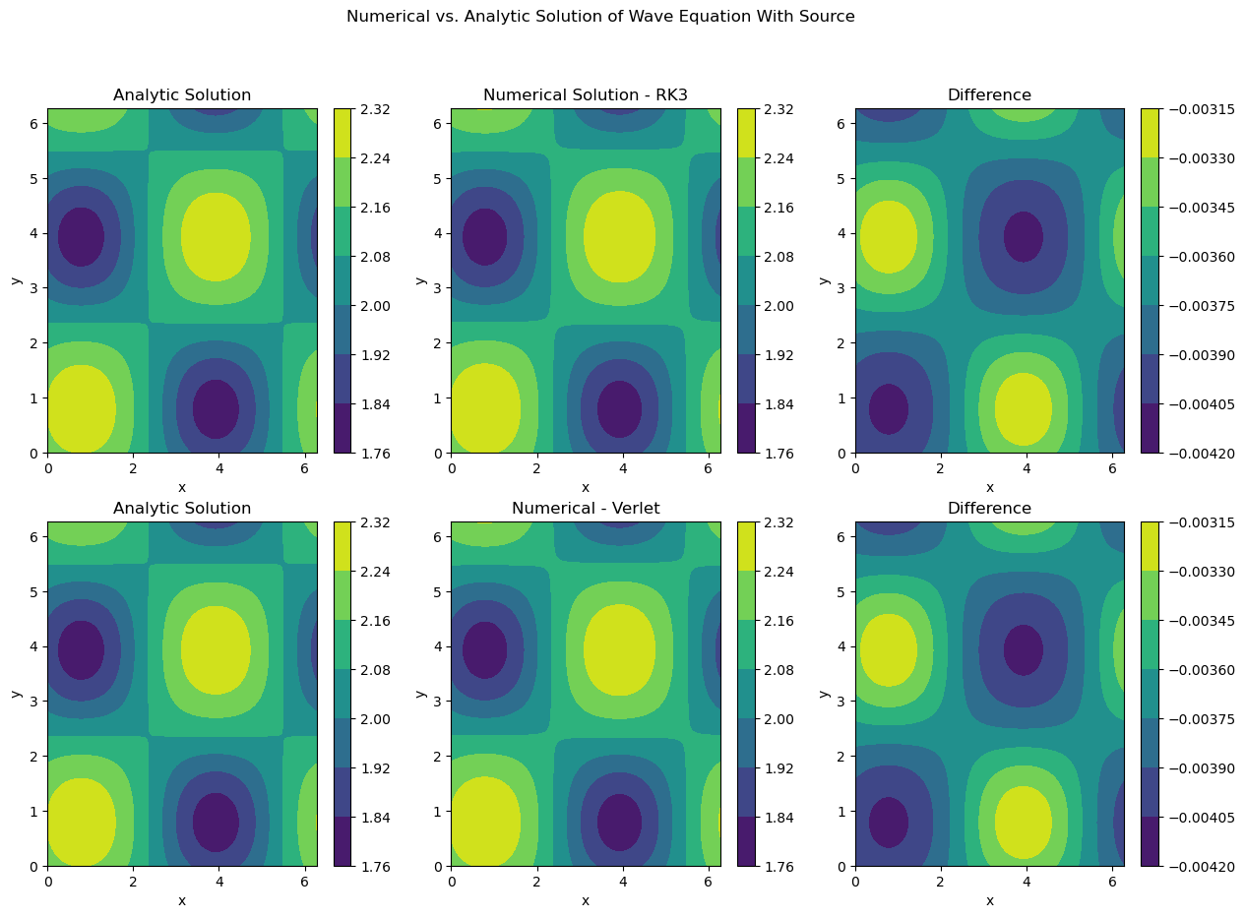
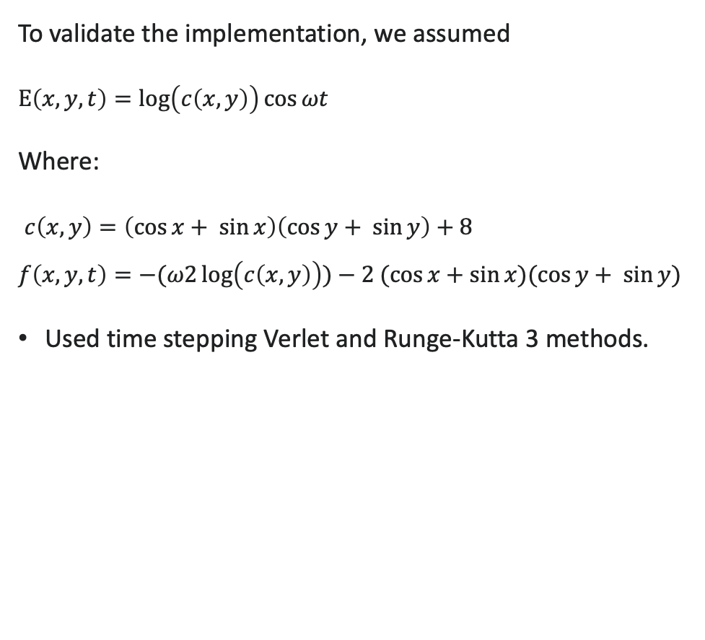
Manufacture solution
To validate the implementation, we assumed
$Ε\left(x,y,t\right)=\log\left(c\left(x,y\right)\right)\cos{ωt}$
Where:
$c\left(x,y\right)=\left(\cos{x}+ \sin{x}\right)\left(\cos{y+ \sin{y}}\right)+8$
$$f\left(x,y,t\right)=−(ω2\log\left(c\left(x,y\right)\right))−2 (\cos{x}+\sin{x})(\cos{y}+ \sin{y})$$
Used time stepping Verlet and Runge-Kutta 3 methods.
3

Slide 4
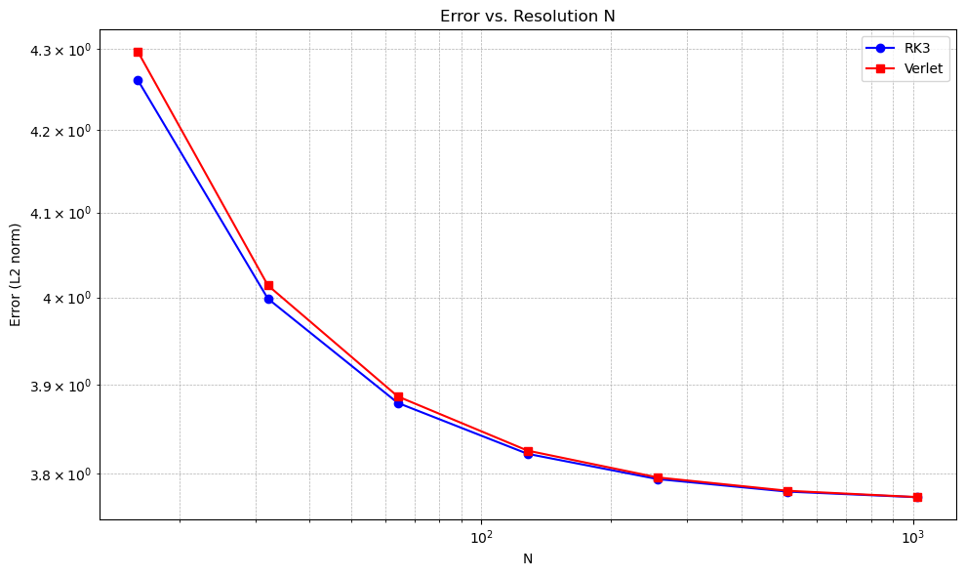
Error Analysis
l2 norm of the difference between the analytical and numerical solutions. It was preformed several testes for the number of grid points (it affects the calculated dt and then the number of steps), N = [16, 32, 64, 128, 256, 512, 1024]. The results indicate that with larger time steps, both methods converge in resolution
4

Slide 5
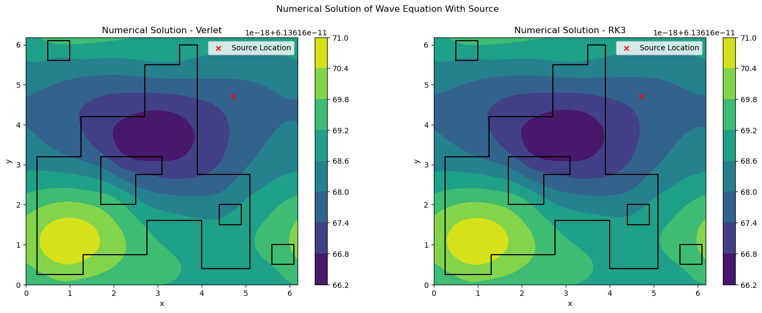
Simulation using gaussian – sinusoidal source
5

Slide 6
Simulation using gaussian – gaussian source
6

Slide 7
Future work
It could be implementation of a more realistic boundary conditions
7

