Slide 1
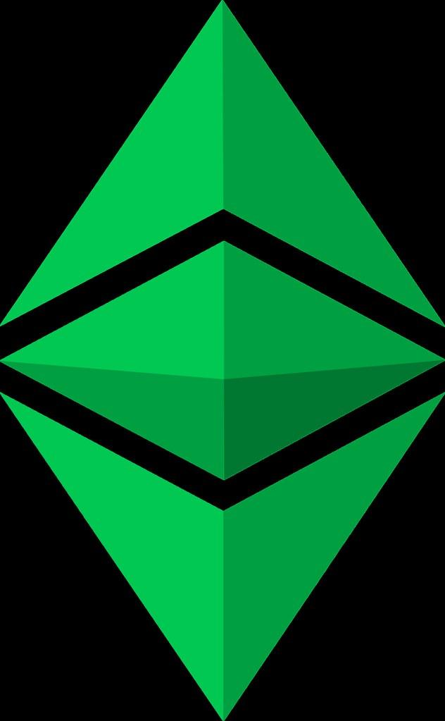
Blockheads
A Decentralized NFT Marketplace Demonstration

Slide 2

The Blockheads Team
Emmanuel George
Jacob Rougeau
Jamie Zarate
Lindsey Hardouin
Tony Landero

Slide 3
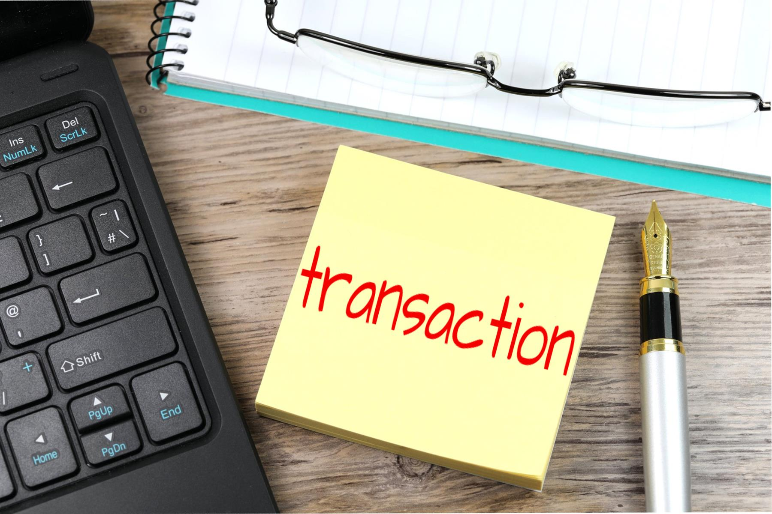
Ideation
Digital creators worldwide need a means to mint and to sell their artwork
Buyers need a simplified UI through which they can purchase digital artwork

Slide 4
User Stories
Artist
Tokenization
Consignment
Buyer
View Inventory
Make purchase & receive transfer of NFT
MarketPlace Owner
Multi page app for artist/buyer UIs
Tokenization & Storage
Funds transfer from buyer to seller / commission collection
NFT transfer to buyer
Record keeping

Slide 5
Technologies
Streamlit Library
MultiApp Library
Pinata API
IPFS
MetaMask
Remix IDE
Ganache
OpenZeppelin Contracts

Slide 6
Live Demo

Slide 7
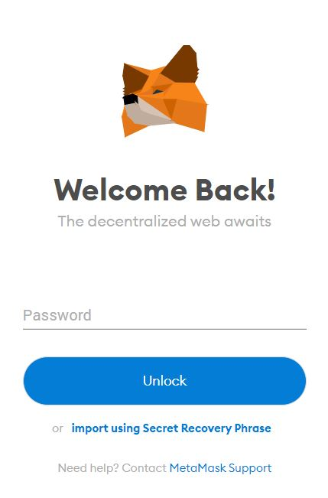
Future Developments
Image gallery
Auction capabilities
Browser Web3 connectivity (non python)
Mint NFTs as collections
Mint NFT with royalty structure encoded

Slide 8

Questions

