Slide 1
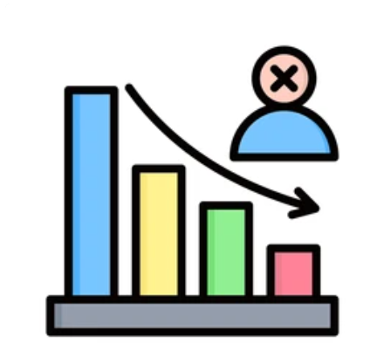
CUSTOMER CHURN PREDICTION PROJECT
Predictive analytics

Slide 2
Overview:
Our company offers telecommunication services to customers spread across various locations
Customers enjoy diverse billing tariffs and subscription packages.

Slide 3
The Current challenges: Significant drop in recurrent venue Expensive budgets on customer retention. Sustained customer churn
Desired Outcome
Grow the customer base.
Minimize customer retention costs.
Understand customer behaviours
Predict and minimize churn

Slide 4
Objectives of the Project
Identify the factors that influence churn.
1
Identify customers who are likely to exit.
2
Propose way forward to manage churn

Slide 5
Model Success Metrics
Capture at least 85% of all the customer who churn(Recall of 85%).
High ability to exclude false positives and false negatives achieving an F1 score of at least 85%.
Identify features that influence customer churn.

Slide 6
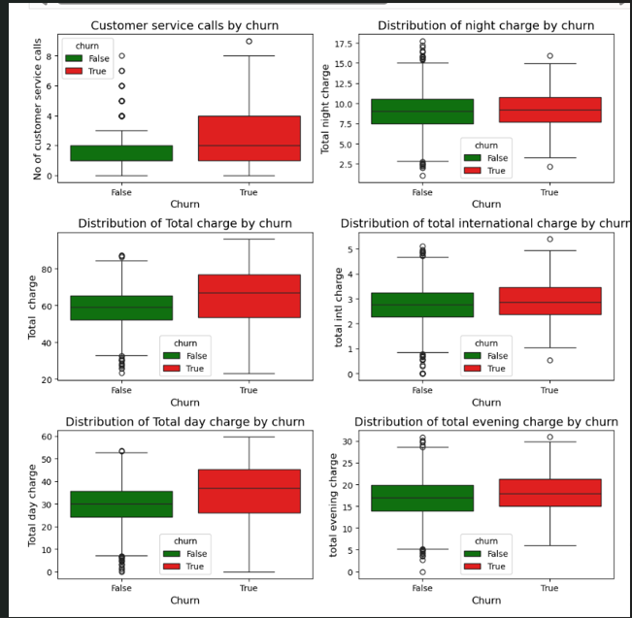
Factors influencing churn: Chunners had received a higher customer service calls . Service recovery was done. Churners experienced relatively higher total charges. Churners experienced higher day time charges.

Slide 7
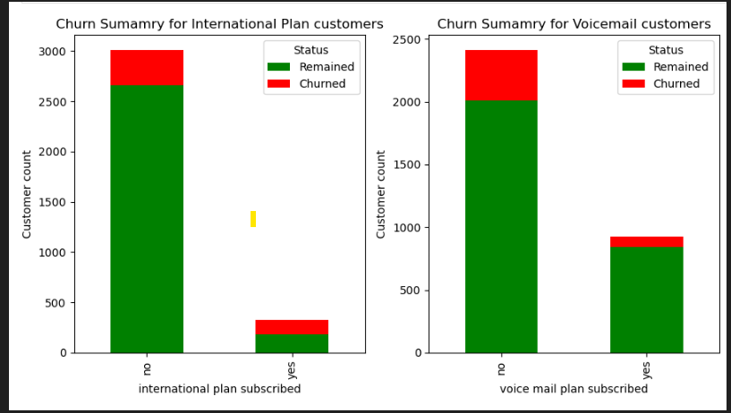
Churn summary by subscription type
Less customers were on voice mail plan. More customers were retained.
Most customers were not on international plan.

Slide 8
Models performance

Slide 9
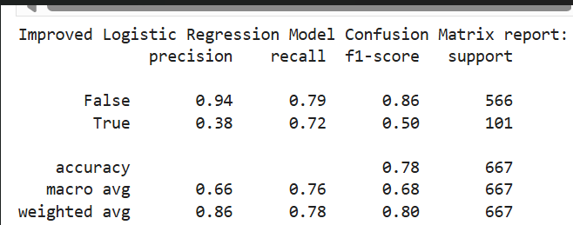
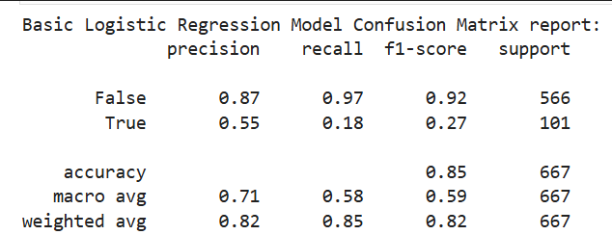
Logistic Regression Models Evaluation
Basic Model
Was 85% accurate. Lower capacity to correctly predict churners since it is only accurate 55% of the time. Of all the customers who churned, the model only predicted 18%. The model has a higher balanced score of F1 of 92% in predicting non churners.
Improved model
Was 78% accurate. The ability to correctly predict churners 72% Predicting churners has improved to 50% F1 score Performed better in predicting churners than the base model.

Slide 10
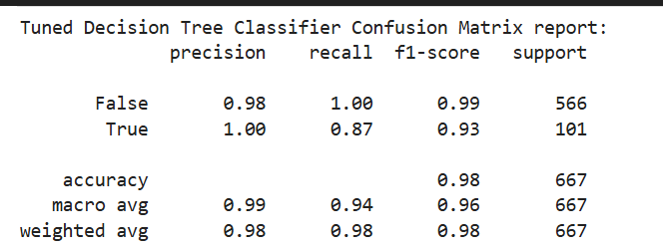
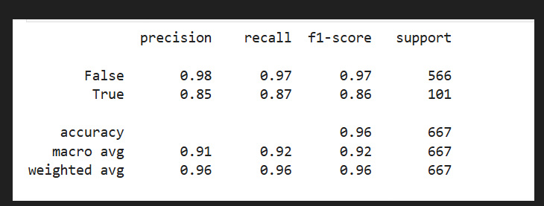
Decision Tree Models Evaluation
Basic Decision tree
Improved Decision Tree
Overall accuracy improved to 96%.
Ability to ccorrectly predict churners improved to 87%
Balanced score in predicting churners has improved to 86%
The model exceeded the company thresholds.
Overall accuracy was 98%.
The ability to correctly predict churners was 87%
Balanced between precision and recall at 83%

Slide 11
Recommendations
The company to adopts the improved decision tree classifier model to predict the churn.
The management to take not that there will be 7% risk that true churners will not be detected by the model.
The company undertakes a business impact analysis of the 7% risk to evaluate further investments needed to improve the model.
With new discoveries on the customer profiles, continued enhancement of the model be done to improve its utility.

Slide 12

Thank you

