Slide 1

GROUP4_PHASE2_PROJECT
Analyzing Top-Performing Films for Strategic Success

Slide 2
GROUP MEMBERS
EVAN NDUNGU
VIOLA KIMITEI
ROBERT SUMAILI
ZEENA LISA KARARI

Slide 3
Project Overview
With the rise of original video content among major corporations, our company has decided to establish its own movie studio.
Since we lack experience in film production, it is crucial to understand current trends to make informed decisions.

Slide 4
Business Understanding
As part of the 5-year corporate strategy roll out, our company has identified an expansion opportunity.
The company wants to venture in original video content creation through their new studio.
The company management has an interest in utilizing data on films at the box office to identify best movies. From the best movies, the company management is looking for insights that will influence the investment approach to take.

Slide 5
Objectives
This project aims to analyze the types of films that are currently performing best at the box office. Our review is focused on identifying the below factors that would influence the market penetration strategy:
Identifying the top 10 best performing genres based on the return on investment and sales.
Identifying the top 10 best performing movies based on the return on investment and sales.
Identifying relationship between production cost and the global film sales.
Identifying the impact of movie rating on the global film sales.

Slide 6
Data exploration
The data was obtained form the below sources: Box Office Mojo: https://www.boxofficemojo.com/ IMDB : https://www.imdb.com/ The Rotten Tomatoes : https://www.rottentomatoes.com/ The Movie DB: https://www.themoviedb.org/ The numbers: https://www.the-numbers.com/

Slide 7
Key Findings
Action and adventure genres dominate the highest-grossing films.
Films with a high production budget often yield high returns, but lower-budget films can also be highly profitable.
Best rated films attract the widest audience, maximizing box office revenue.
Strong correlation between critic/audience ratings and overall film performance.

Slide 8
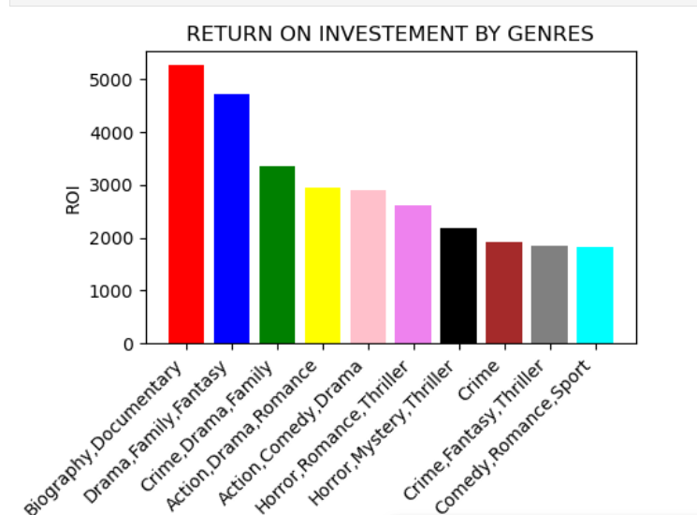
Top 10 best performing genres based on ROI
Top 3 genres were: 1.Biography,Documentry
2.Drama,Family,Fantasy
3.Crime,Drama,Family

Slide 9
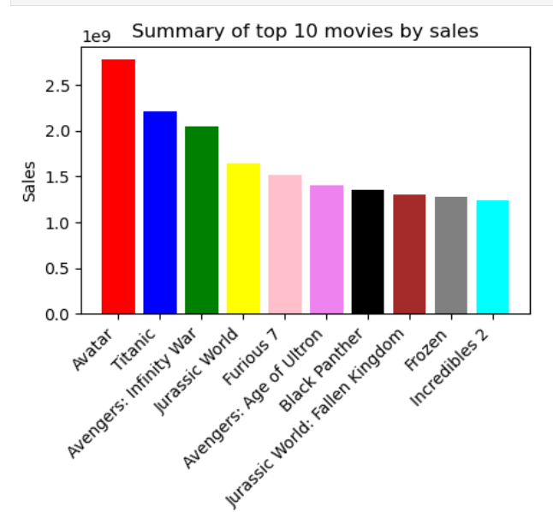
Top 10 movies by sales

Slide 10
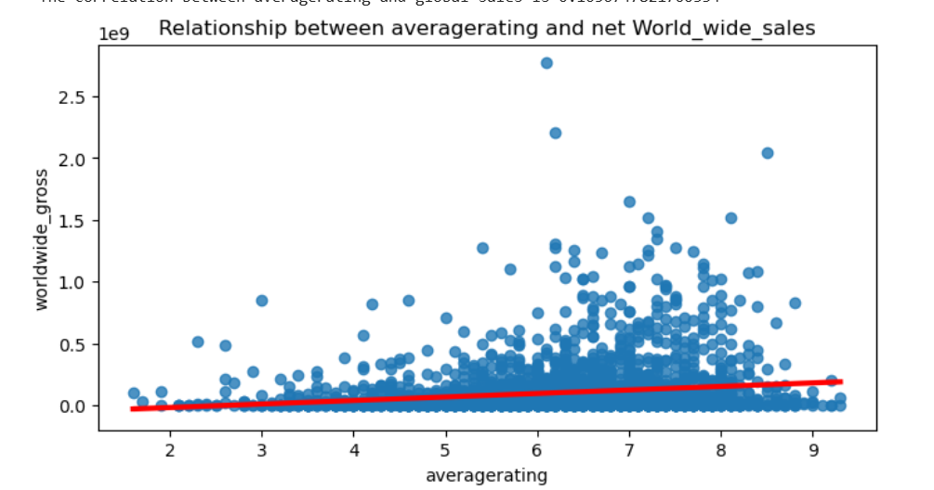
Impact of average rating on global sales
Average rating has a relatively low impact on the global sales.
We noted that the rating can impact sales positively by 2.7%.

Slide 11
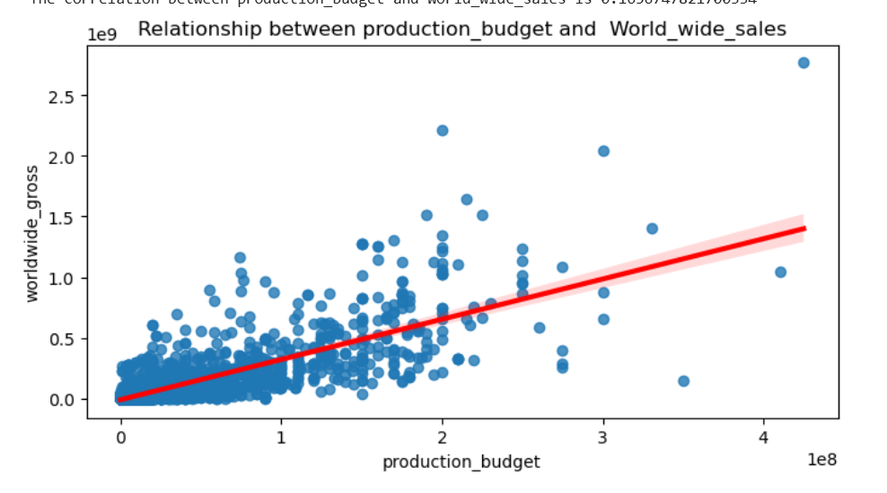
How spending on production budget affects global sales
Production budget has a strong impact on global sales.
It can impact up to 60.5% of the global sales.

Slide 12
Market Trends & Patterns
Superhero films such as avatar register high sales globally.
Family-friendly animated films such as biography and documentary movies register high ROI.
Higher budgets often result in higher revenue, but not always in better ROI.

Slide 13
Recommendations & Conclusion
The company should:
Invest in high-quality action, adventure, and family-friendly genres which will yield high returns on investment.
Spend more on production costs as this may maximize sales by up to 60.5% .
Focus on quality films which will attract higher ratings in the market to increase sales.

