Slide 1
XYZ AVIATION PROPOSAL
Introduction
Methodology
Assumptions
Data Analysis
Results
Recommendations

Slide 2
Introduction
The company is seeking to venture in air travel business and seeks to establish the least risky aircraft to invest in based on aviation Accident Database & Synopses, up to 2023 downloaded from Kaggle.com

Slide 3
Methodology
Explore the aviation accidents data
Identify patterns in the data
Design key risk indicators
Identify the optimal aircraft within the company’s risk profile

Slide 4

Assumptions
I made the below assumptions in the analysis:
For a make to be economically viable to operate , it should have carried at least 500 passengers.
The number of customers involved in the documented accidents is a representation of the market share per make.
Passenger injury/ fatality rate of 10% and below is acceptable to the company.
Company would seek to optimize returns by investing in makes with high market share.

Slide 5
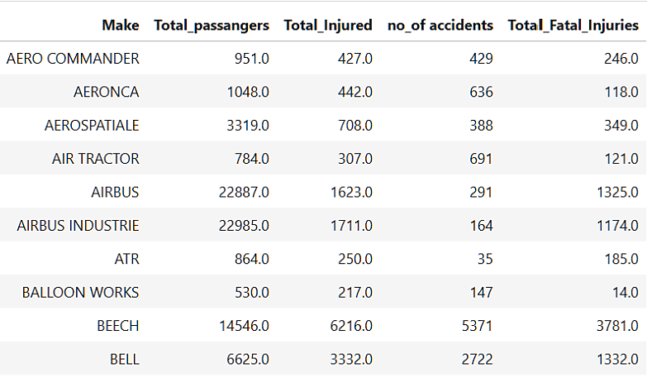
The data
The refined data contained 46 aircraft makes with a total passenger count of 504,515.
our KRIs evaluated the below below fields:
The make of the plane
Total_Fatal_Injuries per accident.
Total_Serious_Injuries per accident.
Total_Minor_Injuries per accident.
Total_Uninjured per accident.

Slide 6

Key risk indicators
The below Key risk indicators were derived:
Injury rate per make of the aircraft.
Fatality rate per make of the aircraft.
Market dominance per make of the aircraft.

Slide 7
RESULTS

Slide 8
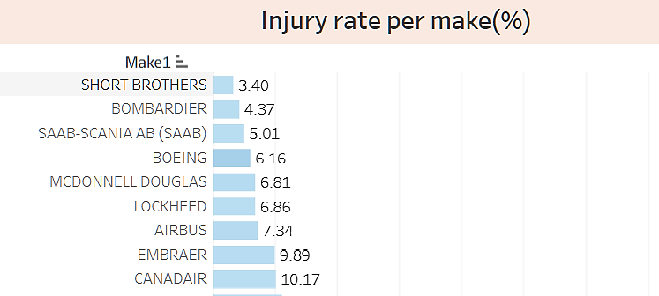
Injury risk by make
8 makes had a passenger injury with a maximum of 10%

Slide 9
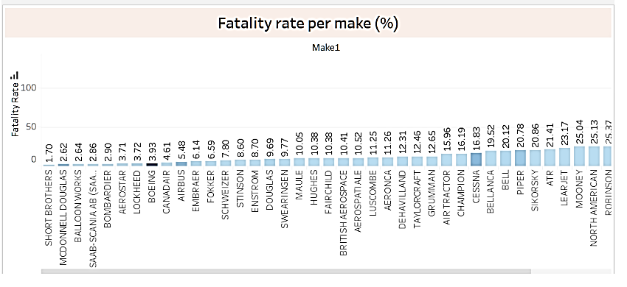
fatality risk by make
17 makes had a passenger fatality with a maximum of 10%

Slide 10
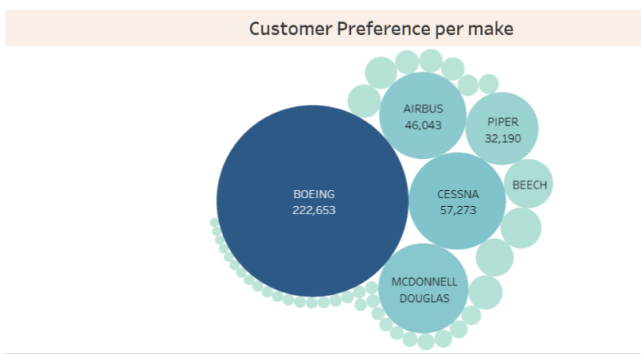
Customer preference per make
The make with the highest customer preference was Boeing

Slide 11
Recommendations
We recommend the company to invest in Boeing aircrafts because:
It has the highest market share having carried 222,653 passengers of the 504,515.
It has the 4th lowest passenger injury rate of 6.16%
It has the 8th lowest passenger fatality rate of 3.93%

