Slide 1
CMSC204
Kartchner
V(StateGraph) = {Oregon, Alaska, Texas, Hawaii, Vermont, NewYork, California}
E(StateGraph) = {(Alaska, Oregon), (Hawaii, Alaska), (Hawaii, Texas), (Texas, Hawaii), (Hawaii, California), (Hawaii, New York), (Texas, Vermont), (Vermont, California), (Vermont, Alaska)}
1. Draw the StateGraph
New York
Hawaii
Oregon
Alaska
Texas
CAlifornia
Vermont
{Oregon, Alaska, Texas, Hawaii, Vermont, new York, California}
{(Alaska, Oregon), (Hawaii, Alaska), (Hawaii, Texas), (Texas, Hawaii), (Hawaii, California), (Hawaii, New York), (Texas, Vermont), (Vermont, California), (Vermont, Alaska)}
no
yes
texas

Slide 2
a. Show the adjacency matrix that would describe the edges in the graph. Store the vertices in alphabetical order
States
Alaska
California
Hawaii
New York
Oregon
Texas
Vermont
0 0 0 0 1 0 0
0 0 0 0 0 0 0
1 1 0 1 0 1 0
0 0 0 0 0 0 0
0 0 0 0 0 0 0
0 0 1 0 0 0 1
1 1 0 0 0 0 0
3. b. Show the adjacency lists
that would describe the edges in the graph
Alaska
California
Hawaii
New York
Oregon
Texas
Vermont
Oregon
Alaska
California
New York
Hawaii
Vermont
Alaska
California

Slide 3
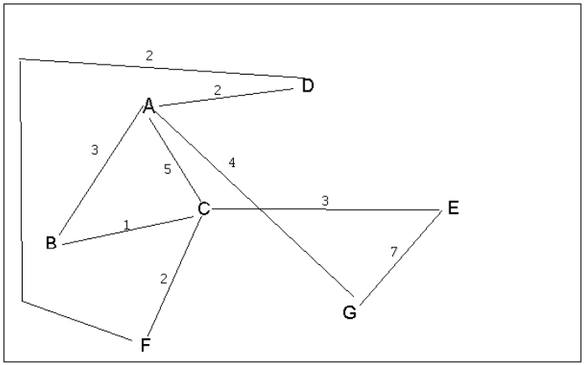

4 a. Which of the following lists the graph nodes in depth first order beginning with E?
A) E, G, F, C, D, B, A
B) G, A, E, C, B, F, D
C) E, G, A, D, F, C, B
D) E, C, F, B, A, D, G
4 b. Which of the following lists the graph nodes in breadth first order beginning at F?
A) F, C, D, A, B, E, G
B) F, D, C, A, B, C, G
C) F, C, D, B, G, A, E
D) a, b, and c are all breadth first traversals

Slide 4
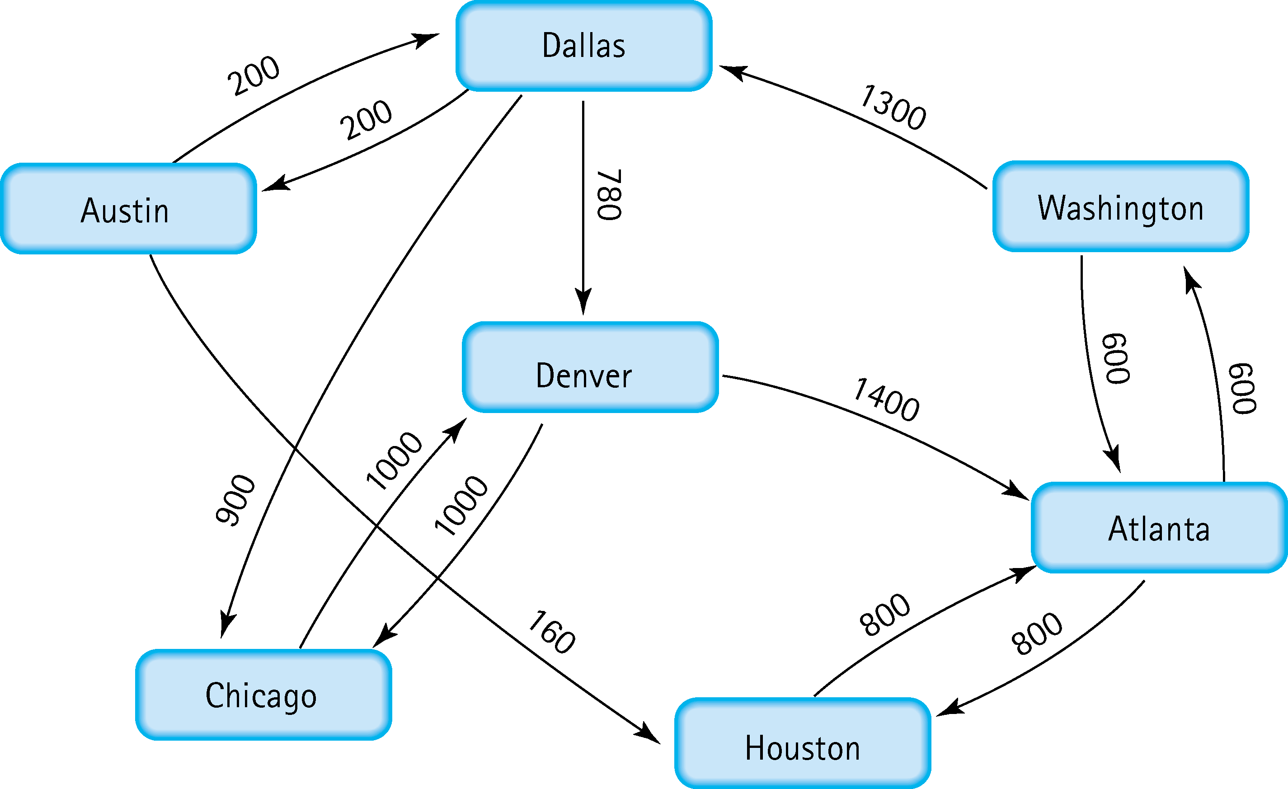
5. Find the shortest distance from Atlanta to every other city
Austin | Dallas | Washington | Atlanta | 2100
Chicago | Dallas | Washington |  | 2800
Dallas | Washington |  |  | 1900
Denver | Dallas | Washington |  | 2680
Houston |  |  |  | 800
Washington |  |  |  | 600

Slide 5
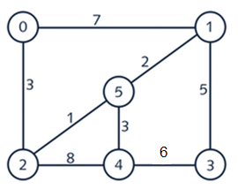

6. Find the minimal spanning tree using Prim’s algorithm. Use
0 as the source vertex . Show the steps.
0
0
5
0
1
0
1
5
5
2
2
2
2
4
0
1
5
2
4
4

Slide 6
7. Find the minimal spanning tree using Kruskal’s algorithm.
Show the weights in order and the steps.
0
1
0
1
5
5
2
4
3
2
4
3
0
1
0
1
5
5
2
4
3
2
4
3
EDGE |  | WEIGHT
0 | 1 | 7
0 | 2 | 3
1 | 3 | 5
2 | 5 | 1
1 | 5 | 2
0 | 2 | 3
4 | 5 | 3
2 | 4 | 8
0
1
5
2
4
3

Slide 7
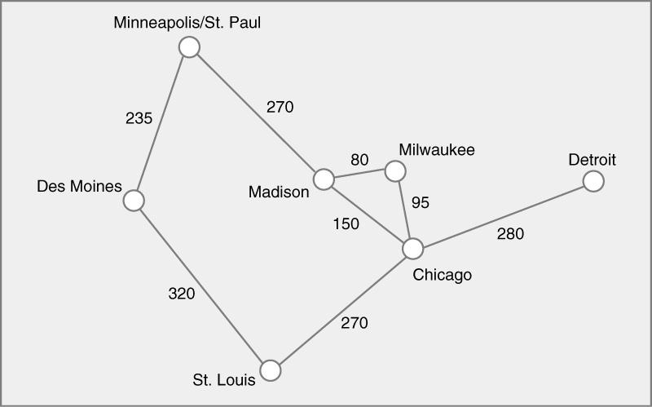
8. Find the minimal spanning tree using the algorithm you prefer. Use
Minneapolis/St. Paul as the source vertex
Mad | Mil | 80
Mil | Chi | 95
Min | Des | 235
Min | Mad | 270
Chi | STL | 270
Chi | Det | 280
Des | STL | 320

Slide 8
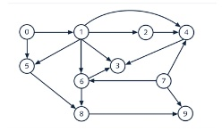
9. List the nodes of the graph in a breadth first topological ordering. Show the
steps using arrays predCount, topologicalOrder and a queue
predCount | 0 | 1 | 1 | 3 | 3 | 2 | 2 | 0 | 2 | 2
topologicalOrder | 0 | 7 | 1 | 2 | 5 | 6 | 4 | 8 | 3 | 9
queue | 0 | 7 | 1 | 2 | 5 | 6 | 4 | 8 | 3 | 9
predCount | 0 | 0 | 1 | 3 | 3 | 1 | 2 | 0 | 2 | 2
predCount | 0 | 0 | 1 | 3 | 2 | 1 | 1 | 0 | 2 | 1
predCount | 0 | 0 | 0 | 2 | 1 | 0 | 0 | 0 | 2 | 1
predCount | 0 | 0 | 0 | 1 | 0 | 0 | 0 | 0 | 0 | 1

Slide 9
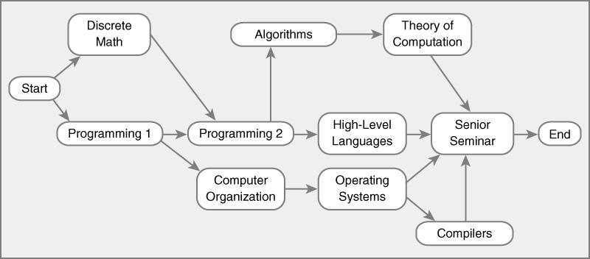
10. List the nodes of the graph in a breadth first topological ordering.
Start
Discrete Math
Programming 1
Computer Organization
Programming 2
Algorithms
High-level Languages
Compilers
Theory of Computation
Senior Seminar
End

