Slide 1
An Overview of MadCap Flare
PRESENTED BY
Jennifer Morse
Director, Customer Success
jmorse@madcapsoftware.com

Slide 2

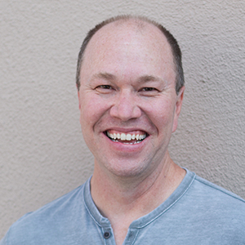


core benefits
Maximize Content Re-use
Publish to Multiple Outputs
Improved self service
Flexible and Easy to Use
Single-source authoring is for anybody who wants to work less and produce more.
Paul stoecklein
Documentation Manager | MadCap Software

Slide 3






Multiple source publishing Limitations
User Guide – Standard Product A
User Guide – Standard Product B
User Guide– Standard
User Guide – Enterprise Product A
Original Draft
User Guide
User Guide – Enterprise Product B
User Guide – Enterprise

Slide 4
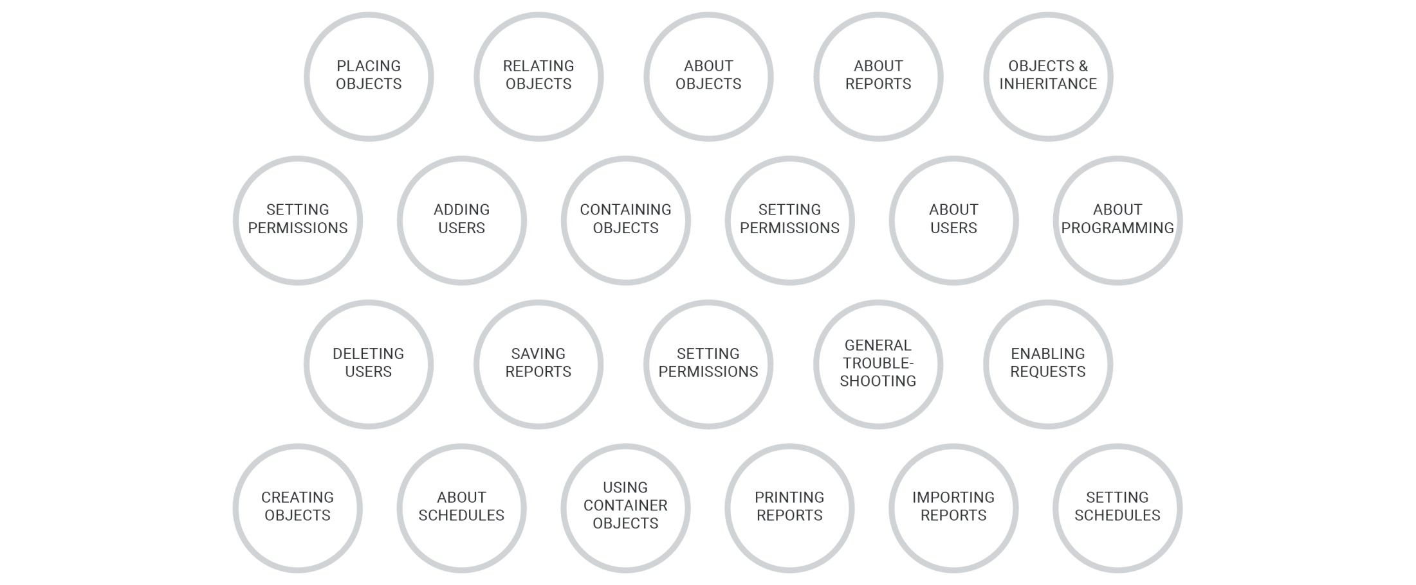
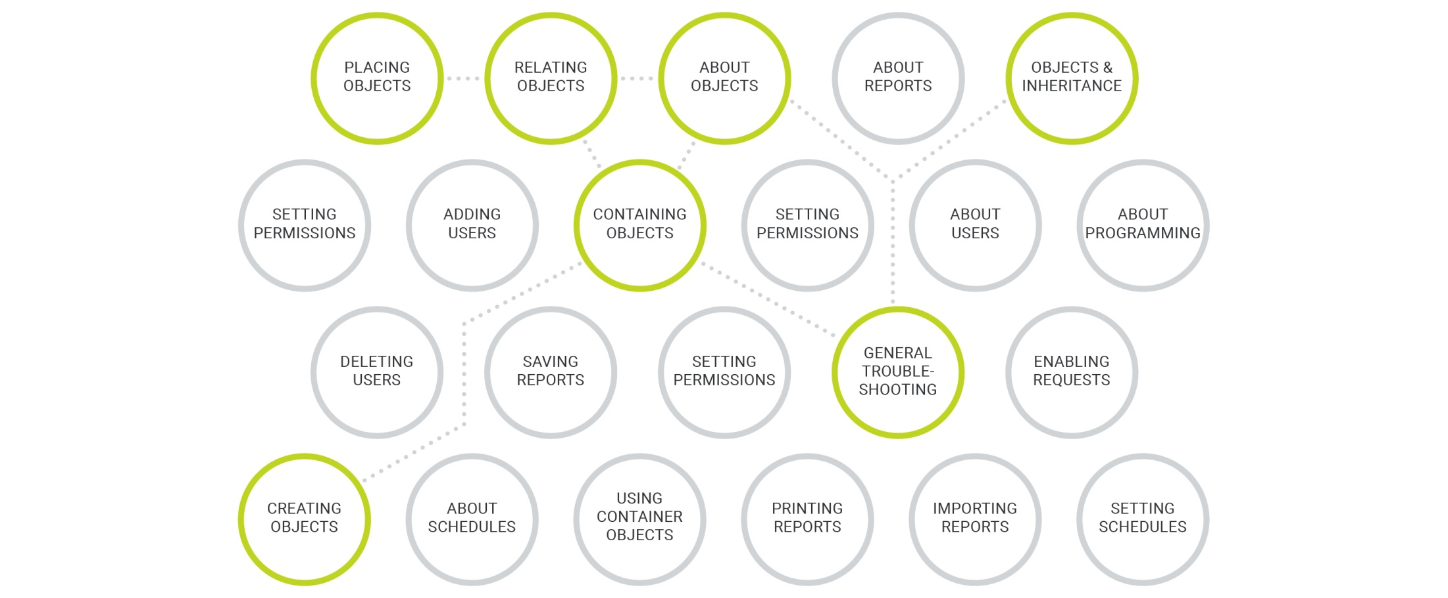
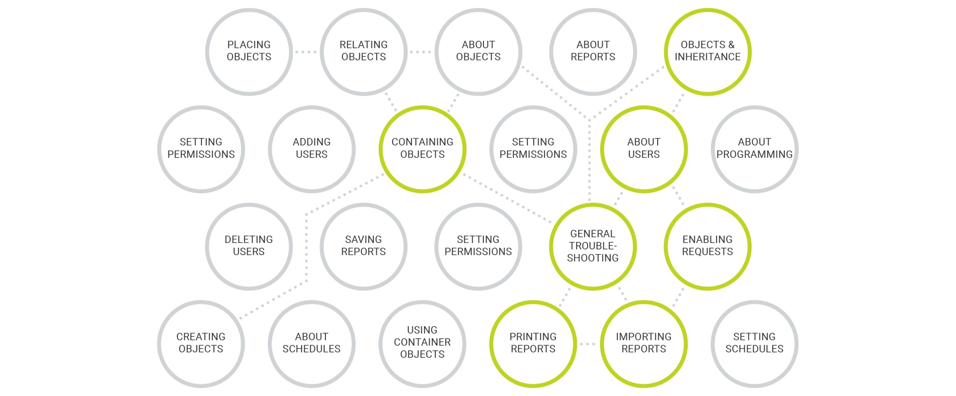
Remember – think topics

Slide 5

Madcap softare concepts:
Single-Source Publishing

Slide 6
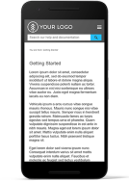
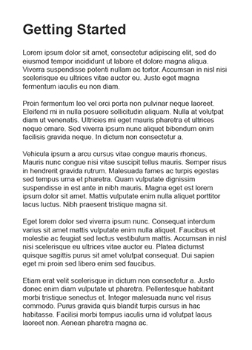
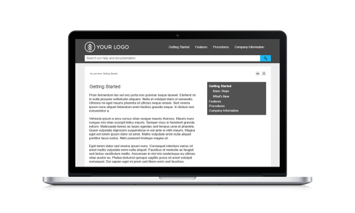
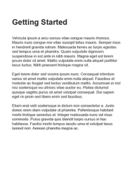


Single sourcing: work flow
Create Master Source Files (Content)
Add Conditional Tags/Variables (Customize)
Define Publishing Targets (Output)
Generate 3
Different Outputs
TARGET – Standard HTML 5
Include: Standard Info
Exclude: Enterprise Info
PDF Info
Define other specific attributes
TARGET – Standard HTML5
TARGET – Enterprise HTML5
TARGET – Enterprise HTML 5
Include: Enterprise Info
Exclude: Standard Info
PDF Info
Define other specific attributes
TARGET – Standard PDF
Include: PDF & Standard Info
Exclude: Enterprise Info
Define other specific attributes
TARGET – Standard PDF (PDF only)

Slide 7

Madcap flare workflow
IMPORT
CREATE/EDIT
PUBLISH
Microsoft Word
Microsoft Excel
Adobe FrameMaker
Atlassian Confluence
RoboHelp and other Help Projects
Author-It
HTML files
Doc-To-Help Projects
.CHM files
DITA
Print
PDF
Microsoft Word
Web Browser
Responsive HTML5
Windows Desktop
HTML Help (.CHM)
Other
Clean XHTML
DITA
EclipseHelp
EPUB
Salesforce Knowledge
Zendesk

Slide 8

Thank you!
Jennifer Morse
jmorse@madcapsoftware.com
Notes:
That takes us through the end of Module 7. In Modules 8 and 9 next, we learn about SENDING TOPICS FOR REVIEW AND BUILDING TARGETS

