Slide 1
Wink Tour

Slide 2
Hi! Welcome to the Wink tour!
Wink is a software tool to make presentations and tutorials about using software programs.
Let’s walk through a few features.

Slide 3
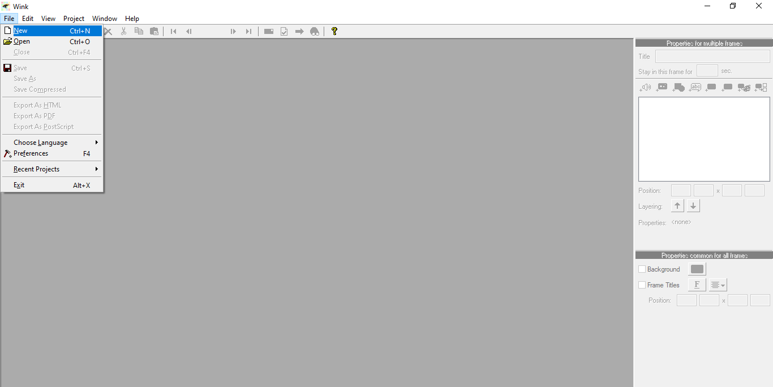
1
File menu
Use the File menu to create a new Wink file by clicking on File and selecting New.

Slide 4
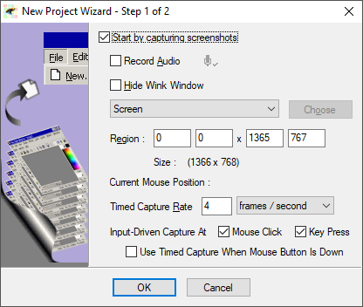
Define a capture area.
When recording audio, it is best to use a headset and avoid typing on keyboard while speaking.
2

Slide 5
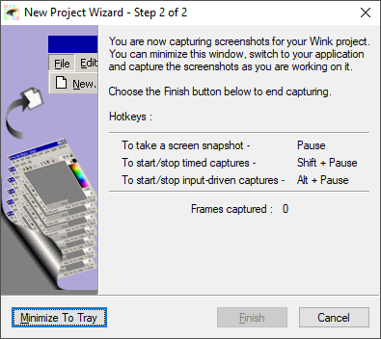
Defining Hotkeys.
Here you see the screenshot hotkey is Pause.
3
Minimize To Tray
To begin your project, click Minimize To Tray button.
4

Slide 6
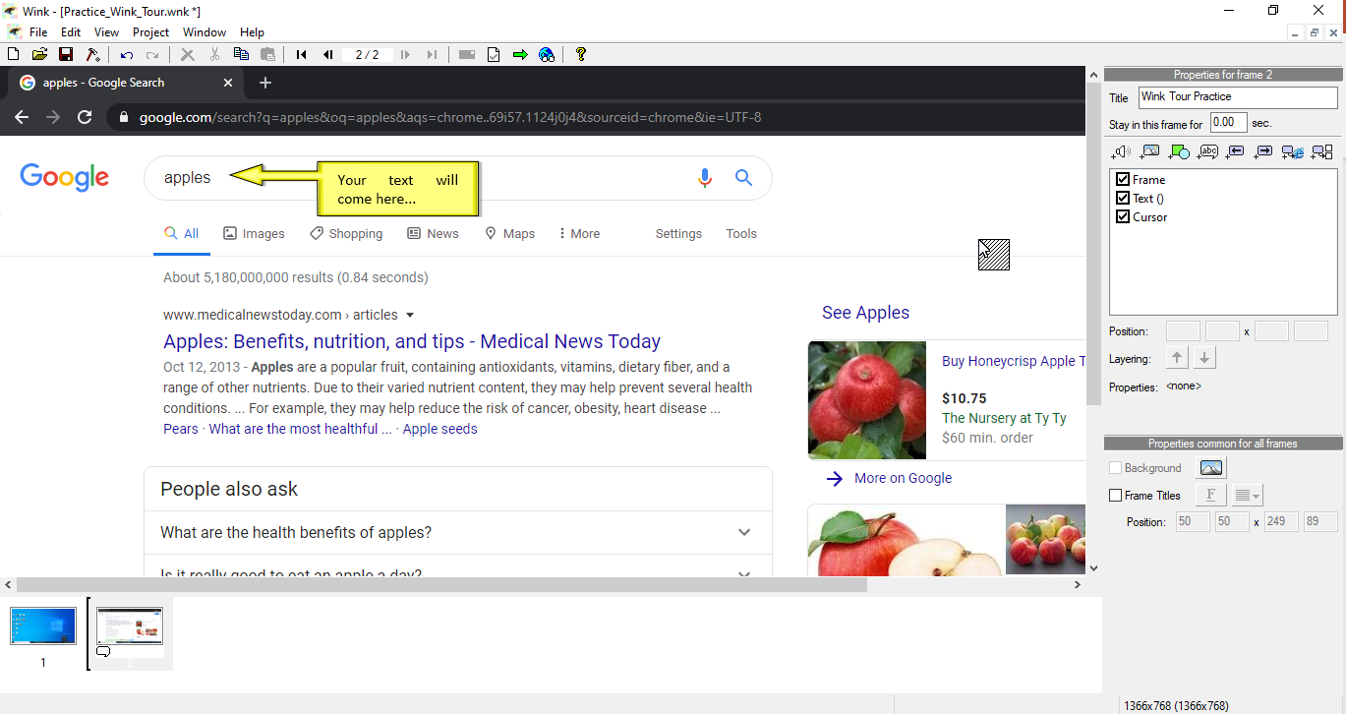
Add Textbox
To add a textbox, go to the Properties bar and click the Add Textbox button.
5
Congratulations! You have completed the Wink tour!

