Slide 1
Wink Tour

Slide 2
Hi! Welcome to the Wink tour!
Wink is a software tool to make presentations and tutorials about using software programs.
Now I’m going to walk you through a few features in Wink to help you get started.

Slide 3
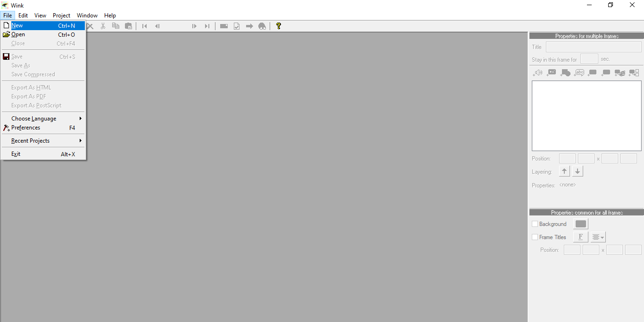
File tab
Use the File tab to create a new Wink file by clicking on File and selecting New.
1

Slide 4
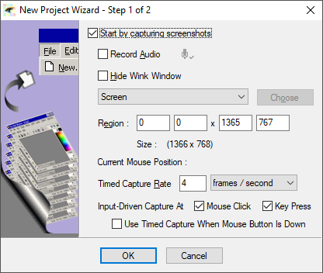
New Project Wizard – Step 1 of 2
Use New Project Wizard Step 1 of 2 to define capture area.
2

Slide 5
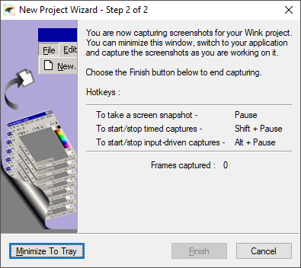
3
New Project Wizard – Step 2 of 2
Use New Project Wizard Step 2 of 2 to define the Hotkeys to capture screenshots.
For example, I took a screen snapshot of a Google search by pressing Pause. You will see this on the next screen.
Minimize To Tray
To begin your project, click Minimize To Tray button.
4

Slide 6
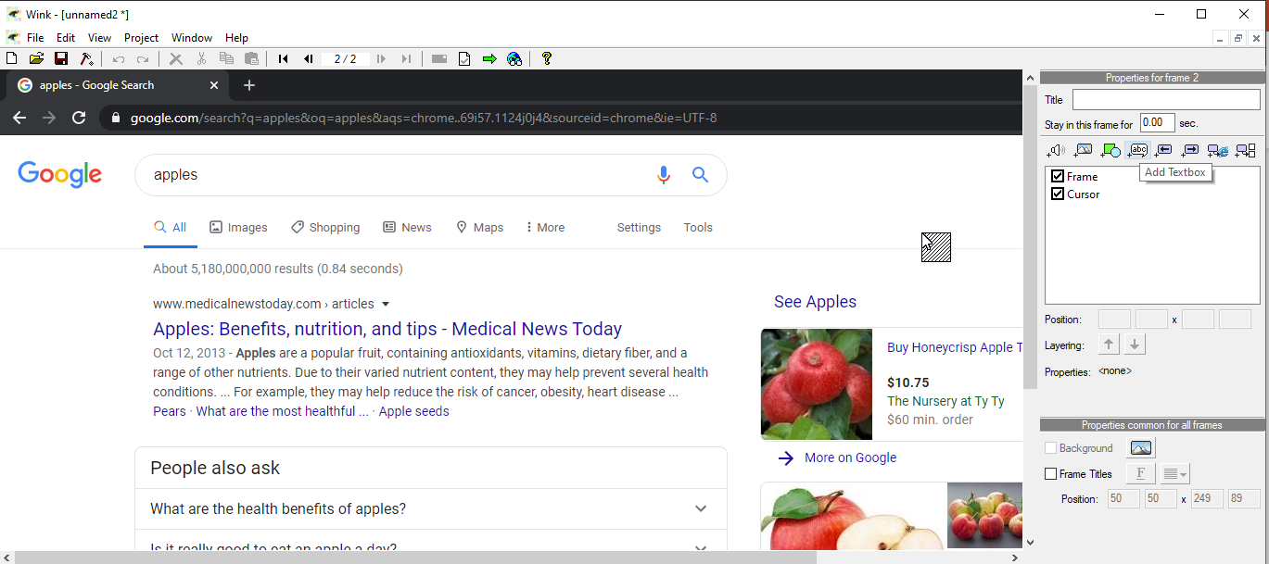
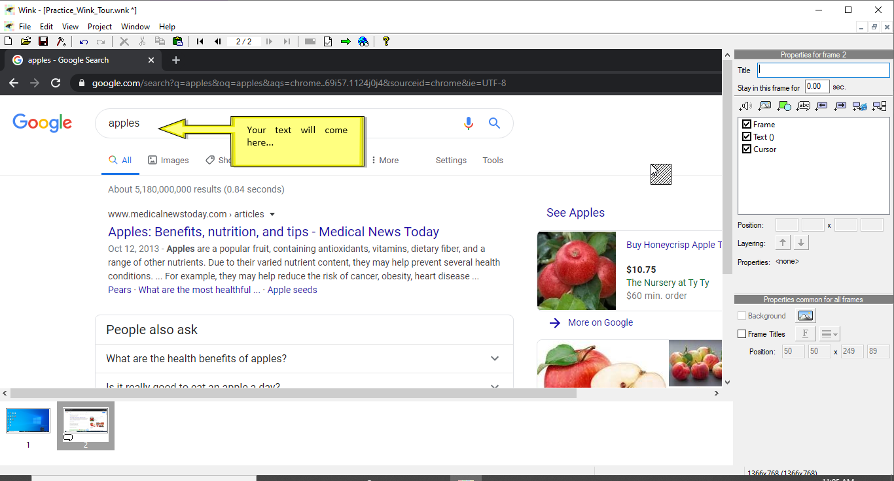
Add Textbox
To add a textbox, go to the Properties bar and click the Add Textbox button.
5
Congratulations! You have completed the Wink tour!

