Slide 1
Meghana Tour Mockup

Slide 2
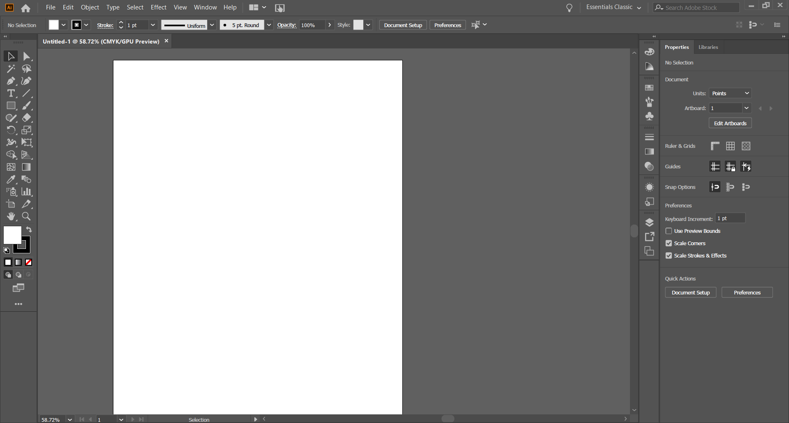
Artboard
You can start composing your creative ideas on the artboard. To create another artboard, click “Window” > “Artboard” in the top menu bar.
Press next for more information.
back
next
end

Slide 3
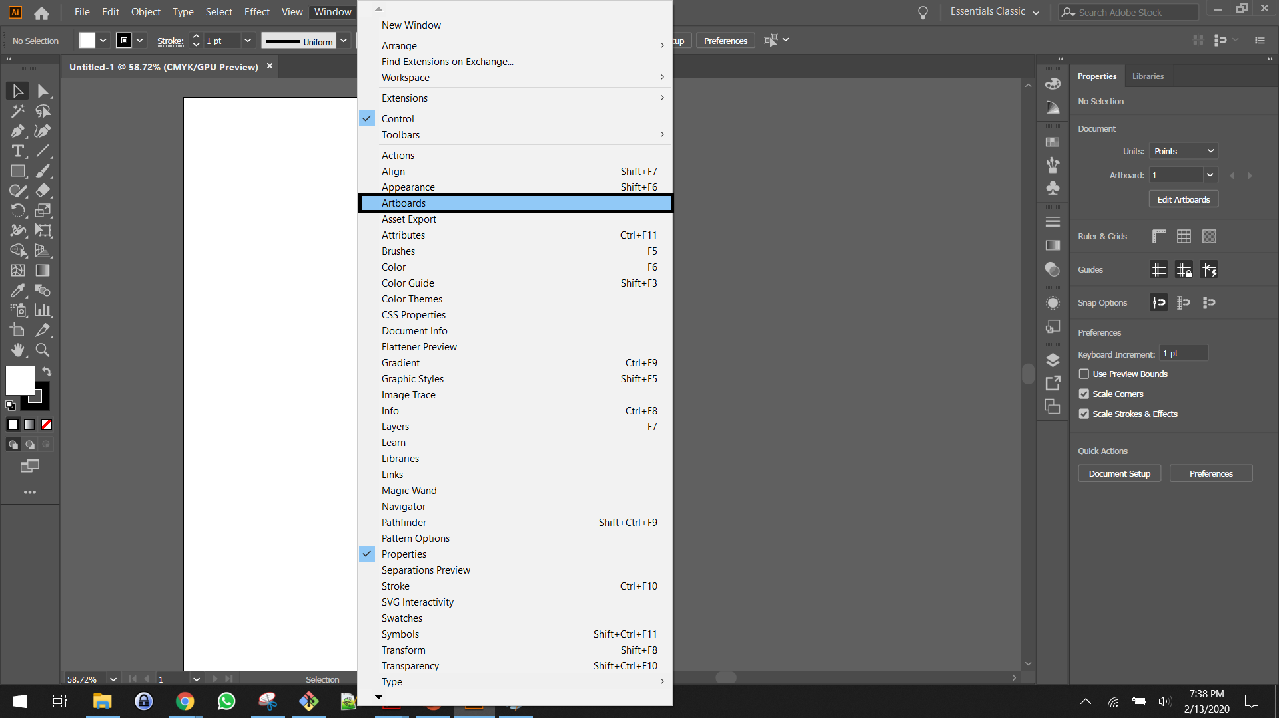
Artboards
Click “Artboards” to enable the “Artboards” panel.
Press next for the next step.
back
next
end

Slide 4
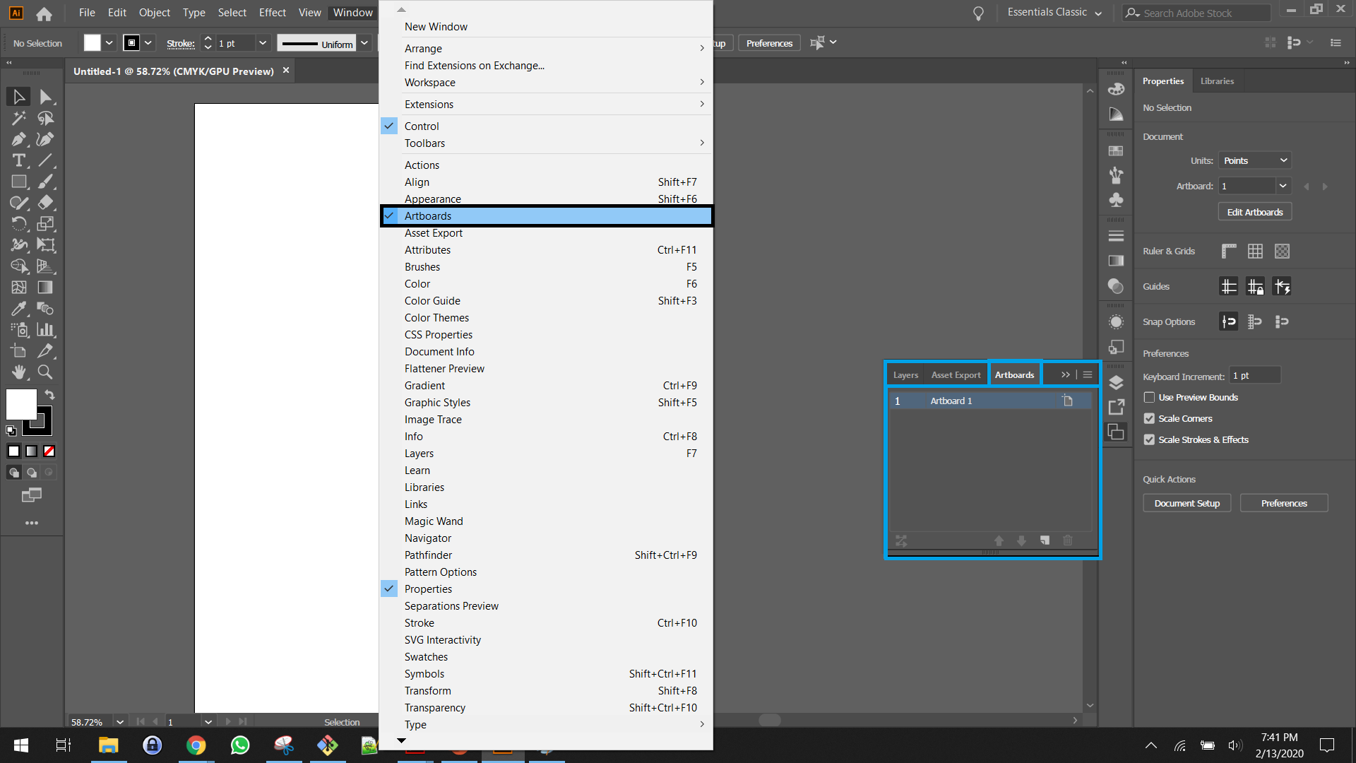
Artboards
Clicking “Artboards” in the “Window” dropdown enables the “Artboards” panel below.
Press next for the next step.
back
next
end

