Slide 1
Garageband: Get Started Editing Your Podcast
A Tour Mock-Up
Challenge: Create a Tour with a Single, Static Page
by Anita Weiner

Slide 2
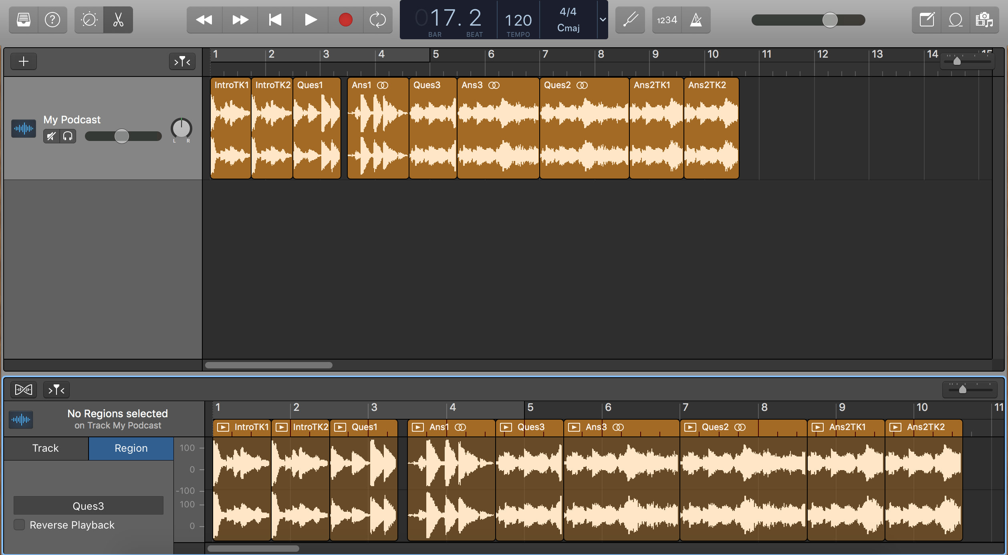
Congratulations! You’ve just recorded your first podcast. Before you upload it for the world to hear, maybe you want to cut out a bad take? Shorten your guest’s answers? Or rearrange the order of your questions? This tour gets you started.
Back Next End

Slide 3
Before you can cut, move, copy, loop, or trim a section of your podcast, you’ll first need to create that section. Each section you create is called an “audio region.” Here is an audio region. Audio regions can be any size.
Back Next End

Slide 4
This track currently has nine audio regions. You can create new regions anytime.
Back Next End

Slide 5
This is the Audio Editor. You create new audio regions here. When you open the Audio Editor, your track appears in this window.
Back Next End

Slide 6
To open or close the Audio Editor window, click the Editors button.
Back Next End

Slide 7
How to Create an Audio Region
In the Audio Editor, highlight the section you want to edit and then click it. The new audio region appears. (To highlight a section, place the cursor in the lower half of the track until it turns from an arrow into a plus sign (+). Then click and drag the cursor left or right.)
Back Next End

Slide 8
Name your region here
Back Next End

Slide 9
Now you are ready to edit your regions. Make edits here in the workspace...
Back Next End

Slide 10
... or in the Audio Editor. Have fun!
Back Next End

