Slide 1
Garageband: Editing with Audio Regions
A Tour Mock-Up
by Anita Weiner

Slide 2
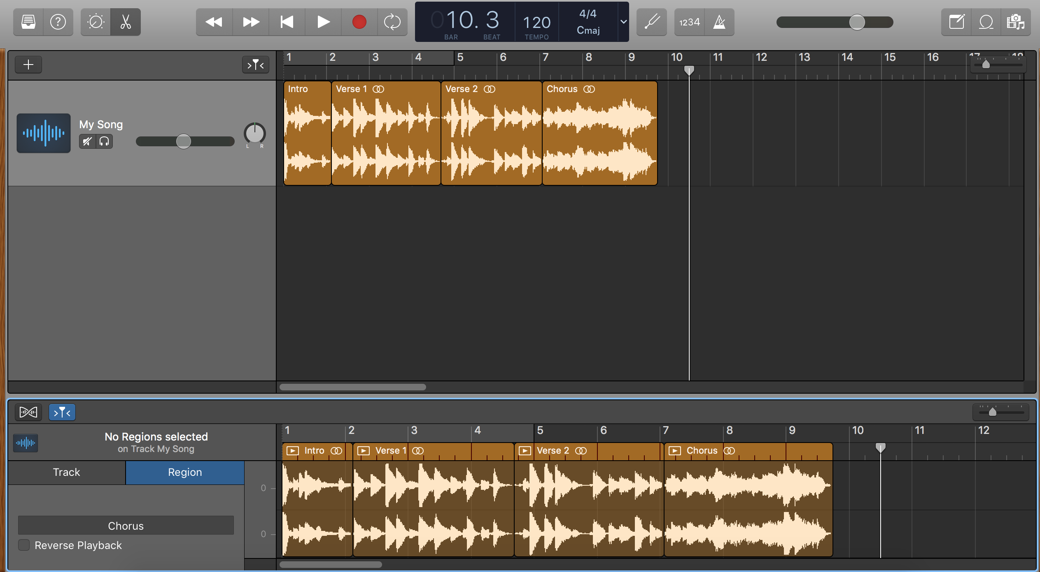
Create Audio Regions to Edit Sections of your Track
Here is an audio region. Once you have your track in the Workspace, you can separate your track into sections – audio regions – and then edit each audio region however you want. Move, loop, trim, copy, fade, EQ, and much more.
Back Next End

Slide 3
This track currently has four audio regions: Intro, Verse 1, Verse 2, and Chorus. You can create new regions anytime.
Back Next End

Slide 4
This is the Audio Editor window where you create new audio regions for your tracks.
Back Next End

Slide 5
To open or close the Audio Editor window, click the Editors button.
Back Next End

Slide 6
How to Create an Audio Region
To create an audio region, highlight the region you want to create in the Audio Editor and then click the highlighted region. (To highlight, place the cursor in the lower half of the waveform until it turns into a marquee pointer (+) and then drag left or right.)
Back Next End

Slide 7
Name your region here
Back Next End

Slide 8
Now you are ready to edit your regions. Make edits in the Workspace...
Back Next End

Slide 9
... or the Audio Editor. Have fun!
Back Next End

