Slide 1
Mockup Tour of Creating a New Artboard in Adobe Illustrator
Meghana Arvind
MCC Tech Writing Spring 2020

Slide 2
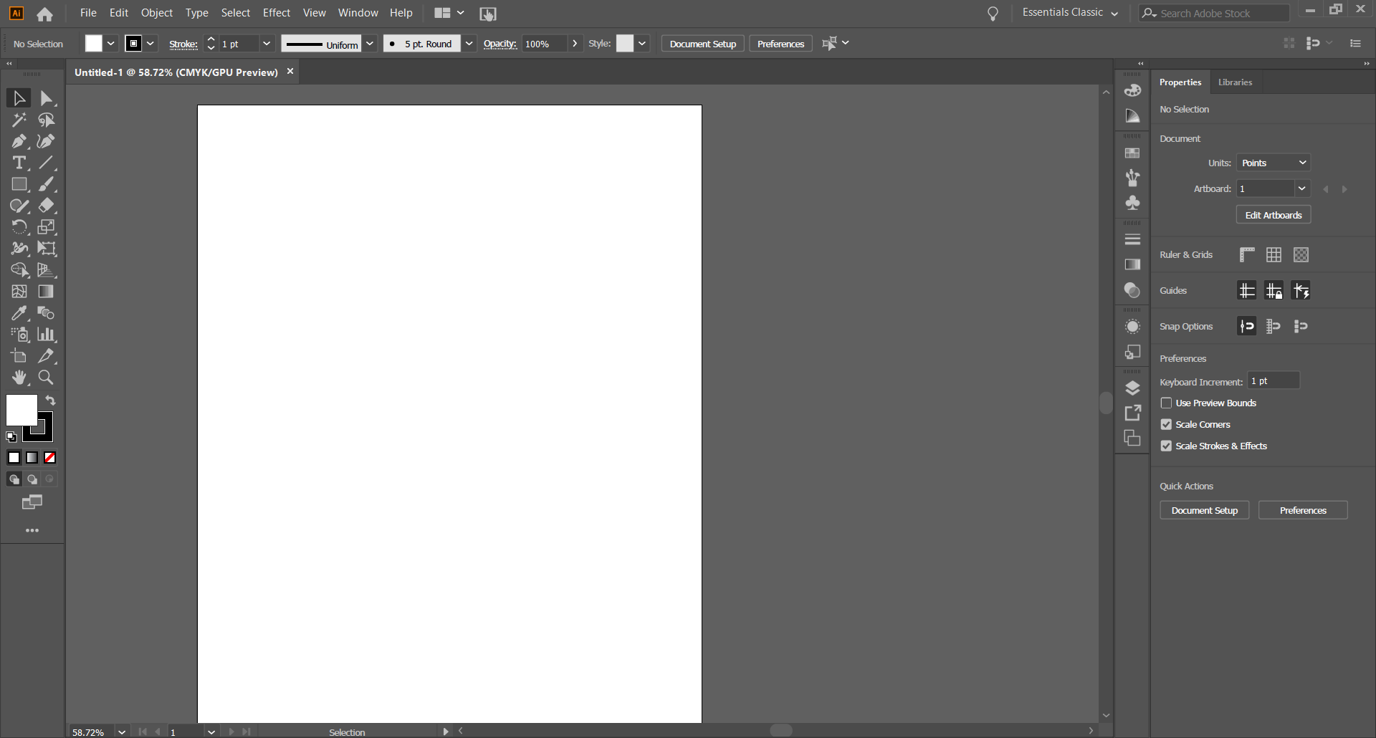
Artboard
You can start composing your creative ideas on the artboard. To create another artboard, click “Window” > “Artboard” in the top menu bar.
Press next for more information.
back
next
end

Slide 3
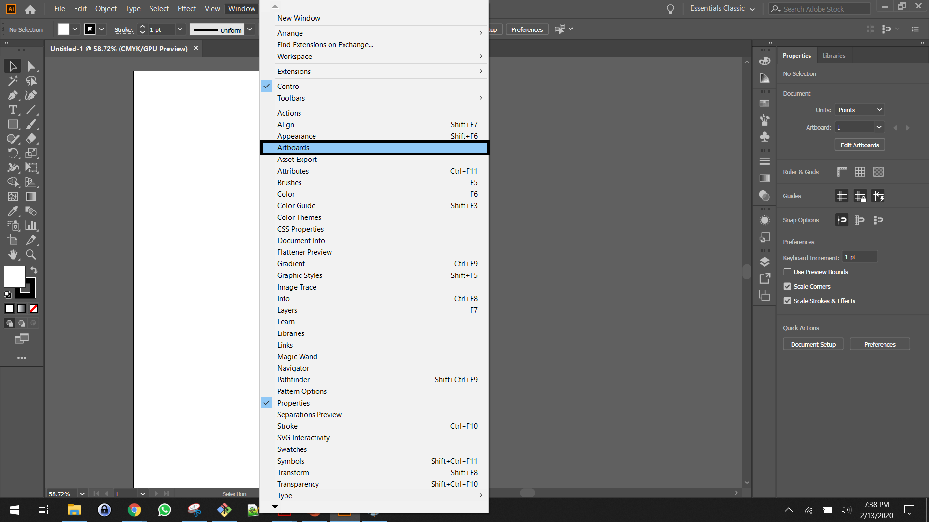
Artboard
Click “Artboards” to enable the “Artboards” panel.
Press next for the next step or press back to go to a previous step.
back
next
end

Slide 4
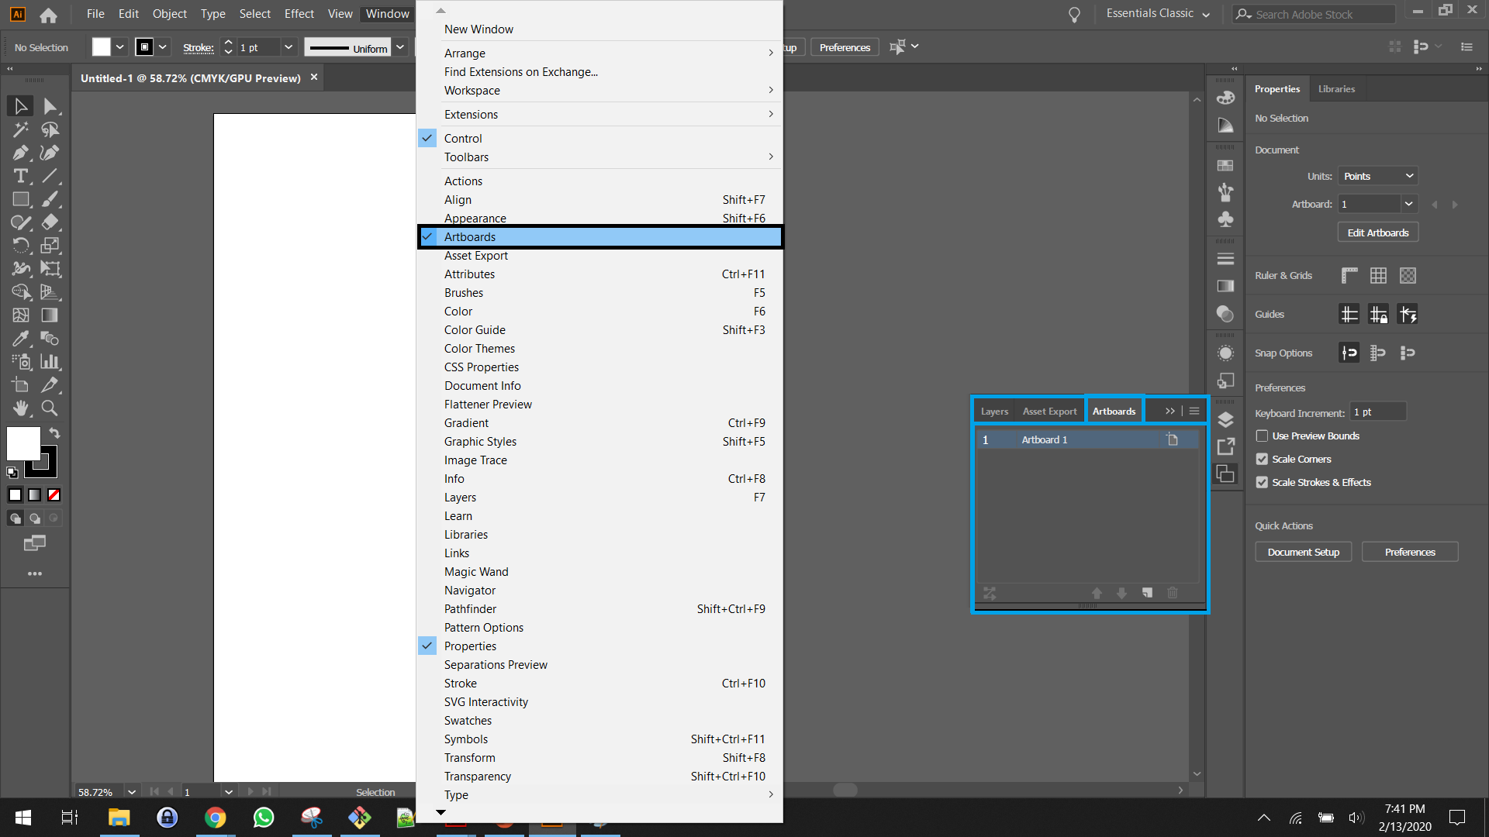
Artboard
Clicking “Artboards” in the “Window” dropdown enables the “Artboards” panel below.
Press next for the next step or press back to go to a previous step.
back
next
end

Slide 5
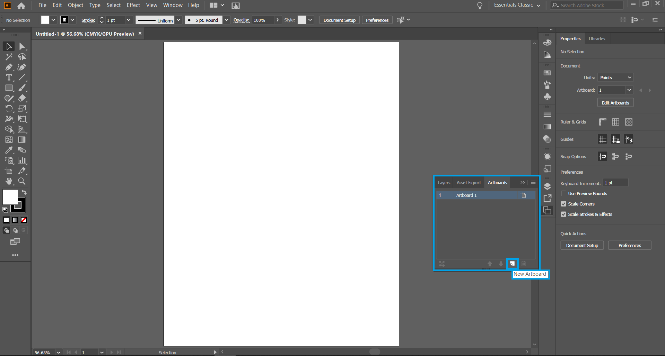
Artboard
Clicking “New Artboard” in the “Artboard” panel creates a new artboard.
Press next for the next step or press back to go to a previous step.
back
next
end

Slide 6
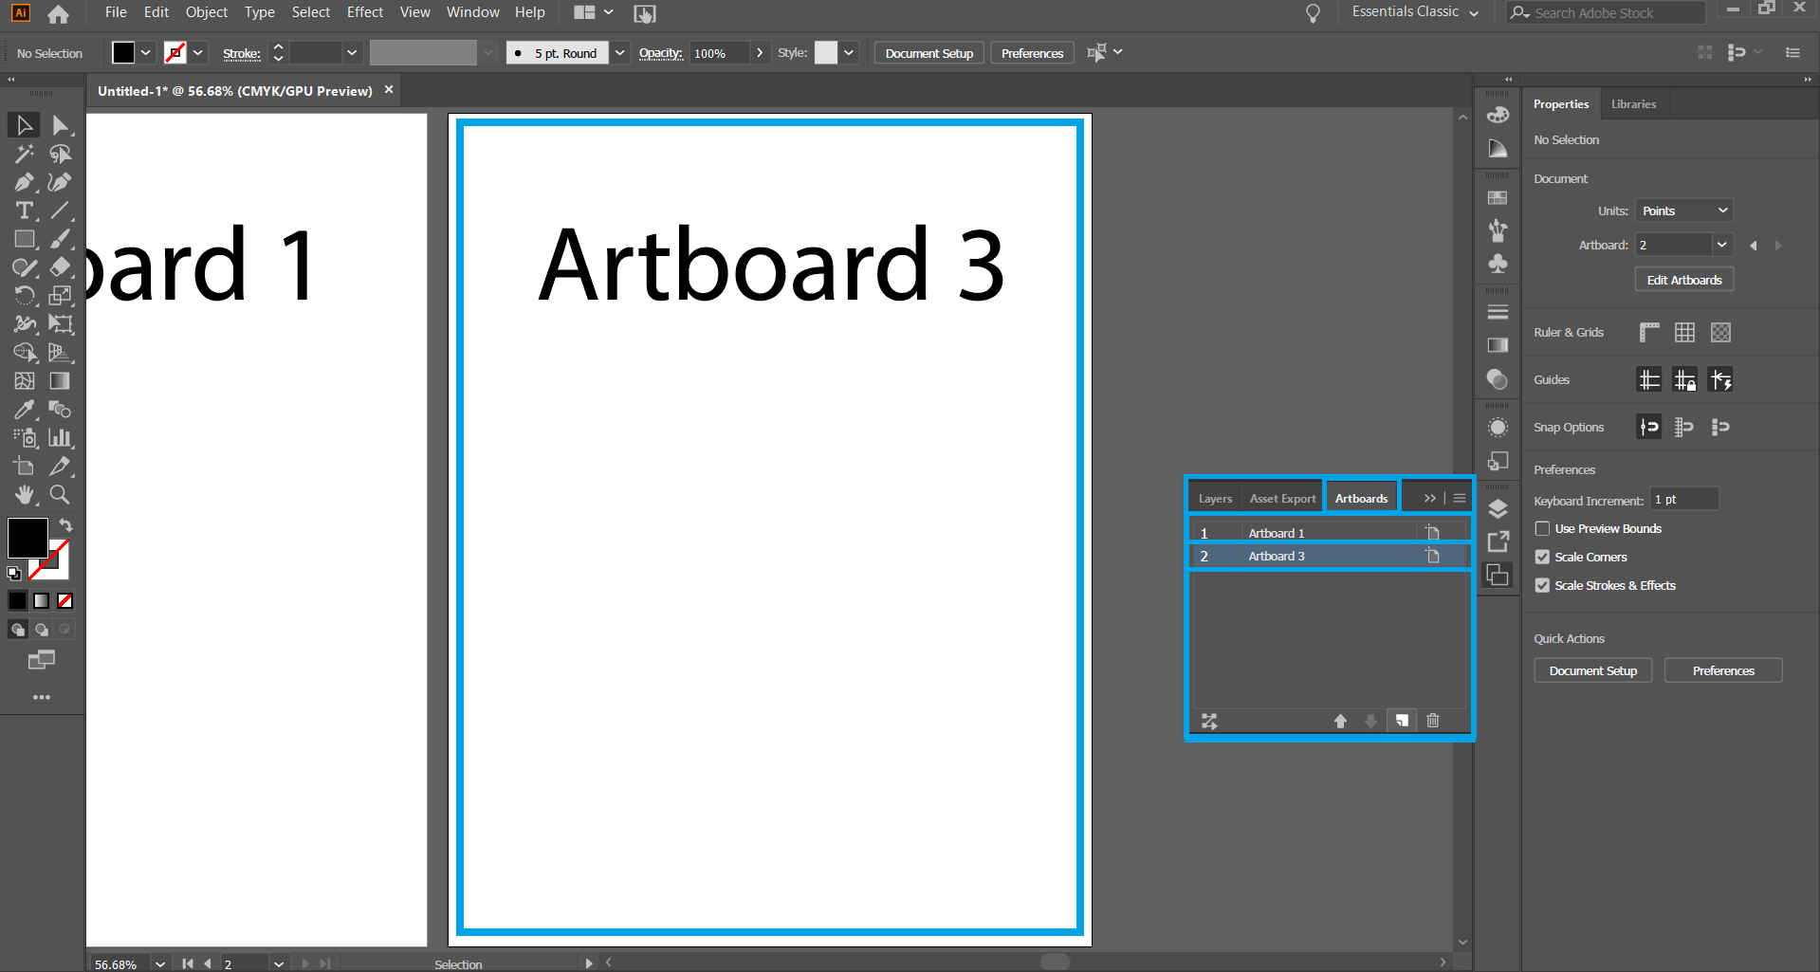
Artboard
The new artboard that you created by pressing the button in the previous step is on layer 2 and named “Artboard 3” by default. You can change the name by double clicking on the artboard name.
Press back to go to a previous step.
back
next
end

