Slide 1
OneNote Basics: Creating a Notebook
Andrea MacGown

Slide 2


Slide 3
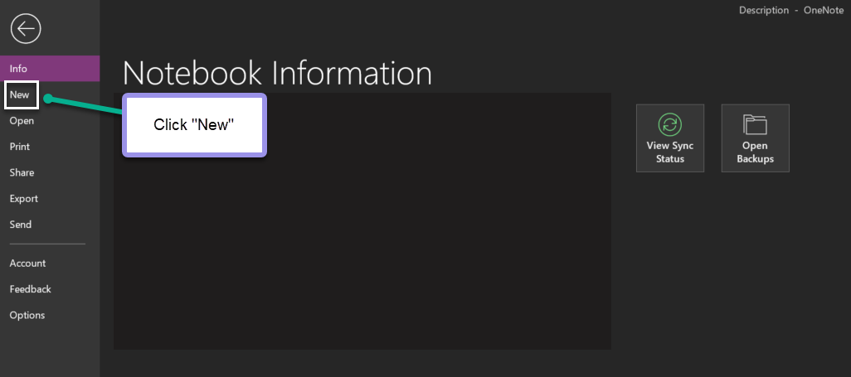

Slide 4
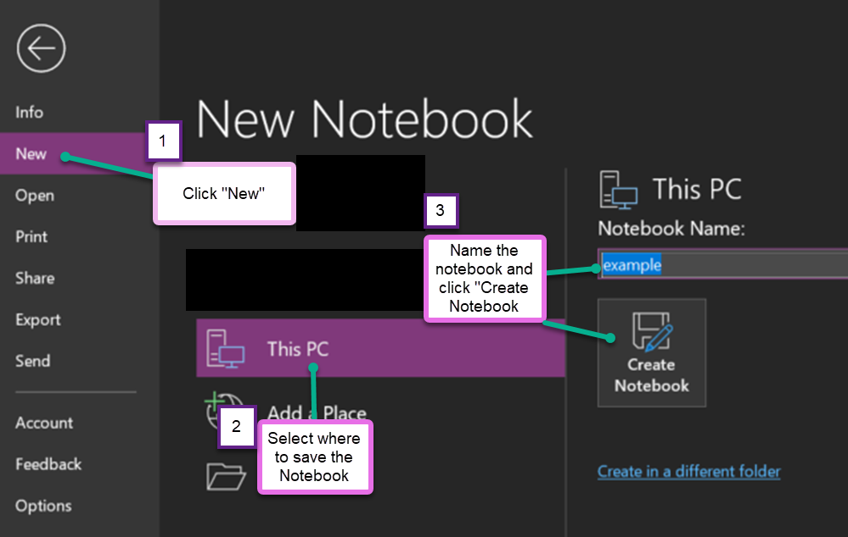

Slide 5
