Slide 1
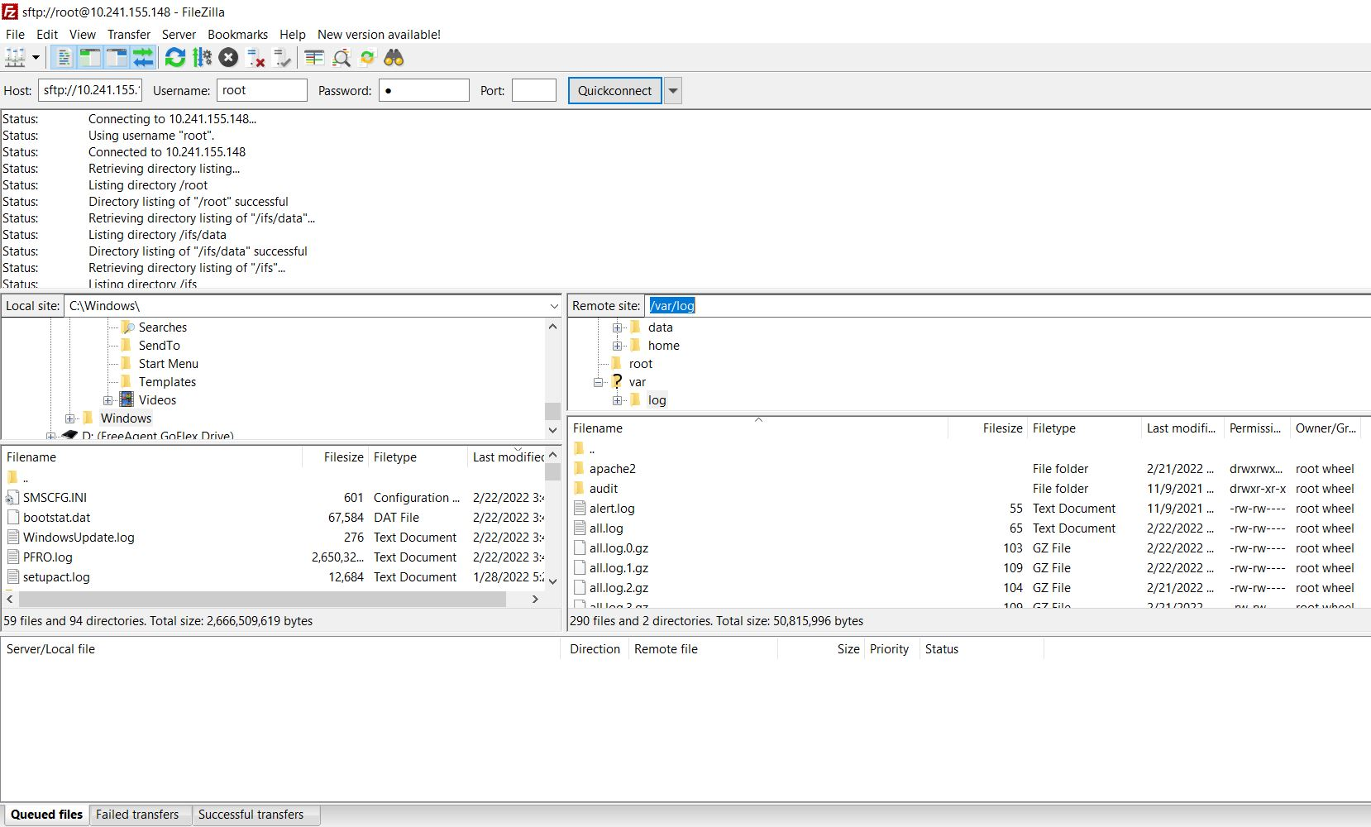
Host Field
Add the IP address for the connection

Slide 2
Username
Add the username for the connection

Slide 3
Password
Enter the password for the connection

Slide 4
Port
Add the port, typically port 21 (ftp) or 22 (ssh)

