Slide 1
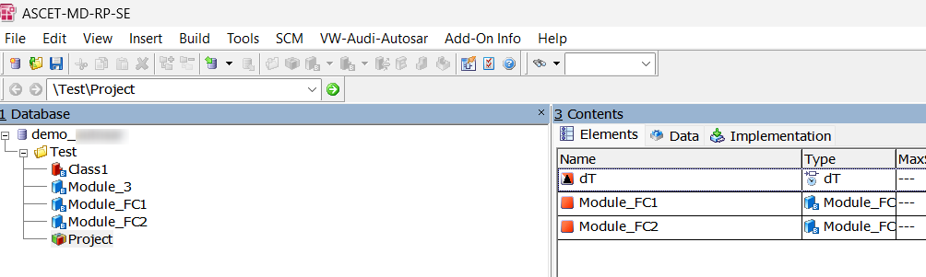
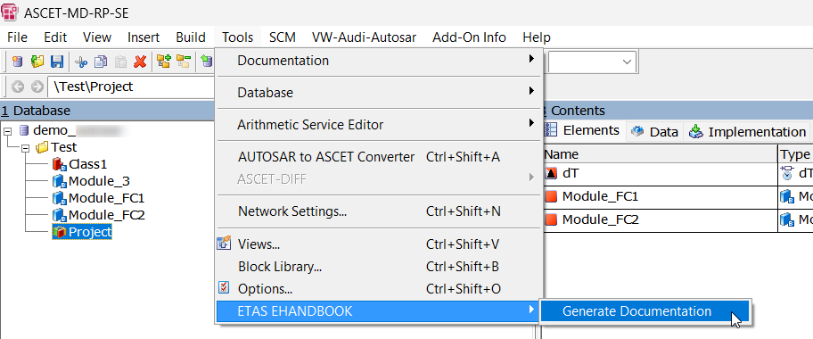
Step 1 : Import the AXL file shared in the location. (TestInput.axl)
Step 2 : Choose the project to be processed and navigate to Tools, ETAS EHANDBOOK and choose Generate Documentation.

Slide 2
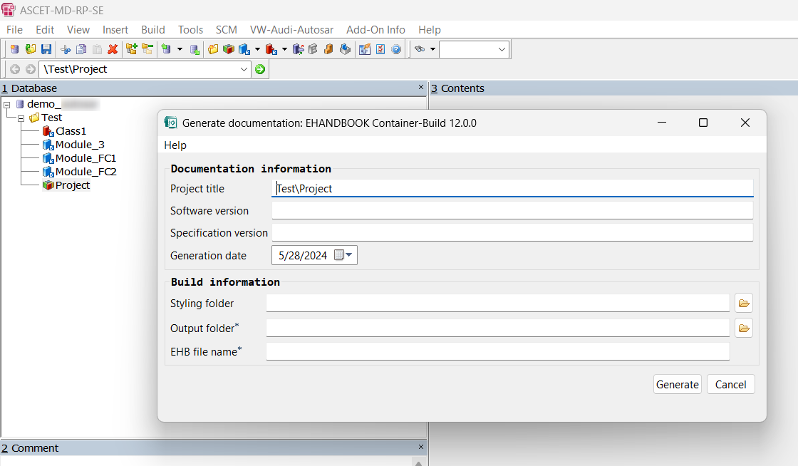
Step 3 : A window pops up with details to be entered by the user.

Slide 3
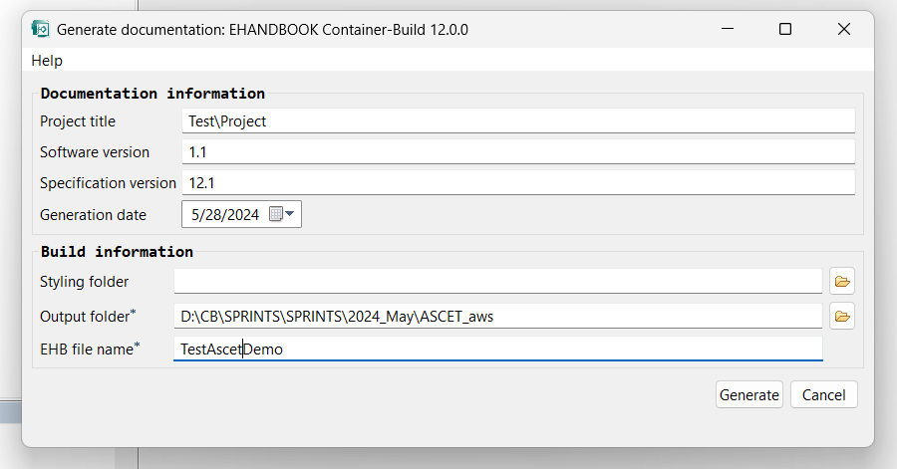
Step 4 : Hit Generate after filling all details.

Slide 4
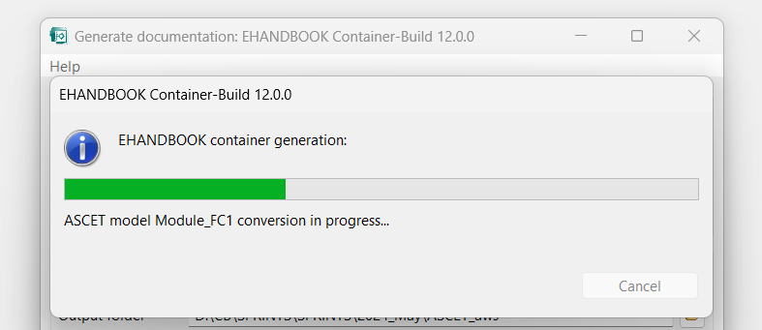
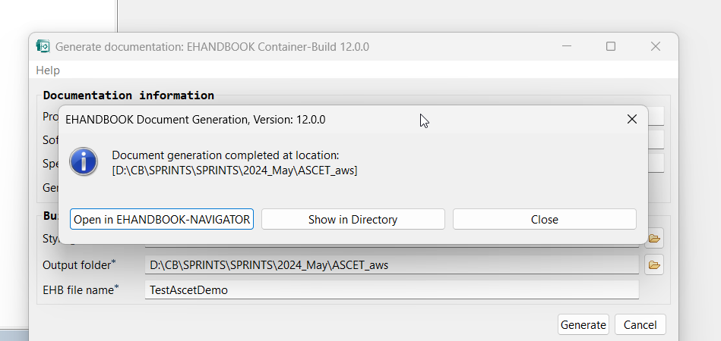
Step 5 : The progress bar is shown on the screen and after container is generated you will see the following pop up.

Slide 5
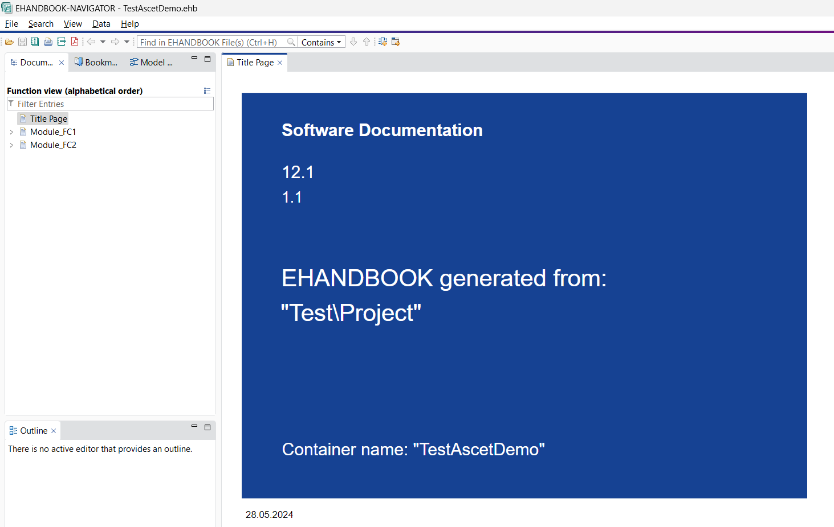
Step 6 : View the container in the navigator.

Slide 6
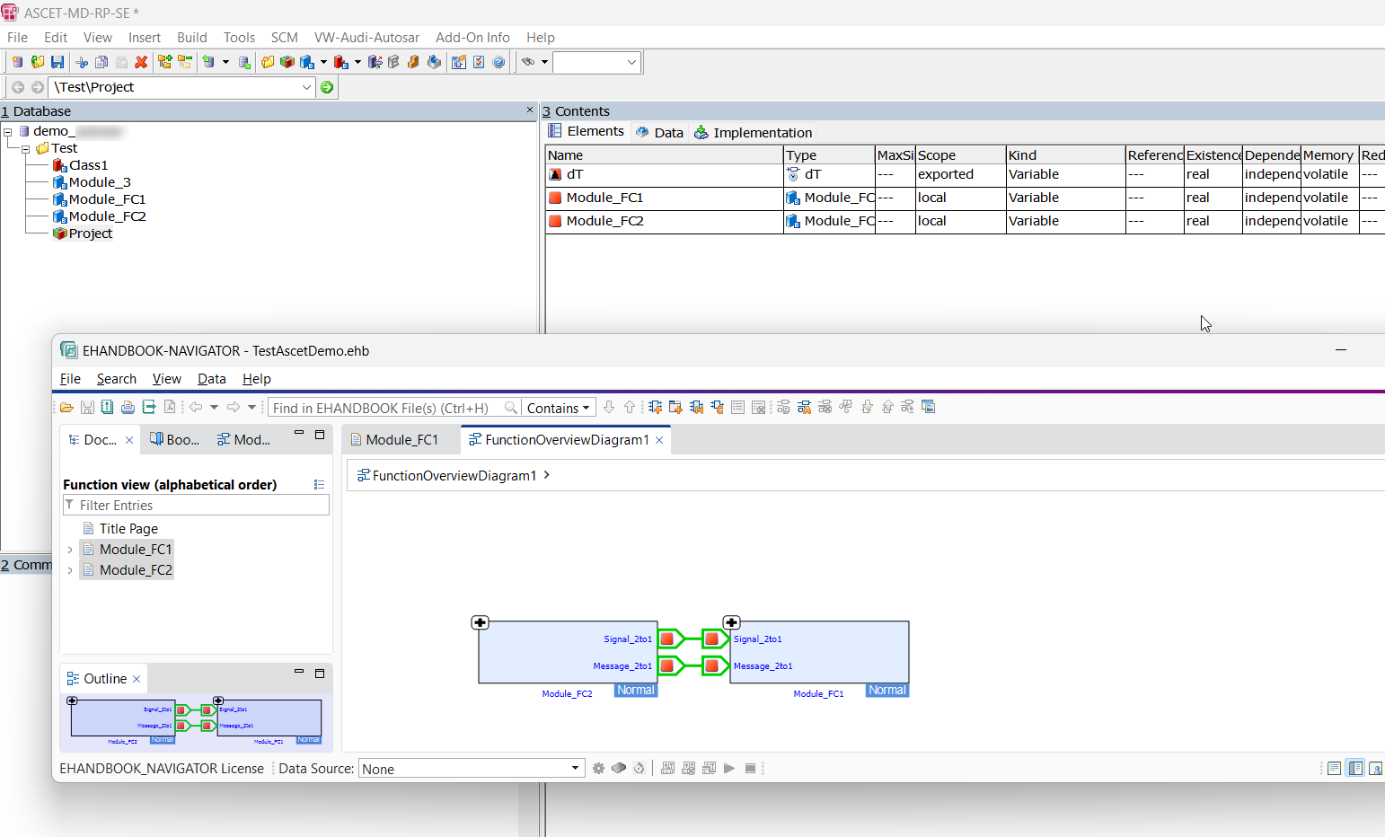
Important : Modules which are referred in the Project are only processed by EHANDBOOK and hence creates new FC entries for these modules. In this example, Module_3 is not referred inside the project and so does not appear in the container.

