Slide 1
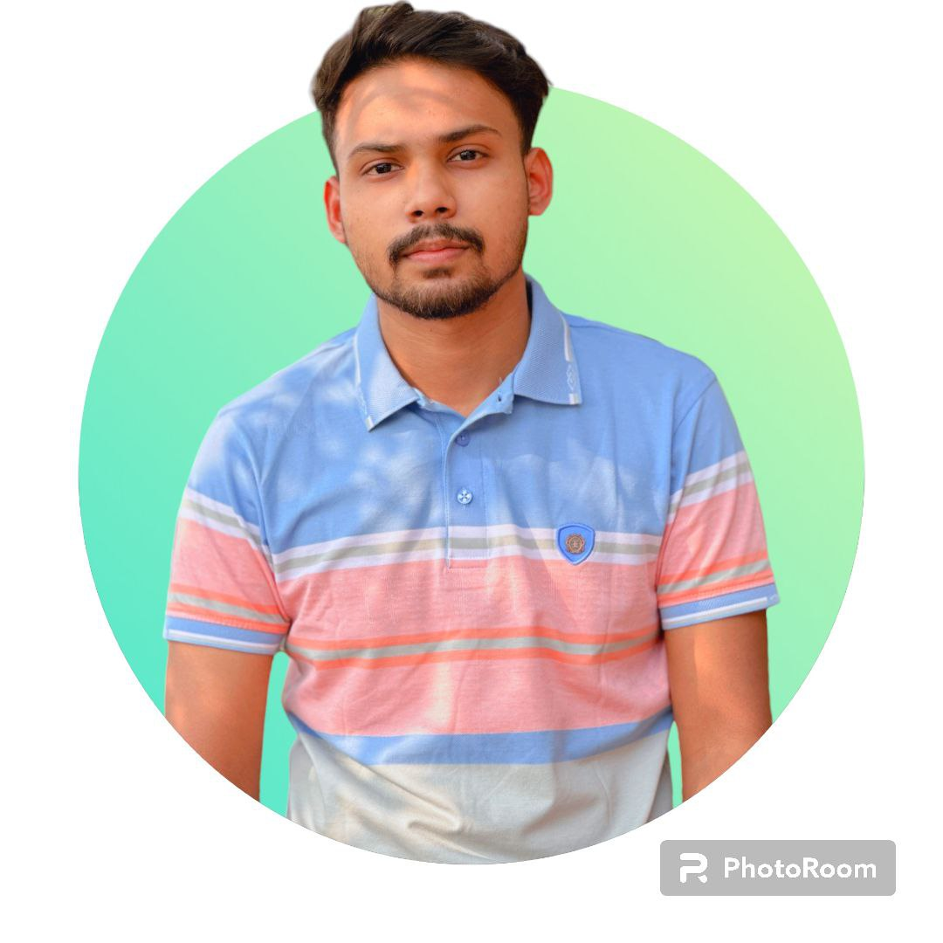
Blood Donor
Life is Easy
TONMOY SUTRADHAR
Director
ID: 22-46568-1
Blood: B+
Email: tonmoy@gmail.com
Phone: 01779-148110

