Slide 1

Automatic Dark Light
Project Name
COURSE INSTRUCTOR: TANVIR IBNE ANWAR
Group - 01
NAME | ID
Ekramul Haque | 22-46570-1
Kazi Abdullah Jarif | 22-46386-1
Mahin Montasir Afif | 22-46573-1
Abdullah Al Noman | 22-46609-1
Azharul Islam | 22-46816-1

Slide 2
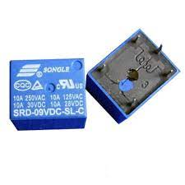
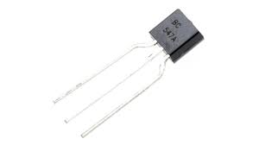
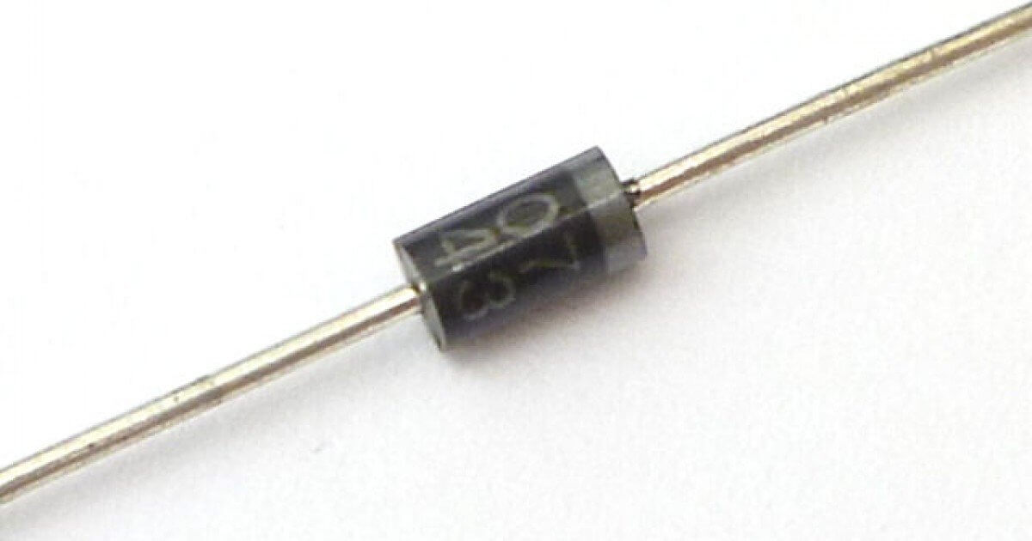
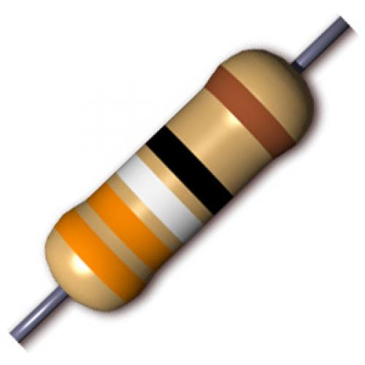
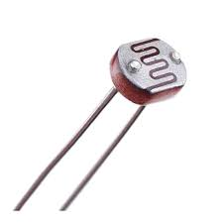
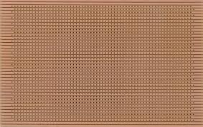
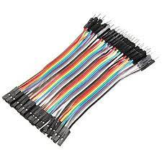

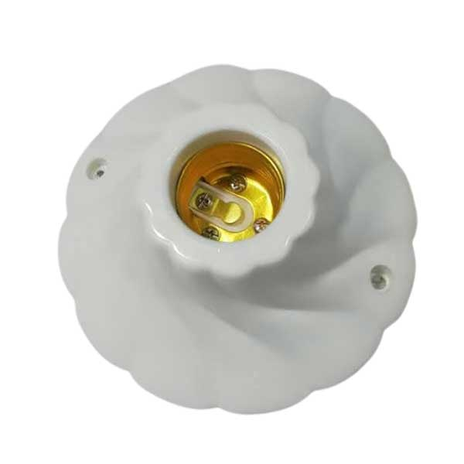
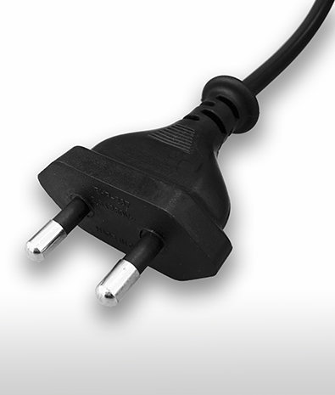
COMPONENTS
9V DC Relay
BC547A Transistor
1N 4007 diode
100KΩ resistor
Small LDR
Veroboard
Connecting wire
Light
Light Holder
Plug (2 pin )

Slide 3
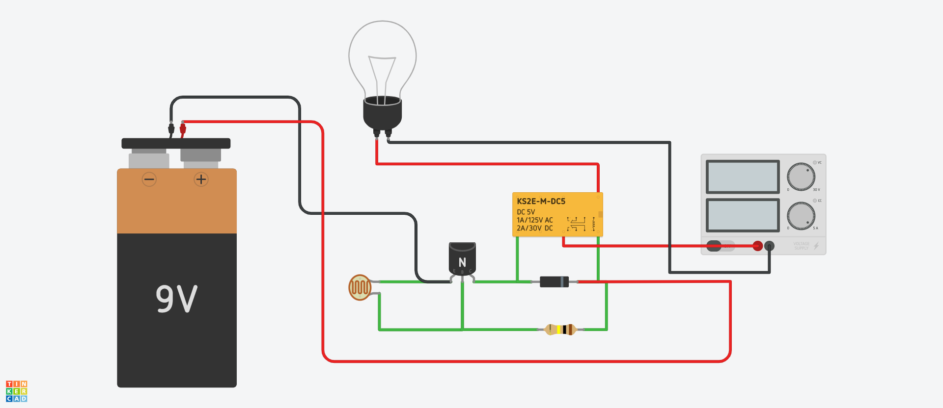
Circuit Diagram

Slide 4
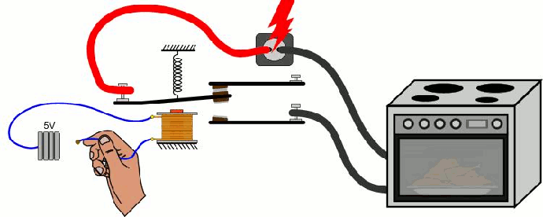
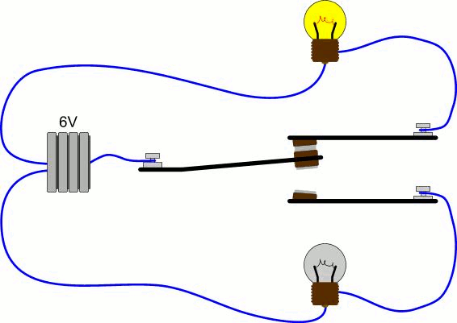
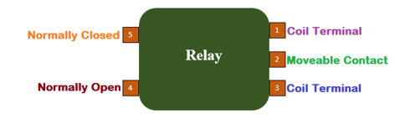
Common
Relay Working Principle

Slide 5
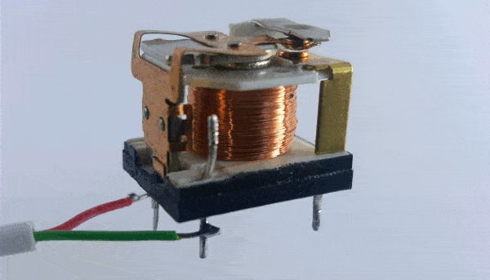

Slide 6
Signal Generator for Relay

Slide 7
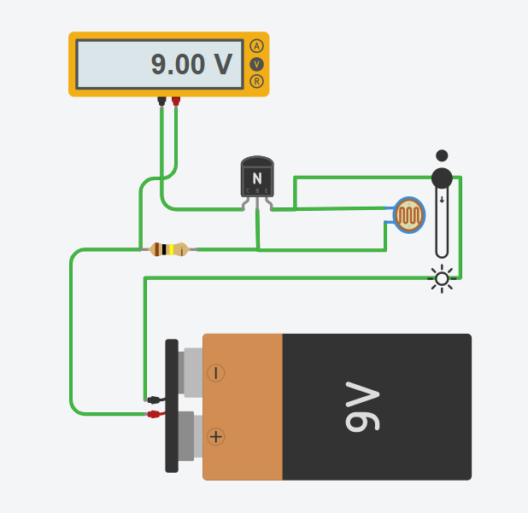
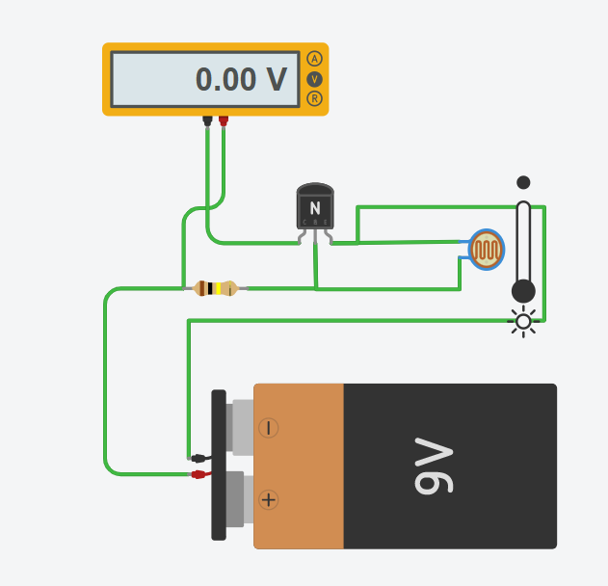
Signal Generator for Relay
When Light is low
When Light is High

Slide 8
Relay Feedback Current
Why?

Slide 9
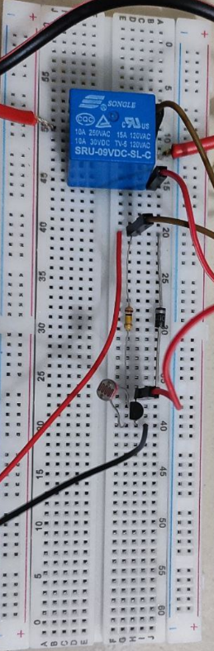
Practical Demonstration of Circuit Diagram

Slide 10


Slide 12




Alarm
Office
Emergency Light

Slide 13


