Slide 1
Foundational Industry Energy Dataset
Preliminary analysis
August 8, 2023

Slide 2
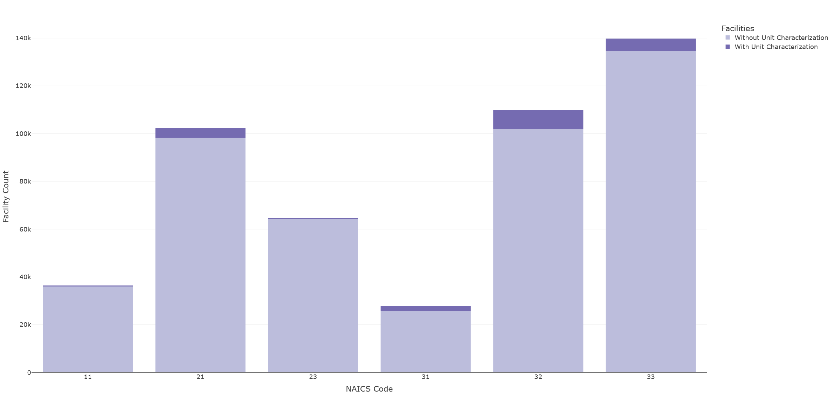
Only a small portion of facilities have unit-level data (i.e. have any unit type specification): 0.7% (mining) – ~6% (mfg)

Slide 3
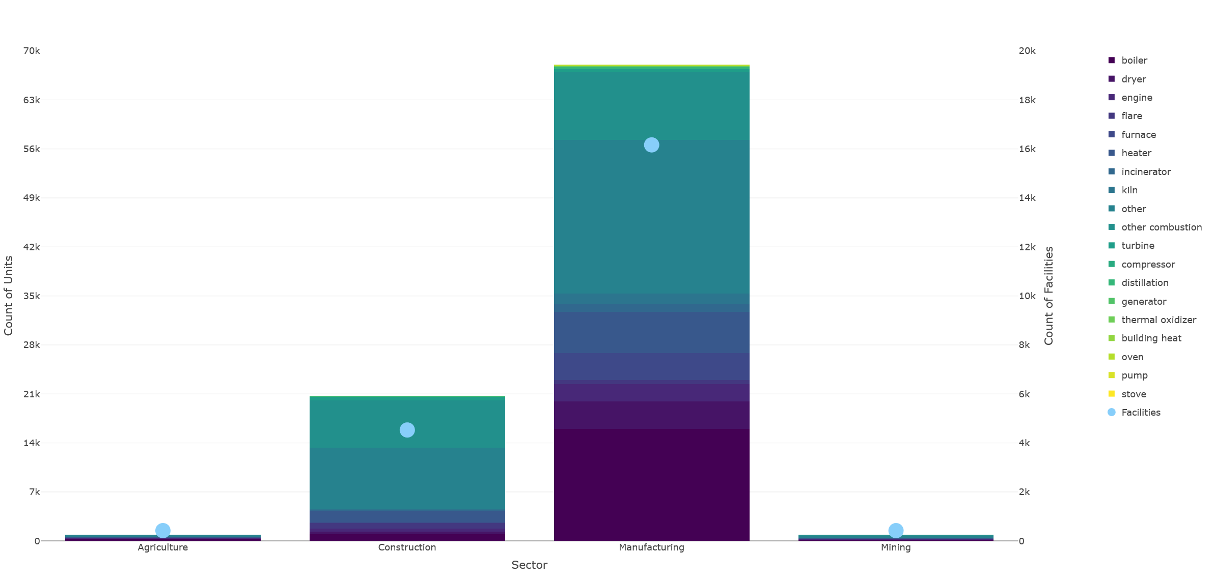

Slide 4
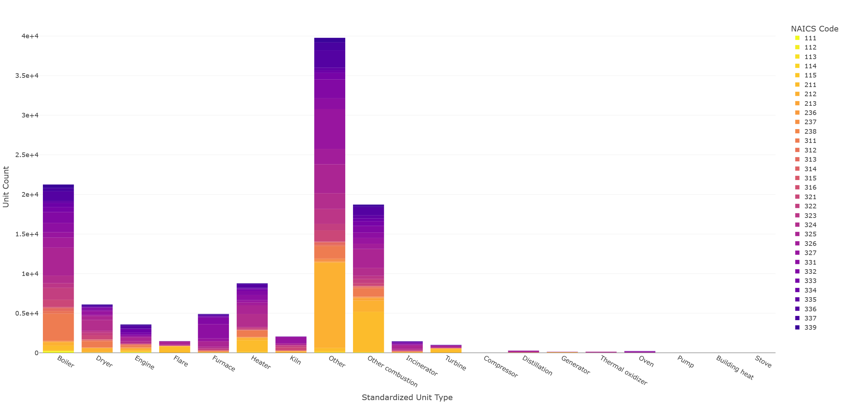

Slide 5
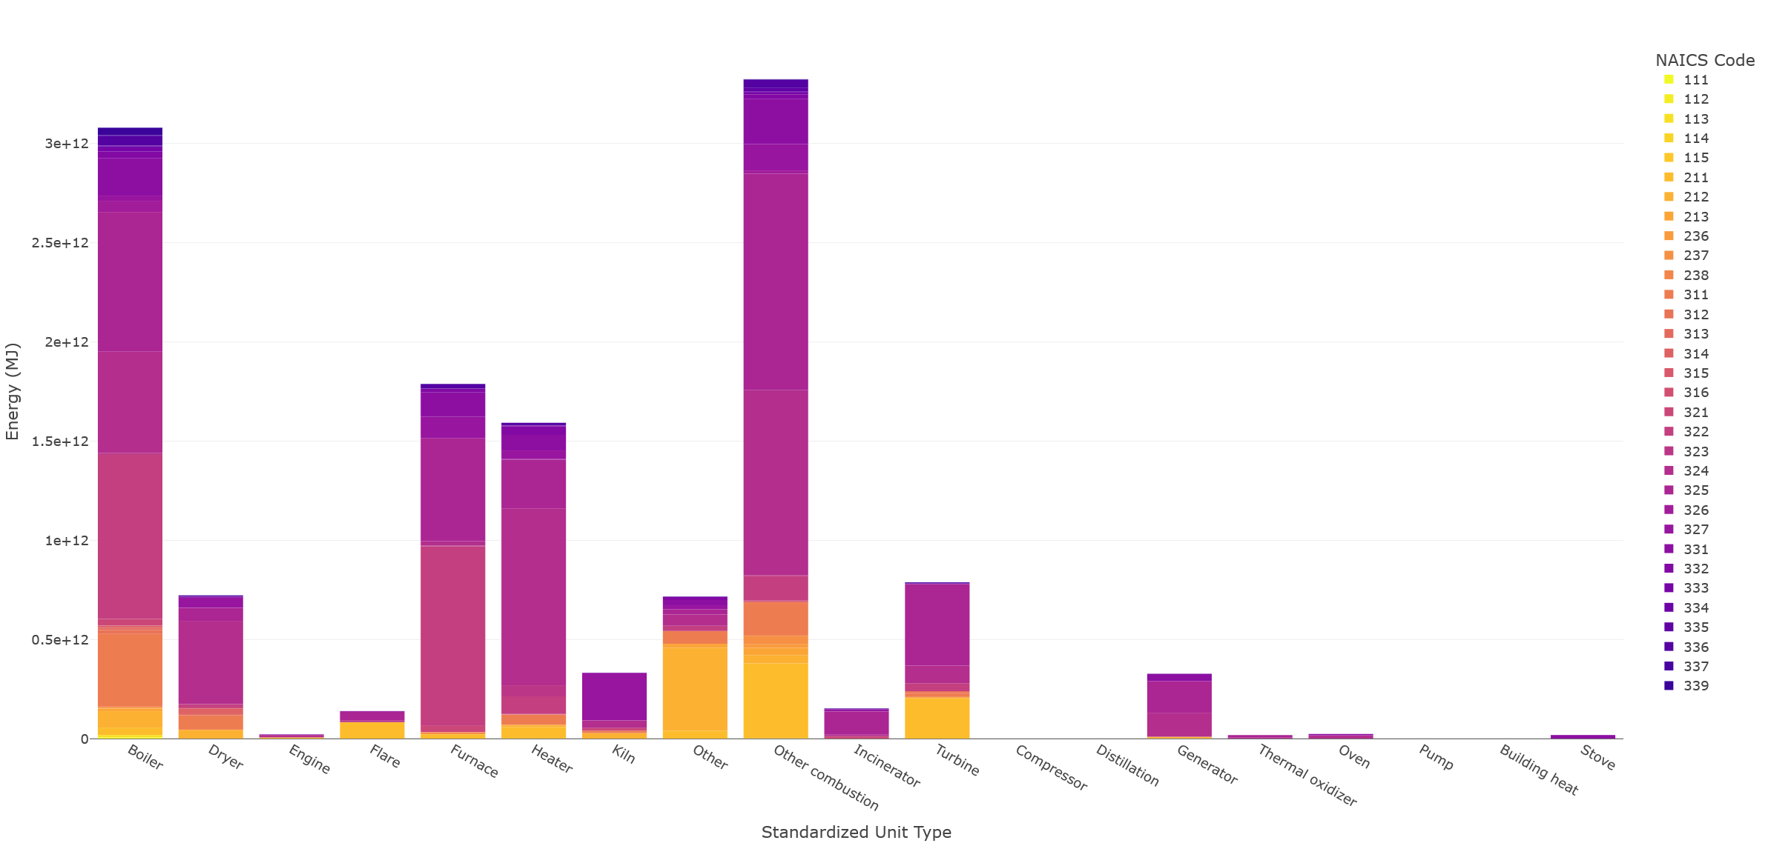

Slide 6
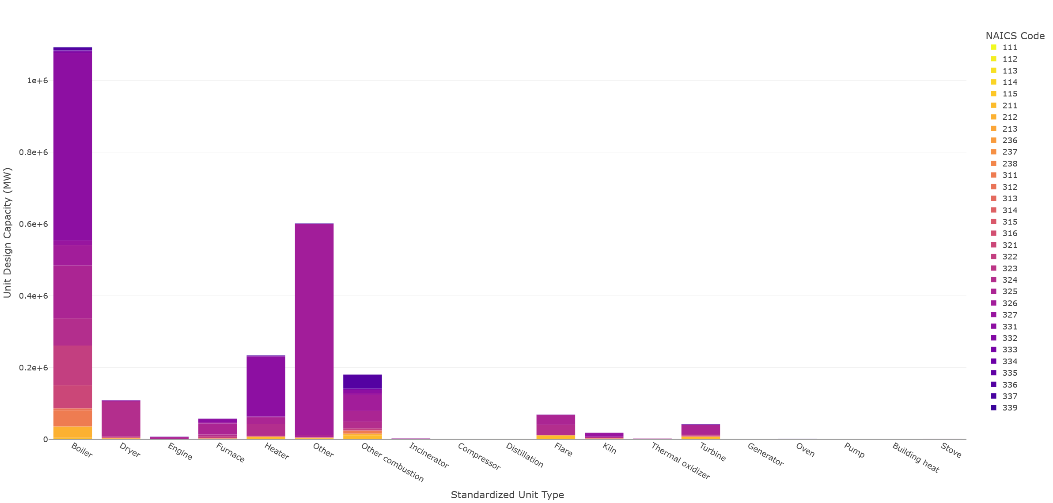

Slide 7
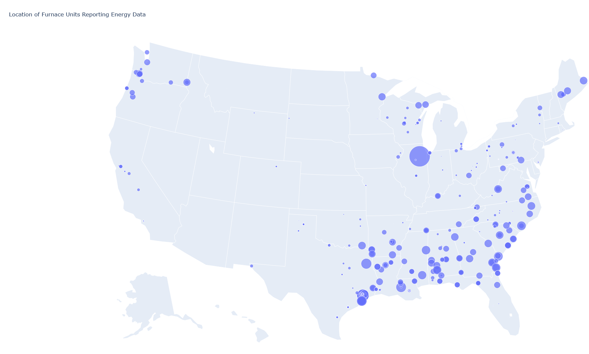
Unit capacity and energy-related data are not reported consistently

Slide 8
