Slide 2
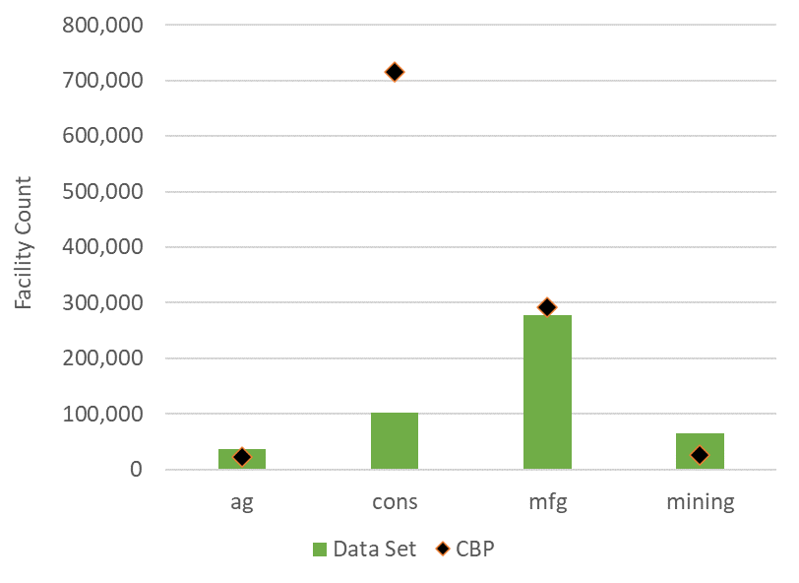
Takeaways:
Data set covers nearly all ag, mfg, and mining facilities
NAICS mis-coding likely across all sectors
Offshore facilities included in data set, but not in CBP?

Slide 3
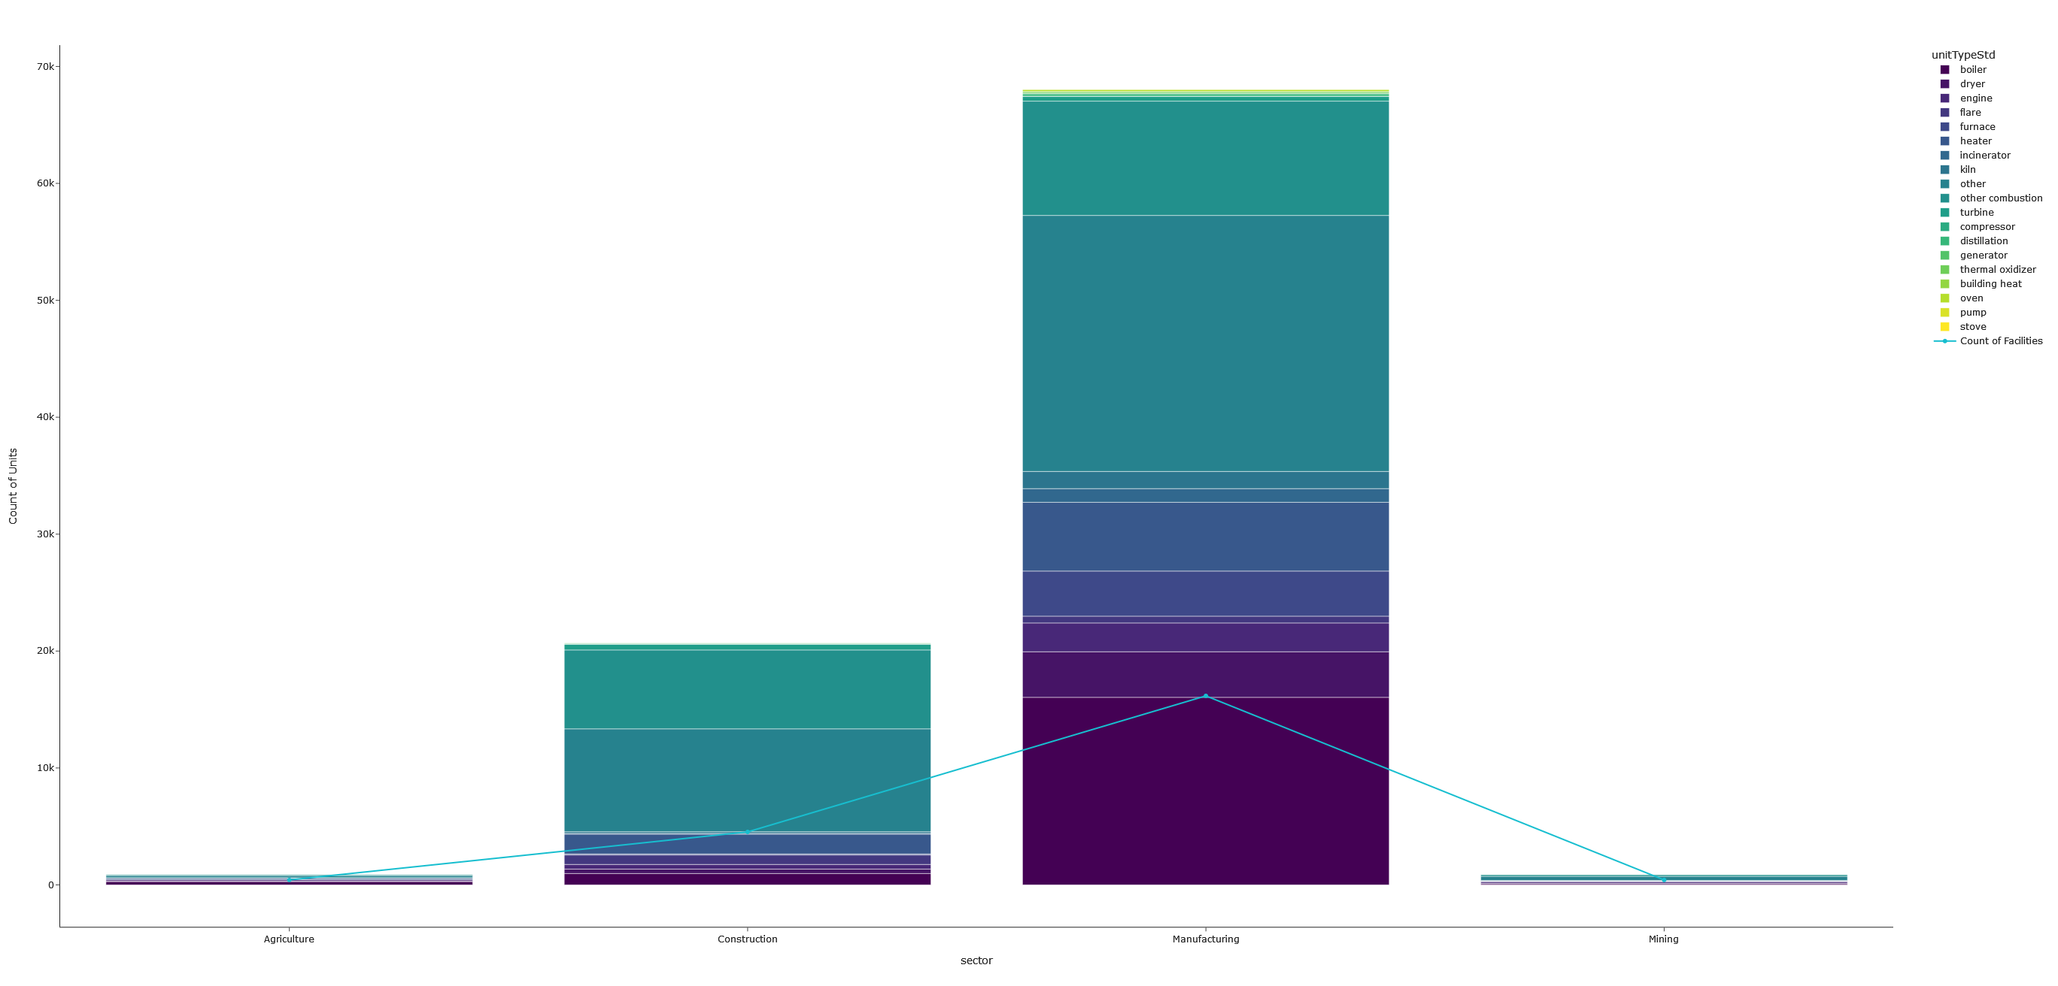

Slide 4
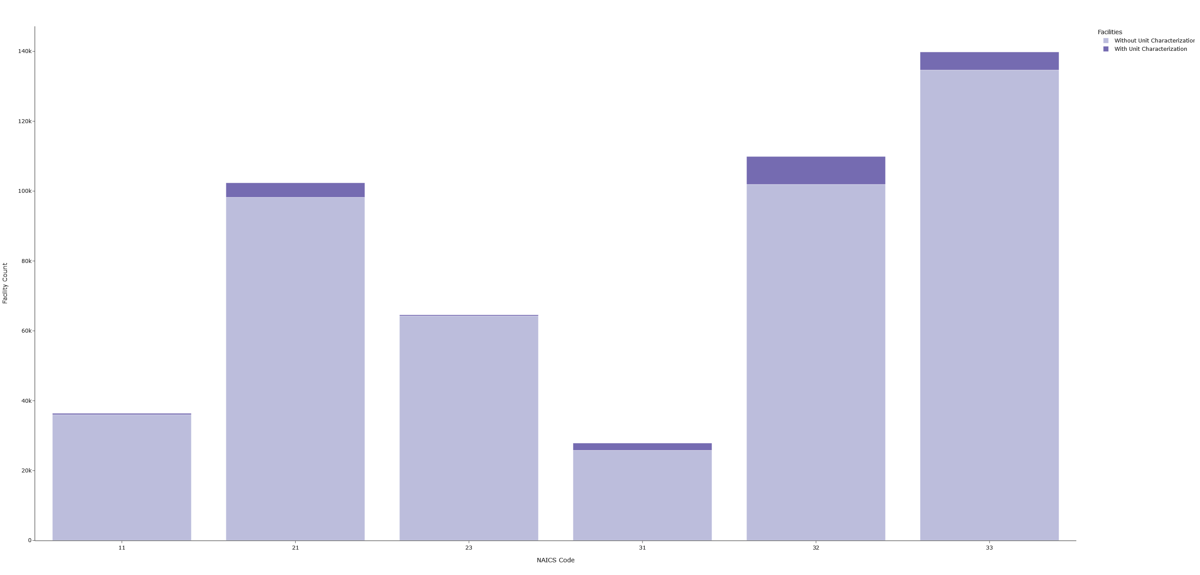
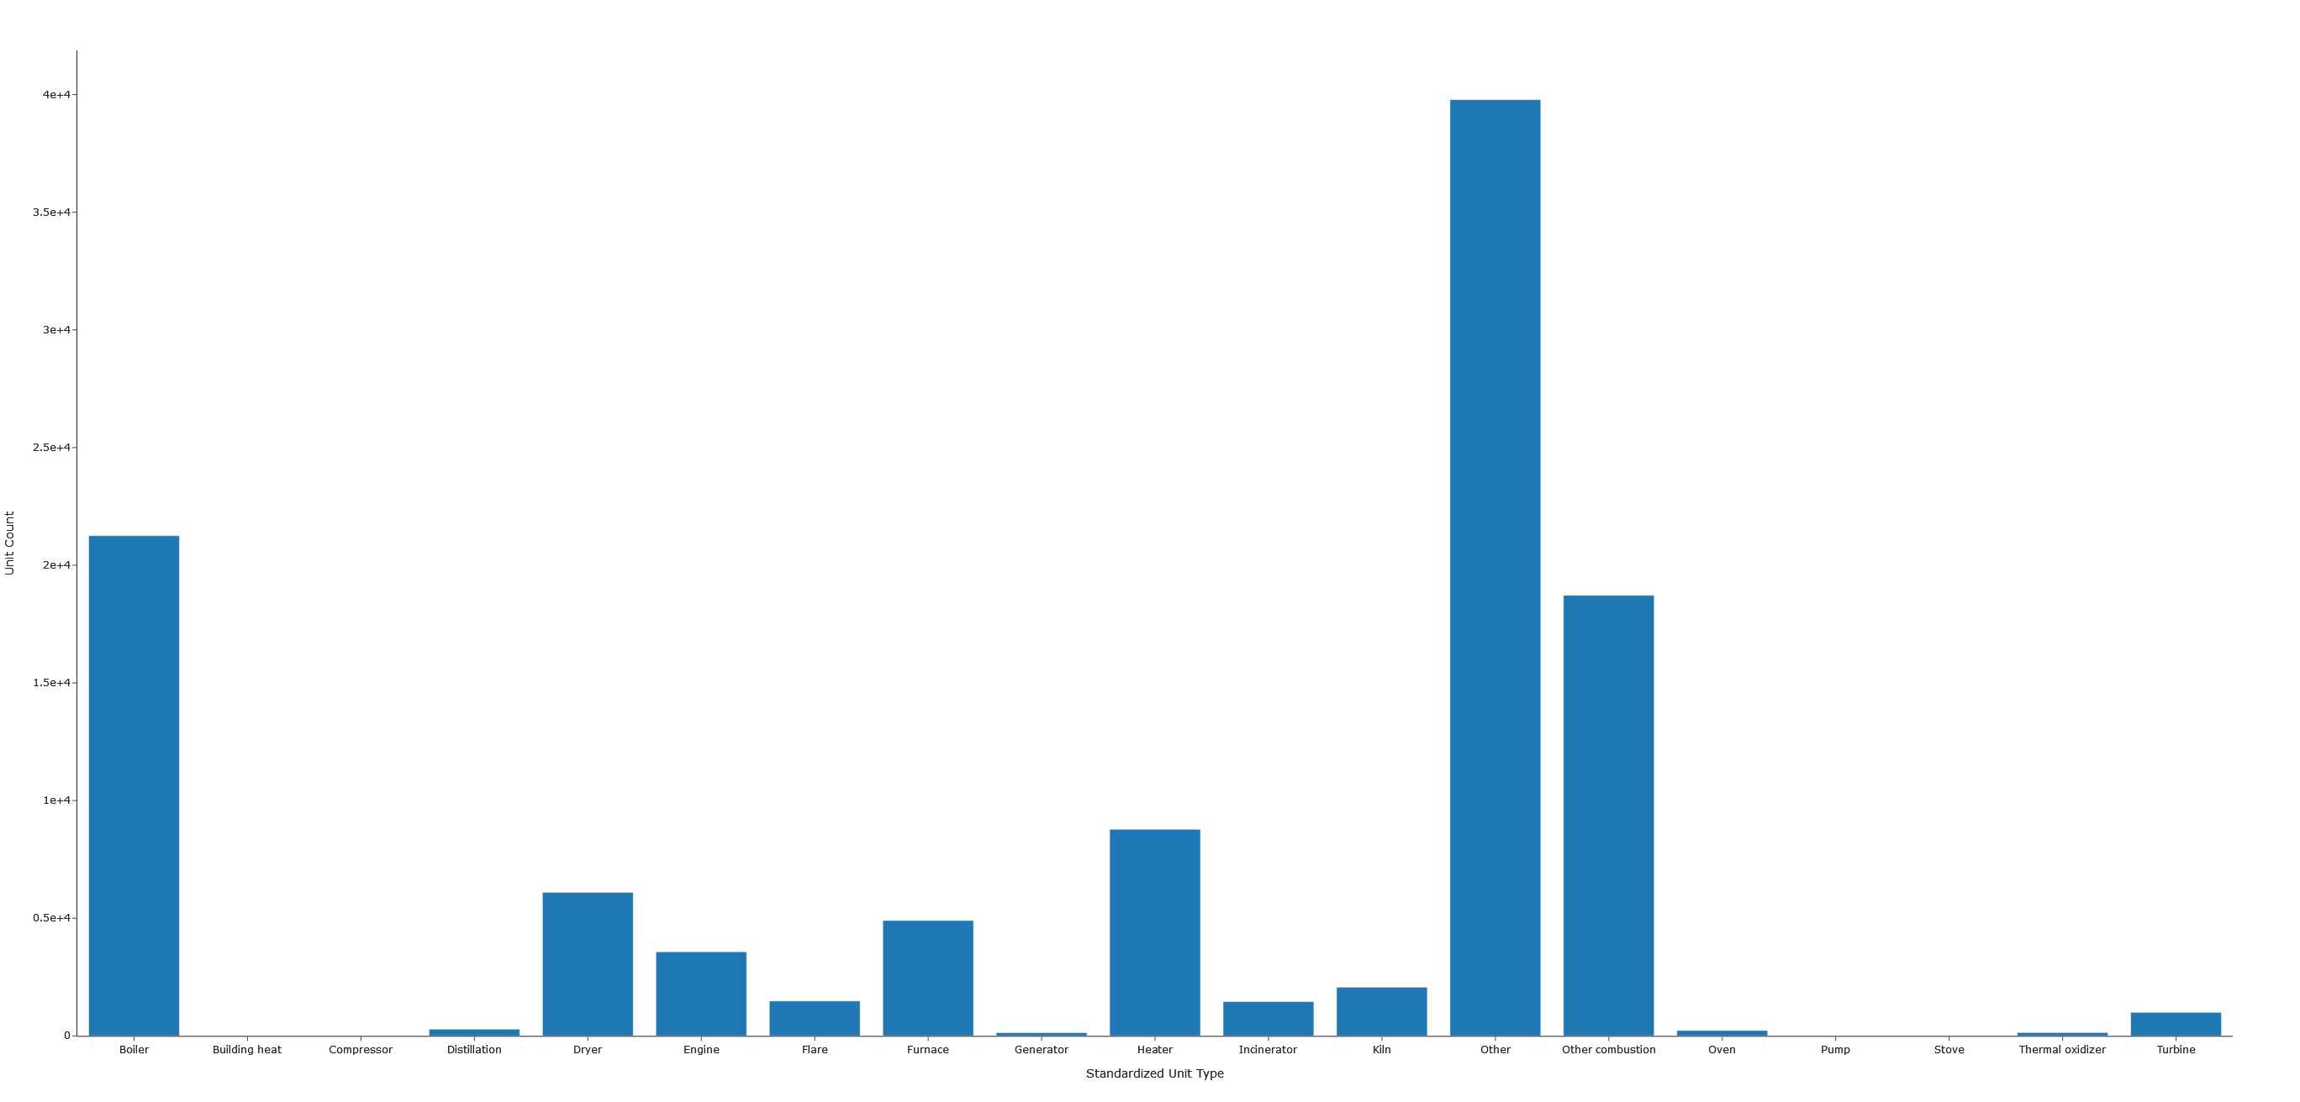

Slide 5
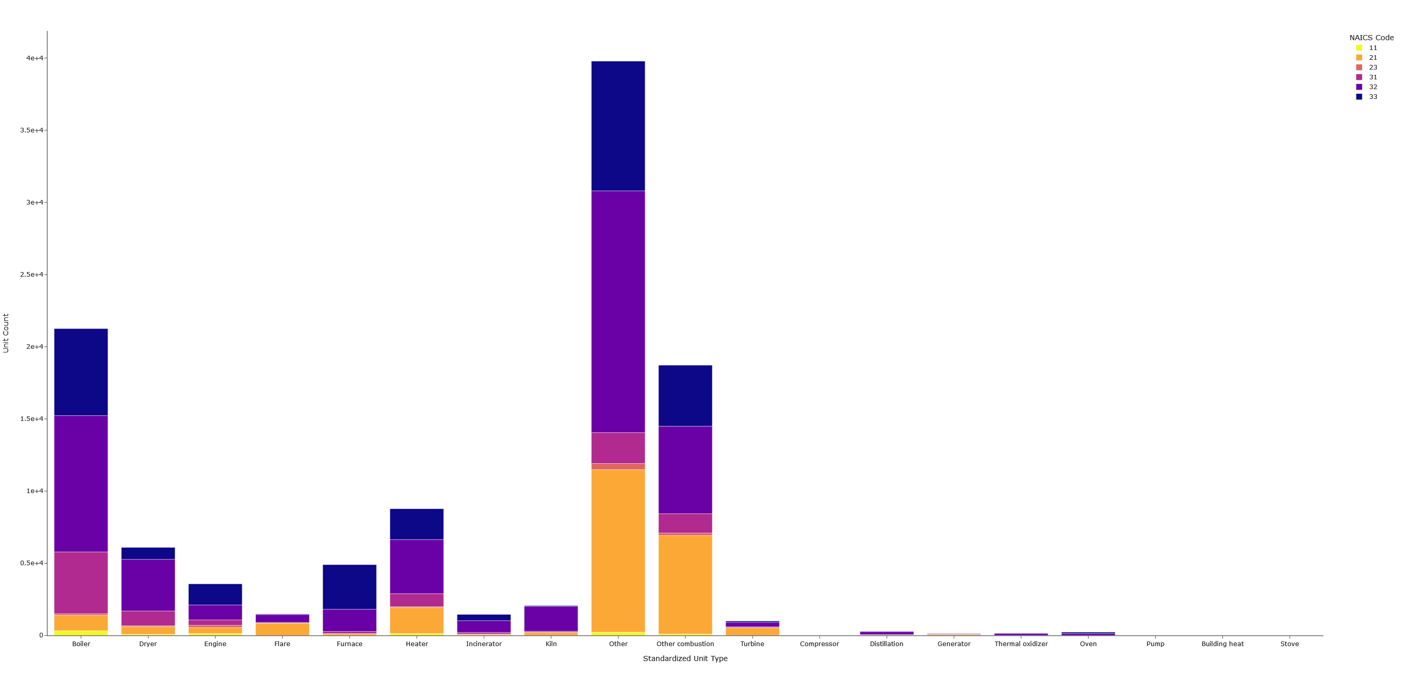

Slide 6
