Slide 1
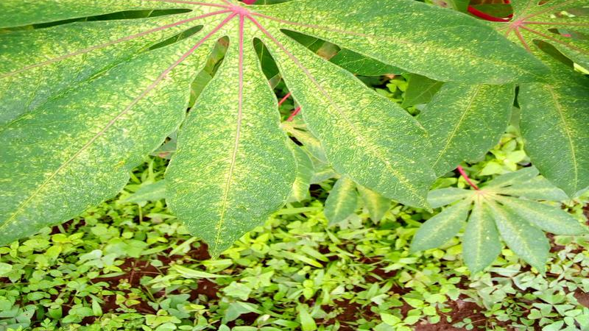
Image Classification of Crop Diseases Using Deep Learning
Presenter:Ethan Hazari
Student Id:400673849
Email:hazarm3@mcmaster.ca

Slide 2
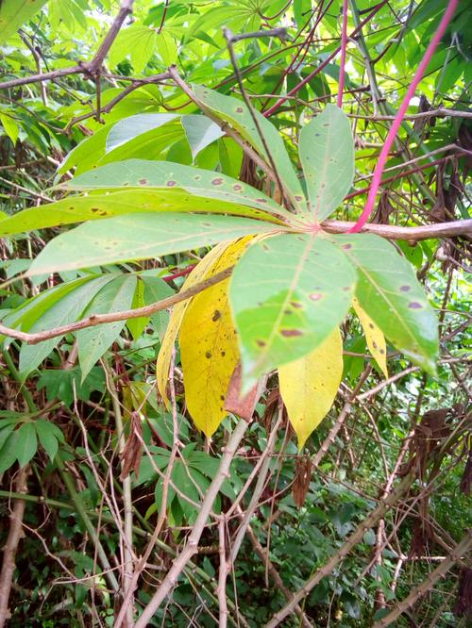
Problem Statement & Objectives
Title: Introduction & Objectives
The Problem : Crop disease significantly impact agricultural yield. Early and accurate detection is critical.
The Objective :Automate disease classification using neural networks.
The Approach: Compare two distinct deep learning architecture to evaluate the trade-off between computational efficiency and classification accuracy.

Slide 3
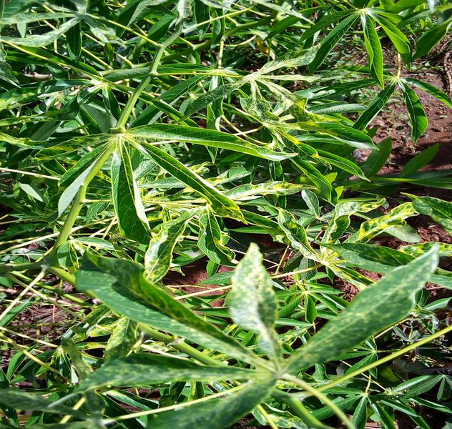
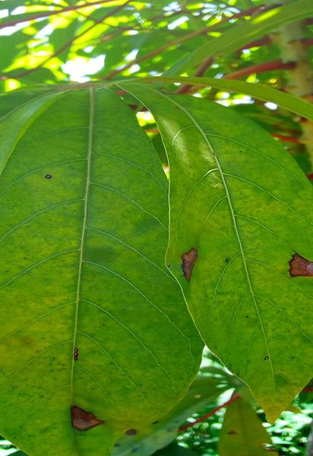
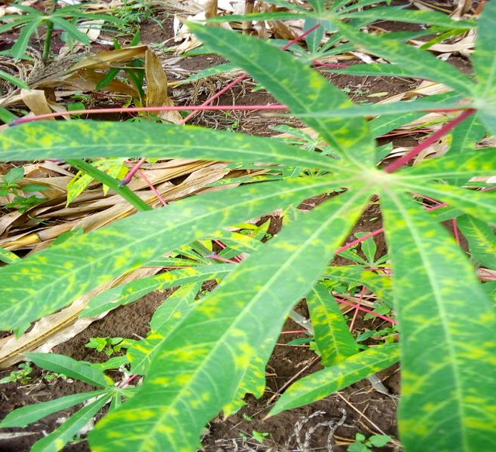
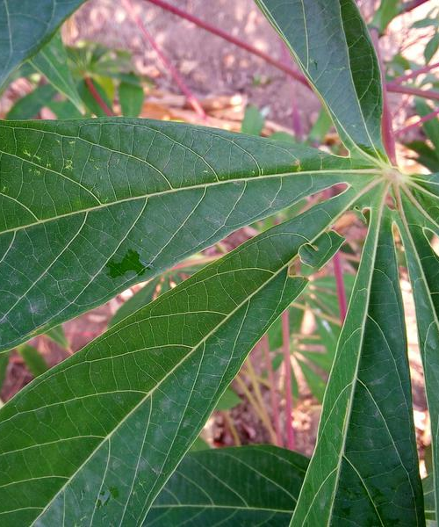
Dataset & Data Preprocessing
Title : Dataset Preparation & Normalization
Datasets: Images of crop leaves categorized into 5 classes (4 disease states, 1 healthy).
RGB Conversion: Ensured all images uniformly use the RGB (Red, Green, Blue) color format.
Resizing: Standardized all images to 224x224 pixels to meet model input requirements.
Tensor Conversion : Transformed raw pixel data (0-255) into PyTorch Tensors (mathematical matrices scaled between 0.0 and 1.0).
Normalization : Adjusted color channels using standard mean and standard deviation to stabilize neural network training.

Slide 4
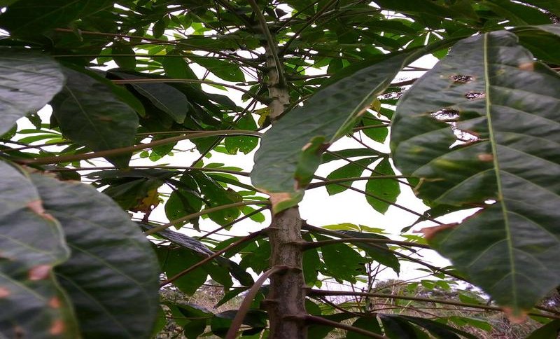
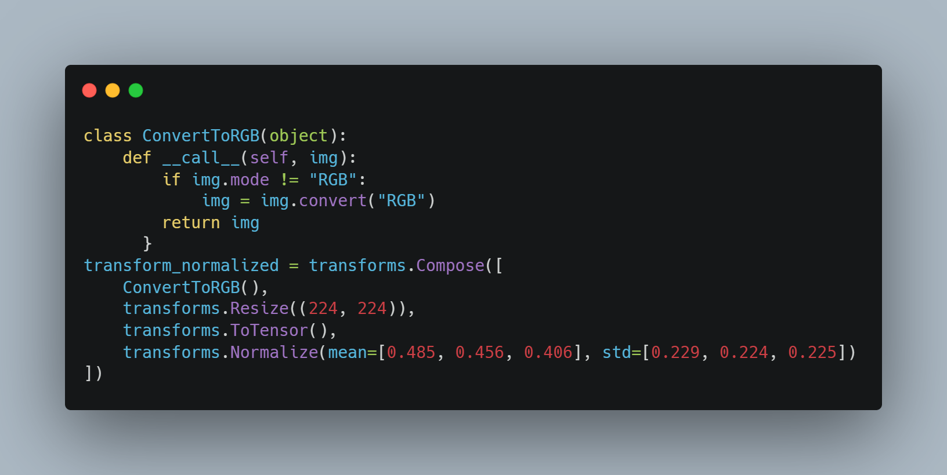
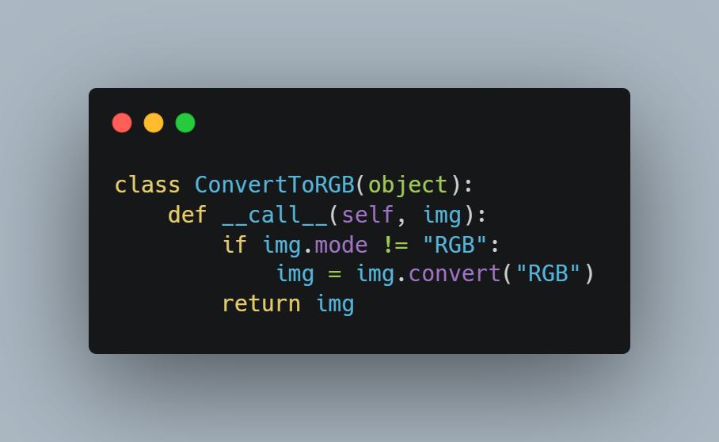
Original Image
Resize
Tensor
Normalized Output

Slide 5
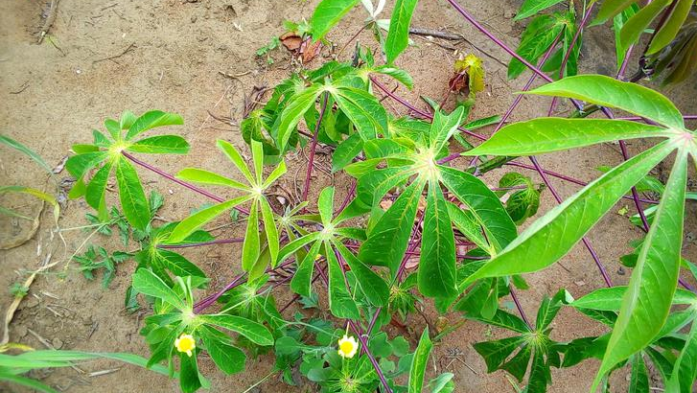
Evaluation Methodology
Title: Rigorous Testing via K-Fold Cross-Validation
Methodology:3-Fold Cross-Validation
Definition:The dataset is split into 3 equal parts. The model trains on 2 parts and tests on the 3rd. This rotates until all parts have been used for testing
Why use it? Prevents data bias, ensures the model generalizes well to unseen data, and provides a highly reliable average accuracy score

Slide 6
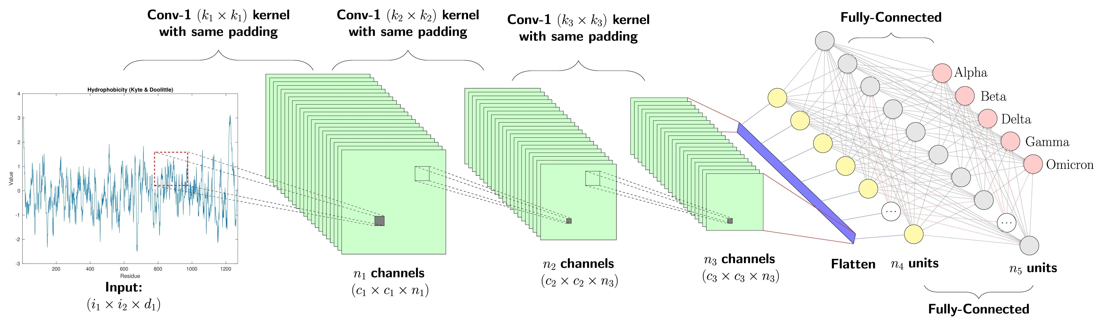
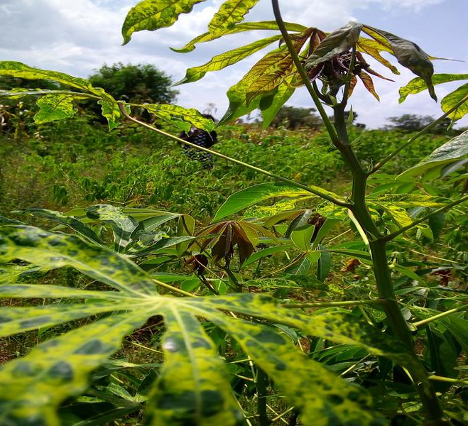
Method 1 - Baseline Custom Model
Title: Method 1: Simple CNN (Baseline)
Architecture: A lightweight, custom-built Convolutional Neural Network (CNN)
CNN Definition: A network designed to automatically extract spatial features (like edges, textures, and shapes) from images using scanning filters.
Purpose: Serves as the experimental baseline. It trains very quickly but must learn all visual features from scratch.

Slide 7
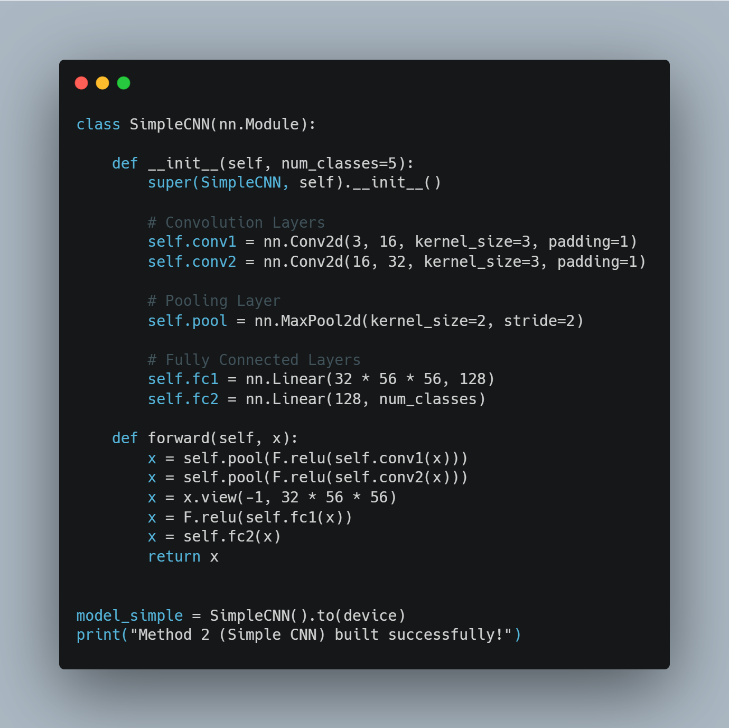
Baseline Custom Model

Slide 8
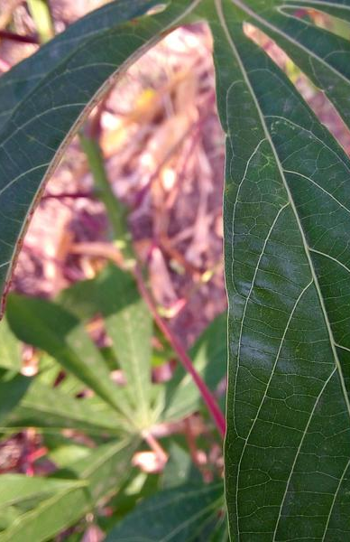
Method 2 - Advanced Transfer Learning
Title: Method 2: ResNet50 (Transfer Learning)
Architecture: ResNet50 (Residual Network with 50 layers).
Transfer Learning Definition: Taking a massive model pre-trained on millions of standard images and "transferring" its knowledge to our specific crop dataset.
Modification: The final Fully Connected (FC) layer was replaced to output exactly 5 classes instead of its original 1,000.
Purpose: Expected to achieve high accuracy due to pre-learned feature detection, at the cost of higher computation time.

Slide 9
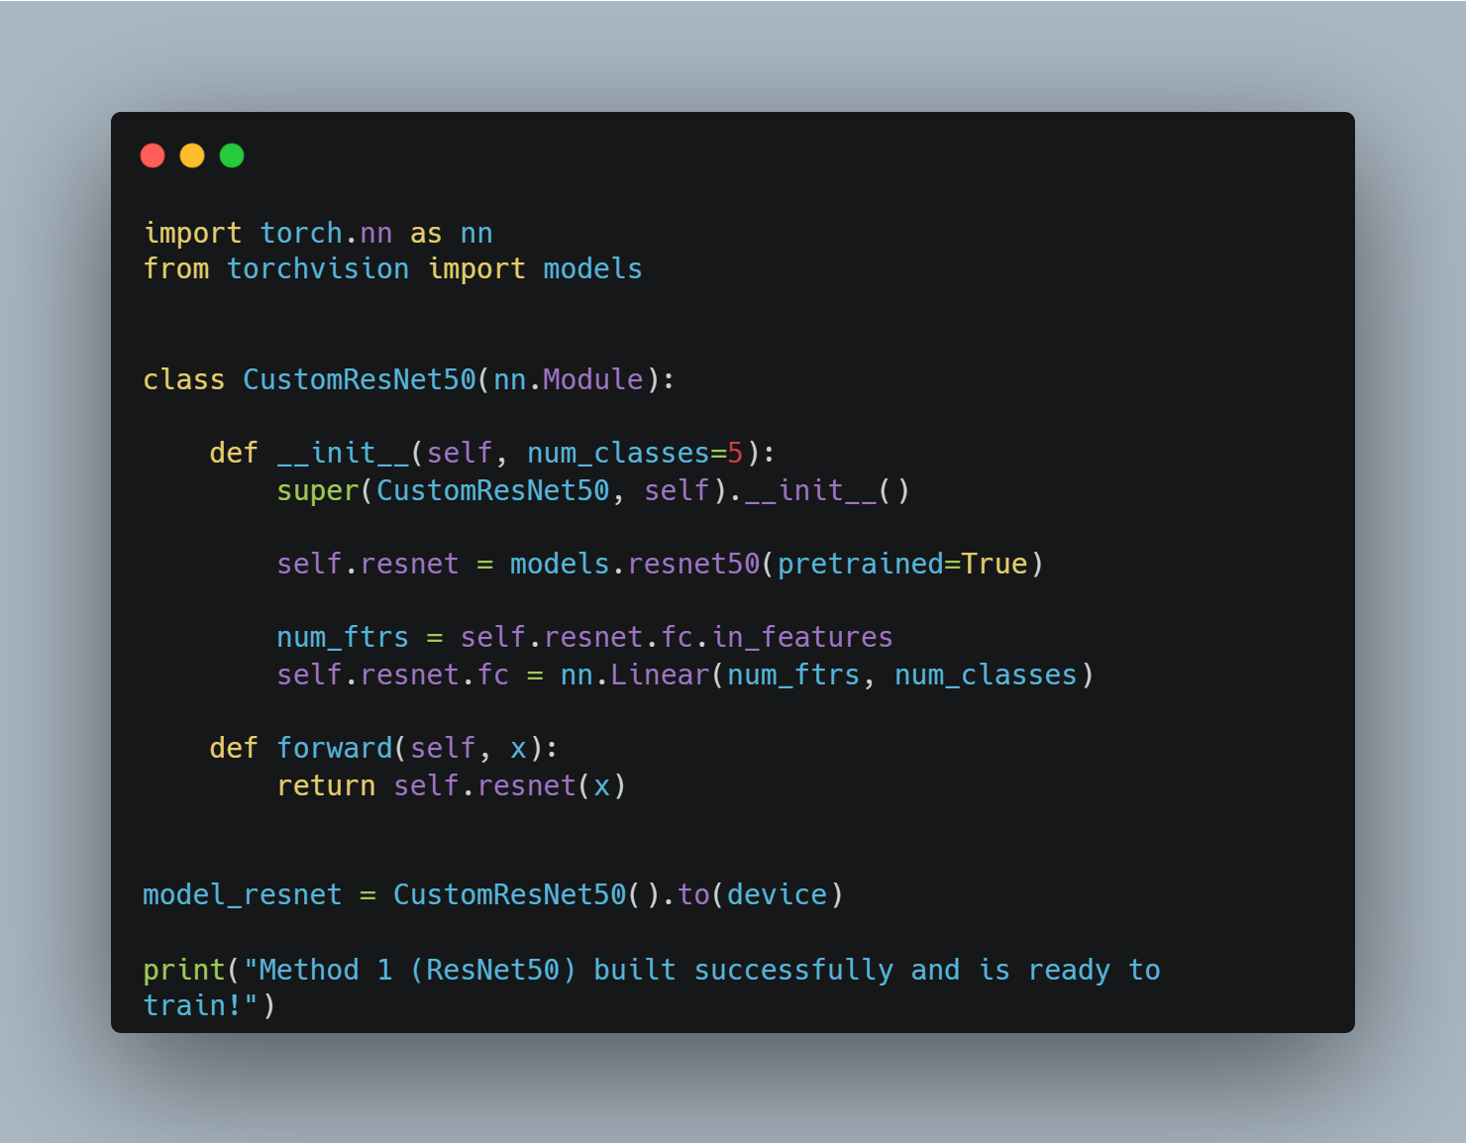
Advanced Transfer Learning

Slide 10
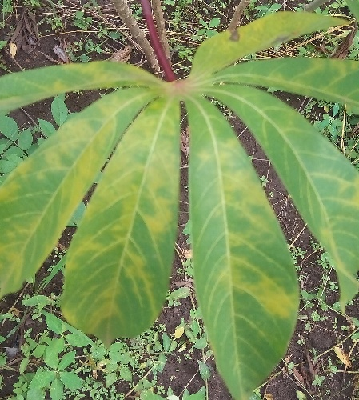
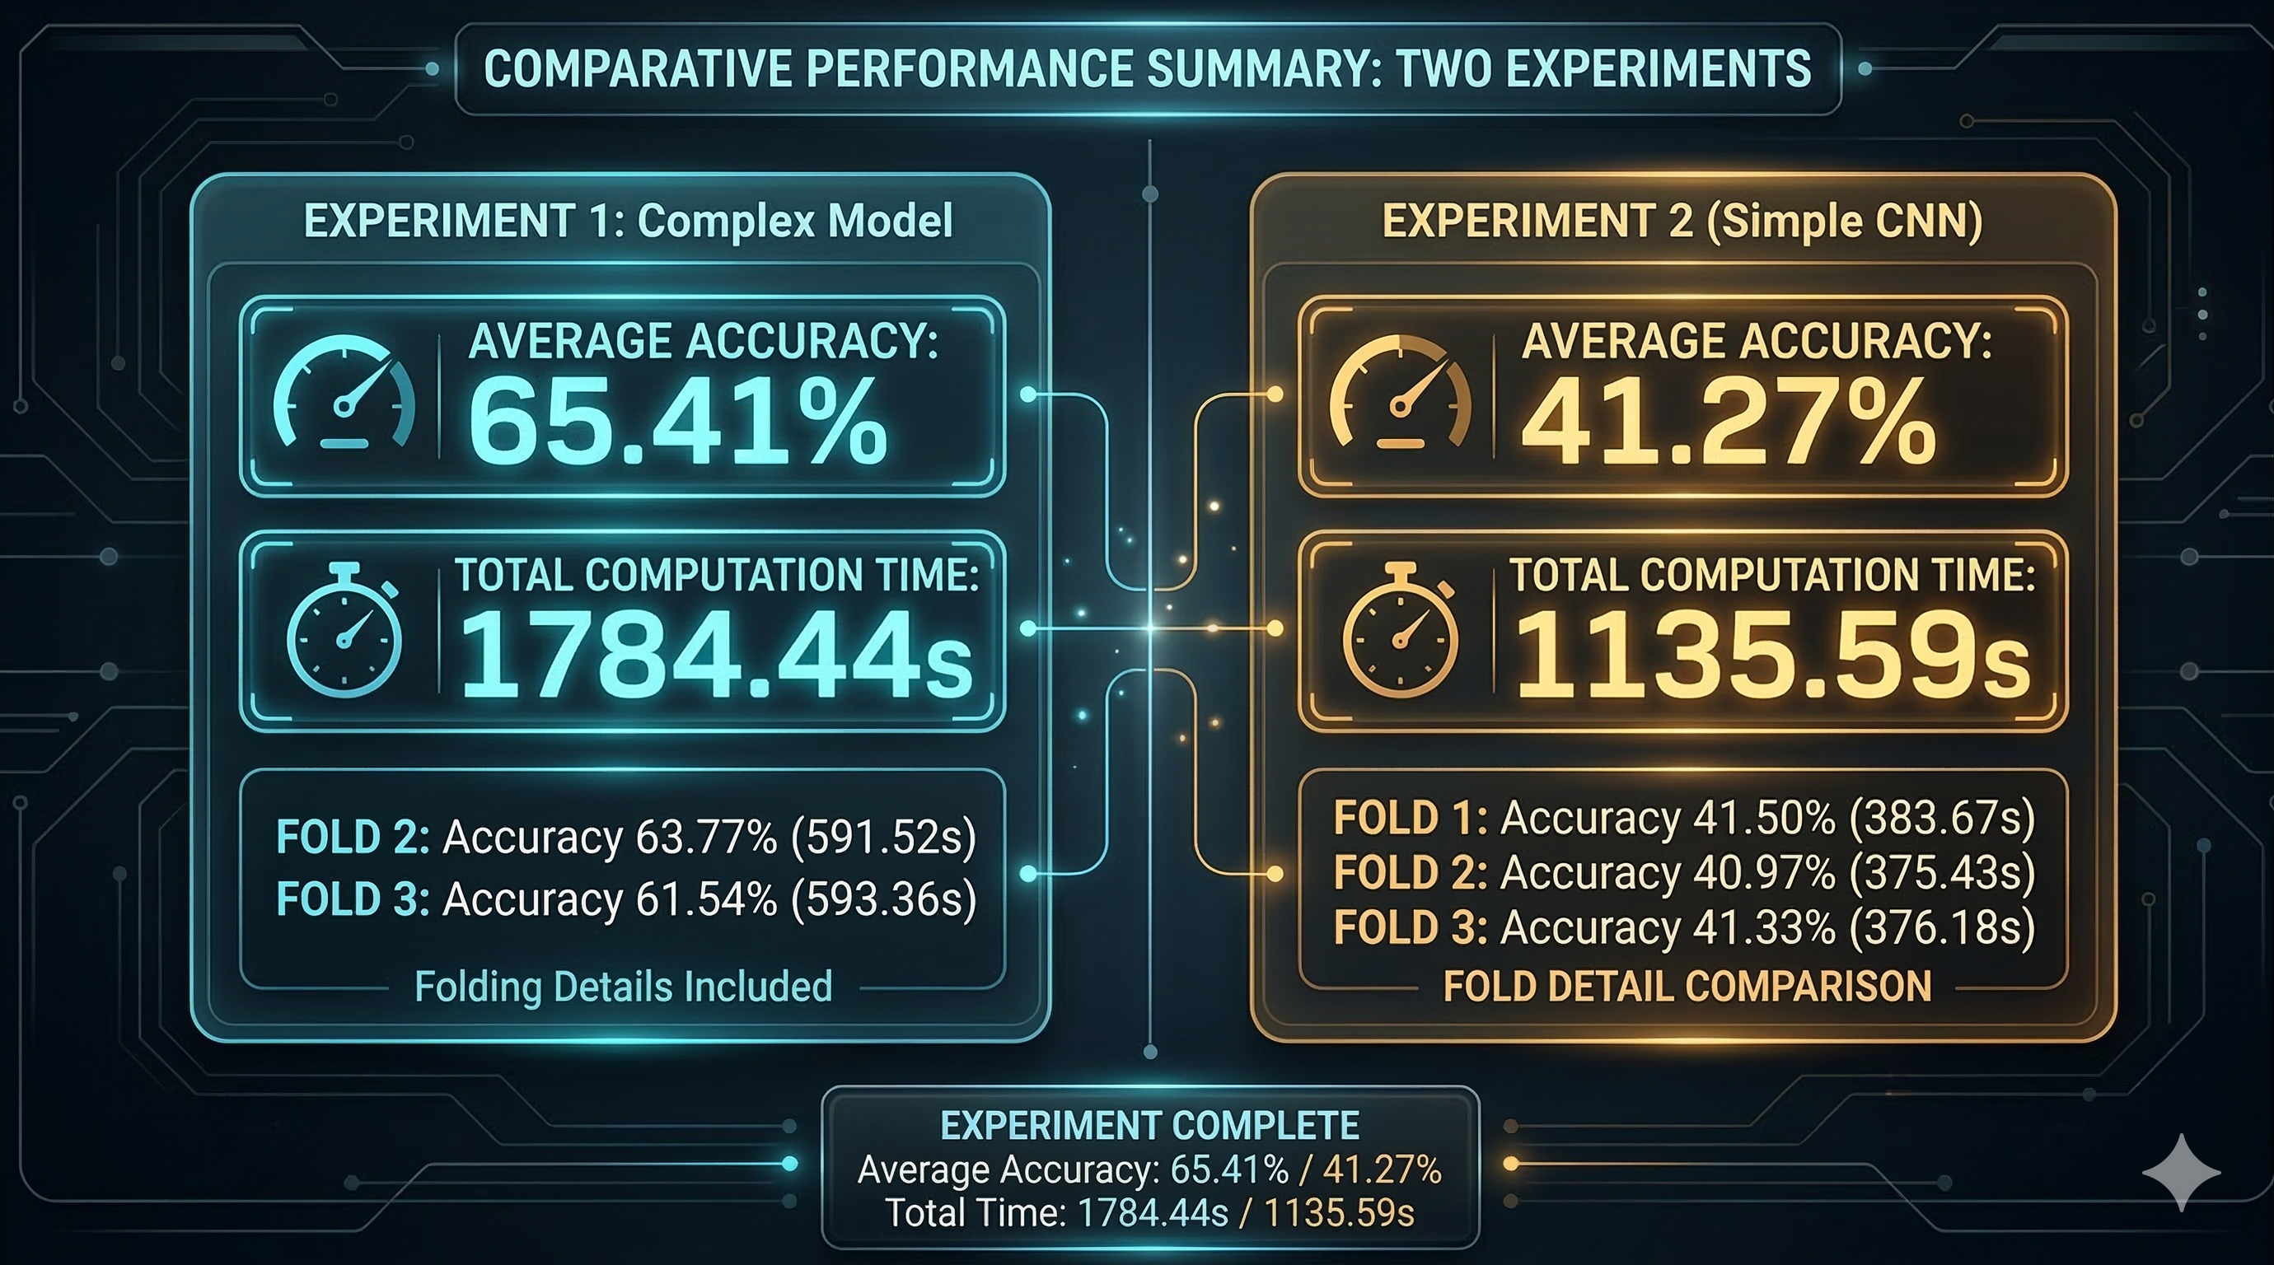
Results & Comparison

Slide 11
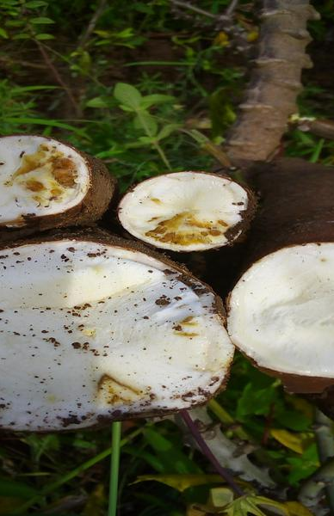
Conclusion
The Simple CNN established a fast baseline, successfully performing better than random guessing (41% vs 20%).
Transfer learning via ResNet50 significantly improved accuracy to 65.41%, demonstrating the power of pre-trained networks.
The trade-off is computational cost, as ResNet50 took ~1.57 times longer to train (1784.44 seconds vs 1135.59 seconds).
Final Verdict: For agricultural deployment where accuracy is paramount over training speed, ResNet50 is the superior architecture.

