Slide 1

Team Swagasaurus Product Presentation
Alex Chen
Pat Bobell
Maddie Burris
Fred Silberberg
Jason Whitehouse

Slide 2
Team Management Roles
Alex Woodyard (PM)
Alex Gorowara (DM)
Maddie Burris (QM)
Fred Silberberg (RE)
Jason Whitehouse (PE)
Zac Chupka (PM)
Matt Costi (DM)
Kyle Burns (QM)
Steve Kordell (RE)
Conor Geary (PE)
Alex Chen (PM)
Pat Bobell (DM)
Chris Keane (QM)
Mitch Cassie (RE)
Nick Massa (PE)
Zac Chupka
(President/King)

Slide 3
What Didn’t Work
Testing
Meeting dependence
Informal organization
Focus during meetings
Issue tracking
Notes:
-only 50% code coverage; discovered GUI testing really late and thus missing a lot of GUI coverage
-team only worked during meeting times; no independent work; if missed meeting, couldn’t really make up for it
-didn’t have meeting minutes; no real documentation of who was working on what until it was done and recorded in VersionOne
-because we were so “fun” we would get off task often
-we did very little issue tracking until the last iteration

Slide 4
What Worked
Full team work sessions
Merge early and often
Fluid Sub-teams
Quality assurance
Team Culture
Notes:
-meetings twice a week where every team member made it at some point
-did not wait until end of the week to merge. Merged either when done with feature or continually as added elements
-added to team comradery and team members who’re familiar with almost everything instead of just certain features
-people running through Janeway just seeing if things are working and trying to do things to make features break
-team very close nit, open with problems with each other, had fun with it

Slide 5
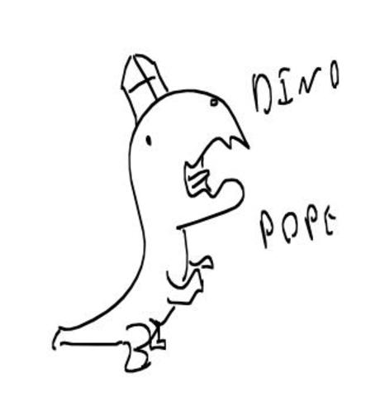

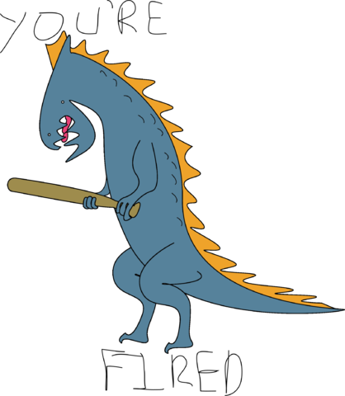
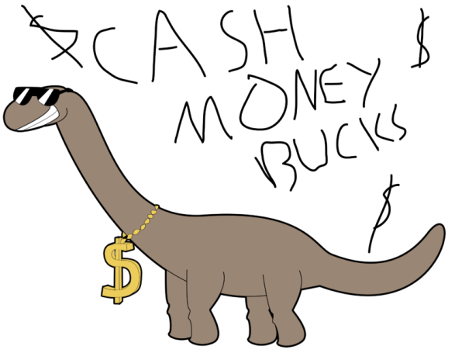

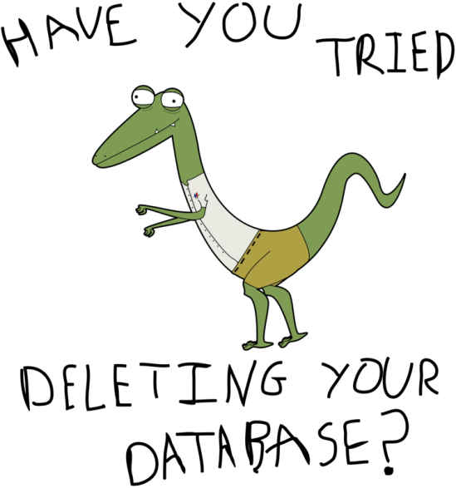

Slide 6
User Stories Completed
Create a Requirement
Requirements persist between Sessions
View a Requirement
Change a requirement’s status
Assign requirements to people
Edit a requirement
User can view a log of a requirement
Enter a requirement estimate
Schedule a requirement for an iteration
Delete a requirement
Make user manual available
View requirements in a table format
Create iteration
Make save button always visible
Show deleted folder in tree view
Add tasks to requirement
Create bar and pie charts for requirements
Sort requirements
Estimate several requirements
Right click context menus in tree view
Ability to close multiple tabs
Filter requirements based on iterations from tree view
Calculating estimated effort for hierarchal requirements
Add an acceptance test to a requirement
Assign requirement management position to users
Filter requirements
Disable certain actions depending on permissions
Add sub-requirements to a requirement

Slide 7
Product Overview
Ease of use
Visual design
End user materials
Tree/Hierarchical view
Drag and drop
Context menus
Live validation
Customizable split pane
Tab organization
Comprehensive user manual
Video tutorials
Notes:
Three focuses while creating project

Slide 8
Product Features
User Manual
Drag and Drop
Live analytics
Persistent side panel

Slide 9
Demo

Slide 10
Questions?

Slide 11
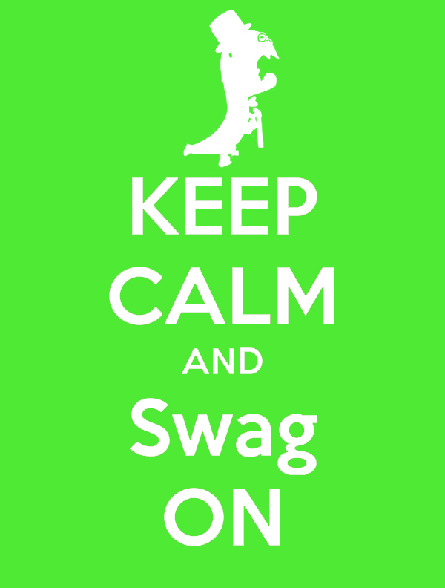
Thank you

