Slide 1
SAC-593T
New Techniques to Develop Low Latency Network Apps
Ben Schultz
Osman Ertugay
Ed Briggs
Microsoft Corporation
Notes:
29.08.2019 09:22 nachm.
<number>
© 2010 Microsoft Corporation. All rights reserved. Microsoft, Windows, Windows Vista and other product names are or may be registered trademarks and/or trademarks in the U.S. and/or other countries.
The information herein is for informational purposes only and represents the current view of Microsoft Corporation as of the date of this presentation. Because Microsoft must respond to changing market conditions, it should not be interpreted to be a commitment on the part of Microsoft, and Microsoft cannot guarantee the accuracy of any information provided after the date of this presentation. MICROSOFT MAKES NO WARRANTIES, EXPRESS, IMPLIED OR STATUTORY, AS TO THE INFORMATION IN THIS PRESENTATION.

Slide 2

Pay
Pre-Pay
Notes:
<number>

Slide 3
Agenda
What’s new and why it matters
How we improved I/O
How to use Registered I/O (RIO)
You’ll leave with examples of how to
Create low latency apps with Windows Server 8
Notes:
<number>

Slide 4
Low Latency and Predictability
The Problem:
…At Scale
Today’s multicast aggregate stock market feed: 5 million updates/second
300,000 packets per second
600,000 packets per second
Traffic rates are increasing
Notes:
<number>

Slide 5
For many performance critical apps …every microsecond saved means money
Notes:
<number>

Slide 6
In the past…
Approach
Sockets
Hardware Acceleration
Application type
General Apps
Low Latency Apps
Compatibility with UDP/TCP
Yes
No
Modifications
N/A
Extensive
Notes:
<number>

Slide 7
Windows Server 8
Approach | Application Type | Compatibility with UDP/TCP | Modifications
Sockets | General Apps | Yes | N/A
Hardware Acceleration | Low Latency Apps | No | Extensive
RIO Sockets | Low Latency Apps | Yes | Moderate
Extreme Low
Latency Apps
Notes:
<number>

Slide 8
Your app must move data quickly …but you don’t want to rewrite your entire app or depend on custom hardware
Notes:
<number>

Slide 9
Windows Server 8 delivers
Lower Latency
RIO ~15 - 30% reduction in latency
Better Predictability
Variability (stdev) reduced by a factor of 7
Maximum values reduced by a factor of 5
Higher Throughput
Windows Server 2008R2 sustains ~2 Million datagrams per second
With RIO, we have seen double the datagrams per second
Notes:
<number>

Slide 10
Winsock I/O Model
Notes:
<number>

Slide 11
I/O Model, Phases, Elements
Windows Overlapped I/O Model
I/O initiation
I/O processing
I/O completion
Socket handles → True OS handles
Data buffers provided by the app
Multiple completion methods supported by the OS
Notes:
<number>

Slide 12
I/O Initiation
I/O Processing
I/O Completion
I/O Initiation
WSARecv(socket, buffer)
User Virtual Address
Space
App
Winsock
Physical
Memory
User
Kernel
I/O Manager
Winsock/Transport
I/O Request
NIC
Notes:
29.08.2019 09:22 nachm.
©2005 Microsoft Corporation. All rights reserved.
This presentation is for informational purposes only. Microsoft makes no warranties, express or implied, in this summary.
<number>

Slide 13
I/O Initiation
I/O Processing
I/O Completion
I/O Processing
WSARecv(socket, buffer)
User Virtual Address
Space
App
Winsock
Physical
Memory
User
Kernel
I/O Manager
Winsock/Transport
I/O Request
NIC
DMA
Notes:
29.08.2019 09:22 nachm.
©2005 Microsoft Corporation. All rights reserved.
This presentation is for informational purposes only. Microsoft makes no warranties, express or implied, in this summary.
<number>

Slide 14
I/O Initiation
I/O Processing
I/O Completion
I/O Completion
WSARecv(socket, buffer)
User Virtual Address
Space
App
GetQueuedCompletionStatus()
Winsock
Physical
Memory
User
Kernel
I/O Manager
Winsock/Transport
I/O Request
NIC
Notes:
29.08.2019 09:22 nachm.
©2005 Microsoft Corporation. All rights reserved.
This presentation is for informational purposes only. Microsoft makes no warranties, express or implied, in this summary.
<number>

Slide 15
Summary
Single I/O request may involve
Memory lock & unlock
Multiple handle look-ups
Multiple system calls
Works fine for general Windows I/O
Can do much better for demanding apps
RIO
Notes:
29.08.2019 09:22 nachm.
©2005 Microsoft Corporation. All rights reserved.
This presentation is for informational purposes only. Microsoft makes no warranties, express or implied, in this summary.
<number>

Slide 16
RIO Buffer Handling
User Virtual Address
Space
App
RIORegisterBuffer(buffer,size)
rbid
Winsock
Physical
Memory
User
Kernel
I/O Manager
Winsock/Transport
RB
NIC
Notes:
29.08.2019 09:22 nachm.
©2005 Microsoft Corporation. All rights reserved.
This presentation is for informational purposes only. Microsoft makes no warranties, express or implied, in this summary.
<number>

Slide 17
RIO Queues
RIOCreateCompletionQueue(size)
RIOCreateRequestQueue(socket,size,cq)
App
rq
cq
Winsock
RQ
User
Kernel
CQ
I/O Manager
Winsock/Transport
NIC
Notes:
29.08.2019 09:22 nachm.
©2005 Microsoft Corporation. All rights reserved.
This presentation is for informational purposes only. Microsoft makes no warranties, express or implied, in this summary.
<number>

Slide 18
RIO I/O Initiation & Completion
RIOReceive(rq,rbid)
RIODequeueCompletion(cq)
App
RIONotify(cq)
Winsock
RQ
C
R
CQ
User
Kernel
I/O Manager
Winsock/Transport
C
R
NIC
Notes:
29.08.2019 09:22 nachm.
©2005 Microsoft Corporation. All rights reserved.
This presentation is for informational purposes only. Microsoft makes no warranties, express or implied, in this summary.
<number>

Slide 19
RIO Summary
Separated I/O buffer handling from actual I/O
Notes:
<number>

Slide 20
RIO Summary
Separated I/O buffer handling from actual I/O
App
User
Kernel
OS Kernel
Pending I/O requests
Completed I/O requests
Reduced I/O cost, improved predictability
Notes:
<number>

Slide 21
Key RIO Programming Considerations
Buffer handling moved to app
SO_SNDBUF, SO_RCVBUF are not applicable for RIO
Ensure to prepost enough requests
To avoid dropping incoming packets
To avoid stalling the send pipe
RIO buffers, RQs, CQs always locked in physical memory
Trading memory for reduced CPU cycles per I/O

Slide 22
Developing apps with the RIO socket API
Notes:
<number>

Slide 23
RIO Sockets are an extension to Winsock
Same as regular sockets
bind
listen
accept
connect
join multicast groups
setsockopt (not all options apply to RIO)
IOCTL (not all IOCTLs apply to RIO)
What is New for RIO
RIOSend, RIOSendEx, RIOReceive, RIOReceiveEx
RIOCreateRequestQueue (and related)
RIOCreateCompletionQueue (and related)
RIODequeueCompletion
RIONotify
RIORegisterBuffer
Notes:
<number>

Slide 24
RIO Socket API Concepts
All RIO IO is performed with Registered Buffers
Typical use:
Allocate a large buffer area
Malloc, new(), HeapAlloc, VirtualAllocExNuma()
Register it with RIORegisterBuffer()
Carve it up with RIO_BUF descriptors
When you are all finished (e.g. at shutdown)
RIODeregisterBuffer()
Quick Review
Notes:
<number>

Slide 25
RIO API Description
RIO Buffer
Registered
Memory
RIO_Buf
Descriptors
RIO_BUF descriptors are used to carve up the large RIOBUFFER which is ‘locked down’
RIOSend/RIOReceive calls use RIO_BUF descriptors to perform I/O
Offset
Length
Offset
Length
Offset
Length

Slide 26
RIO Request and Completion Queues
Each RIO socket has dedicated request queue, and a completion queue
Each RIO socket has separate completion queues for SEND and RECV
OR
App
App
Socket
Socket
Socket
DLLs
Socket
DLLs
Request Queue
Completion Queue (CQ)
Request Queue
Send
CQ
Receive
CQ

Slide 27
RIO Request and Completion Queues
Completion Queues may be shared, making it easy to handle multiple sockets.
Alternatively, separate completion queues make it easy to segregate completions to different cores or NUMA nodes.
App
Socket
Socket
Socket
Socket
DLLs
Request Queues
Shared
CQ

Slide 28

Creating a RIO Socket
SOCKET SocketHandle = WSASocket(
AF_INET,
SOCK_DGRAM,
IPPROTO_UDP,
NULL,
0,
WSA_FLAG_REGISTERED_IO);
Notes:
<number>

Slide 29
Creating a RIO Completion Queue
RIOCreateCompletionQueue
RRIO_CQ RIOCreateCompletionQueue(
DWORD QueueSize,
PRIO_NOTIFICATION_COMPLETION CompletionNotificationType)
The CompletionNotificationType allows you specify which sort of notification you’d like when and I/O completes:
None – (used when polling)
Windows IO Completion Port
Windows Event
Notes:
<number>

Slide 30
Creating a RIO Request Queue
RIOCreateRequestQueue
RIO_RQ CQ = RIOCreateRequestQueue(
SocketHandle,
MaxOutstandingReceiveRequests,
Reserved,
MaxOutstandingSendRequests,
Reserved,
CompletionQueueForReceiveCompletions,
CompletionQueueForSendCompletions,
UserSpecifiedPerSocketContextInformation);
Notes:
<number>

Slide 31
Send a Message
First Parameter is a Request Queue – not a socket
BOOL RIOSend( RIO_RQ SocketQueue,
PRIO_BUF pData,
ULONG Reserved,
DWORD Flags,
PVOID RequestContext);
//RioSendEx allows you specify other parameters (e.g. destination address etc.)
Notes:
<number>

Slide 32
Send a Message
The data you send is described by a RIO_BUF
BOOL RIOSend( RIO_RQ SocketQueue,
PRIO_BUF pData,
ULONG Reserved,
DWORD Flags,
PVOID RequestContext);
//RioSendEx allows you specify other parameters (e.g. destination address etc.)
Notes:
<number>

Slide 33
Send a Message
BOOL RIOSend( RIO_RQ SocketQueue,
PRIO_BUF pData,
ULONG Reserved,
DWORD Flags,
PVOID RequestContext);
//RioSendEx allows you specify other parameters (e.g. destination address etc.)
Notes:
<number>

Slide 34
Send a Message
BOOL RIOSend( RIO_RQ SocketQueue,
PRIO_BUF pData,
ULONG Reserved,
DWORD Flags,
PVOID RequestContext);
//RioSendEx allows you specify other parameters (e.g. destination address etc.)
Notes:
<number>

Slide 35
I/O completion alternatives
Polling the RIOCompletionQueue
May provide the highest performance and lowest latency, but high CPU utilization
I/O CompletionPort Notification
Easy to integrate RIO with existing IOCP based code
Windows Event Notification
Easy to integrate with existing code that uses Windows Events.
Notes:
<number>

Slide 36
Polling the Completion Queue
ULONG NResults = 0;
RIORESULT Results[MaxResults];
// Poll the completion queue for completions
while (0 == (NResults = RIODequeueCompletion(CQ, &Results[0], MaxResults))) {
YieldProcessor();
}
Notes:
<number>

Slide 37
Use RIO with IOCP and Polling
// Wait for one or more completions, and
// get them all in one operation
GetQueuedCompletionStatus(IocpHandle …)
NResults = RIODequeueCompletion(CQ, &Results[0], MaxResults);
Notes:
<number>

Slide 38
Wiring up a completion port to RIO Sockets
RIO_NOTIFICATION_COMPLETION NotificationCompletion;
NotificationCompletion.Type = RIO_IOCP_COMPLETION;
NotificationCompletion.Iocp.IocpHandle = Iocp;
NotificationCompletion.Iocp.Overlapped = &Overlapped;
NotificationCompletion.Iocp.CompletionKey = NULL;
CQ = Rio.RIOCreateCompletionQueue(QueueSize, &NotificationCompletion);
Notes:
<number>

Slide 39
RIO API Summary
RIO Sockets
Extension of WinSock
Use Request Queues and Completion Queues
Use previously Registered Buffers for I/O
Allow for fast polling of I/O completions
Can be used with IOCP and Win32 Events for efficient waits

Slide 40
Adding RIO Sockets
to Your App

Slide 41
Adding RIO to Your App
Install Windows Server 8
Install with Windows 8 SDK
Install Visual Studio 2010
Set the Visual Studio C++ Project settings to use new SDK headers/libs
Change “Platform Toolset” to Windows 8 SDK
Write your code
Compile

Slide 42
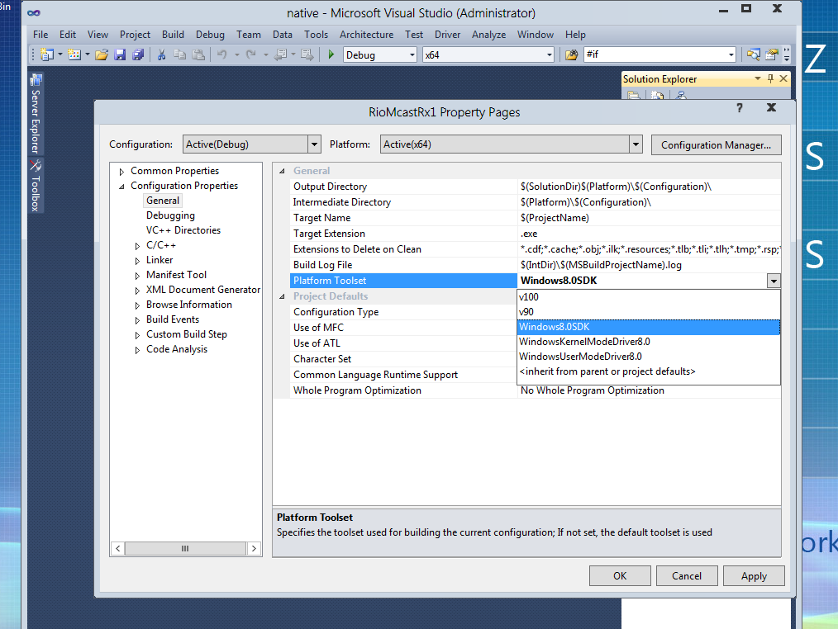

Slide 43
Adding RIO to Your App
Determine if your system supports RIO at run-time
Check Windows version information.
Attempt to create a RIO socket. This will fail if RIO is not supported.
Attempt to retrieve the RIO Function Extensions. This will fail if RIO is not supported.
You can include RIO code in your app safely
…even if the runtime platform doesn’t support RIO
RIO Functionality won’t work – of course
But no Runtime Linkage problems
This also means you could develop your code on Windows 7 and copy it to Windows Server 8 machine for testing.
Notes:
<number>

Slide 44
Adding RIO Sockets to Your App
Determine the style of completion you want
Poll, IOCP, Event
Determine the sort of buffering you require
Varies by receive rate
May want to consider lock free lists, or per-NUMA node pools
Arrange for more asynchronous I/O where necessary
For UDP receive, you can’t rely on a large socket receive buffer with RIO
You many need to post multiple asynchronous receives to create the necessary buffering for high rates of receive traffic
Instrument your code with Concurrency Visualizer markers and/or ETW
Notes:
29.08.2019 09:22 nachm.
©2005 Microsoft Corporation. All rights reserved.
This presentation is for informational purposes only. Microsoft makes no warranties, express or implied, in this summary.
<number>

Slide 45
Recap

Slide 46
For many performance critical apps …every microsecond saved means money.
Notes:
<number>

Slide 47
Windows Server 8 delivers
Lower Latency
RIO ~15 - 30% reduction in latency
Better Predictability
Variability (stdev) reduced by a factor of 7
Maximum values reduced by a factor of 5
Higher Throughput
Windows Server 2008R2 sustains ~2 Million datagrams per second
With RIO, we have seen double the datagrams per second
Notes:
<number>

Slide 48
Related sessions
[417] Windows Server 8 Performance and Improvements
[433] Network Acceleration & Other NIC Technologies for the Datacenter
[565] Windows Networking with PowerShell: A Foundation for Datacenter Management

Slide 49

© 2011 Microsoft Corporation. All rights reserved. Microsoft, Windows, Windows Vista and other product names are or may be registered trademarks and/or trademarks in the U.S. and/or other countries.
The information herein is for informational purposes only and represents the current view of Microsoft Corporation as of the date of this presentation. Because Microsoft must respond to changing market conditions, it should not be interpreted to be a commitment on the part of Microsoft, and Microsoft cannot guarantee the accuracy of any information provided after the date of this presentation. MICROSOFT MAKES NO WARRANTIES, EXPRESS, IMPLIED OR STATUTORY, AS TO THE INFORMATION IN THIS PRESENTATION.
Notes:
29.08.2019 09:22 nachm.
<number>
© 2011 Microsoft Corporation. All rights reserved. Microsoft, Windows, Windows Vista and other product names are or may be registered trademarks and/or trademarks in the U.S. and/or other countries.
The information herein is for informational purposes only and represents the current view of Microsoft Corporation as of the date of this presentation. Because Microsoft must respond to changing market conditions, it should not be interpreted to be a commitment on the part of Microsoft, and Microsoft cannot guarantee the accuracy of any information provided after the date of this presentation. MICROSOFT MAKES NO WARRANTIES, EXPRESS, IMPLIED OR STATUTORY, AS TO THE INFORMATION IN THIS PRESENTATION.

