Slide 1
Room Service
By The Matchmakers
Team Members:
Daniel Bailey
Eric Hoffman
Jacques Louis
Daniel Montoya
Ken Orsini

Slide 2
Project Overview
Our application allows student residents and residence administrators to create accounts with access to multiple features regarding chosen area and housing location
Notes:
Daniel Montoya

Slide 3
Execution Overview
- Our product was executed using a division between front-end and back-end programming.
- Both parties worked individually but joined to integrate fairly regularly.
- Text files replaced arrays to represent a database.
- In comparison to the prototype, several classes were added for necessary functionality such as adminPayments and createEvents
Notes:
Ken Orsini

Slide 4
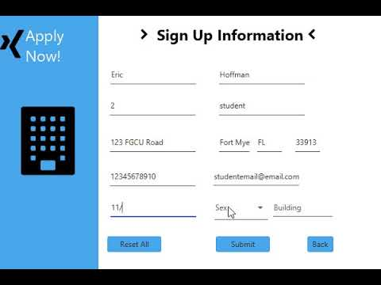
Product Demonstration
Notes:
Eric Hoffman

Slide 5
Known Issues
- An SQL database would have been more preferable for the program
- Administrators cannot mark maintenance requests as completed
- Menu choices cannot be made from within previous selected window
Notes:
Daniel Bailey

Slide 6
Requirements & Testing
- Requirement to allow users to search for housing locations was removed and was not implemented.
- Requirement for resident roommate search and survey was removed.
- All other requirements were met within the program.
- Functionality within the program was successfully tested after integration.
Notes:
Jacques Louis

Slide 7
What We Learned
- Project compatibility must be planned carefully at the start of projects. Compatibility issues can take a long time to solve and should be avoided.
- Division of work leads to a much better execution of tasks and should be taken care of at the beginning of projects.
- Careful planning is an important asset that leads to reaching a final product faster.
Notes:
Daniel Montoya

Slide 8
Thank you for your time

Slide 9
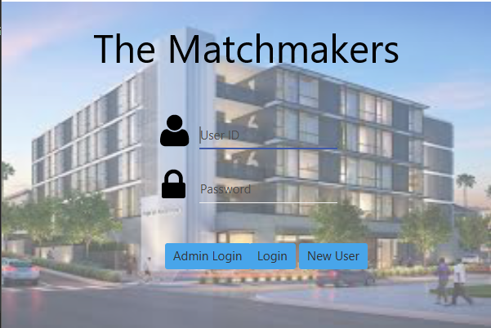
Login Screen

Slide 10
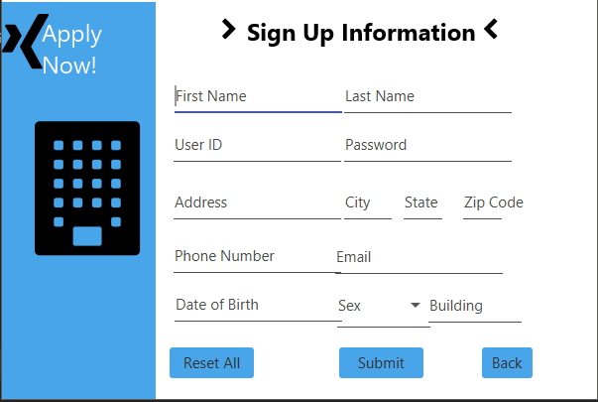
Student Sign Up

Slide 11
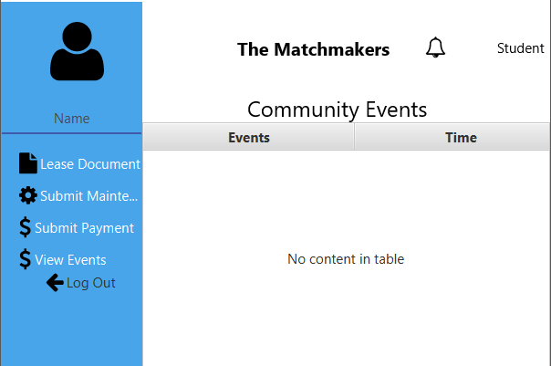
Student Dashboard

Slide 12
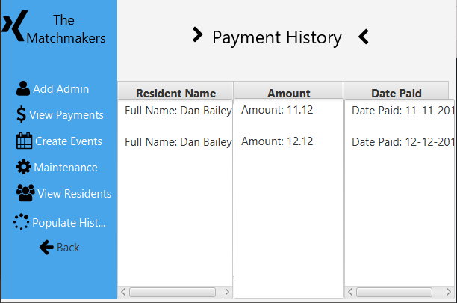
Administrator Dashboard

