Slide 1
Room Service
By The Matchmakers
Team Members:
Daniel Bailey
Eric Hoffman
Jacques Louis
Daniel Montoya
Ken Orsini
Notes:
Introduce group name and product name

Slide 2
Introductions
Daniel Bailey - Lead Backend Developer, Frontend Testing
Eric Hoffman - Project Manager, Backend Developer
Jacques Louis - Frontend Developer, Backend Testing
Daniel Montoya - Lead Frontend Developer
Ken Orsini - QA Testing, Documentation
Notes:
Each person gives introduction, say year at FGCU, position in the group

Slide 3
Project Overview
Our application will allow student residents and residence administrators to create accounts with access to multiple features regarding chosen area and housing location
Notes:
Dan Bailey

Slide 4
Features
Students
Preferences for potential roommates and housing
Request maintenance
View payment history
Change payment methods
Access nearby event information
Administrators
Assign maintenance tasks
View resident payments
Post events being hosted by their organization
Upload resident lease information
Manage housing location
Notes:
Eric read student features, Jac read administrator features

Slide 5
Scheduling
We are estimating for the design to be complete by November 2nd, followed with initial testing completed by November 5th.
The final product is estimated to be complete by December 3rd.
Notes:
Daniel Montoya read scheduling

Slide 6
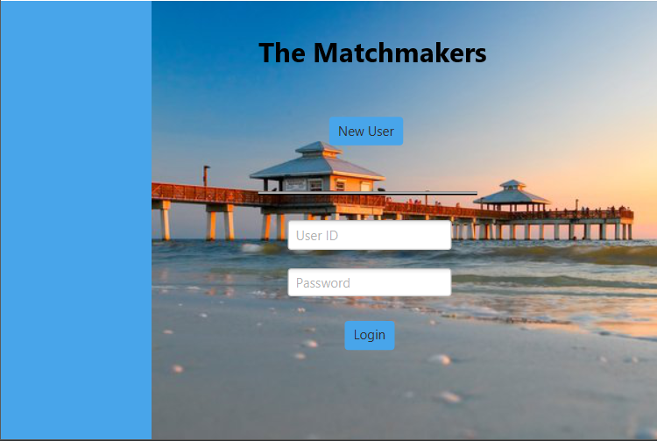
Image of Login Screen
Notes:
Ken Orsini describe picture

Slide 7
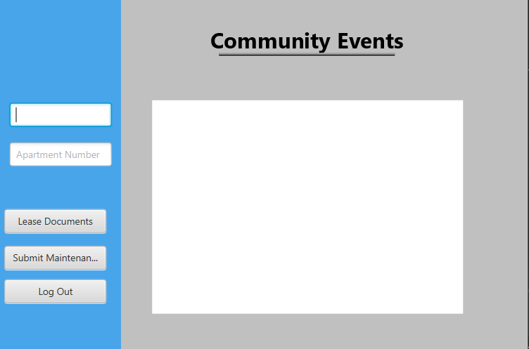
Image of Student Dashboard
Notes:
Ken Orsini describe picture

Slide 8
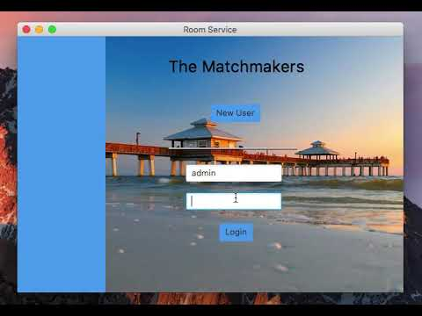
Prototype Demonstration

Slide 9
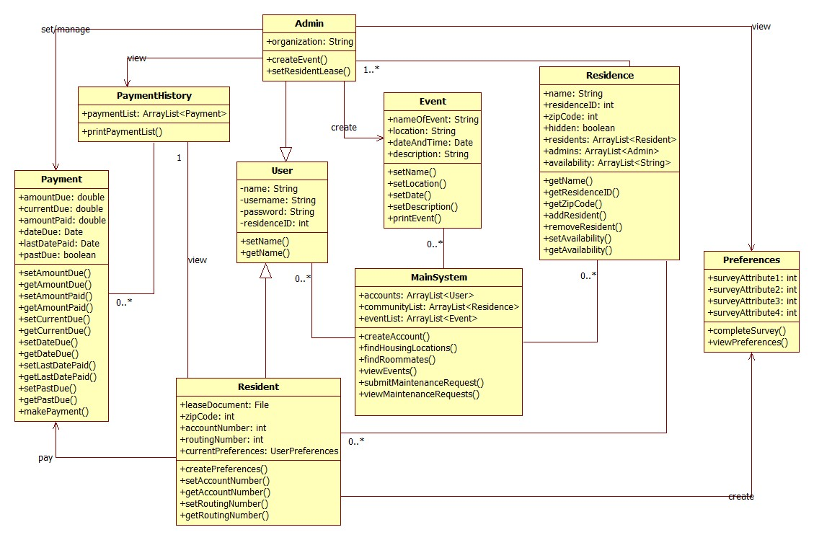
Design Overview - Class Diagram
Notes:
Eric briefly describe class diagram (event, user, residences stored in mainsystem) (payment history separate, preferences stored to residents)

Slide 10
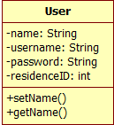
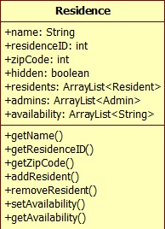
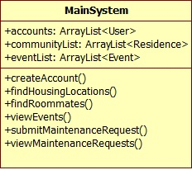
Design Overview - Noted Classes
User Class:
Superclass to administrator and resident subclasses
Residence:
ResidenceID used to associate different administrators or residents with that community
MainSystem:
Stores user accounts, residences, and events
Offers controls for both types of user accounts
Notes:
Jac describe noted classes (user is superclass to admin/student) (residence ID used to categorize/search for residents)

Slide 11
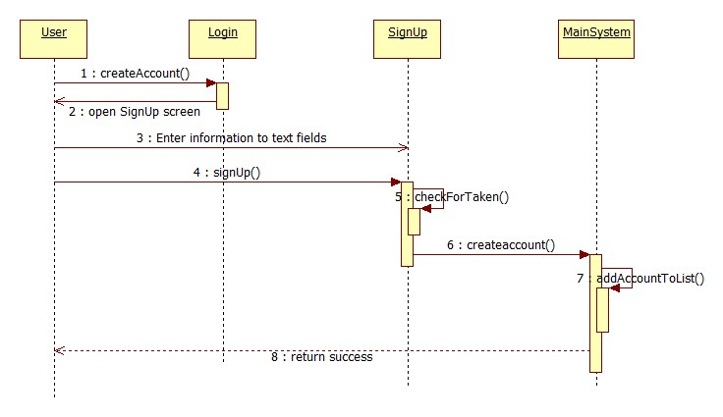
Account creation sequence diagram
Notes:
Ken Orsini describe sequence diagram

Slide 12
Future Challenges and Decisions
Integrating back-end class design with JavaFX controller class structure
Finding a workaround for dynamic creation of user accounts to be stored
Creating better strategies for faster integration between front-end and back-end progress
Notes:
Dan Montoya describe future challenges

Slide 13
Thank you for your time

