Slide 1
Room Service
User Manual
Presented by the Matchmakers

Slide 2
Table of Contents
Chapter 1: Installation
Setup instructions on Windows with zip file
Chapter 2: How to use the application
Login on admin and student/resident
Admin home screen and all screens that correspond with admin home screen buttons
Student home screen and all screens that correspond with student home screen buttons
Chapter 3: Help
Contact us

Slide 3
Chapter 1: Installation
System Requirements
Windows XP or higher
Internet connection
7-zip or anything to unzip a folder
JDK 8, 10, 11
IntelliJ
Installing IntelliJ
First you want to go to www.jetbrains.com/idea/ and click download. You can either download the Ultimate version and use the free trial, or if you are a student you can get it for free. If not click download on community.
Once downloaded, follow the installer and agree to everything to install IntelliJ.
Remember where you downloaded our zip file and extract it to your desired folder.
Once installed, either click file, then new, then project from existing sources, or just create project, then project from existing sources and select the folder from the extracted zip download.

Slide 4
Installation
Installing JDK 8
First you want to go to https://www.oracle.com/technetwork/java/javase/downloads/jdk8-downloads-2133151.html and scroll down to Java SE Development Kit 8u192.
Click the circle next to accept license agreement
Click the last download on the right side of Windows x64
Once it is done downloading go through the installer and select a folder to install it that you will remember.
Once the JDK is installed go into your IntelliJ project click on File in the top left, then Project Structure, then under project and Project SDK, select New, then JDK, and then click the folder you installed it to, and select 1.8.0_192

Slide 5
Installation
7-Zip
First go to https://www.7-zip.org/ and click download next to the 64-bit x64.
Once downloaded, go through the installer and finish installing it
Once installed you can right click on the downloaded zip folder and then hover your mouse over 7-Zip
Then click on Extract here to create the folder in the same spot or click extract files to create it in a different location.

Slide 6
Chapter 2: How to use the Application

Slide 7
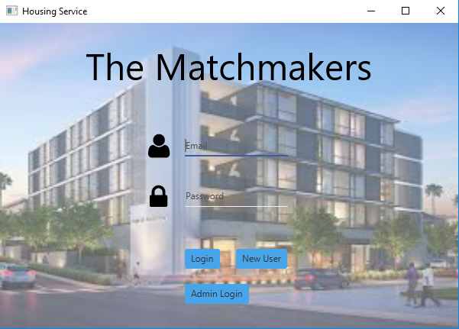
How to use the Application
Login Screen – Admin
To login as admin for the first time, the default email and password are both admin. Once typed in, click on Admin Login to take you to the admin home page.

Slide 8
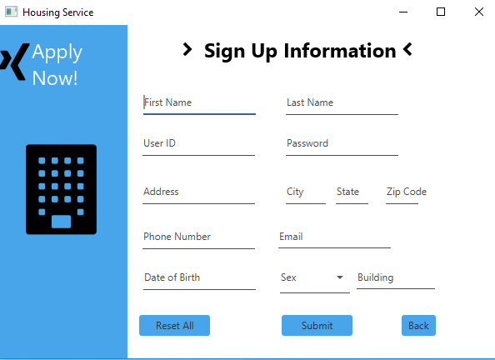
How to use the Application
New Student Login
If you are a student and need to create an account, simply click on New User as it is shown on the slide before this. After clicking on New User you will need to fill in all the fields, and ideally the housing will give you a User ID and your building. Once all fields are filled in correctly, simply push Submit and go back to the login menu. Enter in your email and password you just created and click on Login.

Slide 9
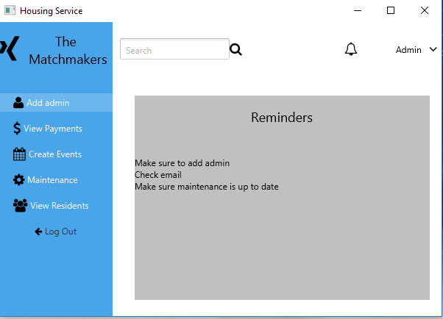
How to use the Application
Admin home screen
On the admin home screen you are able to add an admin, view student payments, create events, view student maintenance requests, and view residents while always being able to click log out.

Slide 10
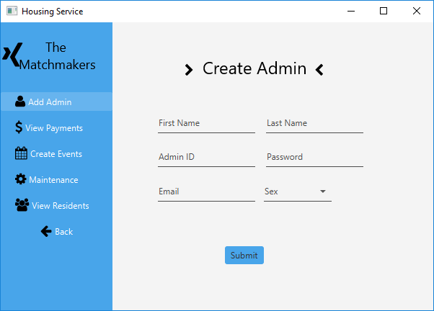
How to use the Application
Create an admin
After clicking on add admin from the admin home screen you will be able to create an admin. Just fill in all the fields of that admin while giving them their ID. After filling out all fields correctly click on submit, and when you are back at the login screen you can now login with the new email and password you just created. After hitting submit you can also click back to go to the admin home page again.

Slide 11
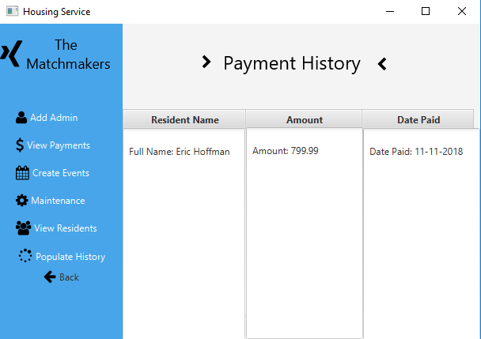
How to use the Application
View Payments - Admin
After clicking on View Payments from the admin home page you will see the payment history page. On this page you can click populate history to update the page and it will show all the payments that have been made by students. You can also click back to go back to the admin home page.

Slide 12
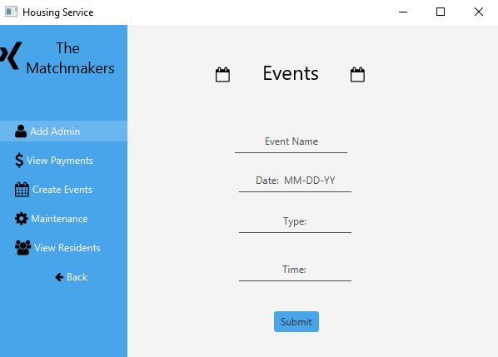
How to use the Application
Create Events - Admin
Once clicking on the create events button from the admin home page you will get the Events screen. Here you are able to create an event by filling in all the fields correctly. Once the fields are filled in you can click submit, and the residents will be able to view the event created. You can also click back at any time to go to the admin home page.

Slide 13
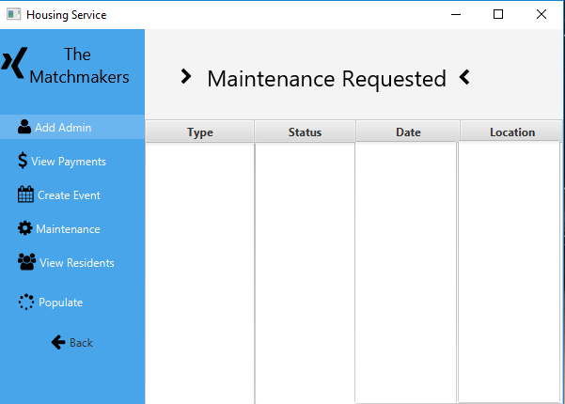
How to use the Application
Maintenance – Admin
After clicking on maintenance from the admin home, you will see the maintenance requested screen. If you hit the button on the top of the screen it will update the page and show all the maintenance requests that students have submitted. You can then hit the back button to go to the admin home page again.

Slide 14
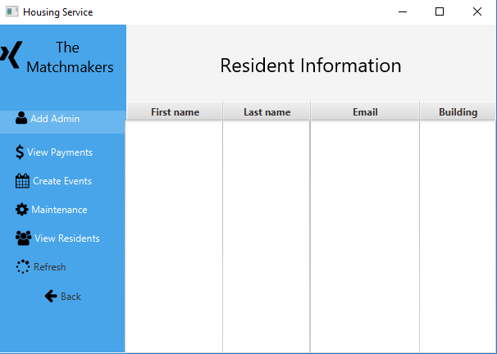
How to use the Application
View Residents – Admin
After clicking view residents from the admin home you will see the resident information screen. By clicking on the Refresh button it will show all the student residents that have created an account. You can also hit back at any time to go back to the admin home page.

Slide 15
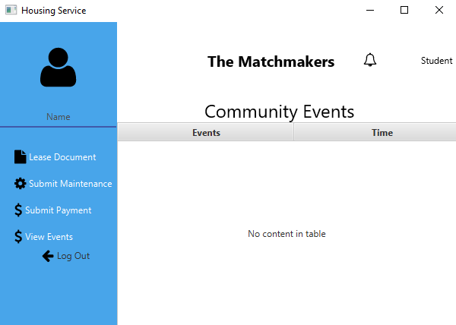
How to use the Application
Student/Resident home page
After typing in the email and password you created for the new user click on login and it will take you to the student/resident home page. On this page you will be able to click on the lease document, submit maintenance, submit payment, view events, and log out buttons.

Slide 16
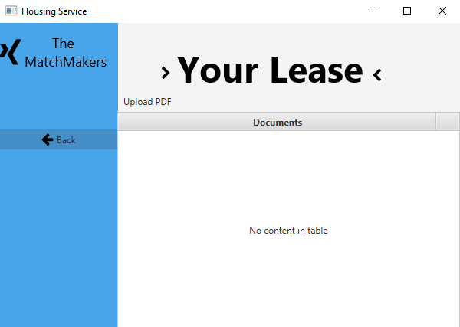
How to use the Application
Lease Document – Student/Resident
After clicking on lease document from the resident home page you will get the Documents screen. On this screen you can click on upload pdf to upload your lease documents, or any other documents you would like. You can also click back to go to the home screen.

Slide 17
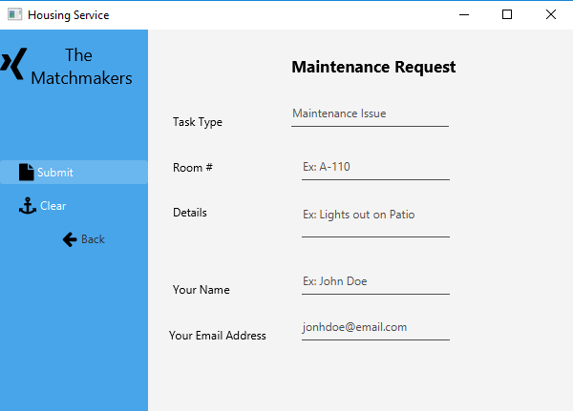
How to use the Application
Maintenance – Student/Resident
After clicking submit maintenance from the home screen it will bring up the maintenance request page. Here you can fill out all the fields to submit a maintenance request if something is wrong in your room. If all fields are filled in correctly you can click submit and then any admin can see the request on their maintenance screen. You can also hit clear to clear all fields or back to go to the home screen.

Slide 18
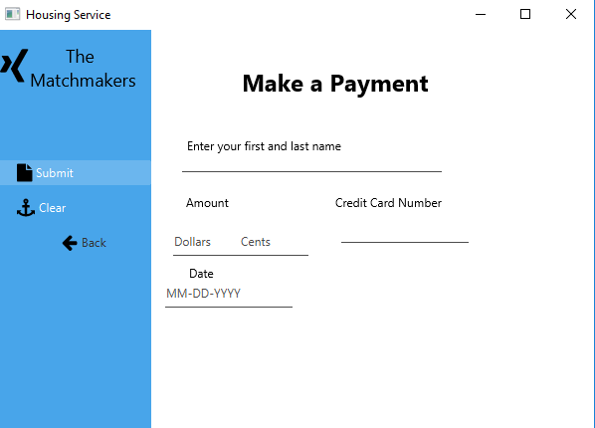
How to use the Application
Submit Payment – Student/Resident
After clicking on submit payment from the student home screen you will get the make a payment screen. Here you can enter your name, amount of payment, credit card number, and the date of payment. Once all fields are filled in correctly you can hit submit and all admins will be able to see your payment on their view payments screen. Again you can clear all fields or click back to go to the home screen.

Slide 19
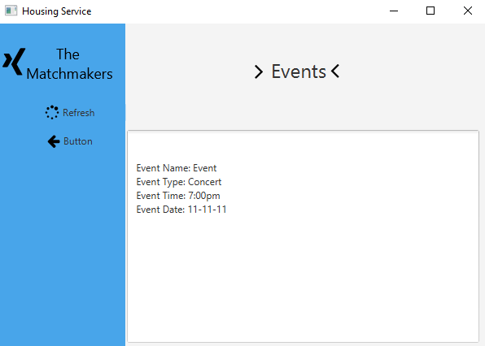
How to use the Application
View Events – Student/Resident
Once clicking view events from the student home screen you will see the events screen. On this screen you can hit refresh and it will show all the events that the admins have created. You can also hit the back button to go back to the home screen.

Slide 20
Chapter 3: Help

Slide 21
Help
Contact Us:
The user manual shows all features of the Application
For any other information or questions please email us:
emhoffman2584@eagle.fgcu.edu

