Slide 1

Journal Club: Anxiolytic effects of quetiapine and lithium and anxiety as a moderator of the antidepressant effect (PMID 41762225)
By Emilio Hospedales, MD
PGY 2 Resident
Notes:
Image source: Microsoft 365 content library

Slide 2
Why This Study Matters
Clinical rationale for journal club
Burden: Depression is common, disabling, and costly—driving morbidity, functional impairment, relapse risk, and frequent health-system use.
Question: What brain structure results in atrophy due to depression?
Evidence gap: prior trials and meta-analyses can be inconsistent or hard to generalize (short follow-up, narrow samples, surrogate outcomes, or residual confounding), leaving uncertainty about real-world effectiveness and safety.
Clinical decision-making: The toolbox. This question affects everyday patients seen in outpatient and inpatient settings; the study tests (in plain terms) whether the intervention/exposure meaningfully improves patient-important outcomes enough to change routine practice.
Notes:
Answer – hippocampus – results in ability to recall biographical information or form new memories

Slide 3

Study Design and Methods
Design, setting, and methodological approach

Slide 4
Design & Methods
Setting and methodological approach
What type of study design?
Re-analysis of an open label randomized trial
Describe setting and recruitment:
- Patients with TRD across several UK sites, Patients over 18 yrs, and TRD defined as failing to adequately respond to at least 2 antidepressant therapies in the current episode each prescribed for at least 6 weeks at minimum therapeutic dose. No hx of lithium or Seroquel and had HAM-D score of at least 14. Patients were stratified from moderate 14-18, severe 19-22, and very severe greater than 23
How long were the patients followed?
52 weeks
What were the target doses?
Lithium plasma between 0.6-1.2 and Seroquel 150-300 mg/day

Slide 5
Outcome measure:
Notes:
Study population, eligibility, and outcome measures

Slide 6
Outcomes
Outcomes & safety measurement
- QIDS-SR assessed weekly time to all cause treatment discontinuation
Second and tertiary anxiety were assessed at visits at baseline 8, 26, and 52 wks
Is anxiety a mediator of the antidepressive effects of lithium or Seroquel
Notes:
This section focuses on who was studied and how key variables were measured, both of which directly influence generalizability and validity. Start by reviewing the inclusion and exclusion criteria in detail, highlighting clinical characteristics such as diagnosis, symptom severity, comorbidities, medication status, and demographic factors. Discuss how restrictive or inclusive these criteria are and what types of real-world patients may be underrepresented or excluded. Examine baseline characteristics and assess whether groups were comparable at study entry. Identify any clinically meaningful imbalances and consider whether randomization or statistical adjustment adequately addressed them. Comment on sample size, recruitment success, and whether the enrolled population reflects typical patients seen in psychiatric practice with respect to age, sex, race and ethnicity, and illness chronicity. Then, describe the primary and secondary outcomes. Specify how outcomes were defined, measured, and timed, including the use of validated psychiatric rating scales or structured interviews. Discuss who rated outcomes and whether assessors were blinded. Evaluate whether the outcomes are patient-centered and clinically meaningful, and whether a minimal clinically important difference was prespecified. Also review how adverse events and safety outcomes were captured. Together, these elements help determine whether the study’s measurements are reliable, valid, and relevant to clinical care.

Slide 7

Statistical Analysis
Analytic strategy and handling of data
Notes:
Analytic strategy and handling of data Image source: Microsoft 365 content library

Slide 8
Handling of data
Appraising rigor, bias, and uncertainty in statistical methods
Analytic strategy
1) Sample size & analysis population
Review power assumptions (effect size, variance, attrition) and whether they are plausible; clarify ITT vs mITT vs per-protocol and implications for bias and interpretability.
2) Primary models & missing data
Assess model fit to outcome type and data structure; for longitudinal psychiatric outcomes, prefer mixed-effects or repeated-measures approaches that address within-subject correlation. Evaluate MI/ML handling and assumptions.
3) Secondary, subgroup, and sensitivity analyses
Distinguish prespecified vs exploratory work; check multiplicity control. Review sensitivity analyses to judge whether conclusions are robust or key uncertainties remain.
Notes:
This section critically appraises the statistical methods used to analyze the data. Begin by reviewing the sample size and power calculations, including the assumed effect size and whether these assumptions were reasonable. Discuss the analysis population, such as intention-to-treat, modified intention-to-treat, or per-protocol, and explain how this choice affects bias and interpretability. Next, outline the primary statistical models used and assess whether they are appropriate for the outcome type and data structure. For longitudinal psychiatric outcomes, consider whether mixed-effects models or repeated-measures approaches were used and whether they appropriately account for within-subject correlation. Examine how missing data were handled, such as multiple imputation or maximum likelihood methods, and discuss the plausibility of the underlying assumptions. Finally, evaluate secondary and subgroup analyses. Determine whether these were prespecified or exploratory, and whether adjustments for multiple comparisons were performed. Review sensitivity analyses and consider whether they meaningfully test the robustness of the findings. This statistical appraisal equips residents to judge whether the analytic approach supports reliable conclusions or leaves important uncertainty unaddressed.

Slide 9
Sociodemographic Characteristics
Notes:
Primary and secondary findings

Slide 10
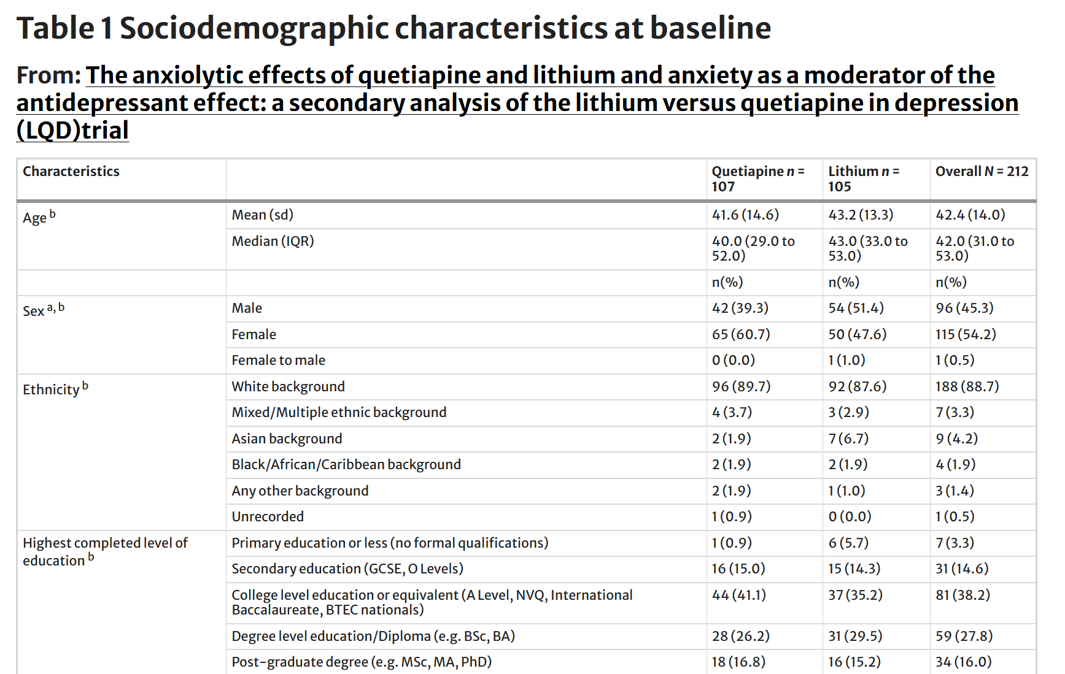
Sociodemographic characteristics at baseline
Effect size, precision, and clinical relevance
Notes:
This section synthesizes the study’s results with an emphasis on effect size, precision, and clinical relevance. Start with participant flow and adherence, noting attrition rates and reasons for dropout. Discuss whether loss to follow-up differed between groups and how this might bias results. Present the primary outcome results clearly, including effect estimates, confidence intervals, and p values. Translate statistical findings into clinically interpretable terms, such as absolute risk reduction or number needed to treat when applicable. Emphasize whether the observed effects meet thresholds for clinical importance, not just statistical significance. Then review key secondary outcomes, subgroup analyses, and safety findings. Highlight any patterns that reinforce or complicate interpretation of the primary result. Discuss adverse events in detail, particularly those relevant to psychiatric practice, such as tolerability, discontinuation due to side effects, or symptom worsening. This balanced presentation helps residents integrate benefits and harms when considering clinical application.

Slide 11
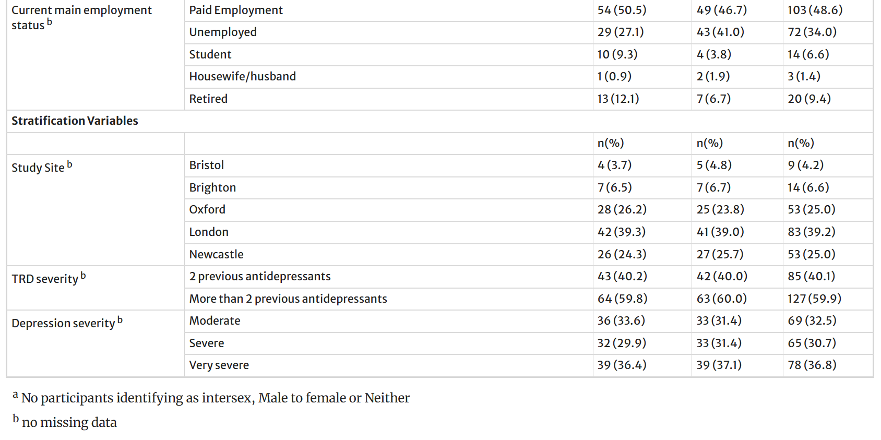
Sociodemographic characteristics at baseline
Effect size, precision, and clinical relevance
Notes:
This section synthesizes the study’s results with an emphasis on effect size, precision, and clinical relevance. Start with participant flow and adherence, noting attrition rates and reasons for dropout. Discuss whether loss to follow-up differed between groups and how this might bias results. Present the primary outcome results clearly, including effect estimates, confidence intervals, and p values. Translate statistical findings into clinically interpretable terms, such as absolute risk reduction or number needed to treat when applicable. Emphasize whether the observed effects meet thresholds for clinical importance, not just statistical significance. Then review key secondary outcomes, subgroup analyses, and safety findings. Highlight any patterns that reinforce or complicate interpretation of the primary result. Discuss adverse events in detail, particularly those relevant to psychiatric practice, such as tolerability, discontinuation due to side effects, or symptom worsening. This balanced presentation helps residents integrate benefits and harms when considering clinical application.

Slide 12
Clinical characteristics at baseline
Notes:
Primary and secondary findings

Slide 13
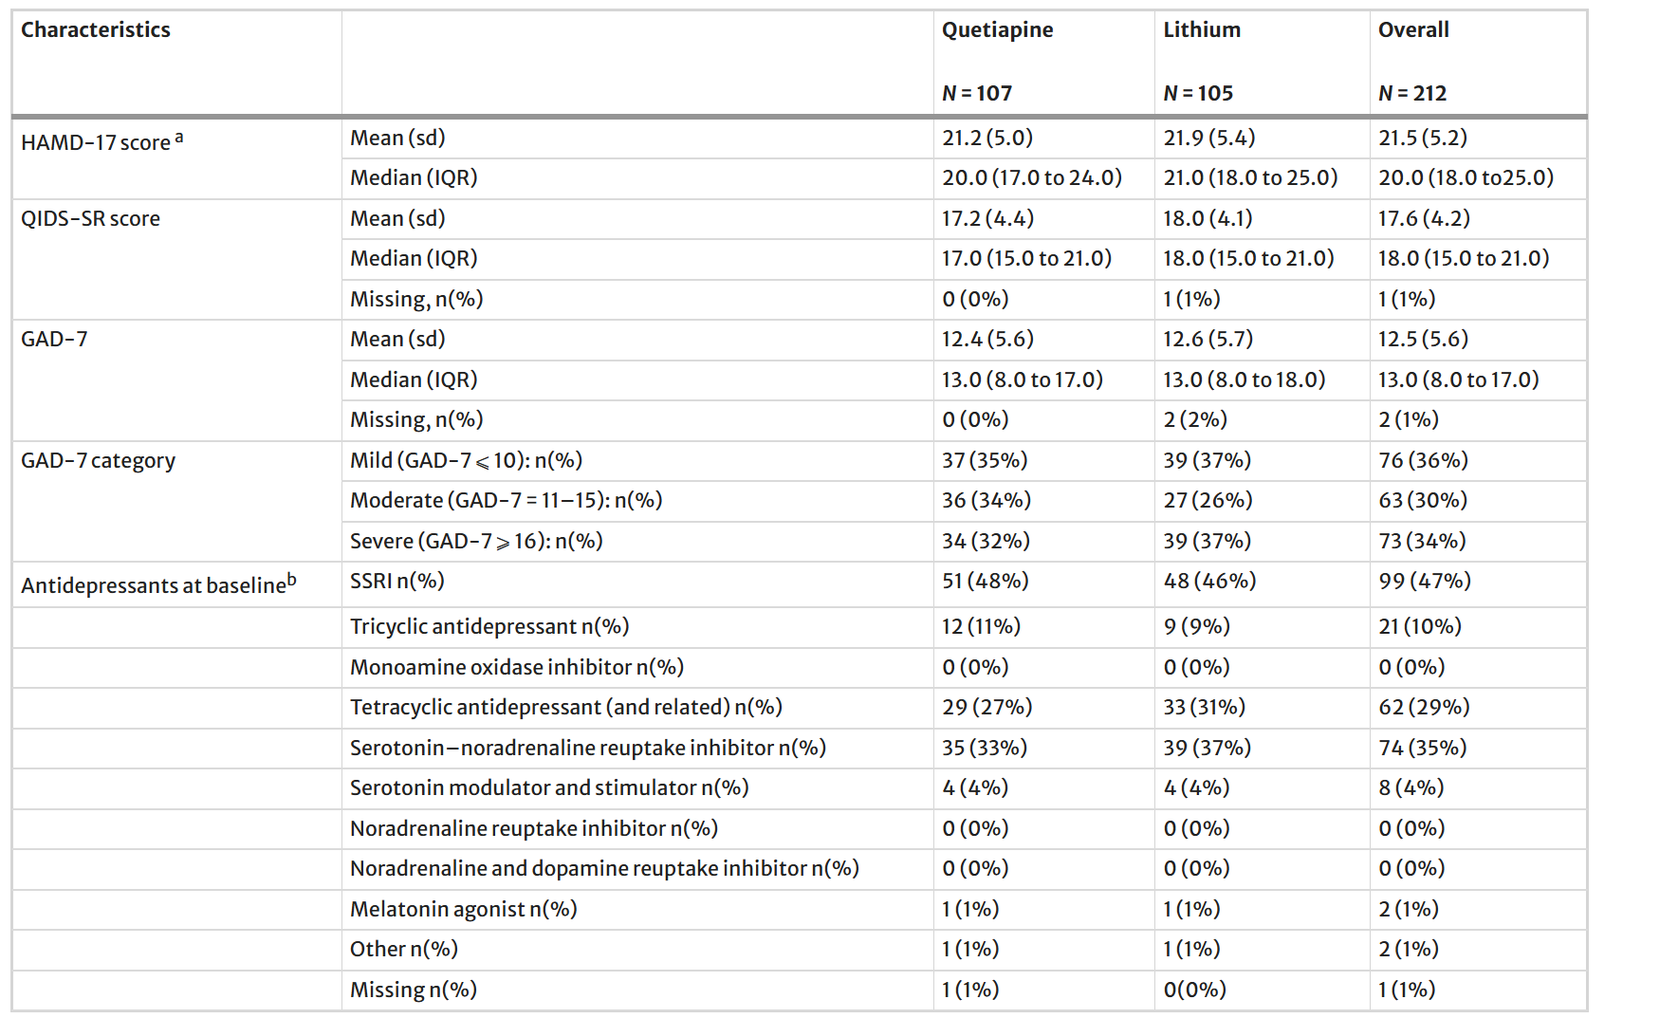
Sociodemographic characteristics at baseline
Effect size, precision, and clinical relevance
Notes:
This section synthesizes the study’s results with an emphasis on effect size, precision, and clinical relevance. Start with participant flow and adherence, noting attrition rates and reasons for dropout. Discuss whether loss to follow-up differed between groups and how this might bias results. Present the primary outcome results clearly, including effect estimates, confidence intervals, and p values. Translate statistical findings into clinically interpretable terms, such as absolute risk reduction or number needed to treat when applicable. Emphasize whether the observed effects meet thresholds for clinical importance, not just statistical significance. Then review key secondary outcomes, subgroup analyses, and safety findings. Highlight any patterns that reinforce or complicate interpretation of the primary result. Discuss adverse events in detail, particularly those relevant to psychiatric practice, such as tolerability, discontinuation due to side effects, or symptom worsening. This balanced presentation helps residents integrate benefits and harms when considering clinical application.

Slide 14
Results
Notes:
Primary and secondary findings

Slide 15
Primary & Secondary Findings
Effect size, precision, and clinical relevance
Mean drug dosing:
Lithium – 681.3
Seroquel 194.7
Adherence?
No differences between groups
Effects on anxiety?
Whole sample anxiety scores reduced from week 0 to week 8 but did not change from week 8 to 26 or 26 to 52
Difference in anxiolytic effect of Seroquel vs lithium?
Little to no difference at 8 weeks or 52 weeks
Anxiety as a moderator of antidepressant effect?
- Across all baseline anxiety groups combined, participants taking Seroquel had lower depression symptoms over 52 week time period than those taking lithium (95% CI −9.8 to −133.5), p 0.023)
However, those with moderate (AUC − 79.7 (95% CI 34.8 to −194.2), p = 0.17) and mild anxiety (AUC 29.7 (95% CI 73.4 to −132.8), p = 0.57), the results were not statistically significant
Notes:
This section synthesizes the study’s results with an emphasis on effect size, precision, and clinical relevance. Start with participant flow and adherence, noting attrition rates and reasons for dropout. Discuss whether loss to follow-up differed between groups and how this might bias results. Present the primary outcome results clearly, including effect estimates, confidence intervals, and p values. Translate statistical findings into clinically interpretable terms, such as absolute risk reduction or number needed to treat when applicable. Emphasize whether the observed effects meet thresholds for clinical importance, not just statistical significance. Then review key secondary outcomes, subgroup analyses, and safety findings. Highlight any patterns that reinforce or complicate interpretation of the primary result. Discuss adverse events in detail, particularly those relevant to psychiatric practice, such as tolerability, discontinuation due to side effects, or symptom worsening. This balanced presentation helps residents integrate benefits and harms when considering clinical application.

Slide 16

Limitations and Clinical Implications
Strengths, limitations, and take-home messages
Notes:
Strengths, limitations, and take-home messages Image source: Microsoft 365 content library

Slide 17

Clinical Context and Rationale
Why this study matters for psychiatry practice
Notes:
Why this study matters for psychiatry practice Image source: Microsoft 365 content library

Slide 18
Major strengths
Rigorous design, high follow-up, and validated outcomes support internal validity and reduce random error.
Strengths & Limits
Practice take-homes
Key limitations (bias)
Open label study
External validity (real-world fit)
Applicability depends on feasibility (cost, monitoring burden) and patient preferences; population differences can shift benefit and tolerability.
Take-home messages
Moderate confidence: consider targeted use in psychiatry practice, but prioritize shared decisions and study gaps for future research.

