Slide 1
A Universal Saver's Match
Next steps in closing the access gap and generating retirement-savings where it matters most
Economic Innovation Group · June 2026

Slide 2
THE PROBLEM
The access gap undermines what the Saver’s Match can do
Why it matters
~3 in 5
The match enacted in federal law rewards households and workers who already hold a qualifying retirement account and who contribute.
The binding constraint is the access gap rather than subsidy. Independent contractors, gig and platform workers, and employees who lack employer-provided retirement plans are left out.
Fixing the access gap is the first, largest step, to unlock the Saver’s Match.
of the dollars the Saver's Match could direct to households will not get there since those workers have no retirement account.
Source: Author's analysis of SIPP 2024 Wave 1. Access-gate estimate compares current-law match offers with the share deliverable given account access.

Slide 3
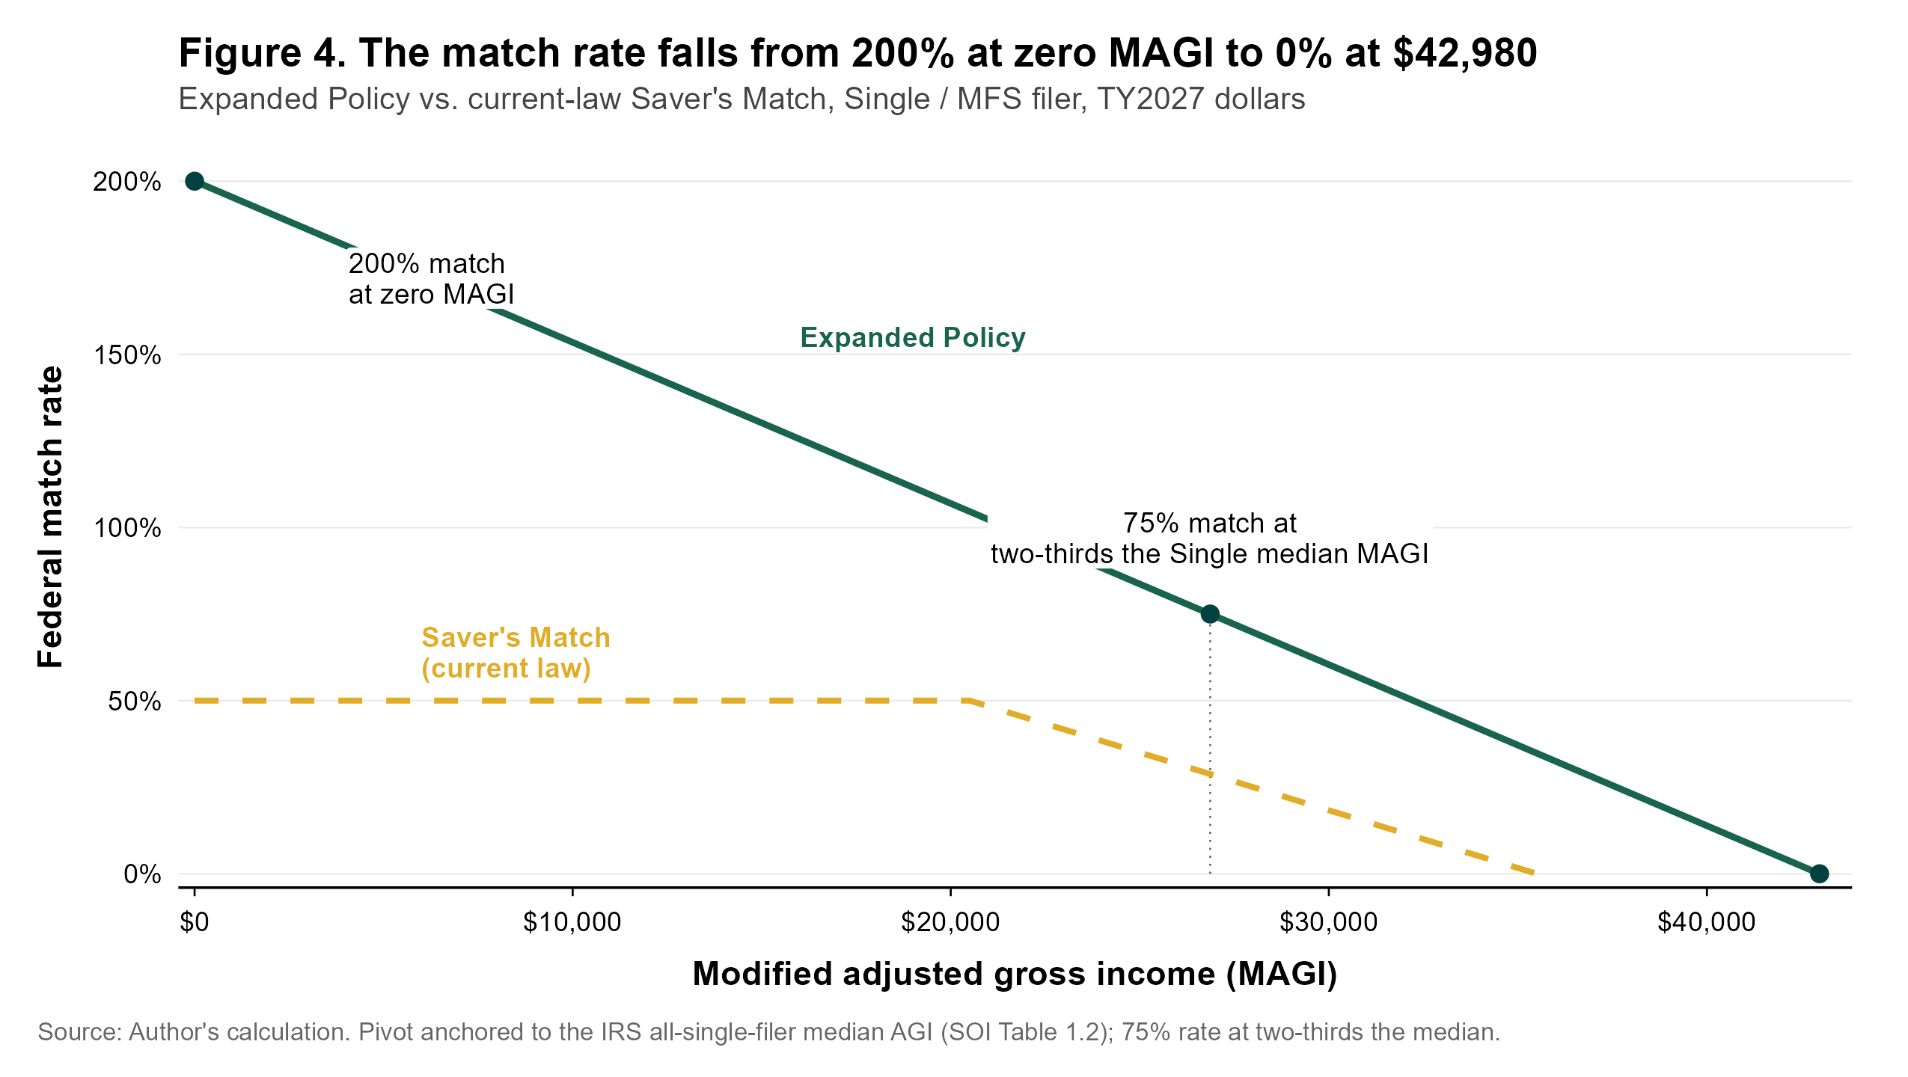
THE DESIGN
Two moving parts to consider
1. A universal automatic account
Workers on a qualifying workplace plan stay in that plan. All other workers default into a low-cost, portable federal account auto-enrolled at a 3 percent default. The self-employed contribute through estimated-tax payments or their hosting platforms, under a worker-classification safe harbor. This account is the active ingredient that closes the access gap.
2. A redesigned match
A single declining line by income: 200 percent for the lowest earners, falling to zero at the top of each band. The credit is capped at $1,000 per individual — $2,000 for a dual-earner couple.
Single filer: the redesigned rate (green) vs. the current-law match (gold).
Easy to administer: the match is set on prior-year income — known when the worker contributes, with no year-end clawback — and a worker's own contributions stay accessible, in the same way RSAA is currently designed.

Slide 4
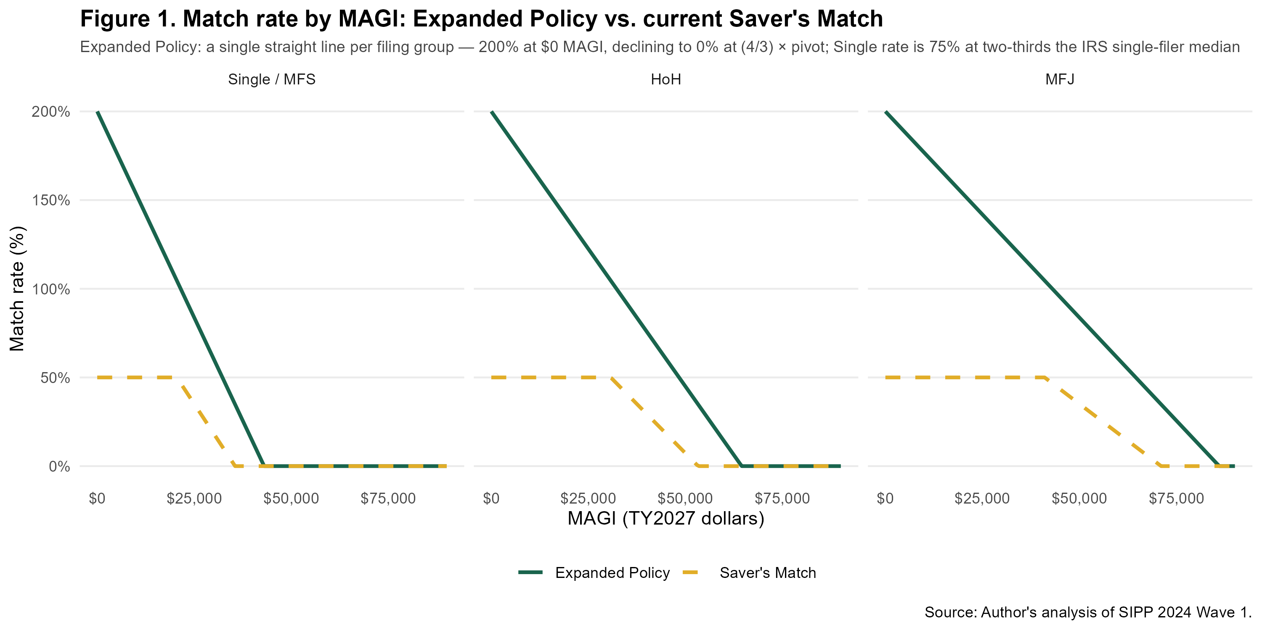
THE SCHEDULE
An income-anchored band, scaled by filing status
Filing status | 50% pivot | Match ends
Single / MFS | $32,235 | $42,980
Head of household | $48,353 | $64,471
Married filing jointly | $64,471 | $85,961
How the band is set. The single-filer pivot is anchored to the IRS median income for single filers (at two-thirds of that median), with the head-of-household and joint bands scaled by the statutory 1.5x and 2.0x ratios already used in current law. It is indexed to chained-CPI inflation and re-anchored to fresh IRS data about once a decade — so the band tracks incomes without repeated acts of Congress, on a basis a budget agency can reproduce.
Source: Author's analysis of SIPP 2024 Wave 1, projected to tax year 2027. Eligibility band anchored to IRS single-filer median income.

Slide 5
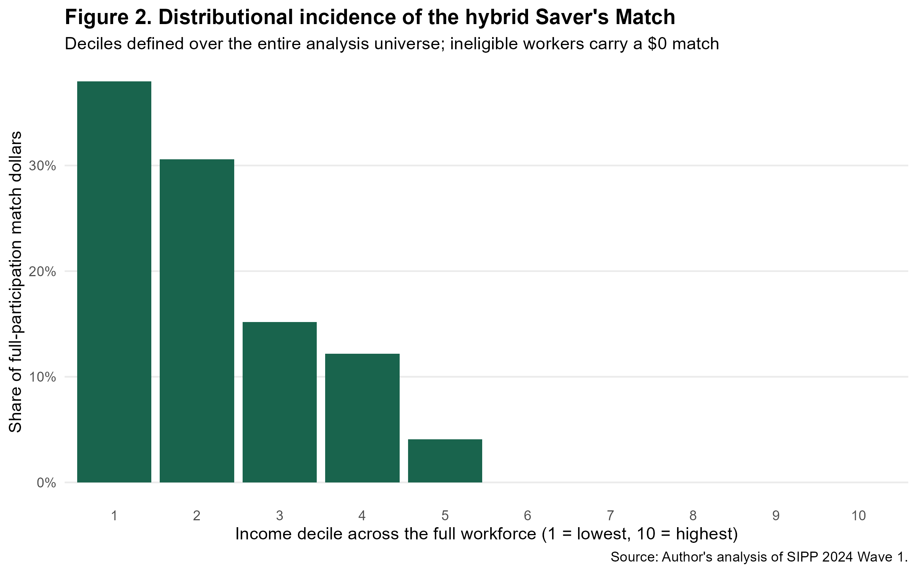
REACH
44.5 million workers — and the dollars land at the bottom
44.5M
58%
84%
eligible workers (~31% of the workforce)
reach the match through the new account
of dollars go to the lowest-earning 30%
Channel | Workers | Avg. income | Avg. rate
New universal account | 26.0M | $34,800 | 85%
Existing workplace plan | 18.5M | $41,300 | 66%
The universal account carries the larger share — it absorbs the self-employed and workers without a plan, who tend to have lower incomes and therefore higher match rates.
Source: Author's analysis of SIPP 2024 Wave 1, projected to tax year 2027. Eligibility band anchored to IRS single-filer median income.

Slide 6
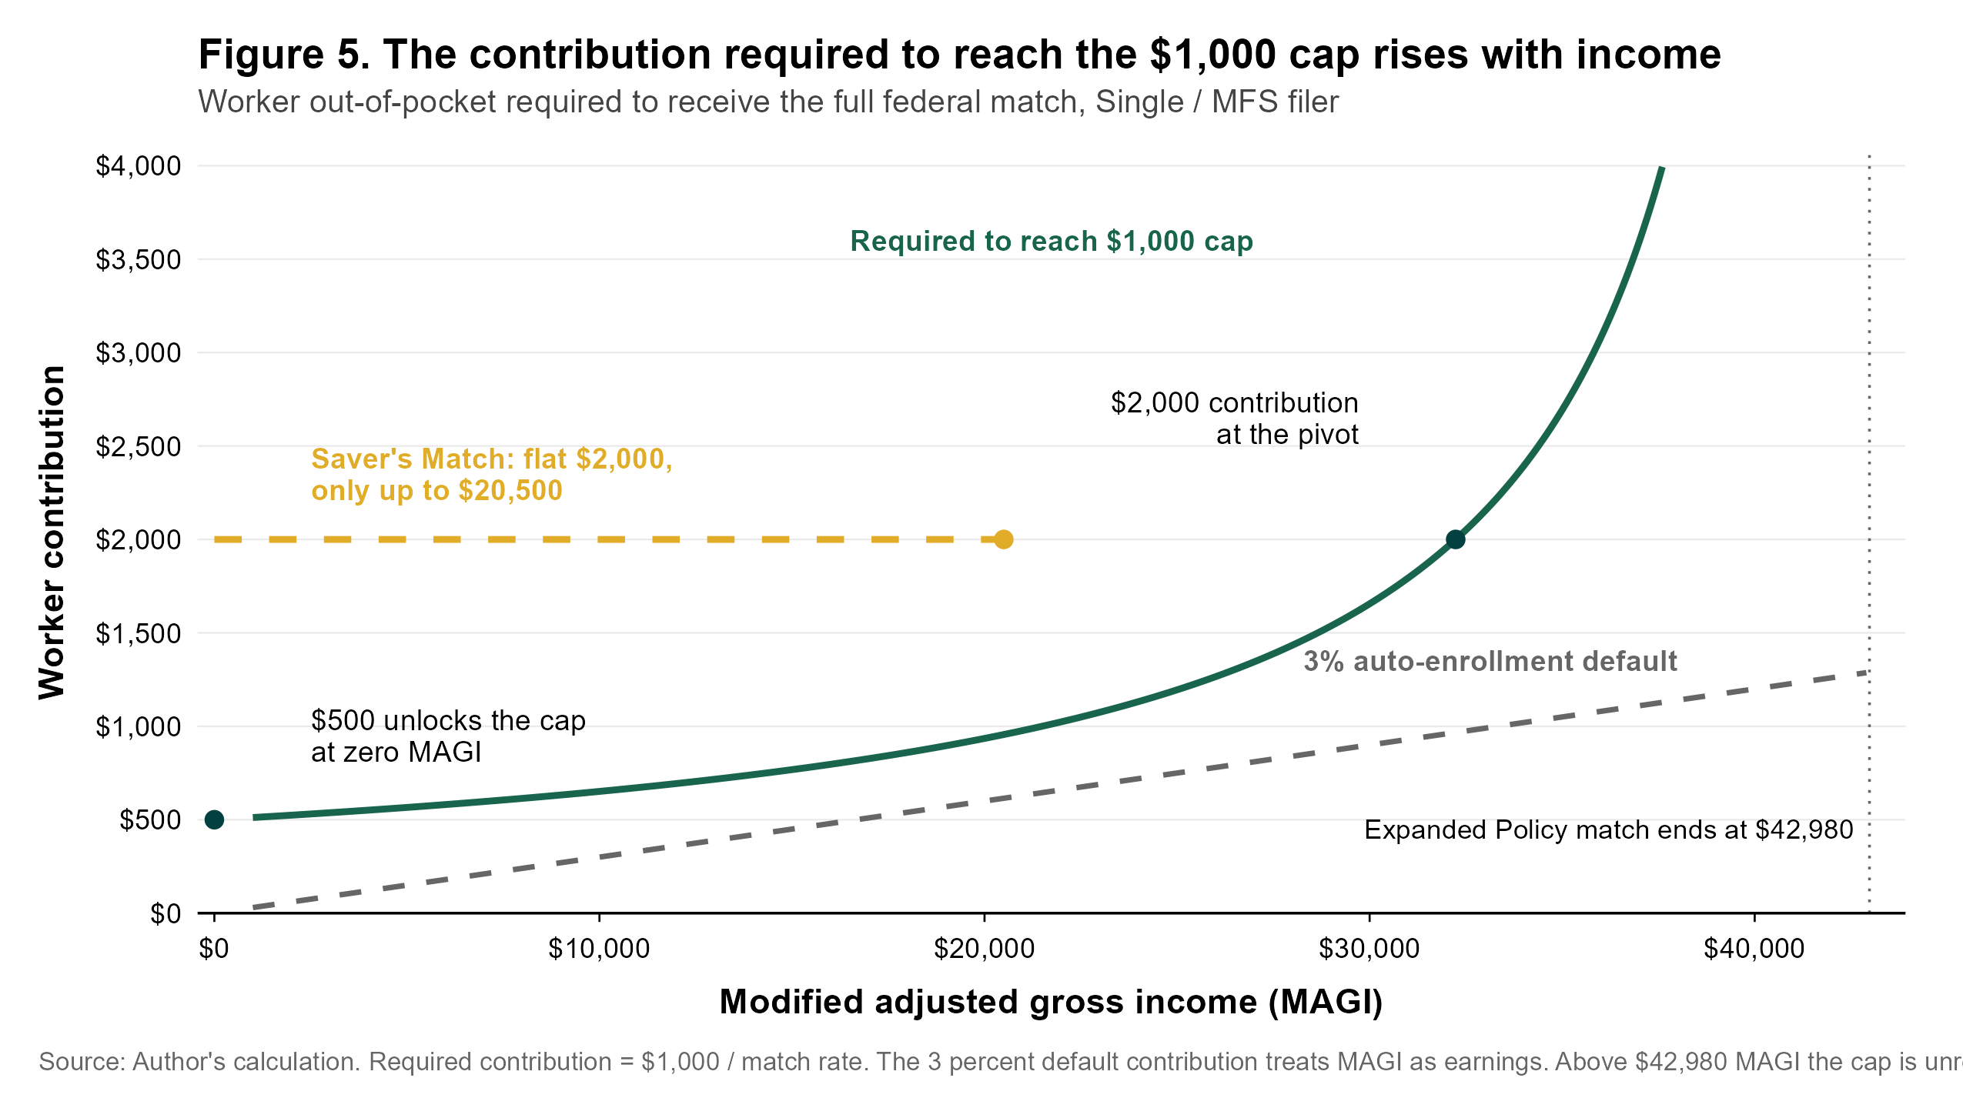
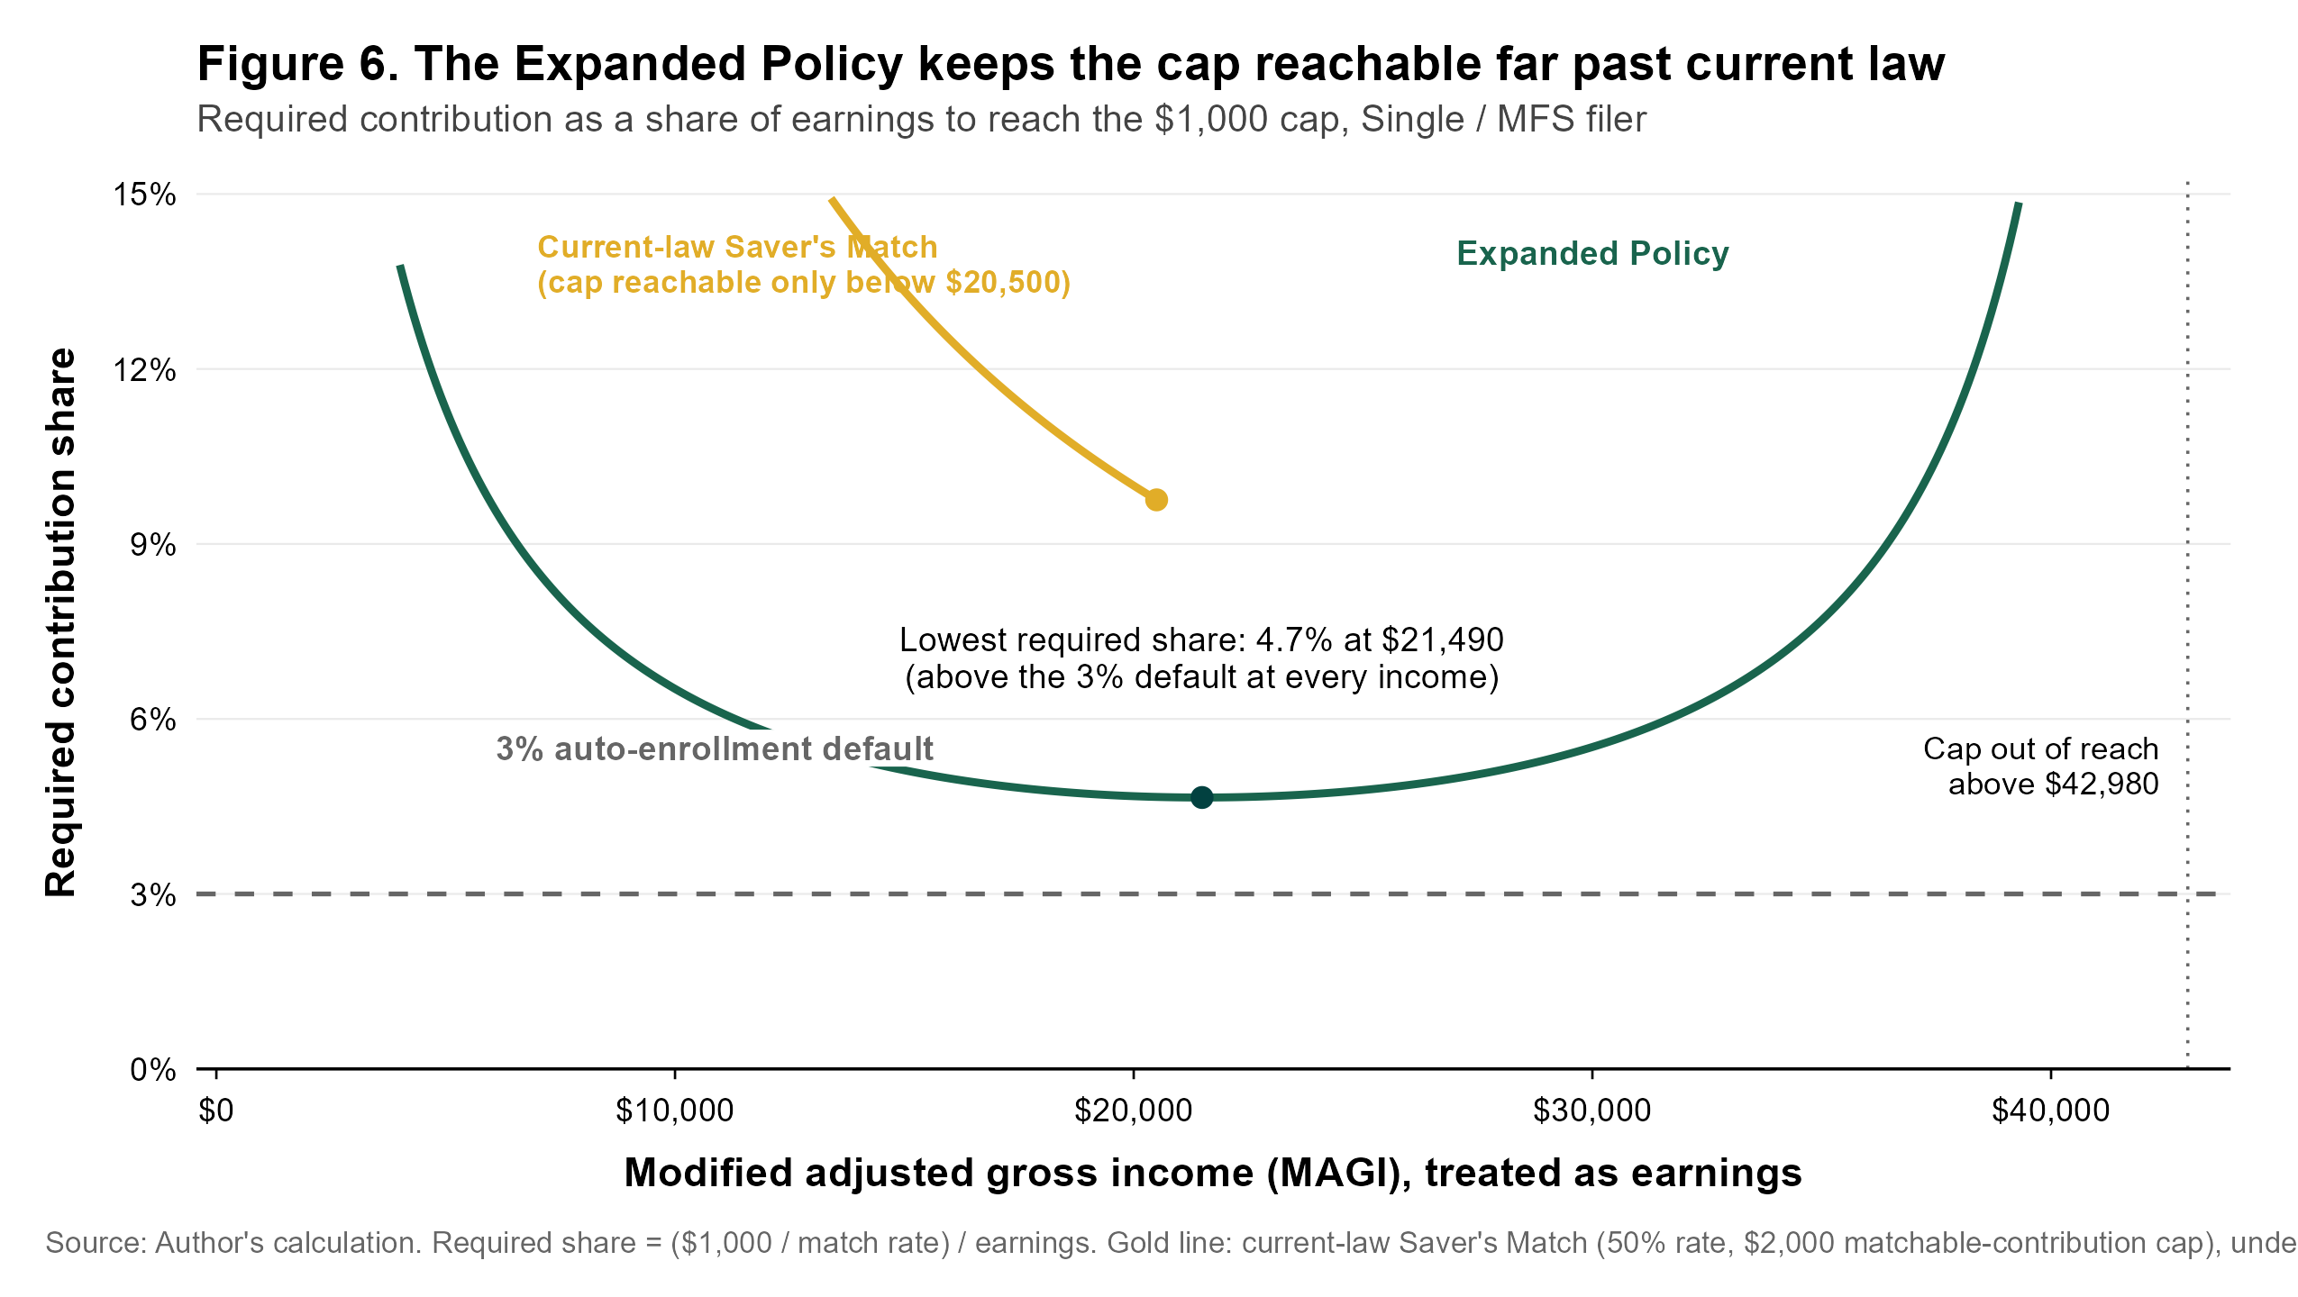
GENEROSITY
A higher rate, and an easier path to the full credit
A far higher subsidy rate
An easier path to the cap
A larger average award
200 percent at the bottom: a worker who sets aside just $500 receives the full $1,000 credit.
The full credit is reachable on about 5 percent of earnings — versus the $2,000 contribution current law requires.
About $537 per participant, against roughly $278 per worker under current law in the same population.
Source: Author's analysis. The over-match at the bottom is deliberate: a dollar is hardest to move out of consumption for the lowest earners.

Slide 7
COST
About $19.1 billion a year under automatic enrollment
Headline case
Versus the enacted match
 | Current law | This proposal
Match rate at the bottom | 50% | up to 200%
Eligible workers | 33.1M | 44.5M
Avg. match per worker | $278 | $537
Compared at full participation, so the difference reflects design alone.
A cost that narrows over time. Workers who retire with more savings draw less on Medicaid and SSI. A RAND analysis on RSAA, a closely related proposal, found that offset large enough to turn it net-positive over several decades.
Source: Author's analysis of SIPP 2024 Wave 1. Long-run offset: RAND analysis of the Retirement Savings for Americans Act.

Slide 8
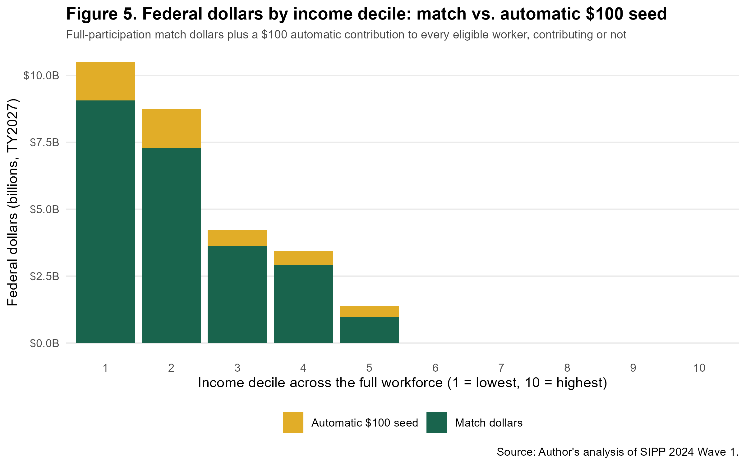
SCENARIO ADD-ON
A $100 automatic seed contribution for every eligible worker
44.5M
+$4.4B
8.9M
eligible workers get a seeded account every year, contributing or not
added annual cost — the same at any participation rate
eligible non-contributors reached who would otherwise get nothing
The goal is account formation, not first-year benefit size: every eligible worker ends the year with a funded account ready to receive a tax refund, a windfall, or a future raise. About 79 percent of seed dollars flow to the lowest-earning 30 percent of the workforce.
The seed can also be phased rather than flat, trading cost against how many workers keep the full $100:
Seed design | Cost | Reach | Full $100
Flat $100 (headline) | $4.4B | 44.5M | 44.5M
Pro-rata with match rate | $1.7B | 44.5M | —
Flat, then taper | $3.6B | 44.5M | 28.1M
Extended taper | $5.3B | 60.3M | 44.5M
Source: Author's analysis of SIPP 2024 Wave 1, projected to tax year 2027. Eligibility band anchored to IRS single-filer median income.

Slide 9
DESIGN & CAVEATS
Built for administrability and durability
Design choices
What to keep in mind
Income-anchored band. IRS median by filing status, chained-CPI indexed, re-anchored each decade.
These are descriptive estimates of what the rules would cost and whom they reach — not a behavioral forecast.
Participation is the largest uncertainty, which is why cost is shown as a range.
Employer responses are not modeled, though we anticipate minimal crowd out risk.
The survey income measure approximates, but does not equal, tax-record MAGI.
Administrative and account-platform costs, and any phase-in, are outside the headline transfer cost.
Prior-year income basis. No year-end clawback; light on current-year work incentives.
Marriage-neutral cap. $1,000 per individual; equal earners treated the same married or single.
Liquidity by design. Own contributions stay accessible; the federal match vests after a short hold.
Self-employed rails. Estimated-tax and platform channels, with a worker-classification safe harbor.
Source: Author's analysis of SIPP 2024 Wave 1, projected to tax year 2027. Eligibility band anchored to IRS single-filer median income.

