Slide 1


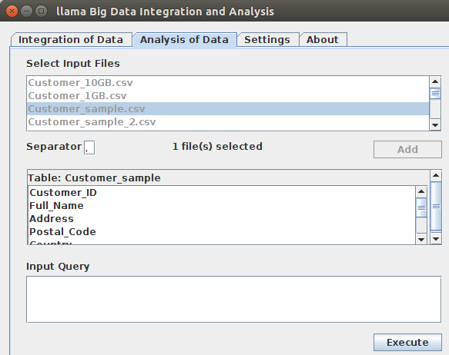
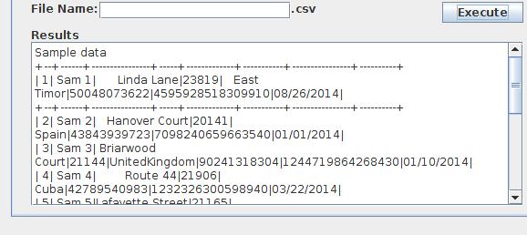
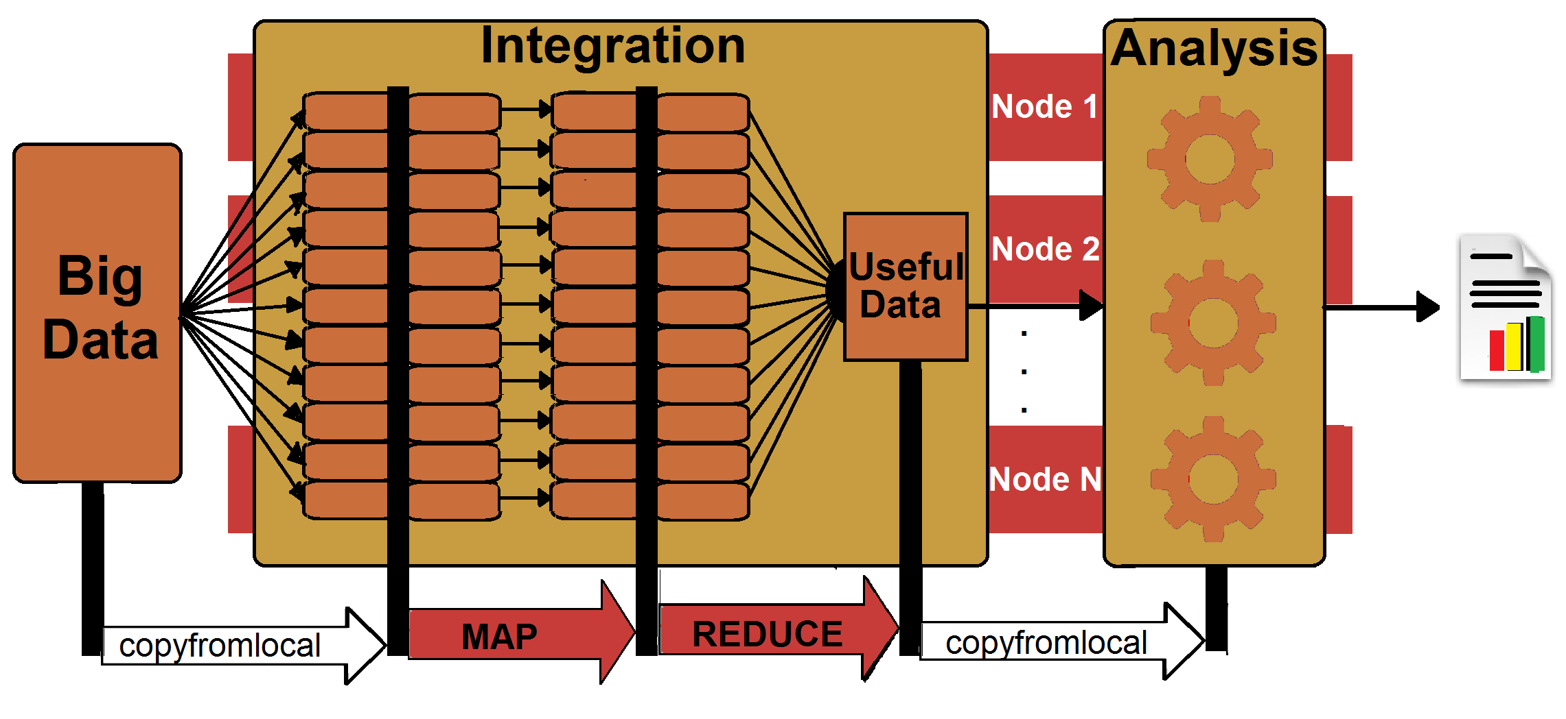
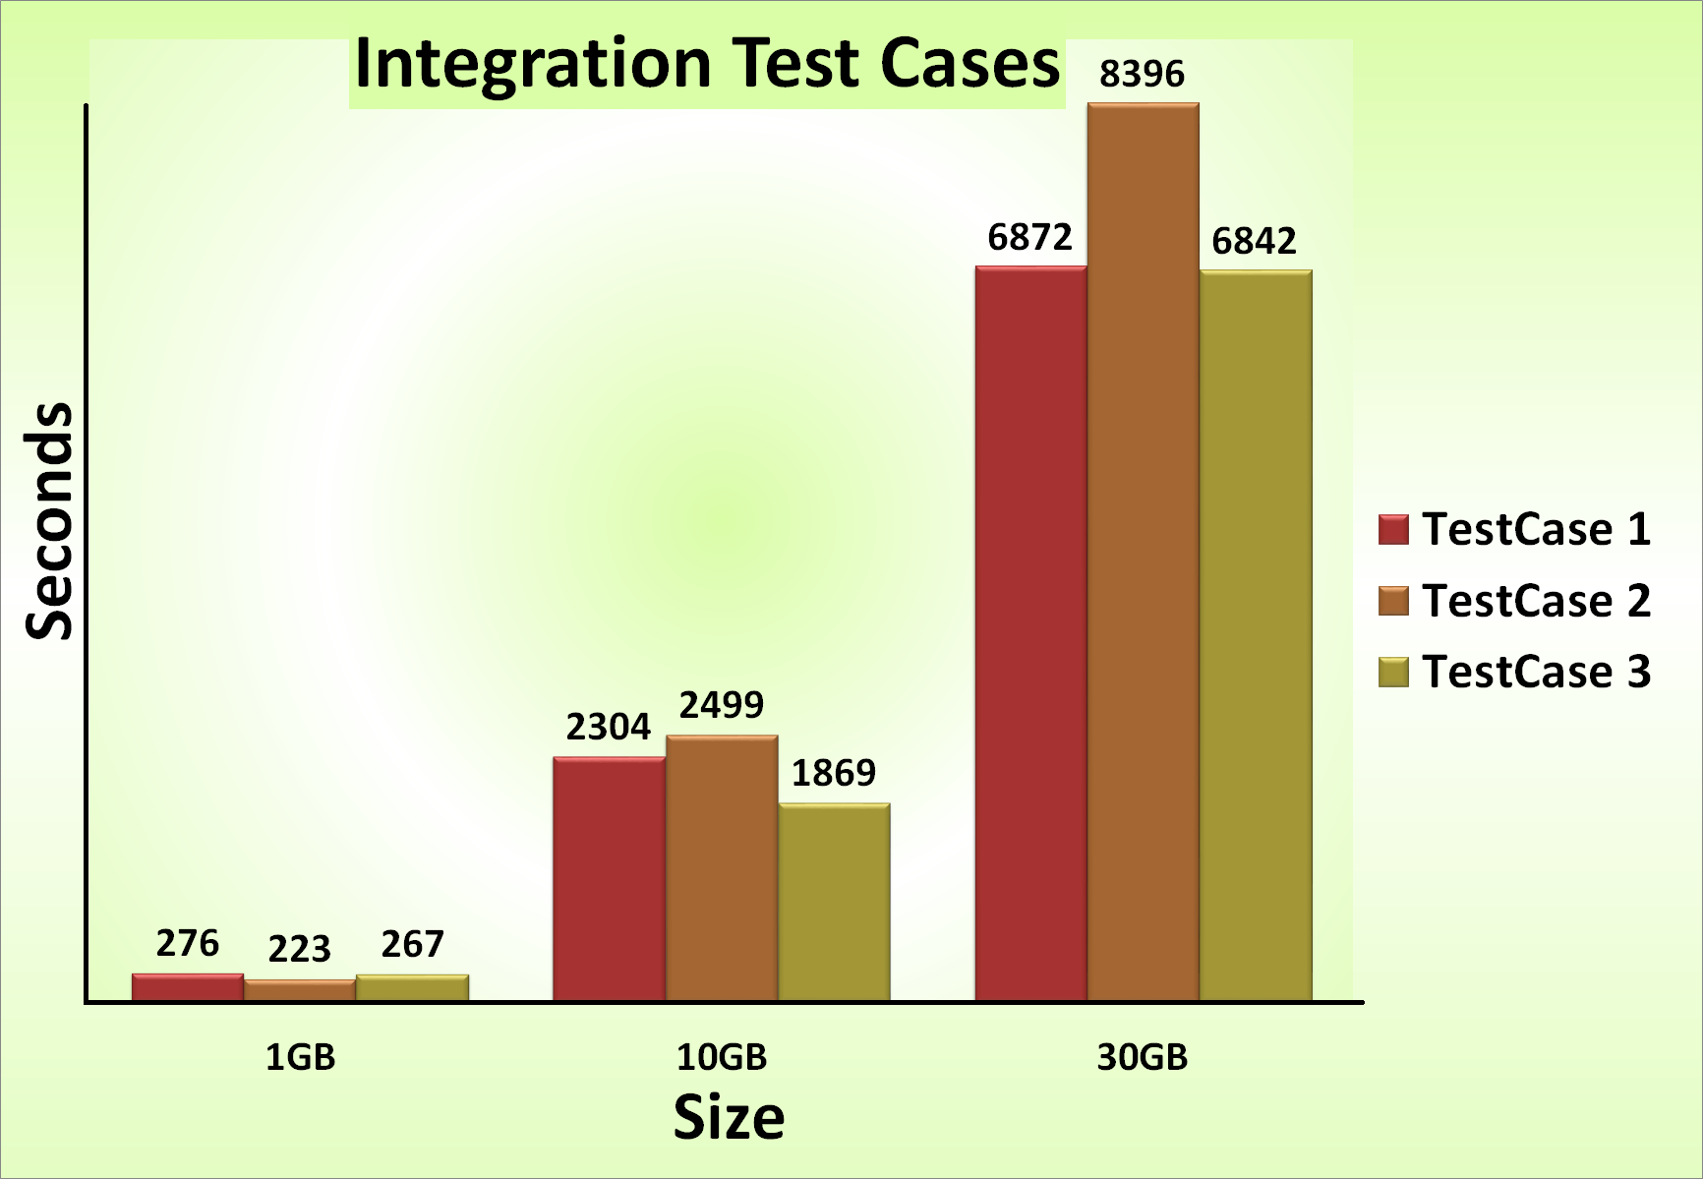
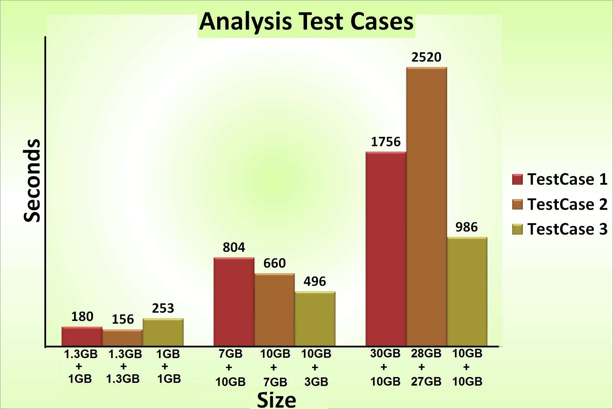


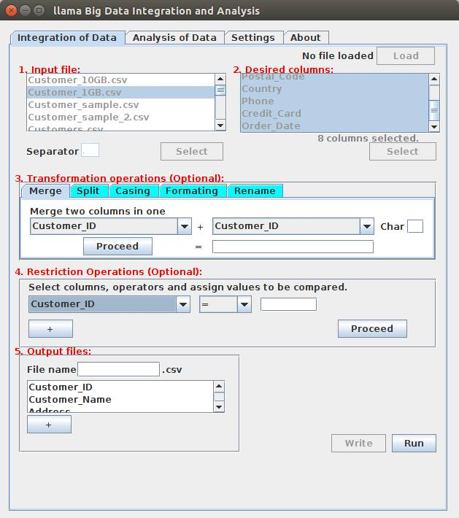



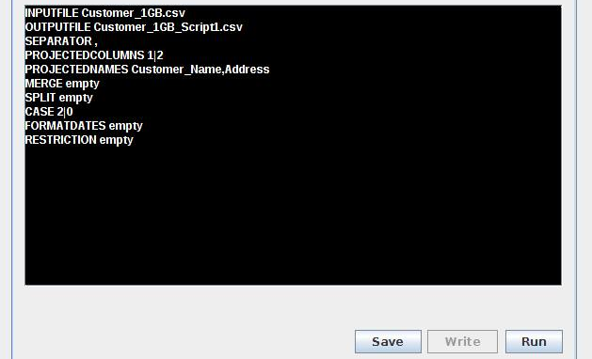

llama Big Data Integration and Analysis
Authors:
Gaurav Kumar, Héctor Ugarte, Miguel Mármol, Tina Boroukhian
Summer Semester 2015
Project Overview
Data Analyser
jh
Llama is Data Integration and Analysis Platform made of two components:
1. Data Integrator: Llama first loads structured plain files. Then data loaded is cleaned, reformatted and filtered using a series of user-selected transformations. Integration jobs can be specified in two ways: either via (1) a graphical User Interface, or (2) a script written in IJSL, for Integration Job Specification Language. If the first method is used, at the end, the job can be exported as an IJSL script that can be used in a later run.
2. Data Analyzer: Once ready, the new data is analyzed by means of SQL queries. The results can be stored for possibly further analysis.
Input File
Selection
Writing Query
Visualization & Saving Results
Input Data (Structured)
DATA Integrator
(Transfor-mations)
Reformatted
Data
DATA Analyser
(Queries)
Analysis Results
System Architecture
Evaluations
jh
[1]
Implementation
Apache Hadoop is an open-source framework for distributed storage and processing of very large data sets on a of commodity hardware. [2]
Tutorial for installation: http://pingax.com/install-apache-hadoop-ubuntu-cluster-setup/
Apache Spark is an open-source cluster computing framework. It employs the concept of RDD which are distributed units of data that resides primarily in memory, hence its high speed. [3]
Tutorial for installation: http://www.trongkhoanguyen.com/2014/11/how-to-install-apache-spark-121-in.html
Data Integrator
Live Demo
Input File
Selection
Columns Selection
Transfor-mations
Selection
Restriction Selection
Output File
Two virtual machines hosted on EIS02
Local Access Master:
User: eis-groupb-master
Password: EIS2015
Hadoop User:
User: hduser
Password: hduser
Remote Access:
Partner ID: 572120720
Password: 268vxh
(*) alternative flow
Write or Load IJSL Script
Remote Access Node:
Partner ID: 572193139
Password: 4d2g1h
Local Access Node:
User:eis-groupb-slave
Password: EIS2015
Software installed:
Ubuntu 14.04 LTS 64bit
JDK 1.8
Apache Hadoop 2.6
Apache Spark 1.4
Github Link:
[1] User Manual: https://docs.google.com/document/d/1Rhdg8mlKdiJpZoFBIyfrao1-czLz4FkjaBdnLxr8V60/edit
[2] Technical Report: https://docs.google.com/document/d/1kNYN4YxueQ0UbKZSeWWSwx5JEsuJFOX08XeEkN7a8S0/edit
References :
[1] http://www.glennklockwood.com/data-intensive/hadoop/mapreduce-workflow.png
[2] https://en.wikipedia.org/wiki/Apache_Hadoop
[3] https://en.wikipedia.org/wiki/Apache_Spark
EIS
Enterprise
Information Systems

