Slide 1
Mentor:
Prof. Dr. Maria-Esther Vidal
Team Members:
Firas, Ernane, Matthew
SEMANTIC BLOCKCHAIN REQUIREMENTS

Slide 2
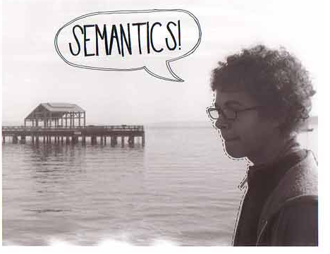
1. Semantically describe the properties of a transaction
Functional

Slide 3
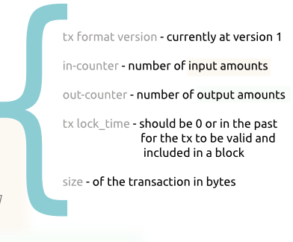
What properties to describe ?
Define or reuse a vocabulary of semantic concepts for transactions and their properties.
Add additional Concepts to the vocabulary.
Allow using internal vocabulary.

Slide 4



Ontology
BlockChain transactions
Semantic Bitcoin Transaction
Different data sources

Slide 5
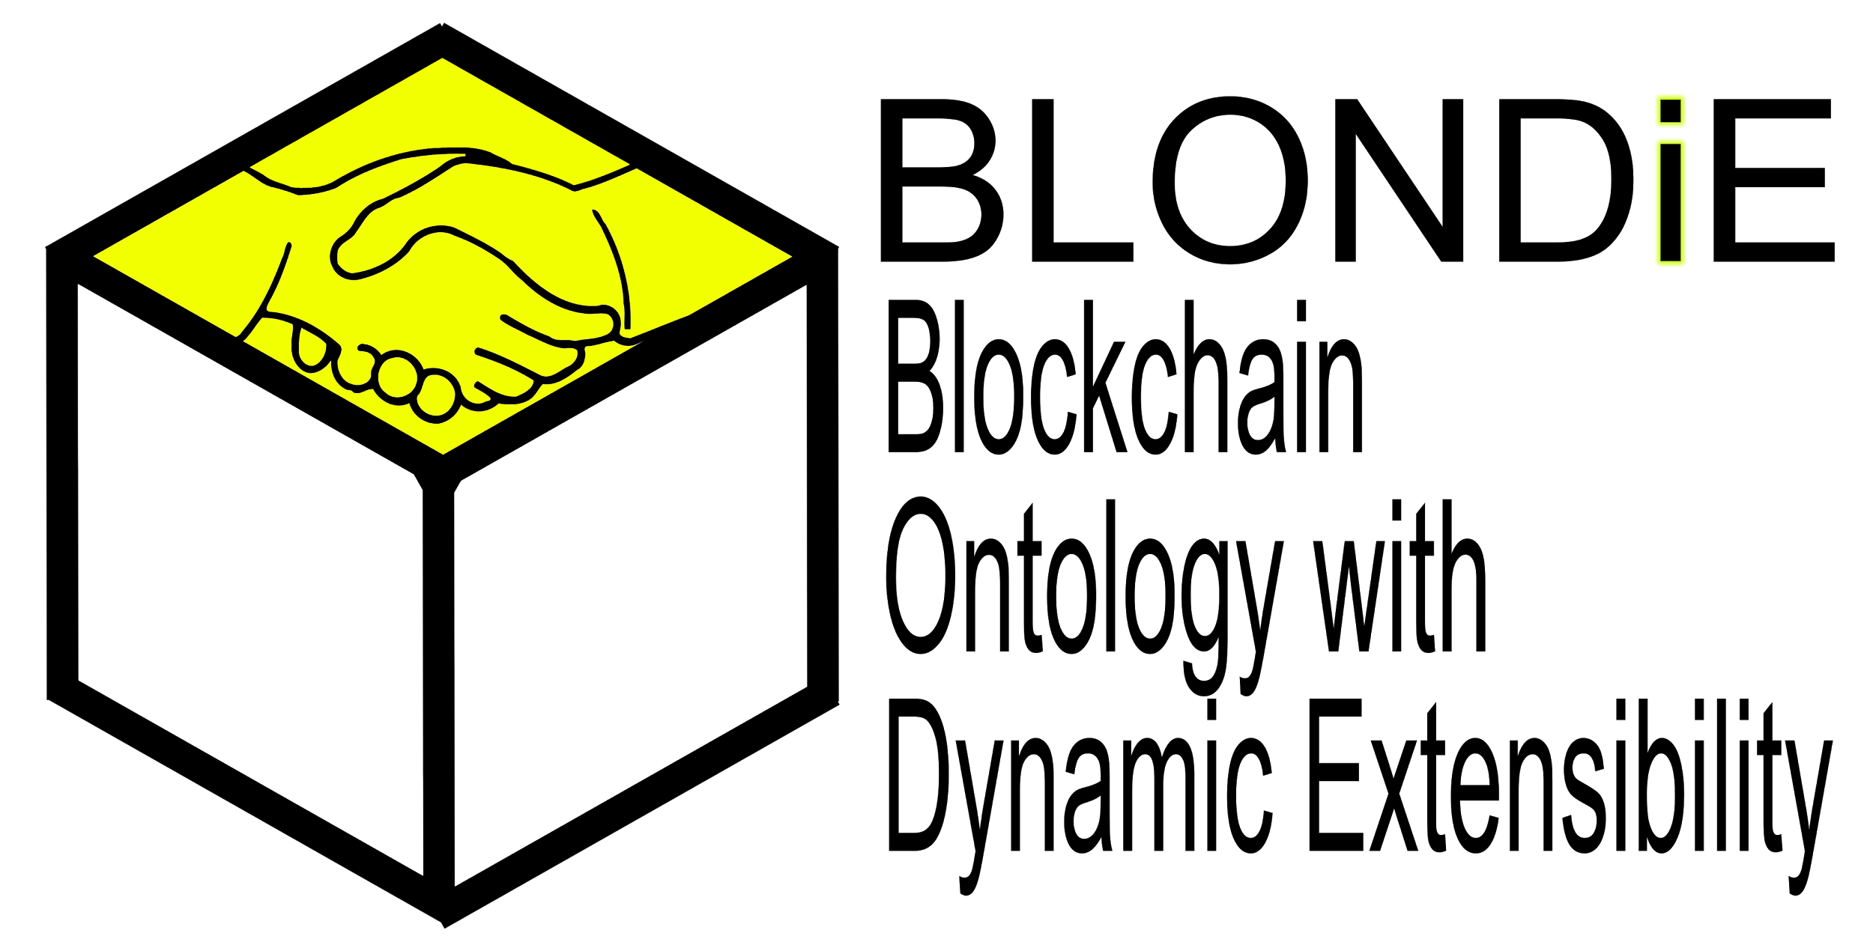
Potential working ontology:

Slide 6
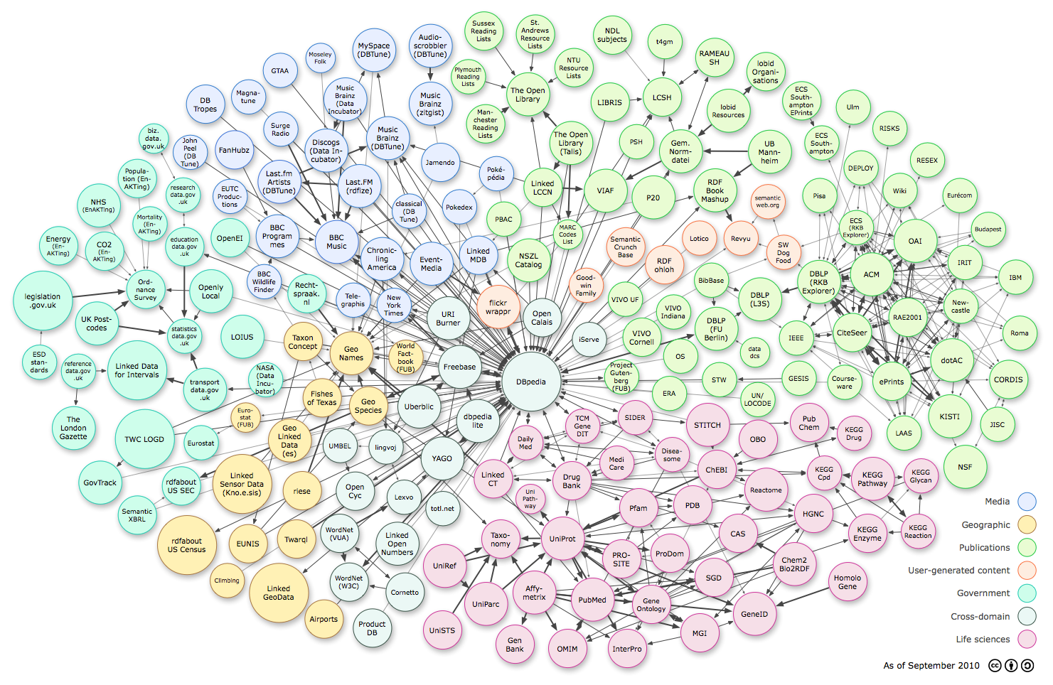
2.
Link to other data sources

Slide 7
LINKED DATA
Imagine you have one of the bitcoin addresses of Bill Gates
You can link that with his FOAF triples: http://dbpedia.org/page/Bill_Gates
We can create a FOAF of satoshi and link it with his transactions:
http://www.theopenledger.com/9-most-famous-bitcoin-addresses/
Try to find who are all this guys:
http://www.bitcoinrichlist.com/top100
Link those bitcoin addresses to their institutions triples https://en.bitcoin.it/wiki/Donation-accepting_organizations_and_projects

Slide 8
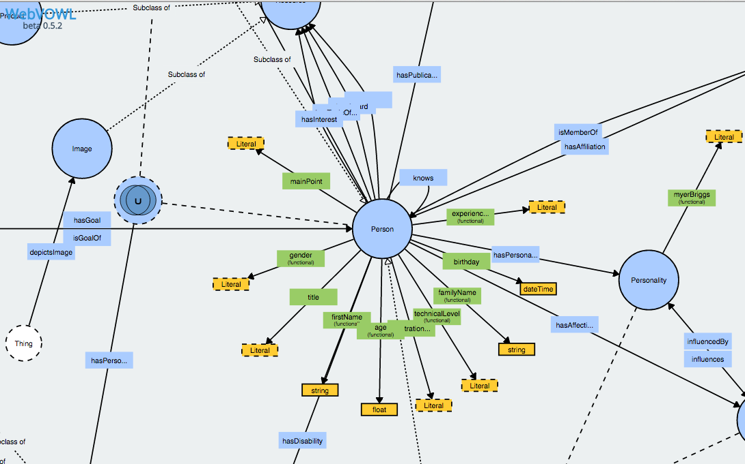
Example:
Personas Ontology (PersonasOnto)

Slide 9
Silk: The Linked Data Integration Framework
Generating links between related data items within different Linked Data sources.
Linked Data publishers can use Silk to set RDF links from their data sources to other data sources on the Web.
Applying data transformations to structured data sources.
http://silkframework.org/

Slide 10
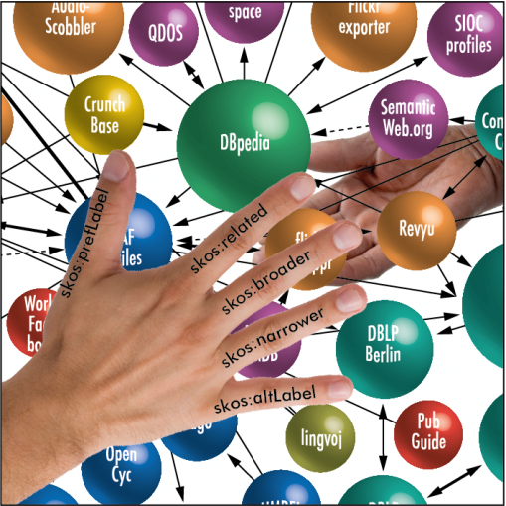
3. Semantic Data Management Techniques

Slide 11



Provide local on the fly processing of transactions
Provide search and track operations on transactions.
Provide reports of transactions with a chosen criteria

Slide 12
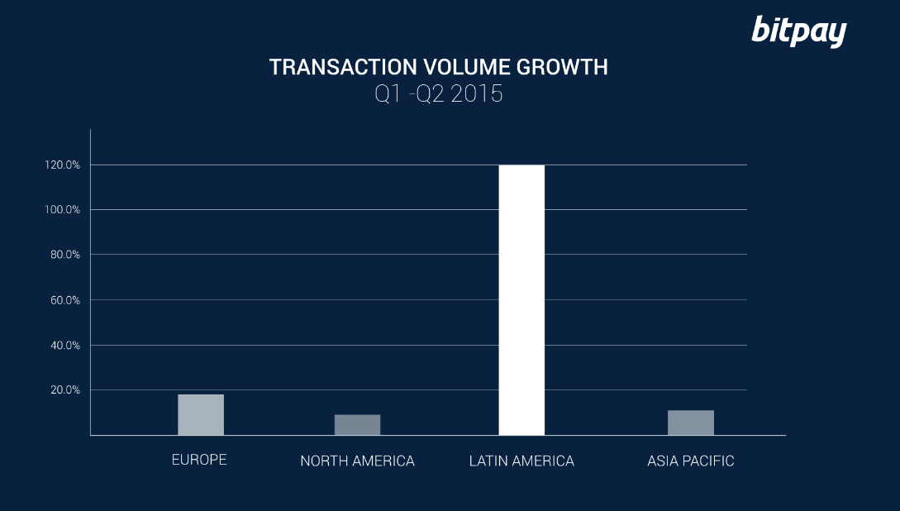

Slide 13
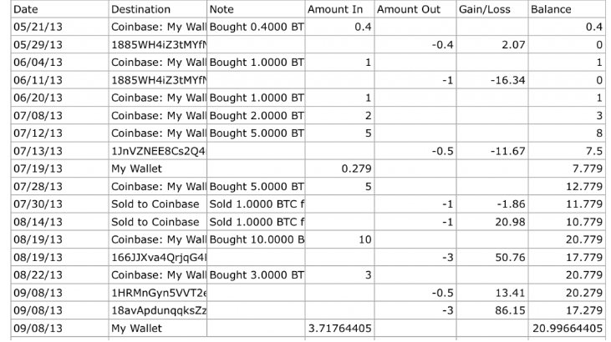
The Balance report

Slide 14

4.
Access control

Slide 15
Access Control and Privacy
Create Access control to the inner vocabulary.
Strict focus on (exclusively) public information.
Ignoring private information:
Location of an address
IP
Wallet information

Slide 16
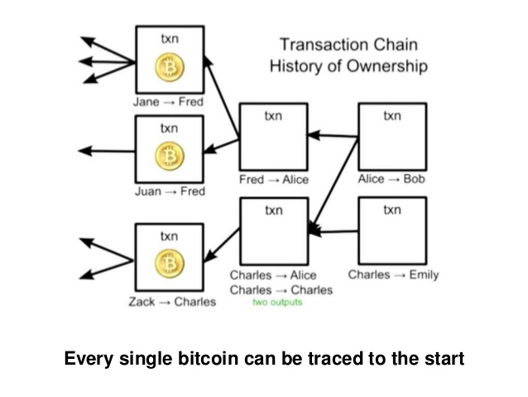
Blockchain Public
Information

Slide 17
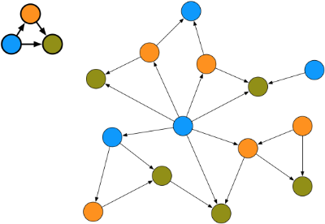
5.
Application Domain

Slide 18
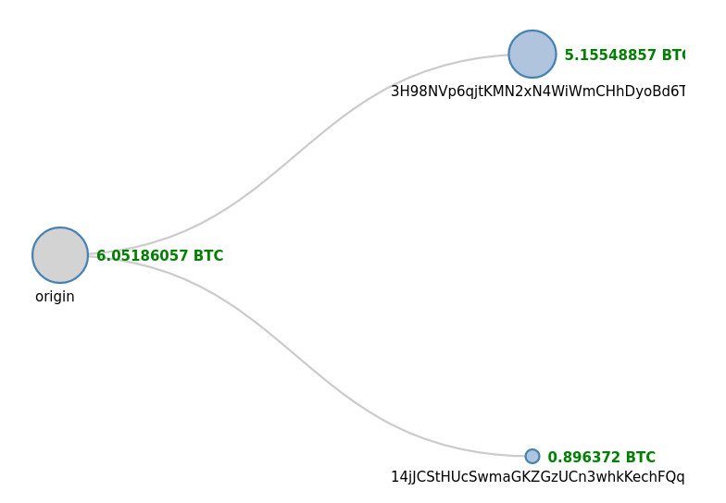
Related to ‘Ego-net community mining applied to friend suggestion’
Subgraph Mining

Slide 19
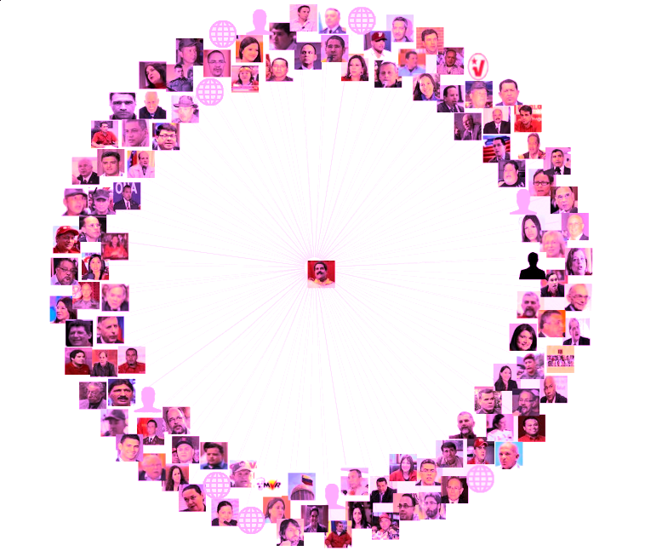
6.
Enhanced Usability

Slide 20
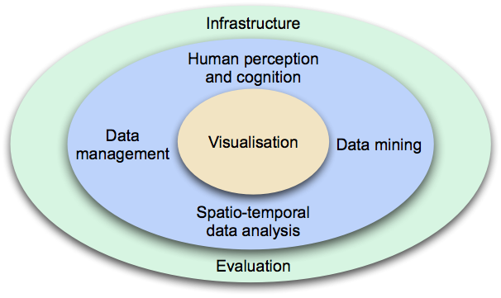
To facilitate visual analysis and reduced cognitive load
Provide Visualization

Slide 21
Non-functional requirements
Performance.
Provide a User friendly visualization.
Process data on the fly.
Security(ignoring private information).
Availability (Redundancy).
User friendly transaction reports.

Slide 22
SEMANTIC BLOCKCHAIN

