Slide 1
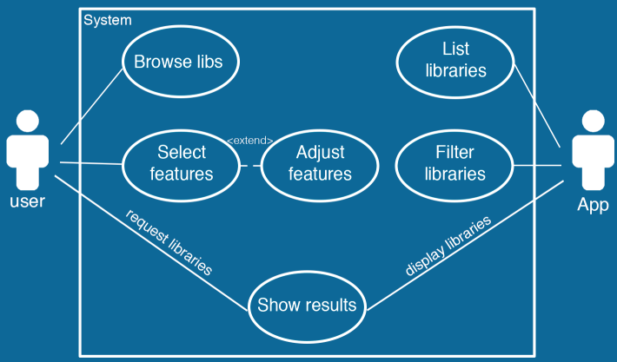

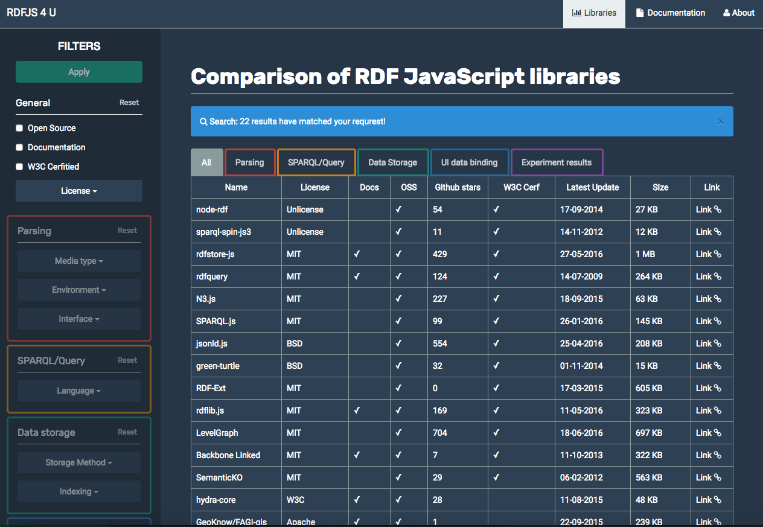










State of the RDF JS Libraries
Todor Tsankov
Mehrdad Bozorg
Mohammad Tahaei
Motivation
RDF & semantic web is growing during past decade and many websites are willing to add more information to the HTML tags to make them more machine readable. Therefore, front-end support for such data is needed. This project helps interested people see available RDF-JS libraries, filter them and view two experiments on two SPARQL libraries.
Use Case
Approach
Research on available libraries
Categorize them based on W3C categories:
Parsing
SPARQL/Queries
Storage
UI and Binding
Evaluate two SPARQL supporting libs with Waterloo WatDiv Datasets (http://dsg.uwaterloo.ca/watdiv/)
Experiments
Queries: Simple (Linear), Complex, Snowflake
Datasets: Three different sizes: 100K, 1M, 10M
Challenges
Finding proper dataset
Finding queries
Lack of documentation
Lack of organized and well-defined study
Representing data in a user-friendly manner
Building an easy to maintain & contribute project
Virtual Machine
Application
Easy to use tool to see and find RDF-JS libs
Listing & Filtering of libraries
Available at: http://txwkx.github.io/RDFJS4U/
Open source code is here: https://github.com/txwkx/RDFJS4U
Hostname: vm-<EIS02>
Software installed: a full copy of the source code
Local Access:
OS User: Windows16-StateOfRDFJSlibs
Password: jsstate4rdf
Technologies
Bonn, October 2016
Contact: Todor Tsankov <s6totsan@uni-bonn.de>

