Slide 1
QA Pipeline for Questions Answering
Group members: Victor Ouko
Kai Kenklies
Patrick Seume
Mentor: Kuldeep Singh

Slide 2
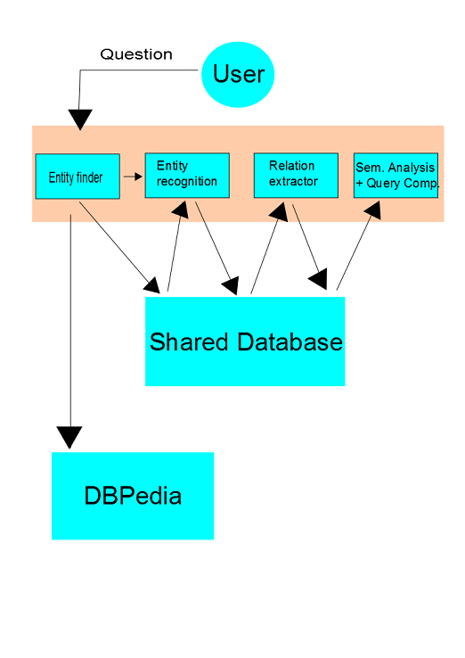
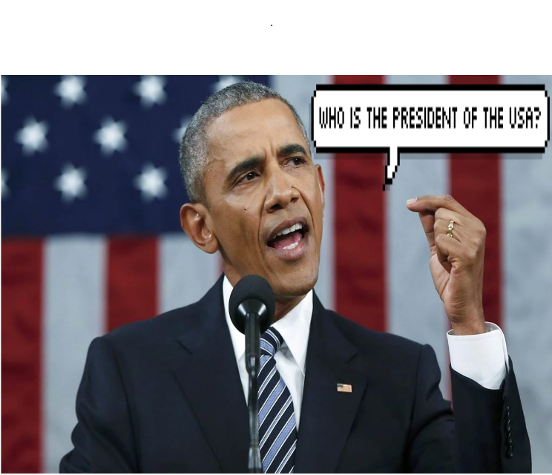
Q&A

